Slide 1



DevOps Solution
Copyright © 2020 Infosenseglobal inc.

Slide 2
01 | Challenges
02 | What is CI/CD?
03 | CI/CD Advantages & Demo
04 | GitLab Project Management
AGENDA

Slide 3
Current Challenges
Move from On Prem to Cloud
Dependency on local onsite resources
Hardware refresh
Software out of date
Current software is capable only for source control

Slide 4
DevOps Solutions
How to make sure that code integration is successful.
How to make sure that code works & it follows all organization standards.
Need of a person to continuously Merge, Build, Test & Deploy the code.
Ensuring software is working as expected and ready to go at any time.

Slide 5
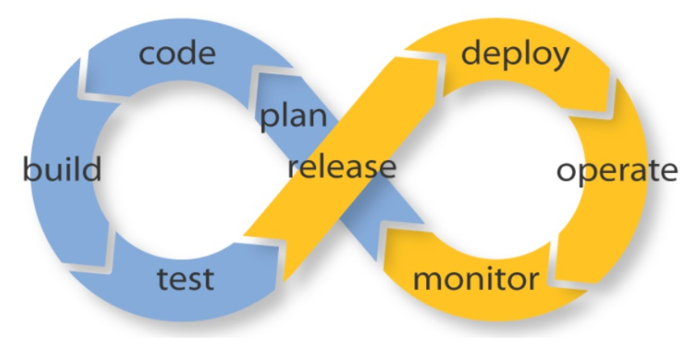
What is CI/CD
Predefined set of tasks that are automatically triggered when some event happens.
Continuous Integration is the practice of testing each change done to your codebase automatically and as early as possible.
Continuous Deployment follows the testing that happens during Continuous Integration and pushes changes to a staging or production system. This makes sure a version of your code is always accessible.

Slide 6
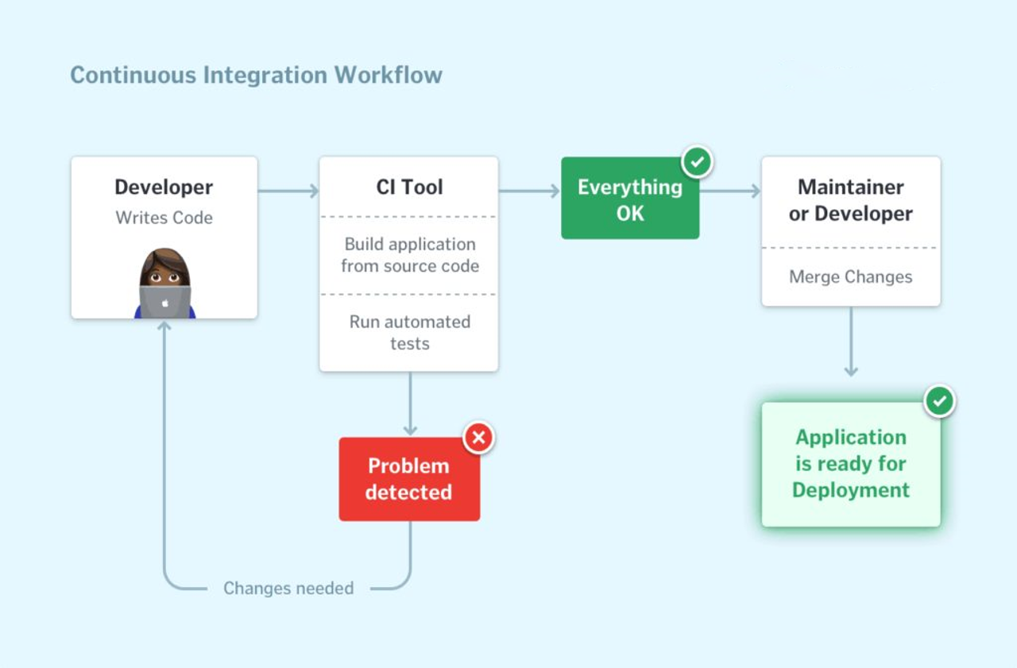

Slide 7
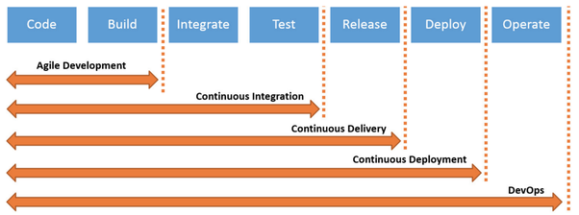
Process Lifecycle

Slide 8
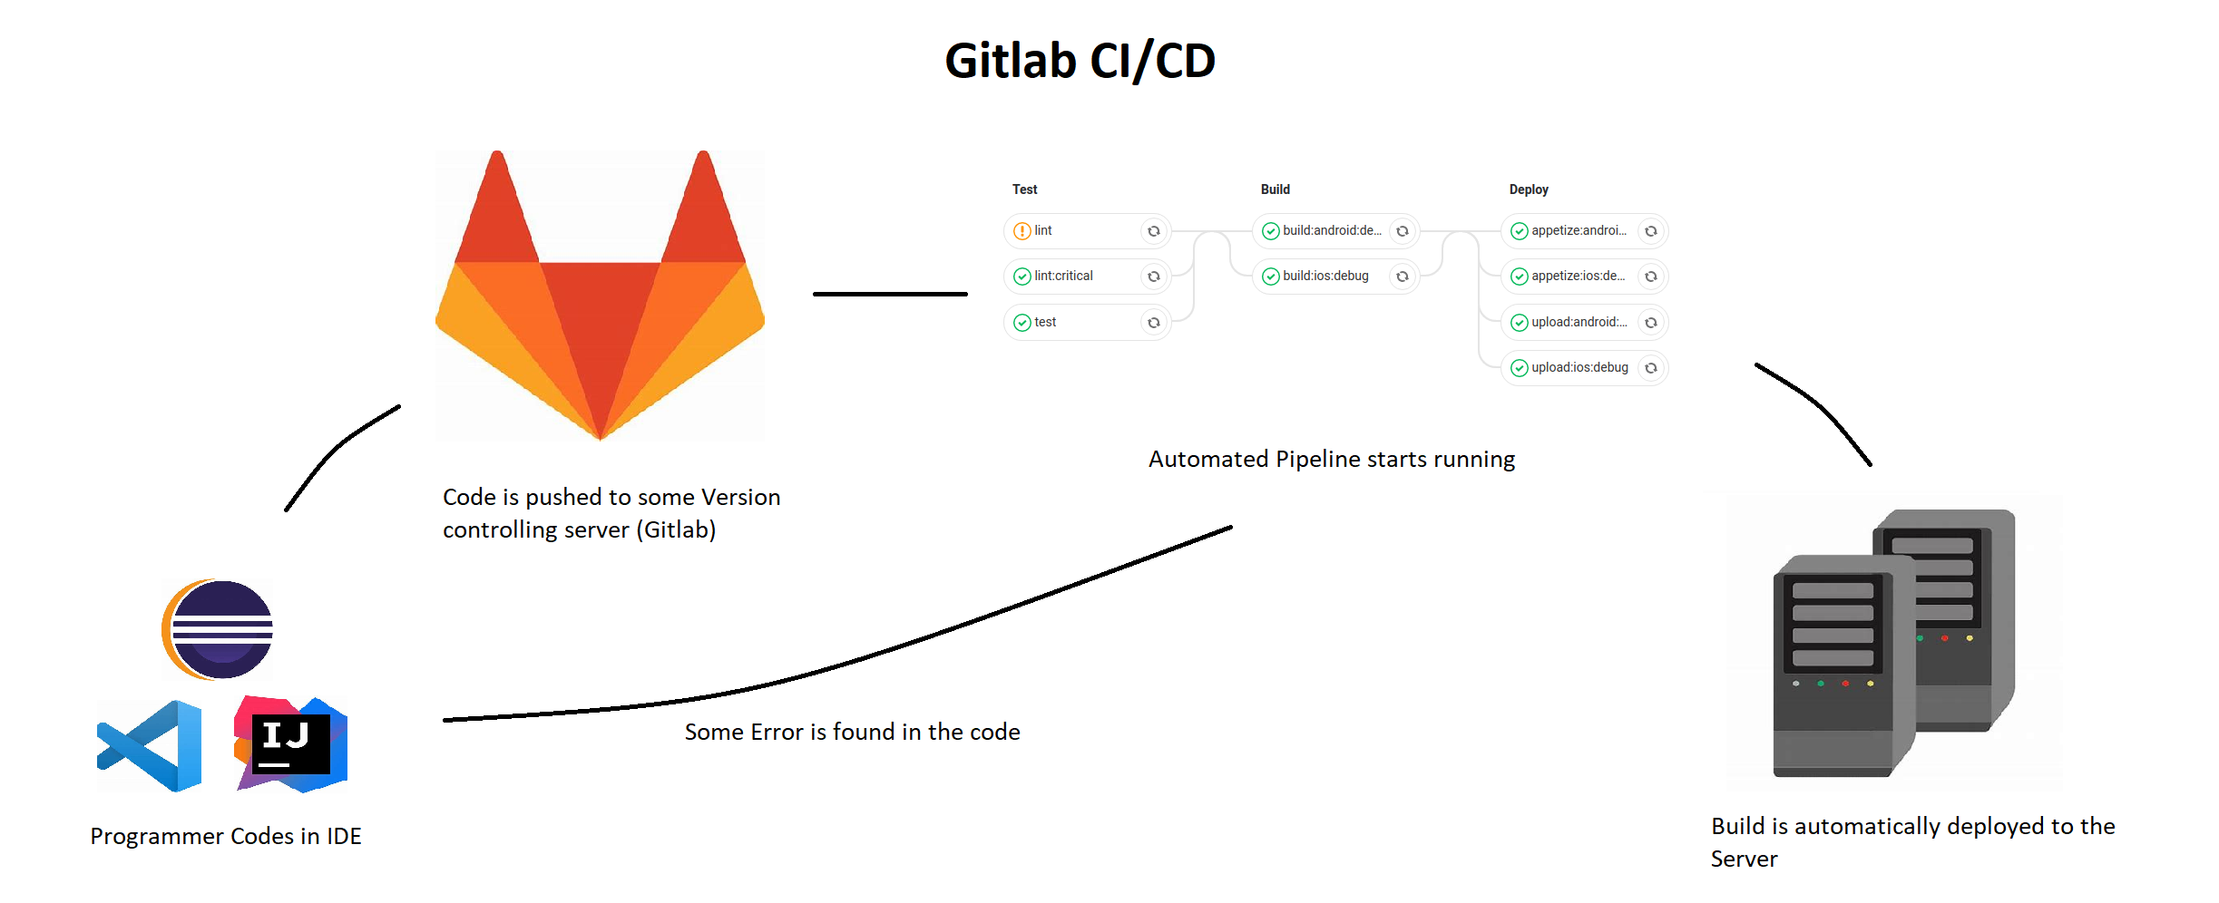
How to use CI/CD

Slide 9
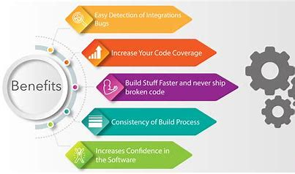
Why CI/CD

Slide 10
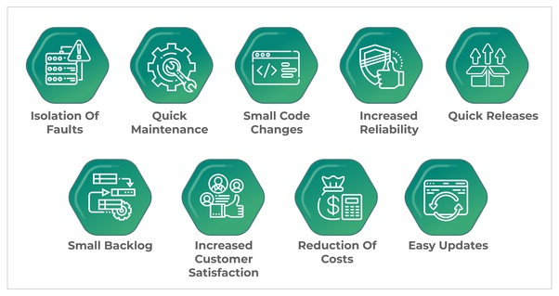

Slide 11
Main Use Cases
Automated Tests
Syntax Checks
Lint Checks
Frontend Checks
Backend Checks
Automated Deployments
Building the code
Staging/Testing Server Deployment
Production Server Deployment

Slide 12
GitLab Project Management
It enables Agile Project Management just as Scrum and Kanban-style project management.
From simple task tracking to DevOps life cycle, it can cover whole team.
Agile artifacts / Methods | GitLab
Sprint / Iteration | Milestone
Task-(Plan, assign and track) | Issues
Organize work | Labels , Milestones
Visualize work | Boards
Burndown chart | Burndown chart

Slide 13
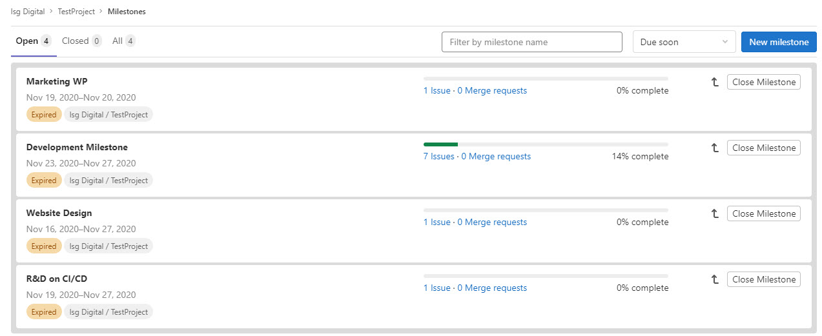
Sprints as Milestones
Sprint - Represents a finite time period in which work is to be completed
GitLab’s Milestones feature supports this.

Slide 14
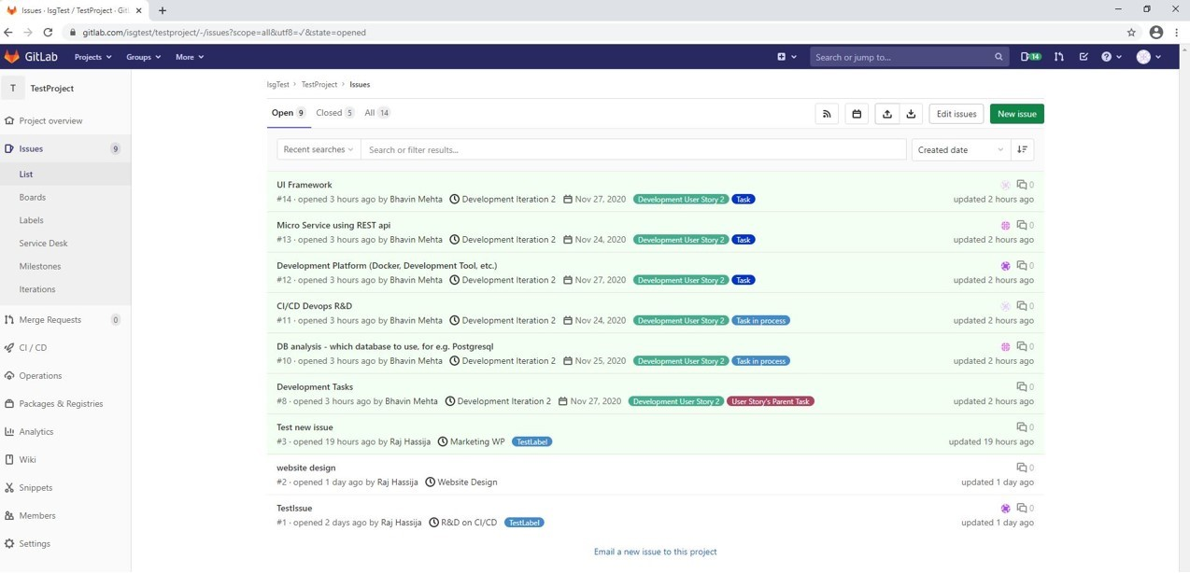
Tasks as Issues (Plan, assign and track)

Slide 15
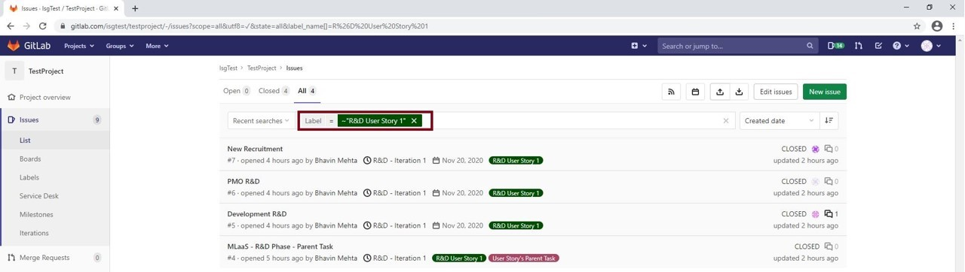
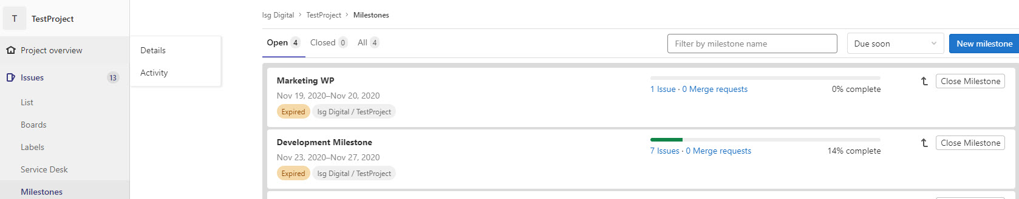
Organize work
Labeling filter at Issue level
Milestones to organize dedicated sprint issues

Slide 16
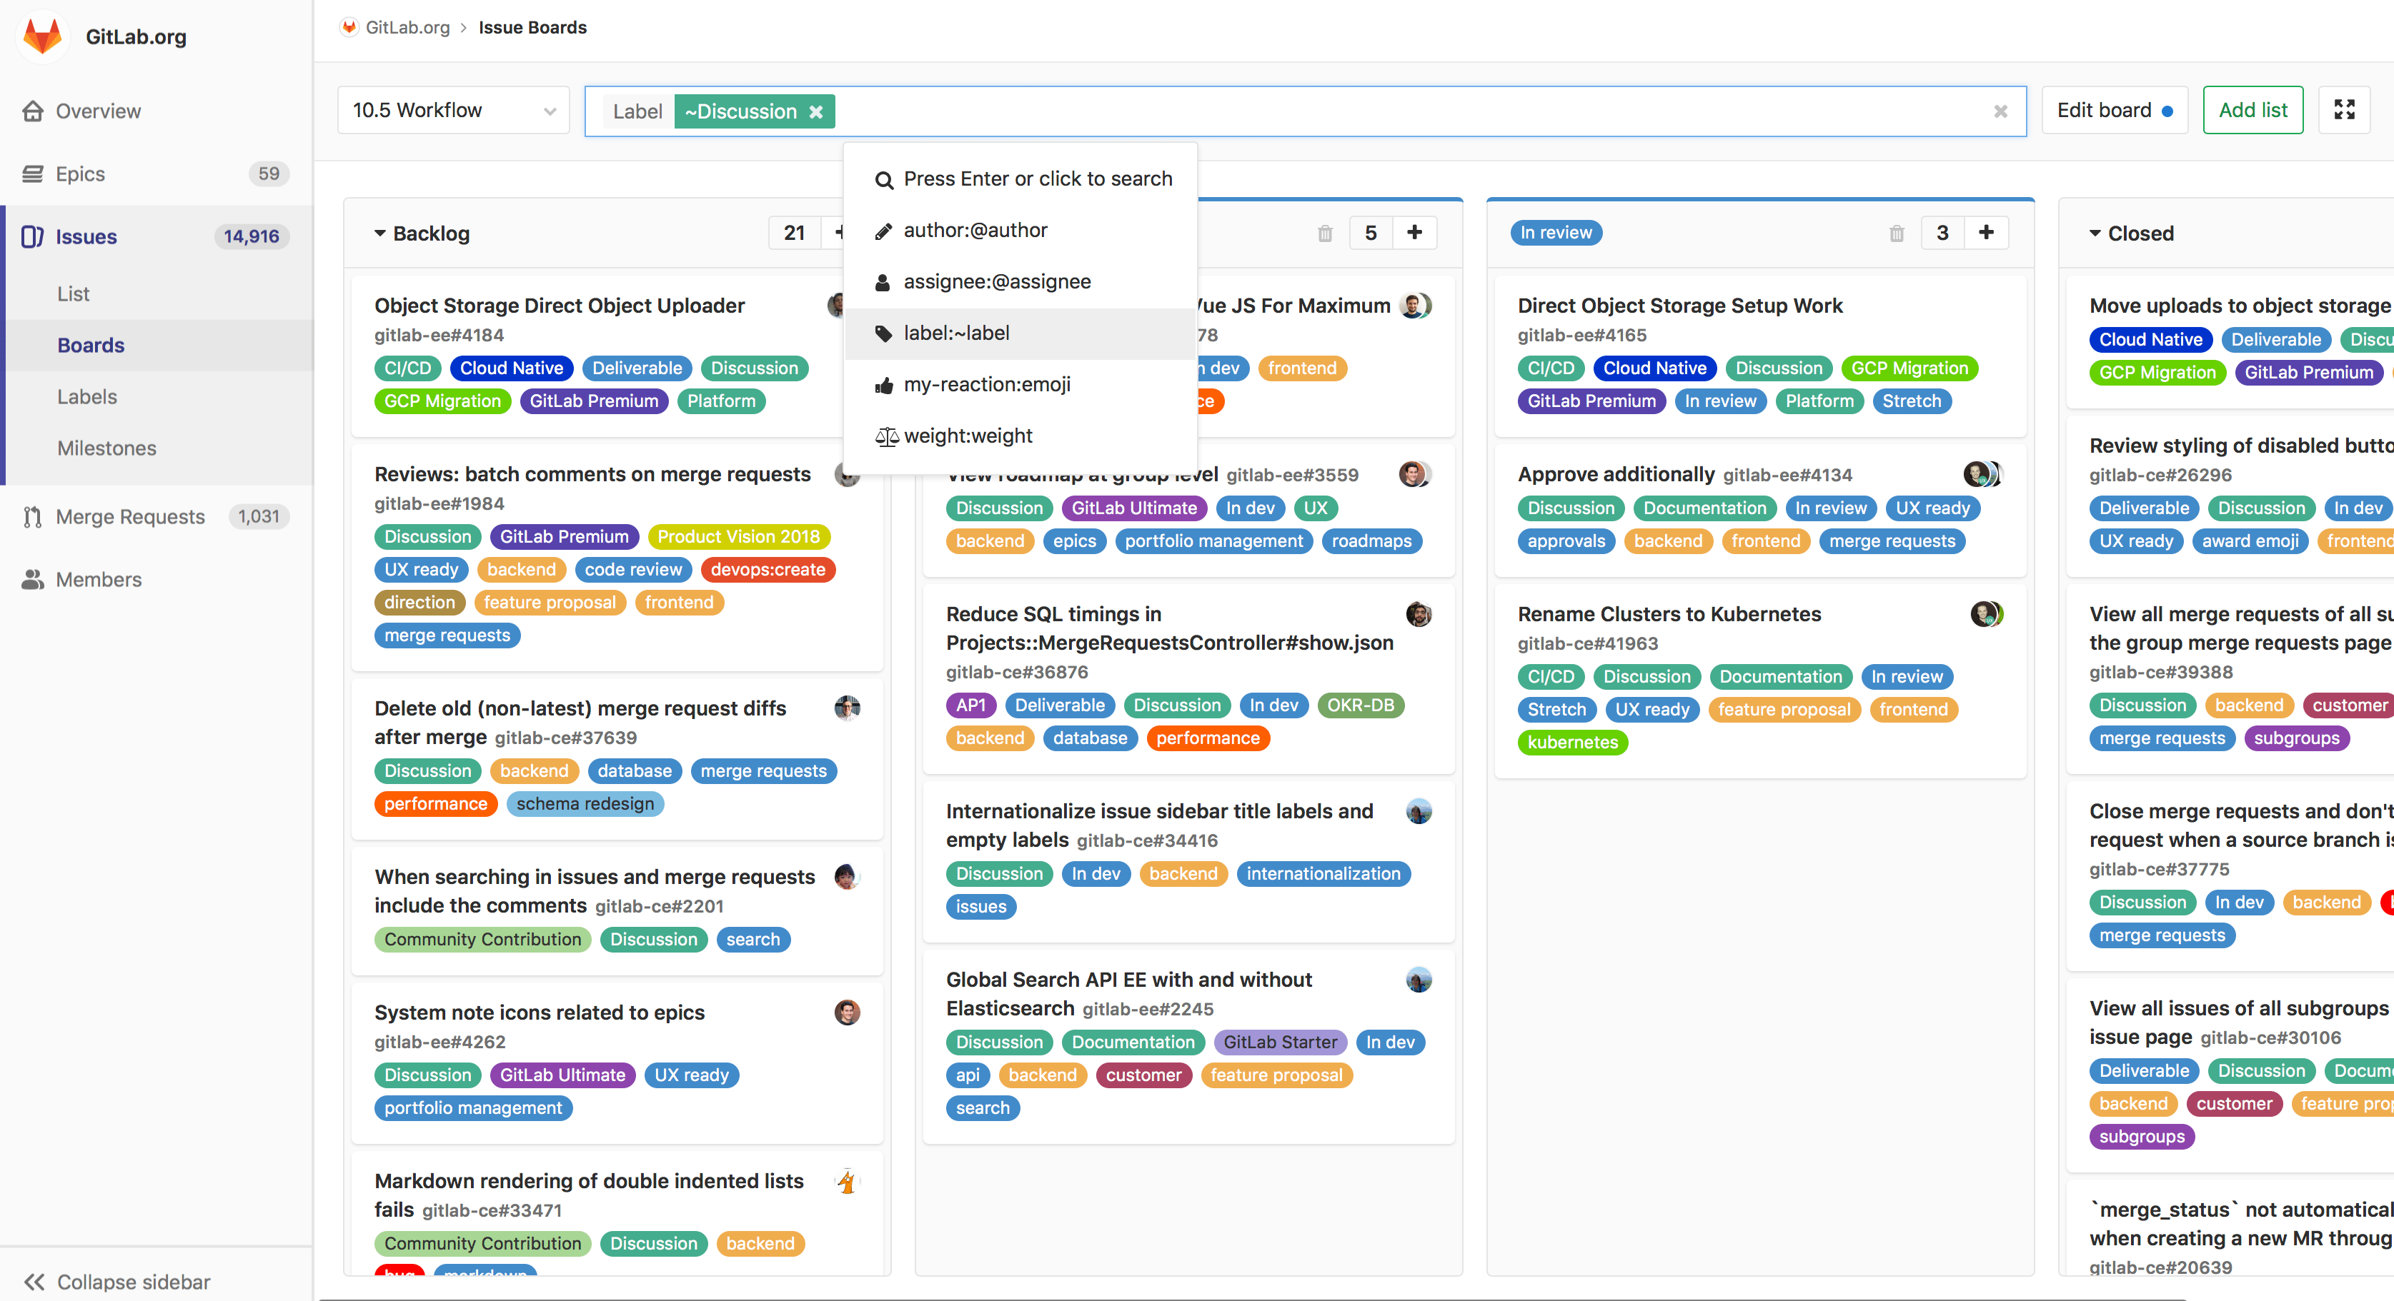
Visualize work through Boards

Slide 17
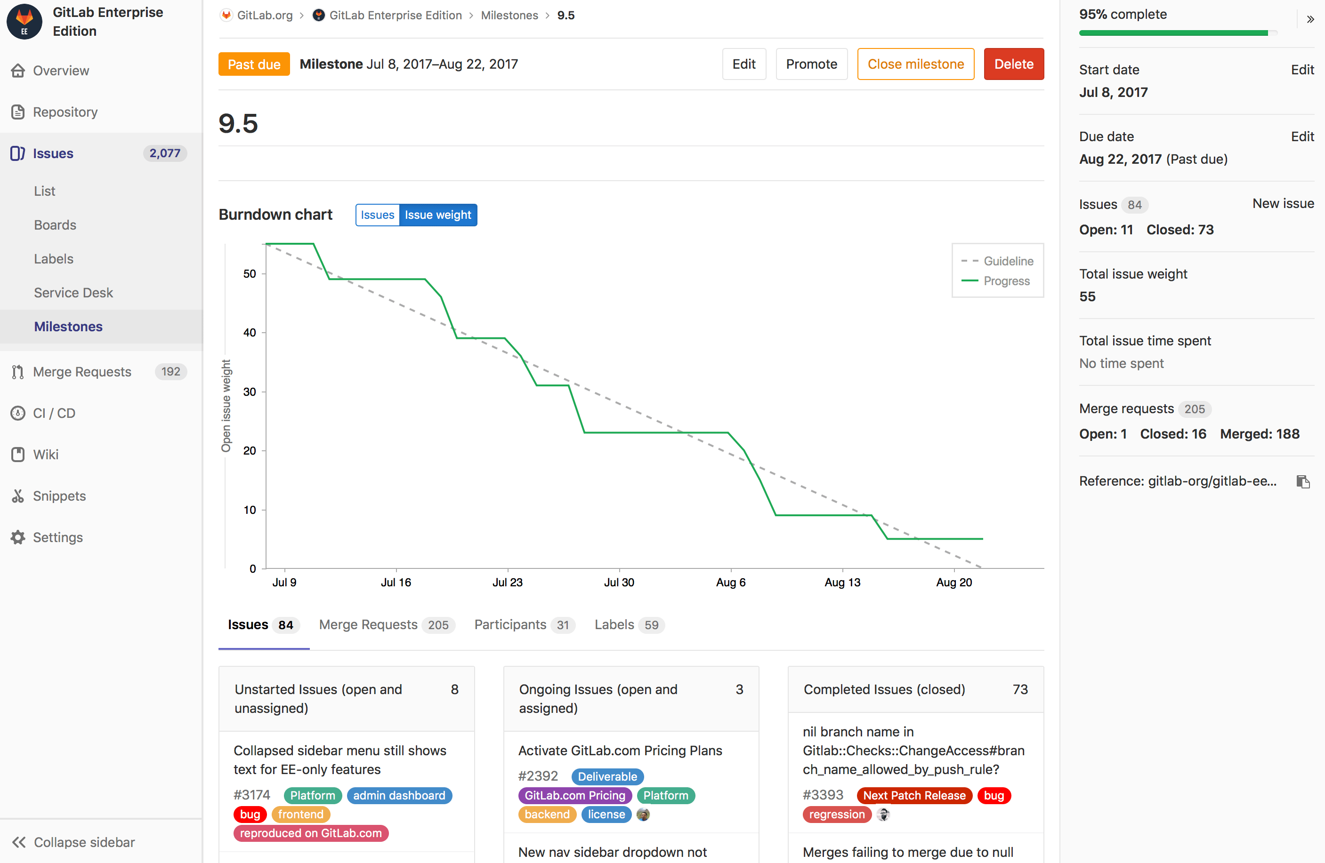
Burndown Chart in Milestone

Slide 18
Thank You

