Slide 1


Slide 2
Docker technology
is one implementation of container based virtualization technologies

Slide 3
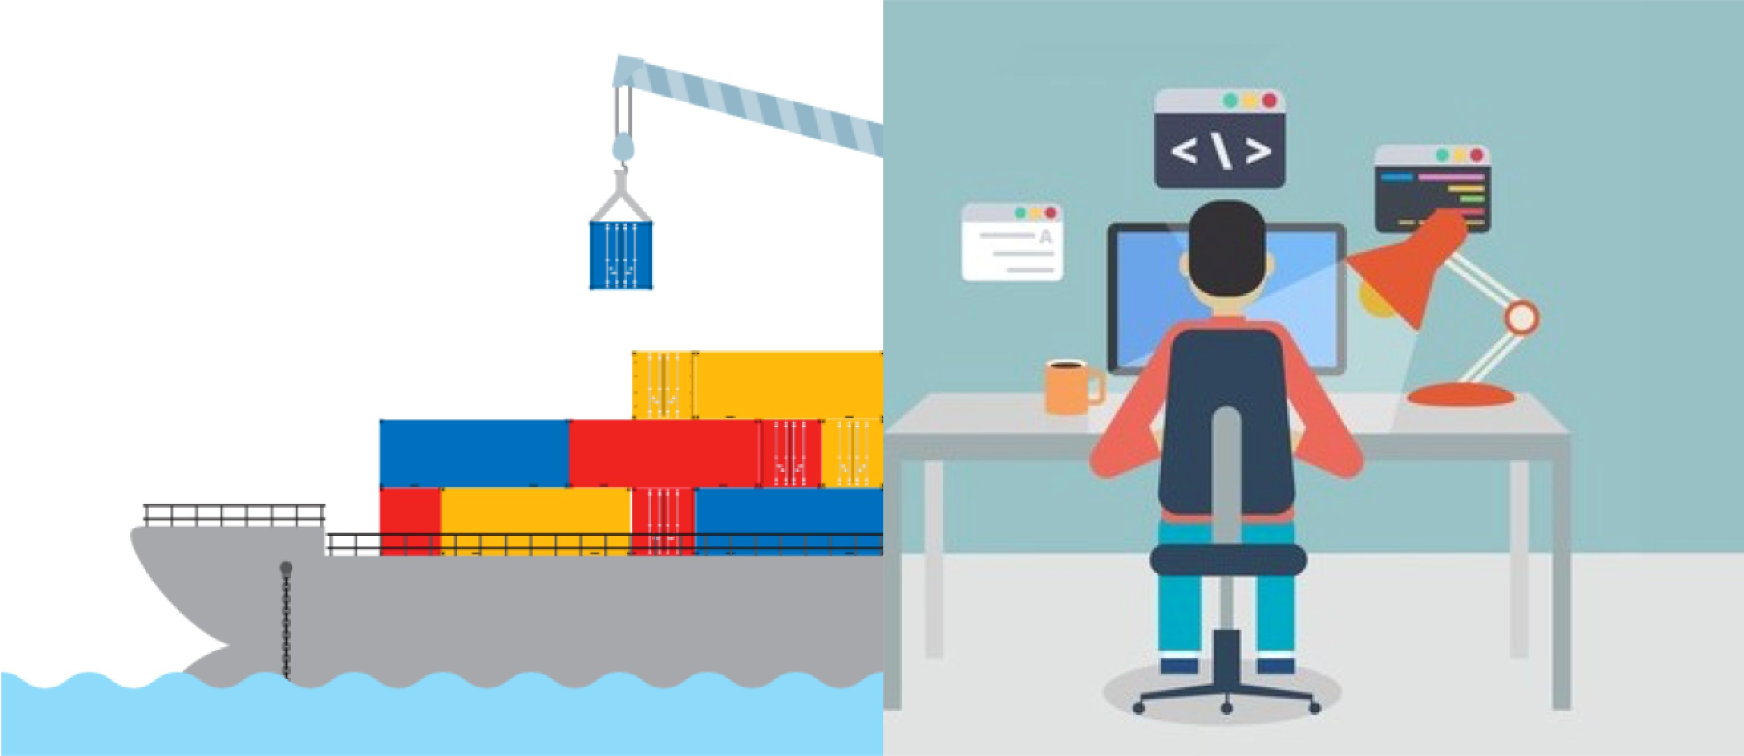

Slide 4
Introduction to Virtualization Technologies

Slide 5





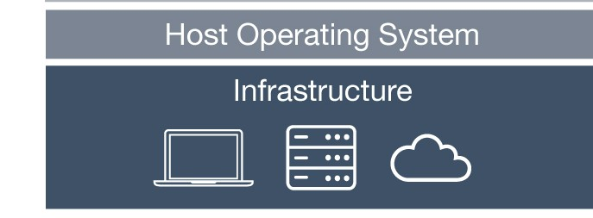
Pre-Virtualization World
Problems:
Huge Cost
Slow Deployment
Hard to Migrate
Pre-Virtualization

Slide 6
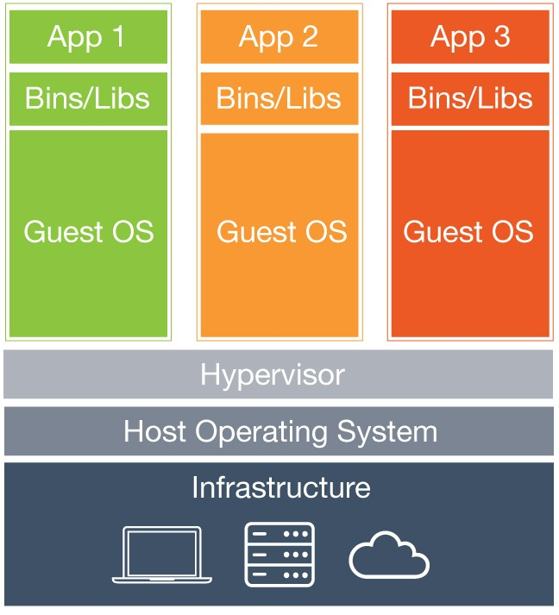
Hypervisor-based Virtualization
Benefits:
Cost-Efficient
Easy to Scale
Limitations:
Kernel Resource Duplication
Application Portability Issue
Hypervisor-based Virtualization

Slide 7

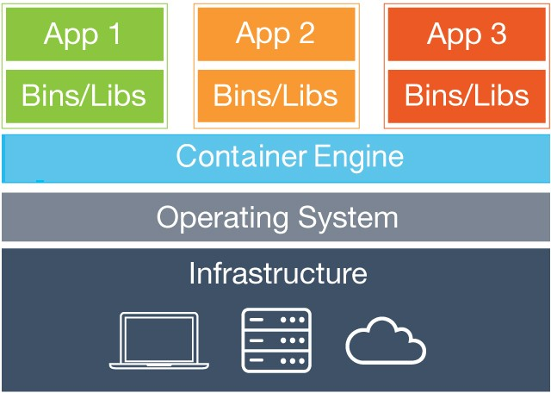
Hypervisor-based VS Container-based Virtualization
Containers
Hypervisor-based Virtualization
Container-based Virtualization

Slide 8














Runtime Isolation
Application A JRE 8 Container A | Application B
 | JRE 7
 | Container B
Container Engine
Operating System/Kernel
Physical Server
Eg. Two app running on a docker engine with different version in different container

Slide 9

Container Virtualization
Benefits:
Containers
Cost-Efficient
Fast Deployment
Guaranteed Portability
Container Virtualization

Slide 10
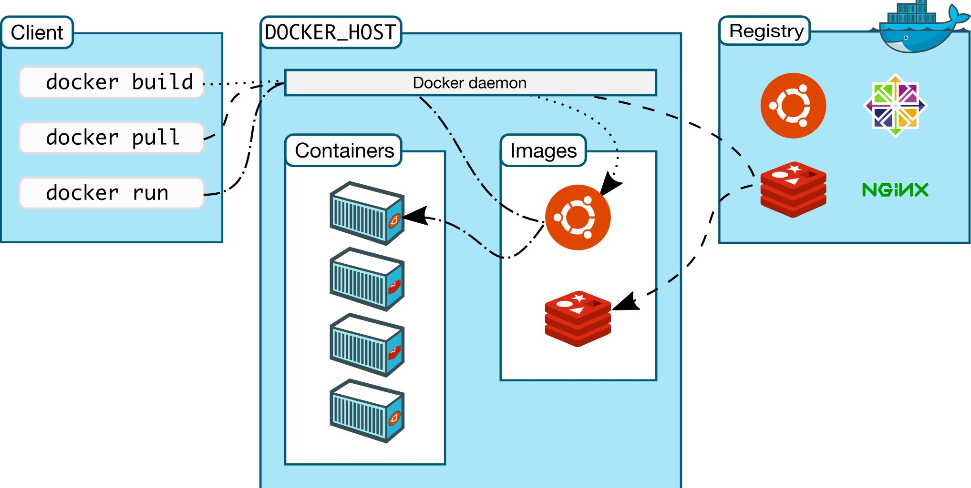
Docker Workflow
When client first build the image at that time it’s create a image for the requirement(eg. Python,postgres)
Then, when we pull the image it first check in local system and if not found then it pull from the docker registry(Docker Hub)
At the run time it runs in the container that contains complete dependencies

Slide 11
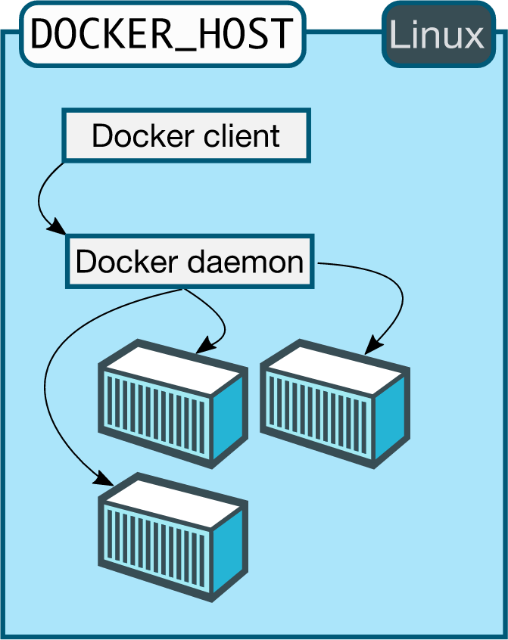
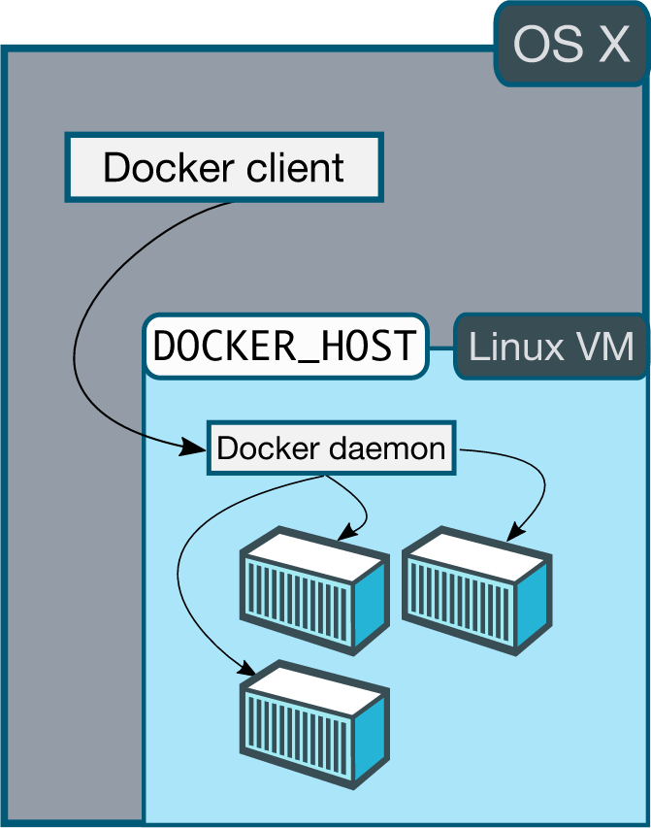
Docker Workflow
Now see Linux VM is inside the container when it runs(docker host)

Slide 12
Docker
Client-Server Architecture

Slide 13
Install Docker Software
Link for downloading docker : https://docs.docker.com/get-docker/

Slide 14
Important Docker Concepts

Slide 15
Images
Images are read only templates used to create containers.
Images are created with the docker build command, either by us or by other docker users.
Images are composed of layers of other images.
Images are stored in a Docker registry.

Slide 16
Containers
If an image is a class, then a container is an instance of a class - a runtime object.
Containers are lightweight and portable encapsulations of an environment in which to run applications.
Containers are created from images. Inside a container, it has all the binaries and dependencies needed to run the application.

Slide 17
Registries and Repositories
A registry is where we store our images.
You can host your own registry, or you can use Docker’s public registry which is called DockerHub.
Inside a registry, images are stored in repositories.
Docker repository is a collection of different docker images with the same name, that have different tags, each tag usually represents a different version of the image.

Slide 18
Why Using Official Images
Clear Documentation
Dedicated Team for Reviewing Image Content
Security Update in a Timely Manner

Slide 19
Docker Image Layers

Slide 20
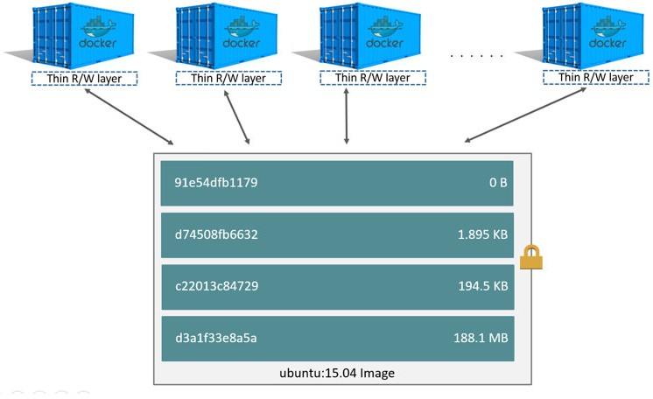
Image Layers
image layer , layers are created on the base image and that other image layer is that we written in compose-file.

Slide 21
Build Docker Images
Approach 1: committing changes made in a container

Slide 22
Ways to Build a Docker Image
Commit changes made in a Docker container.
Write a Dockerfile.

Slide 23
Steps
Spin up a container from a base image.
Install Git package in the container.
Commit changes made in the container.

Slide 24
Docker commit
Docker commit command would save the changes we made to the Docker container’s file system to a new image.
docker commit
container_ID
repository_name:tag

Slide 25
Build Docker Images
Approach 2: Writing a Dockerfile

Slide 26
Dockerfile and Instructions
A Dockerfile is a text document that contains all the instructions users provide to assemble an image.
Each instruction will create a new image layer to the image.
Instructions specify what to do when building the image.

Slide 27
Docker Build Context
Docker build command takes the path to the build context as an argument.
When build starts, docker client would pack all the files in the build context into a tarball then transfer the tarball file to the daemon.
By default, docker would search for the Dockerfile in the build context path.

Slide 28
IMP for creating Dockerfile (Reference)
FROM
RUN
CMD
LABEL
EXPOSE
ENV
ADD
COPY
ENTRYPOINT
VOLUME
WORKDIR
For deep details : https://docs.docker.com/engine/reference/builder/#run

Slide 29
Docker Cache
Each time Docker executes an instruction it builds a new image layer.
The next time, if the instruction doesn't change, Docker will simply reuse the existing layer.

Slide 30
Dockerfile with Aggressive Caching
FROM ubuntu:14.04
reusing cache
RUN apt-get update
reusing cache
RUN apt-get install -y git
curl

Slide 31
Cache Busting
FROM ubuntu:14.04
RUN apt-get update && apt-get install -y \ git \
curl

Slide 32
Cache Busting
You can also achieve cache-busting by specifying a package version. This is known as version pinning.
RUN apt-get update && apt-get install -y \ package-bar \
package-baz \ package-foo=1.3.*

Slide 33
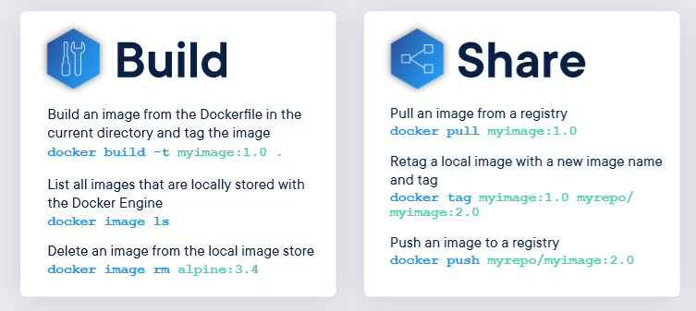
Commands for build or push an image

Slide 34
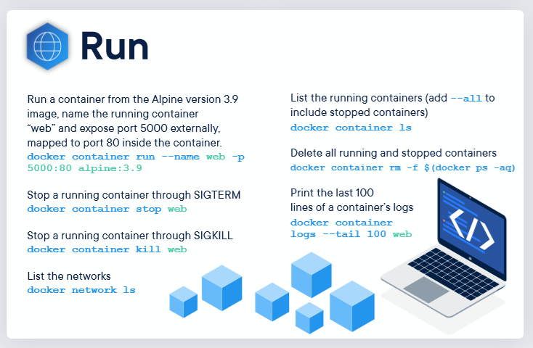
Commands for run an image

Slide 35
Docker Container Links

Slide 36
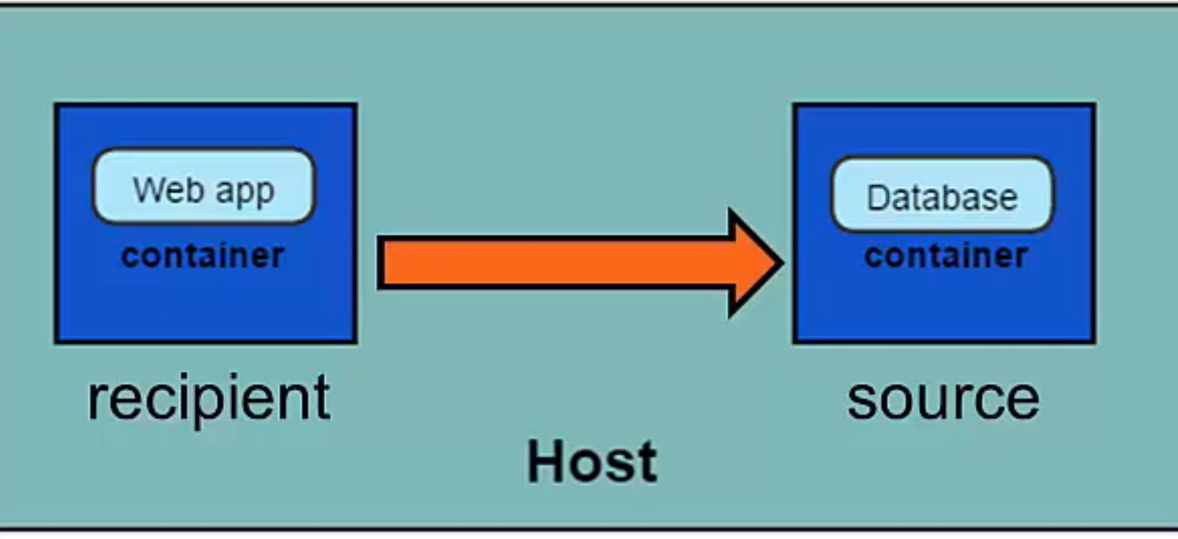
Docker Container Links
Dockerapp
Redis
Suppose we have two app in one there is a python and in another one there is database so in our project we need to connect a container

Slide 37
How container links work behind the scenes?

Slide 38
Benefits of Docker Container Links
The main use for docker container links is when we build an application with a microservice architecture, we are able to run many independent components in different containers.
Docker creates a secure tunnel between the containers that doesn’t need to expose any ports externally on the container.

Slide 39
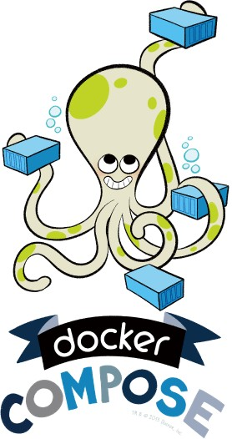
Automate the Docker Workflow with Docker Compose

Slide 40
Deep Dive into Docker Compose Workflow

Slide 41
Why Docker Compose?
Manual linking containers and configuring services become impractical when the number of containers grows.

Slide 42
Docker Compose
Docker compose is a very handy tool to quickly get docker environment up and running.
Docker compose uses yaml files to store the configuration of all the containers, which removes the burden to maintain our scripts for docker orchestration.

Slide 43
Docker Compose Commands
docker compose up starts up all the containers.
docker compose ps checks the status of the containers managed by docker compose.
docker compose logs outputs colored and aggregated logs for the compose-managed containers.
docker compose logs with dash f option outputs appended log when the log grows.
docker compose logs with the container name in the end outputs the logs of a specific container.
docker compose stop stops all the running containers without removing them.
docker compose rm removes all the containers.
docker compose build rebuilds all the images.

Slide 44
Introduction to Docker Networking

Slide 45
Docker Network Types
Closed Network / None Network
Bridge Network
Host Network
Overlay Network

Slide 46
None Network

Slide 47





None Network
Isolated
Isolated
Isolated

Slide 48
None Network
Provides the maximum level of network protection.
Not a good choice if network or Internet connection is required.
Suites well where the container require the maximum level of network security and network access is not necessary.

Slide 49
Bridge Network

Slide 50
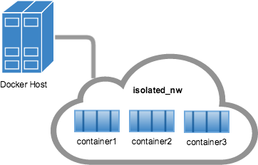
Bridge Network
Threw the bridge network we can connect a different container with one network
By default when container is building up the default network is a bridge network.

Slide 51
















Bridge Network
Container A
Container B
Container Private Network Interface
Container Private Network Interface
Bridge (docker0)
Host
Internet

Slide 52
Host Network

Slide 53
Host Network
The least protected network model, it adds a container on the host's network stack.
Containers deployed on the host stack have full access to the host's interface.
This kind of containers are usually called open containers.

Slide 54
Host Network
Minimum network security level.
No isolation on this type of open containers, thus leave the container widely unprotected.
Containers running in the host network stack should see a higher level of performance than those traversing the docker0 bridge and iptables port mappings.

Slide 55
Another Reference :
https://dev.to/siaarzh/vs-code-with-python-in-docker-quickstart-3ph4
https://hub.docker.com/repository/docker/mkanjaria/isg_test
https://blimpup.io/blog/develop-python-docker-applications-faster/
https://www.compose.com/articles/getting-started-with-compose-postgresql-and-jupyter-notebooks/
https://www.tutorialspoint.com/docker/docker_quick_guide.htm#:~:text=%20Docker%20-%20Continuous%20Integration%20%201%20Step,you%20will%20now%20be%20able%20to...%20More%20
https://code.visualstudio.com/docs/containers/overview

Slide 56
THANK YOU
THANK YOU !!

