Slide 1


CAPSTONE PROJECT - I
FINDLY
Campus Lost & Found Management System
Subject: Capstone Project - I (2CEIT505)
Team ID: CP1_053
Team Members: Ved Joshi • Harsh Kashyap • Rakesh Kavara • Oza Jeel • Vraj Soni
Guided by: Dr. Manan Thakkar
Department of Computer Engineering | Ganpat University - U. V. Patel College of Engineering

Slide 2
INTRODUCTION
Every college campus deals with a constant stream of misplaced belongings - ID cards, wallets, phones, bottles, bags and other items left behind in classrooms, libraries, canteens and hostels. On most campuses this is still handled informally: students ask around, check a notice board, or post in a WhatsApp group, and there is no single place to look.
FINDLY - Campus Lost & Found is a centralised, web-based platform that brings this whole process onto one system. Students can report items they have lost and browse items that have been found, while authorised Staff and Admin users are responsible for logging found items and handling their custody and handover. The system works on role-based access control, so Student, Staff and Admin accounts each get the functions relevant to their responsibility - nothing more.
THREE USER ROLES
1
Student
Reports lost items, browses found items
2
Staff
Logs found items, manages custody & handover
3
Admin
Full control - users, categories, records, reports
FINDLY - Campus Lost & Found System
Introduction

Slide 3
PROBLEM STATEMENT
There is currently no dedicated platform for managing lost and found items on our campus. When a student loses something, the only option is to ask around, check a notice board, or wait for someone to mention it in a group chat - and a person who finds an item usually just hands it to whichever staff member is nearby, with no record of it anywhere. Because none of this goes through a common system, information stays limited to whoever was directly involved, and there is no structured way to search, track status, or know where a found item is currently being kept.
KEY CHALLENGES WITH THE EXISTING (MANUAL) APPROACH
No centralized record - information is scattered across chats, conversations and notice boards
No structured search - students cannot filter found items by category, date or location
No dedicated found-item logging system for Staff/Admin to record what has been handed in
No visibility into item status - active, resolved, or still being handled
No role-based separation between what Students, Staff and Admin should be able to do
No administrative dashboard to view overall lost-and-found activity across campus
FINDLY - Campus Lost & Found System
Problem Statement

Slide 4
PROPOSED SOLUTION
FINDLY replaces this informal process with a single, structured, role-based web platform. Students get one place to report a lost item and search through everything that has been found, instead of depending on word of mouth. Staff and Admin users - the people who actually receive items handed in at a security desk or admin office - log found items into the system and keep track of where each one is being held until it is resolved. When the rightful owner comes forward, Staff/Admin verify them in person and record their name, contact number and enrollment number before handing the item over, so every handover has a proper record behind it.
1
2
3
4
→
→
→
Student reports
a Lost item
Staff/Admin logs
a Found item
Student browses &
recognises their item
Staff/Admin verify
& record handover
FINDLY - Campus Lost & Found System
Proposed Solution

Slide 5
FEATURES
1
Role-Restricted Found-Item Logging
2
Custody Tracking
Only Staff/Admin accounts can log a found item, matching how items are actually handed in physically.
Staff/Admin can record and update exactly where a found item is currently being kept.
3
In-Person Recipient Verification
4
Multi-Filter Search
When an item is handed over, the recipient’s name, contact number and enrollment number are recorded.
Students can filter found items by keyword, category, date and location.
5
Status Tracking
6
In-App Notifications
Every item shows a clear status - Pending, Active, Claimed or Resolved.
Users are notified automatically whenever something relevant to them changes.
7
Admin Dashboard
8
Role-Based Access Control
A single screen summarising pending approvals, pending handovers, resolved items and registered users.
A permission matrix decides exactly which functions each of Student, Staff and Admin can use.
FINDLY - Campus Lost & Found System
Features

Slide 6
SYSTEM REQUIREMENTS
SOFTWARE REQUIREMENTS
HARDWARE REQUIREMENTS
Operating System: Windows 10/11, Linux or macOS (development)
Web Server: Apache (via XAMPP)
Server-Side Language: PHP
Database: MySQL, managed via phpMyAdmin
Front-End: HTML5, CSS3, Bootstrap 5, JavaScript / jQuery
Browser: Any modern browser - Chrome, Firefox or Edge
Design Tool: Figma (UI/UX prototyping)
Version Control: Git & GitHub
Processor: Dual-core 2.0 GHz or higher (development machine)
RAM: 4 GB minimum, 8 GB recommended
Storage: 5 GB free disk space for local server and database
Internet Connection: Required for GitHub, Figma and testing
Client Side: Any device with a modern web browser - desktop, laptop, tablet or smartphone
Server Side (deployment): Standard web hosting supporting PHP and MySQL
FINDLY - Campus Lost & Found System
System Requirements

Slide 7
TECHNOLOGY STACK
FRONT-END
BACK-END
DATABASE
HTML5
CSS3
Bootstrap 5
JavaScript / jQuery
PHP
Apache (XAMPP)
MySQL
phpMyAdmin
→
→
SUPPORTING TOOLS
Git & GitHub - version control and team collaboration
Figma - high-fidelity UI/UX prototyping and page navigation
Postman - manual testing of PHP endpoints during development
Bootstrap Icons / Font Awesome - icons across the interface
FINDLY - Campus Lost & Found System
Technology Stack

Slide 8
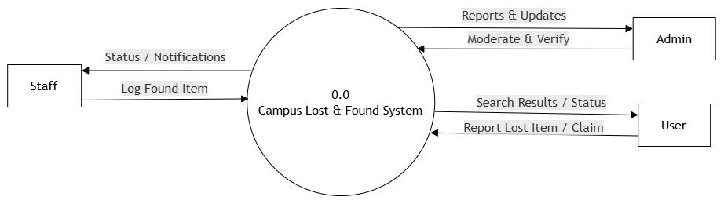
SYSTEM DIAGRAMS
Data Flow Diagram (Context Level)
Shows how data moves between Students, Staff, Admin and the central FINDLY database across authentication, item posting, item resolution and notification processes.
FINDLY - Campus Lost & Found System
Diagrams

Slide 9
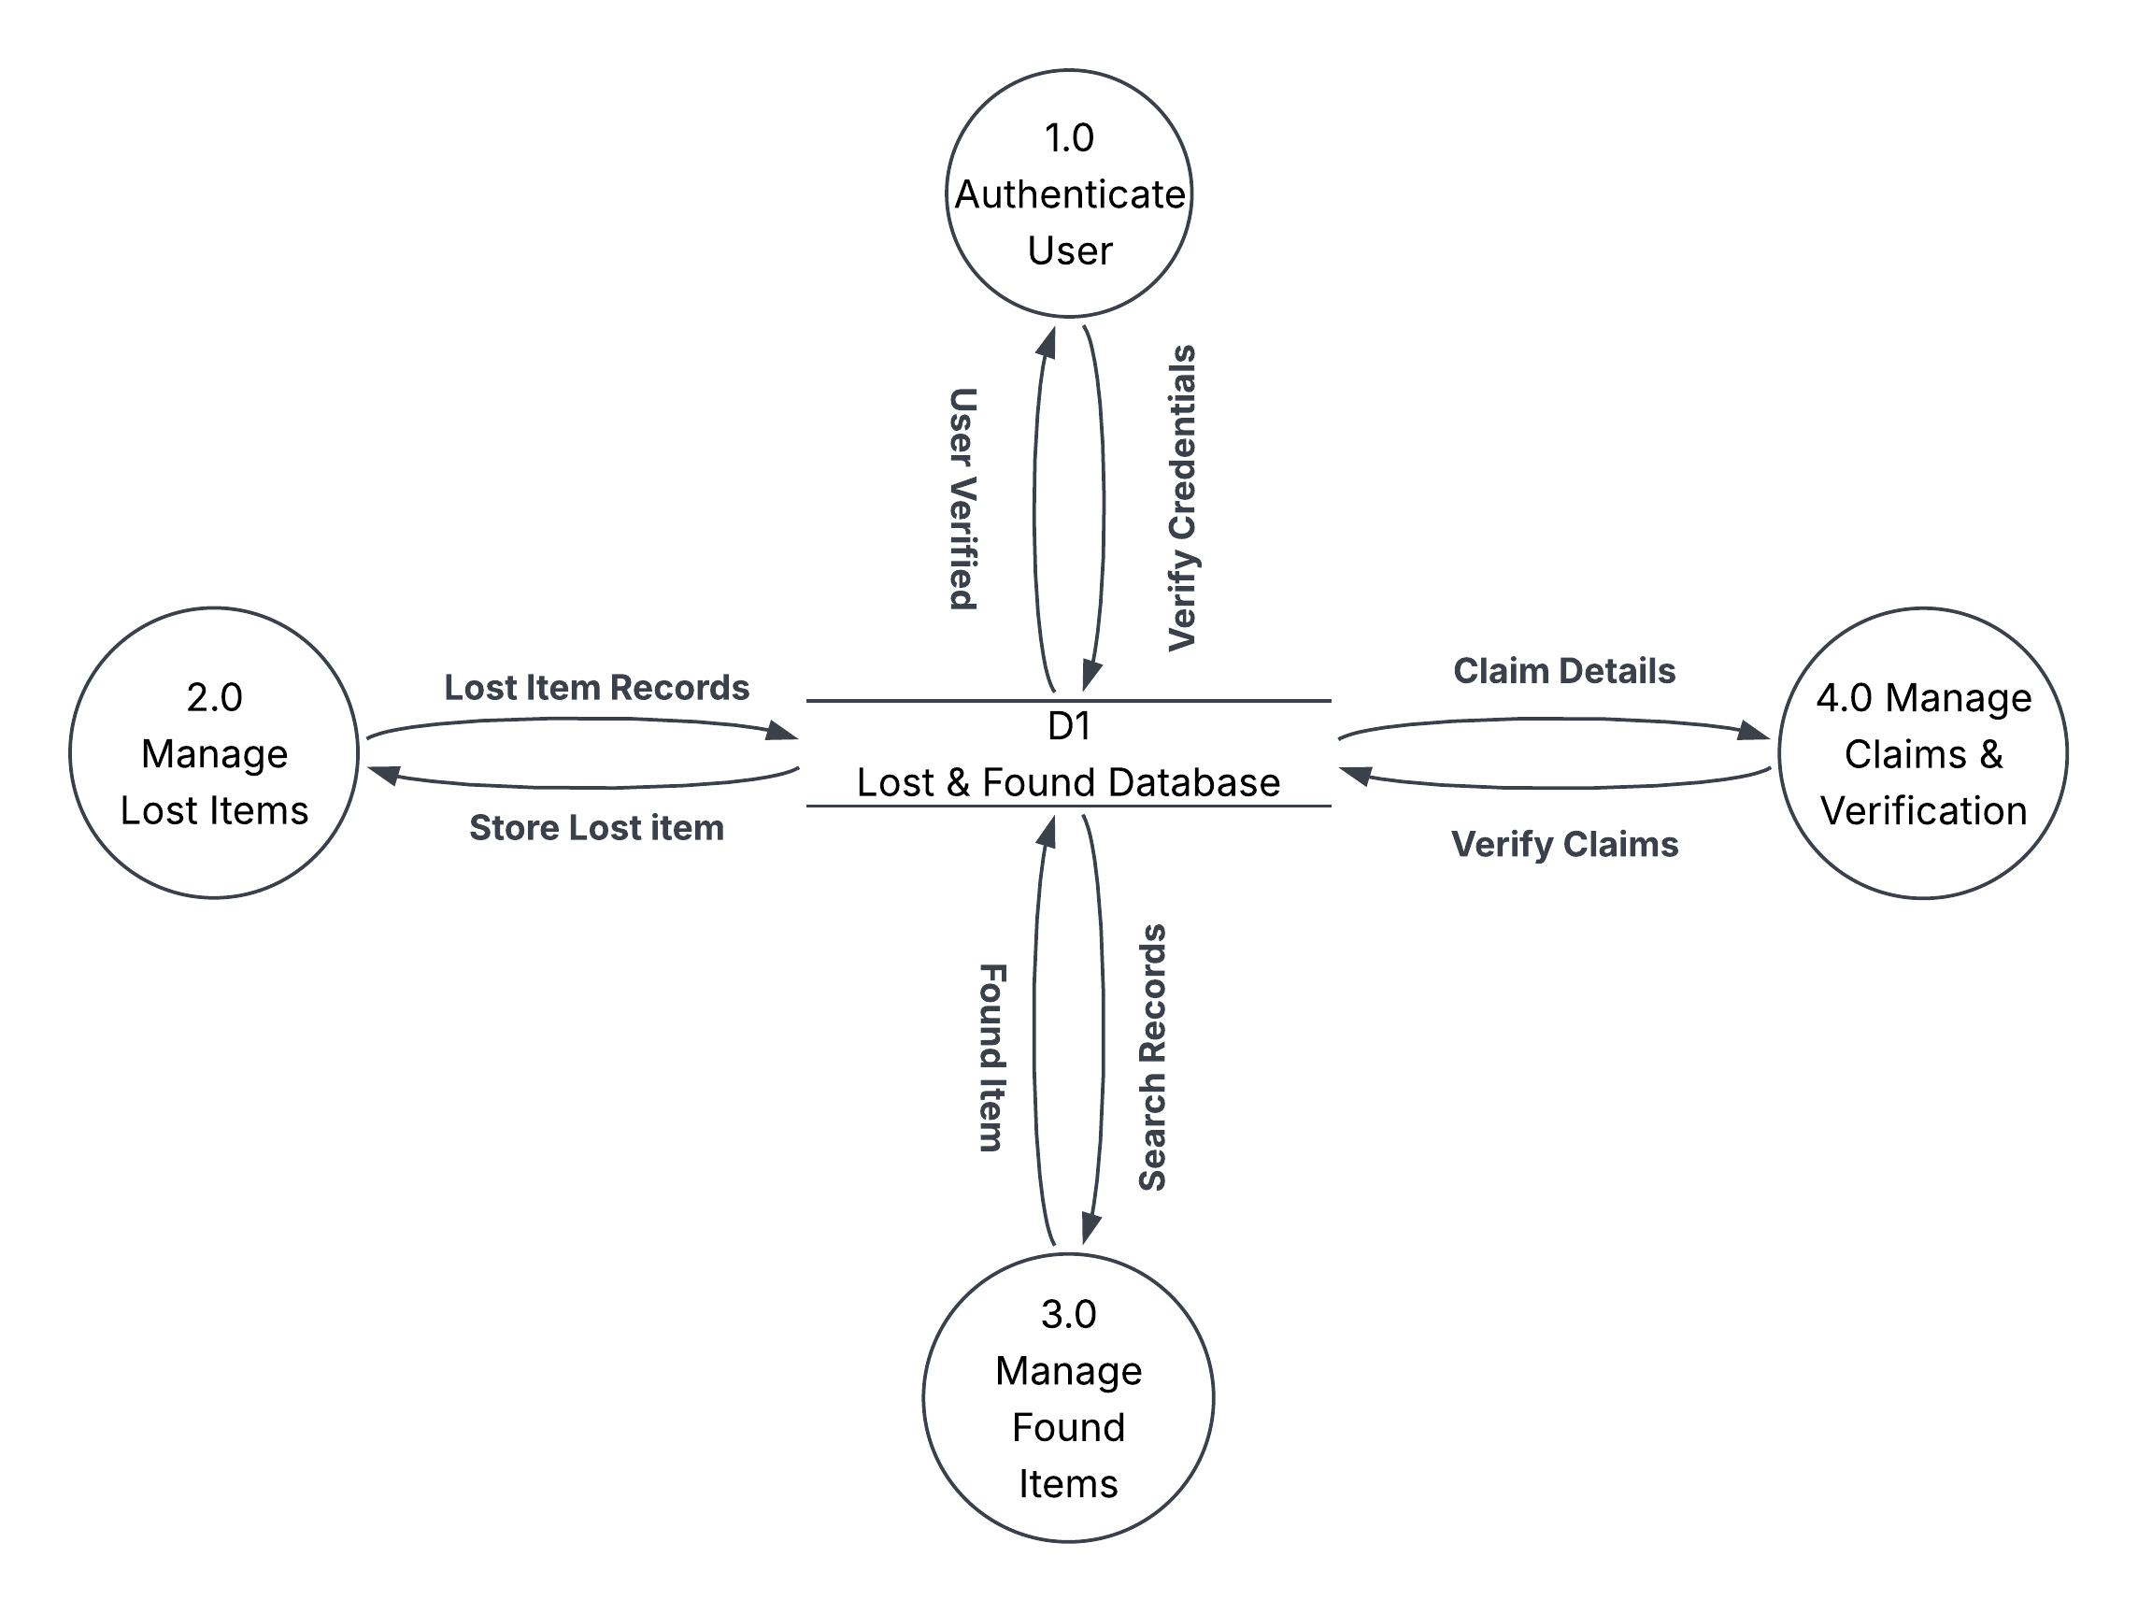
SYSTEM DIAGRAMS
Data Flow Diagram (Level-1)
Shows how data moves between Students, Staff, Admin and the central FINDLY database across authentication, item posting, item resolution and notification processes.
FINDLY - Campus Lost & Found System
Diagrams

Slide 10
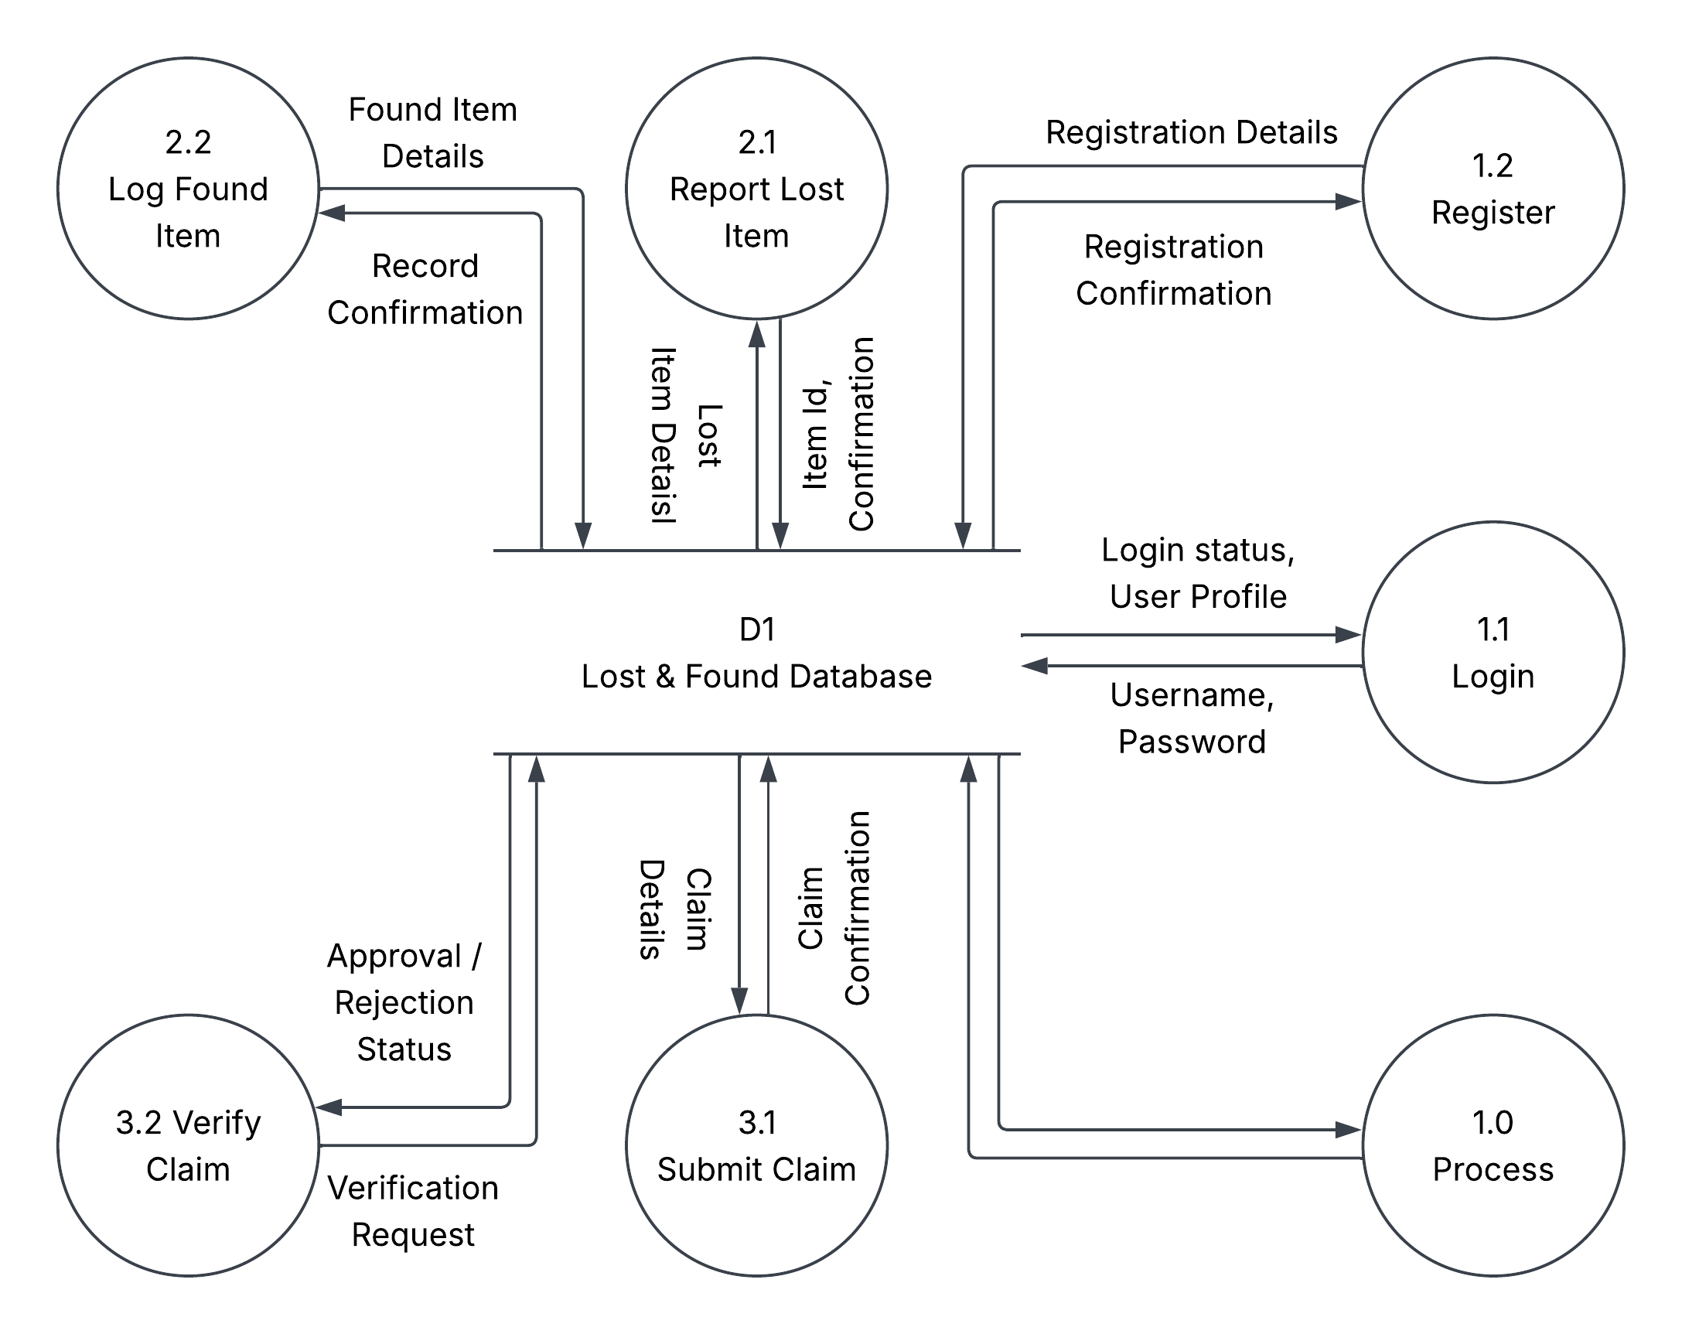
SYSTEM DIAGRAMS
Data Flow Diagram (Level-2)
Shows how data moves between Students, Staff, Admin and the central FINDLY database across authentication, item posting, item resolution and notification processes.
FINDLY - Campus Lost & Found System
Diagrams

Slide 11
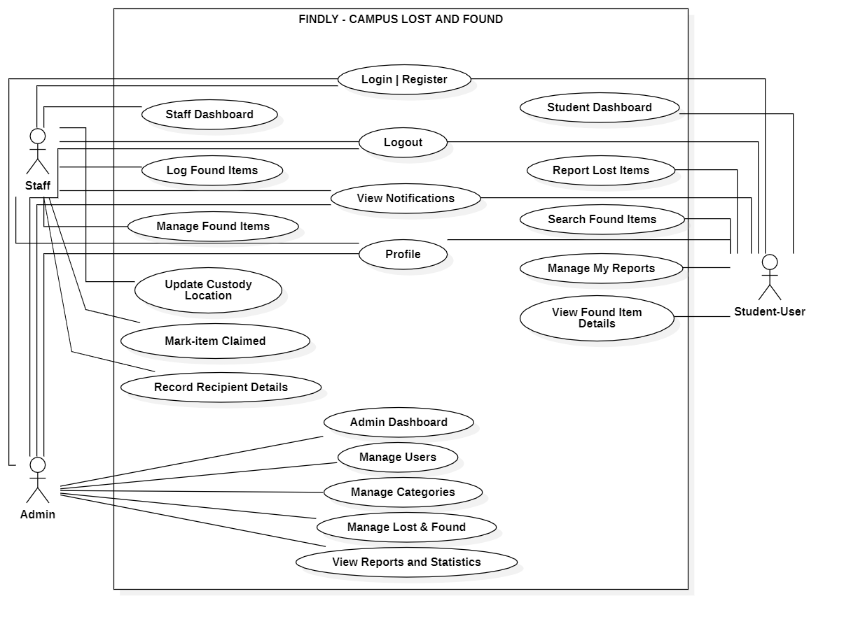
SYSTEM DIAGRAMS
Use Case Diagram (Mandatory)
Actors: Guest, Student, Staff and Admin. Covers Register/Login, Report Lost Item, Browse Found Items, Log Found Item (Staff/Admin only), Mark Item as Claimed, Record Recipient Details, Moderate Posts and Manage Categories/Users.
FINDLY - Campus Lost & Found System
Diagrams

Slide 12
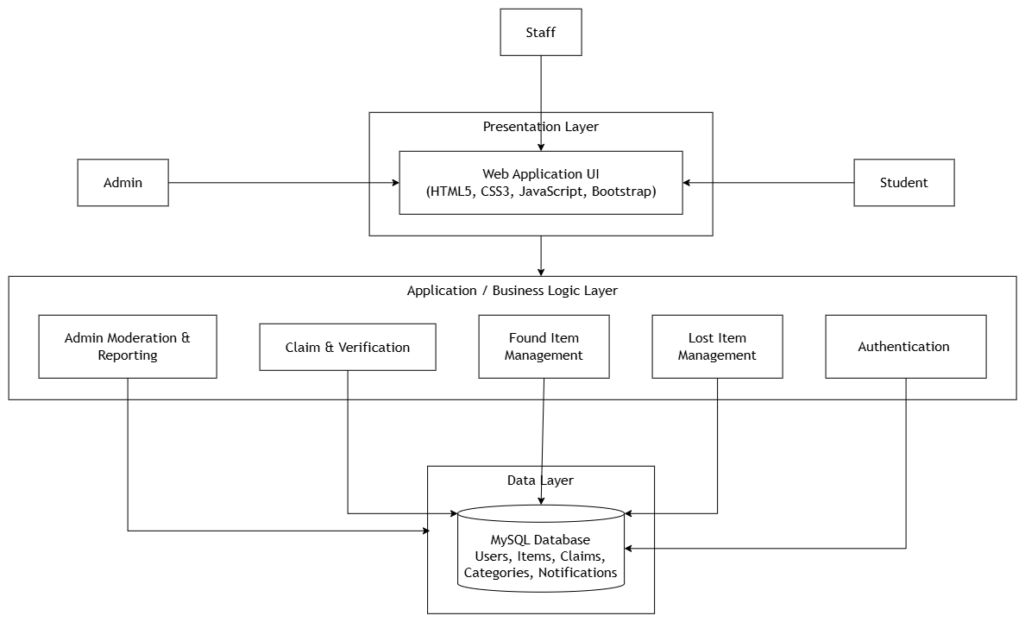
SYSTEM DIAGRAMS
System Architecture (as applicable)
FINDLY - Campus Lost & Found System
Diagrams

Slide 13
FUNCTIONAL REQUIREMENTS
STUDENT MODULE
STAFF MODULE
ADMIN MODULE
Register / Login / Logout
Report a Lost Item
Browse & search Found Items
View own reports; edit or delete them
View item details, profile & notifications
Log a Found Item
Update custody / location information
Mark an item as Claimed
Record recipient details (name, contact, enrollment no.)
Mark an item as Resolved
Moderate pending posts (approve/reject)
Manage categories and users
View dashboard & system statistics
Manage Found-item handover records
All Staff-level functions, in addition to the above
FINDLY - Campus Lost & Found System
Functional Requirements

Slide 14
NON-FUNCTIONAL REQUIREMENTS
Security: Passwords stored using salted hashing; no plain-text storage
Responsive Design: Usable across desktop, tablet and mobile screen sizes
Input Validation: All user input validated; parameterised queries to prevent SQL injection
Reliability: Item and user records remain consistent during normal operation
Role-Based Access: Staff/Admin-only functions enforced on the server side, not just hidden in the UI
Session Security: Authenticated sessions expire according to a defined session policy
Performance: Search and filter operations return results within an acceptable response time
File Upload Security: Image uploads restricted to supported formats and a safe file-size limit
Usability: Simple, minimal-step interface for reporting, searching and logging items
Scalability: Database can accommodate growing users and item records without redesign
FINDLY - Campus Lost & Found System
Non-Functional Requirements

Slide 15
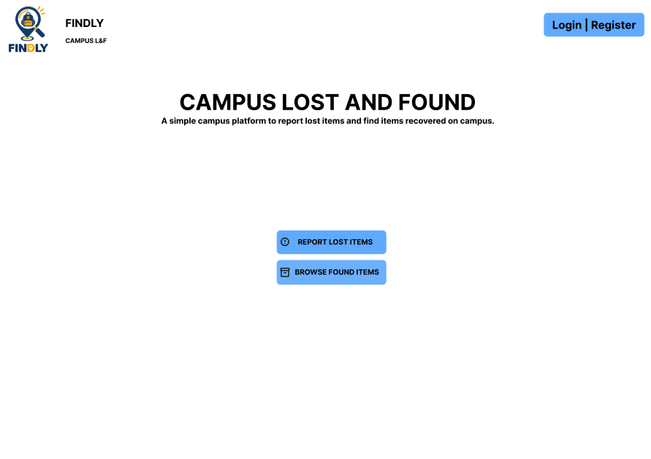
PROTOTYPE DEMONSTRATION
Progress completed so far in Figma
COMPLETED
Authentication flow - Landing, Login, Register, Registration Success
Student Dashboard with quick access to all major actions
Report Lost Item form
My Reports - list view, report details and delete confirmation
IN PROGRESS / PLANNED
Browse Found Items - listing and item-detail view
Staff Module screens - Log Found Item, custody management, handover
Admin Module screens - dashboard, moderation, category & user management
Linking all screens together as one connected, clickable Figma prototype
FINDLY - Campus Lost & Found System
Prototype Demonstration

Slide 16
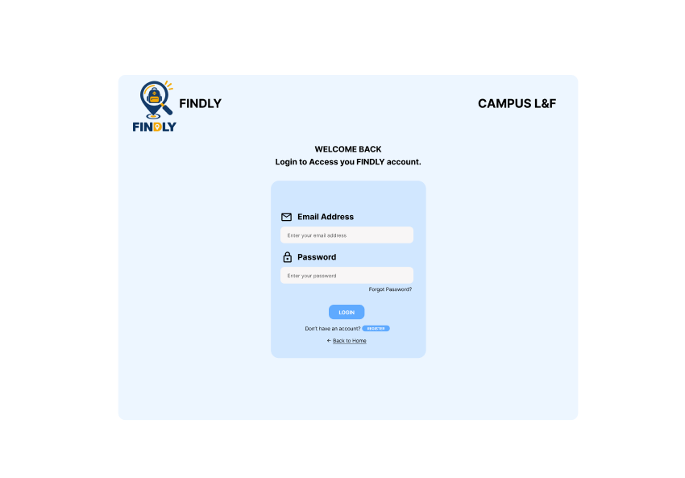
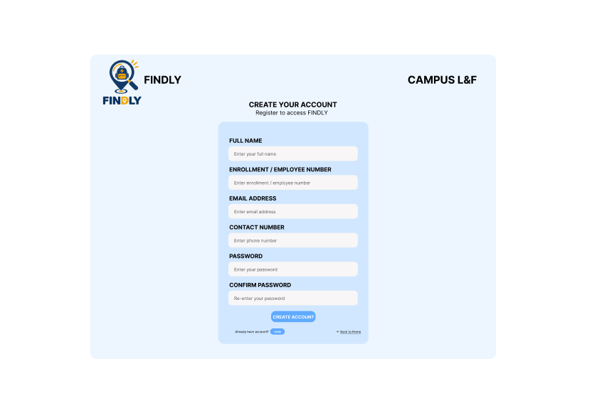
PROTOTYPE DEMONSTRATION
Progress completed so far in Figma
FINDLY - Campus Lost & Found System
Prototype Demonstration

Slide 17
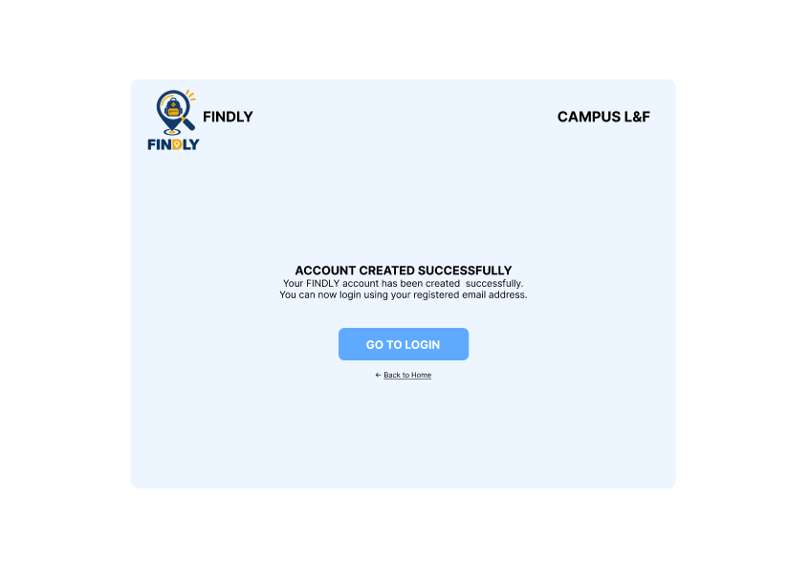
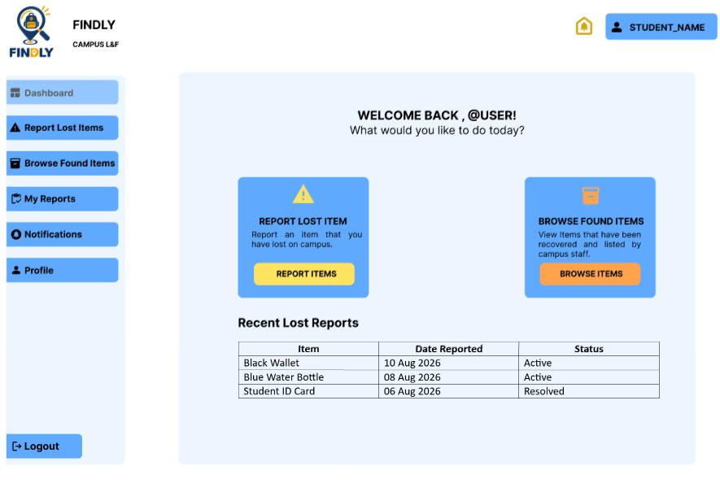
PROTOTYPE DEMONSTRATION
Progress completed so far in Figma
FINDLY - Campus Lost & Found System
Prototype Demonstration

Slide 18
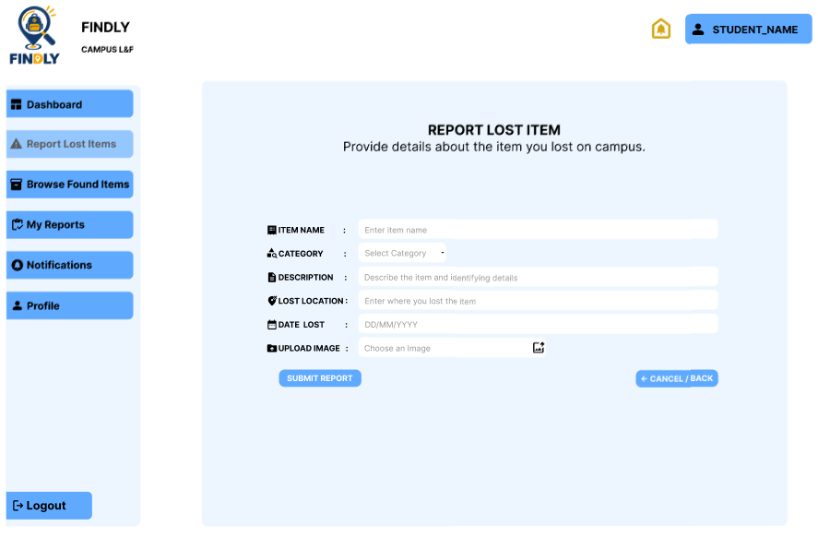
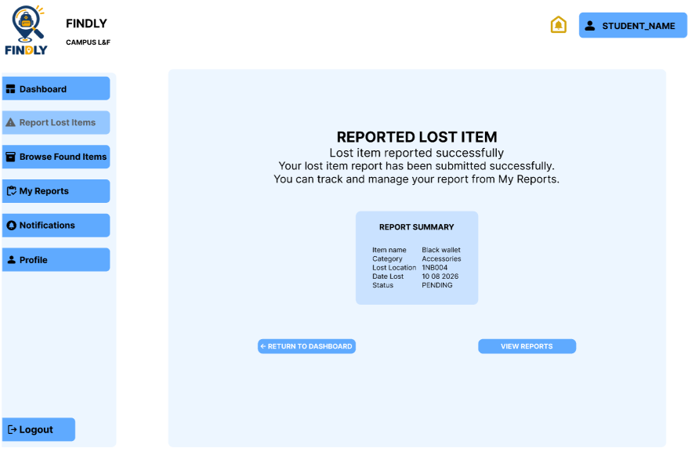
PROTOTYPE DEMONSTRATION
Progress completed so far in Figma
FINDLY - Campus Lost & Found System
Prototype Demonstration

Slide 19
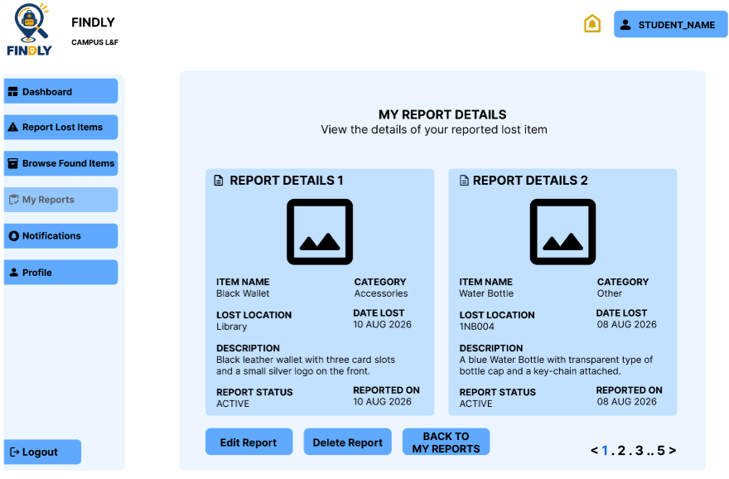
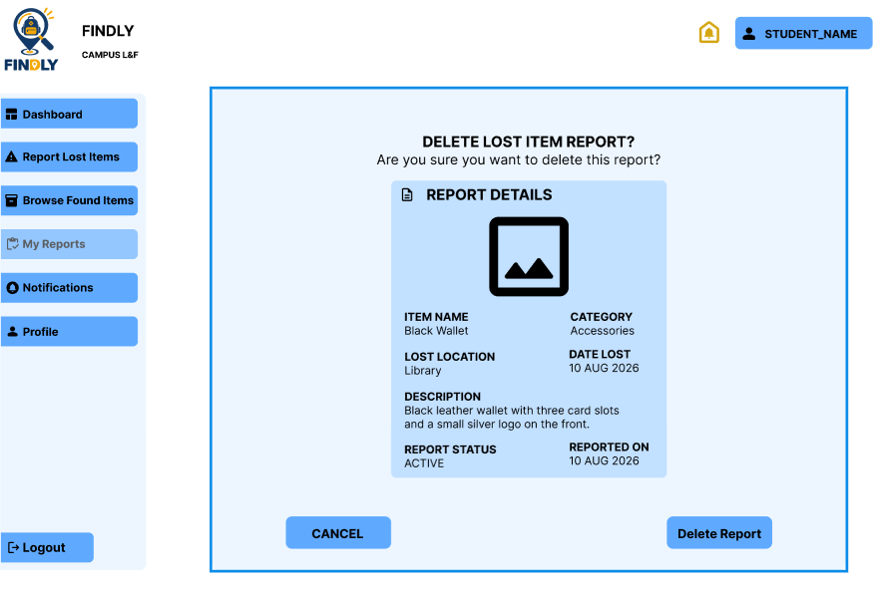
PROTOTYPE DEMONSTRATION
Progress completed so far in Figma
FINDLY - Campus Lost & Found System
Prototype Demonstration

Slide 20
CONCLUSION & FUTURE WORK
CONCLUSION
FINDLY is proposed as our Semester V Capstone Project - I to replace the informal, untracked way lost and found items are currently handled on campus with a single, centralised, role-based web platform. The application restricts Found-item logging and recipient-detail recording so that non-Staff/non-Admin users cannot access these functions at all - only Staff and Admin accounts are permitted to log a found item and record verified recipient details at the point of handover. This is expected to make the process faster, more organised, and more accountable than the notice-board-and-WhatsApp approach we currently rely on, while giving campus administration clear visibility into what is happening at any point in time.
FUTURE WORK
Email / SMS notifications alongside in-app alerts
Automated match-suggestion between Lost and Found postings
QR-code based item tags for faster in-person verification
Integration with the institution’s official student database
Timestamp-based claim screening - flag a claim if the claimant’s Lost report was filed only after the matching Found item was already logged, giving Staff/Admin an extra signal alongside in-person verification
FINDLY - Campus Lost & Found System
Conclusion & Future Work

Slide 21
REFERENCES
[1] S. Sinha et al., "A Novel Approach to Enhance Campus Lost and Found Services through Integration of QR Code with Personalized Item Registration," Proc. TQCEBT, 2024.
[2] "UniFind: Lost and Found Objects Management System for Campus using AI & Cloud Services," ResearchGate preprint, 2025.
[3] "An Effective Lost and Found System in University Campus," Universiti Kebangsaan Malaysia, Vol. 8, Issue 32, 2023.
[4] "Automated Lost and Found System with Peer-to-Peer Matching," JETIR.
[5] "Lost and Found Management System," Int. J. of Research in Engineering and Science (IJRES), Vol. 14, Issue 1, 2026.
[6] "Lost and Found Website for College Campus (FoundLost)," IJFANS Int. J. of Food and Nutritional Sciences, Vol. 13, Issue 04, 2024.
[7] "Lost and Found Management System" (eye-tracking usability study), ResearchGate, 2026.
[8] "A Comparative Study on Lost and Found Management Systems in Academic Institutions," IEEE Xplore, Document 10904362.
[9] R. Vasavi, "Lost and Found System for VNR VJIET," IJERT, Vol. 11, Issue 06, 2022.
[10] P. Choudhary et al., "Find Mine: Find the Lost Items via Mobile App," IEEE, 2021.
FINDLY - Campus Lost & Found System
References

Slide 22
THANK YOU
Questions & Suggestions Welcome
FINDLY - Campus Lost & Found System | Team [CP1_053]

