Slide 1

ChainGuard AI
AI-Powered Supply Chain Disruption Assistant & Fleet Utilisation Optimizer
Problem ID: L2
Category: Software
Supply Chain Disruption Assistant & Fleet Utilisation Optimizer
Team Nexus Chain · 4 Members
Smart India Hackathon 2026
Disruption intelligence · Route optimisation · Fleet utilisation

Slide 2




Proposed Solution
ChainGuard AI is an explainable decision-support platform that assesses supply-chain disruption risks, compares alternate routes and recommends an operationally safer and more efficient response.
INPUT
DECISION ENGINE
ACTION / OUTPUT
Origin & destination
Disruption type & severity
Available trucks
Shipment type & temperature
Disruption assessment
Candidate route generation
Temperature safety validation
Fleet availability check
Risk-aware comparison
AI-recommended route
Alternate route options
Operational explanation
Fleet reassignment
From disruption signal to actionable logistics decision.

Slide 3

Technical Approach
Tech Stack
Frontend
HTML · CSS · JavaScript
Decision Logic
Input
Model
Generate
Validate
Optimize
Rule-based AI prototype · Explainable flow
User logistics data (JSON)
Explainable decision logic
Candidate route proposals
Safety and disruption checks
Select most suitable route
Data
Structured logistics data · JSON model
Integration Ready
Routing API architecture · Future integrations

Slide 4
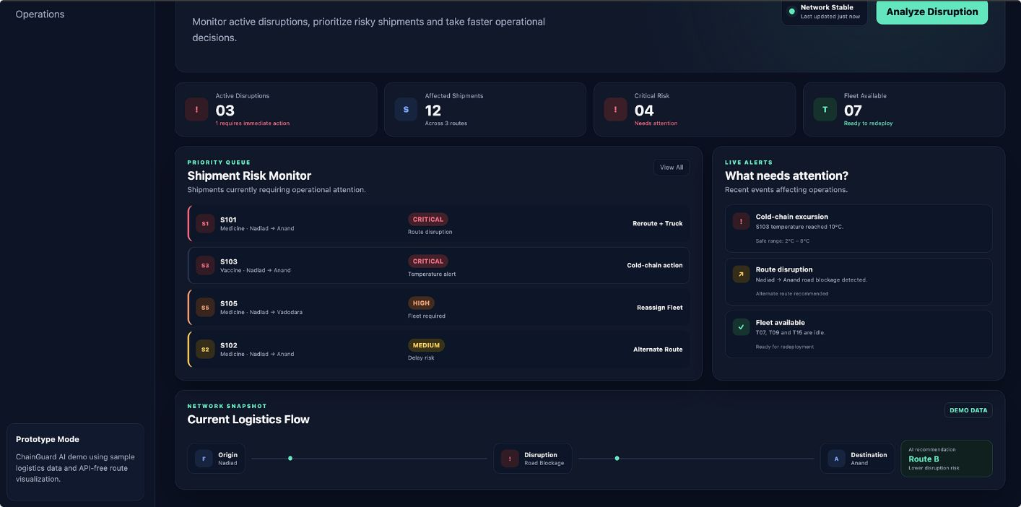

System Workflow & Decision Flow
01
Enter Details
Origin, destination, severity, shipment, temperature, trucks
02
Evaluate
Severity, temperature safety, fleet availability, route risk
03
Generate Alternatives
Route A (High risk · 26 km) · Route B — AI Recommended (Low risk · 32 km) · Route C (Medium risk · 38 km)
04
Explain Decision
Route B selected — lower disruption risk and balanced travel time despite longer distance.
ChainGuard AI does not only recommend a route — it explains the operational reasoning behind every recommendation.

Slide 5
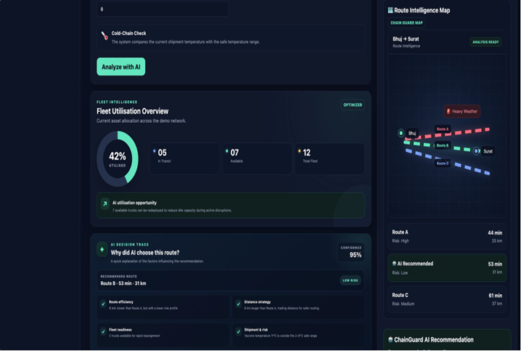
Fleet Utilisation & Explainable AI
Fleet Utilisation
42%
Fleet utilised
05 In Transit · 07 Available
Available vehicles can be redeployed during disruptions.
AI Decision Trace
Why was this route recommended?
✓
Disruption severity assessment
✓
Route travel-time optimisation
✓
Route distance comparison
✓
Fleet availability check
✓
Shipment temperature safety
✓
Operational risk evaluation
Decision Confidence
87%
Prototype estimate
₹1,240
Estimated operational saving · prototype estimate

Slide 6

Feasibility and Impact
Feasible Because
Impact & Benefits
Uses standard web technologies
Works with structured logistics data
Modular route-analysis logic
API-ready architecture
FASTER
SMARTER
Key Challenges & Mitigation
Faster disruption response
Risk-aware route decisions
Challenge | Mitigation
Dynamic disruption conditions | Rule-based safety validation
Real-time fleet availability | Fleet availability checks
Route uncertainty | Risk-aware route comparison
Temperature-sensitive shipments | Modular integration architecture
VISIBLE
EFFICIENT
Clear route & fleet intelligence
Better vehicle utilisation
ChainGuard AI turns complex disruption inputs into a clear, explainable and actionable operational decision.

Slide 7
Roadmap & Future Scope
① Prototype
1
Dashboard
Disruption analysis
Route comparison
Temperature validation
2
② Decision Intelligence
Dynamic AI explanation
Improved route scoring
Advanced fleet optimisation
Better risk evaluation
③ Live Integration
3
Real-time traffic
Weather/disruption feeds
GPS/fleet status
External logistics APIs
4
④ Scale
Multi-city operations
Predictive disruption alerts
Enterprise logistics integration
Large-scale fleet optimisation
Research & References
Constraint-based route optimisation concepts — Route planning and logistics optimisation
Fleet utilisation and logistics optimisation — Vehicle scheduling and resource allocation
HTML / CSS / JavaScript documentation — Web technologies and frontend frameworks
Routing, traffic and logistics API documentation — Integration architecture and external services
Detect disruption. Evaluate risk. Optimise fleet. Explain the decision.

Slide 8
Thank You
ChainGuard AI
AI-Powered Supply Chain Disruption Assistant & Fleet Utilisation Optimizer
Team Nexus Chain · Smart India Hackathon 2026 · Problem Statement ID: L2
DISRUPTION INTELLIGENCE
ROUTE OPTIMISATION
FLEET UTILISATION
EXPLAINABLE AI

