Slide 1

Master the basics of Digital marketing
-By Skill Shalla

Slide 2
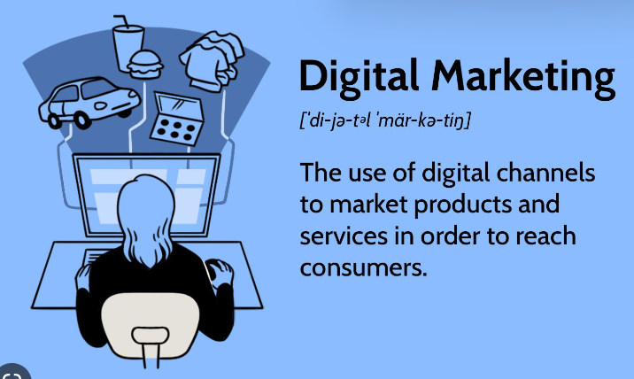
Outline
Introduction to Digital Marketing
Content Marketing
Search Engine Optimization
Social Media Marketing
Web Analytics

Slide 3

What are the essential skills needed to master the basics of digital marketing

Slide 4

Introduction to digital marketing
Definition of Digital Marketing
Benefits of Digital Marketing
Key Components
Types

Slide 5

Content marketing
Definition & Purpose
Types
Strategies
Tools

Slide 6
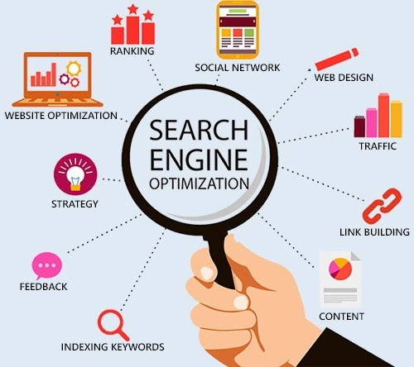
Search engine optimization
Definition & Purpose
Strategies
Tools
Types

Slide 7

Social media marketing
Definition & Purpose
Types
Strategies
Tools

Slide 8

WEB analytics
Definition & Purpose
Types
Strategies
Tools

