Slide 1

A guide to Learning coding & Programming languages

Slide 2
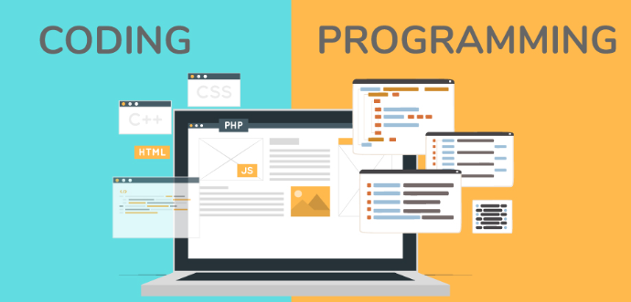
What is Difference between coding & programming languages?

Slide 3

What is Coding & Programming Languages?
Definition of Coding
Definition of Programming Languages
Benefits of learning coding and programming languages

Slide 4
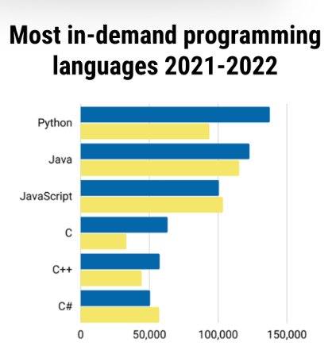

Types of Coding & Programming Languages
Different Coding Languages
Different Programming Languages
Benefits
Popular Languages

Slide 5

How to Chose the Right Language
Consider the Project Requirements
Consider the cost and availability of resources
Consider the ease of use
Consider the Scalability

Slide 6

How to Learn?
Understand the basics
Practise with Tutorials & Projects
Join a Community
Utilize online resources

Slide 7

Preparing to make a Career?
Get Certified
Increase your knowledge
Build a portfolio to work
Network & find job opportunities

