Slide 1

Learn the Basics of Java Programming with Ease
-By Skill Shalla

Slide 2

Outline
Introduction to Java Programming
Basic Syntax of Java Programming
Class & Objects
Array, String & Loops
Advance Java Programming

Slide 3

What are the resources I used for learning the basics?

Slide 4
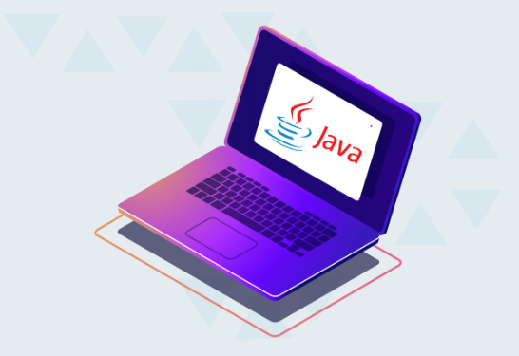
Introduction to Java
What is Java Programming?
Benefits of Java Programming
History of Java Programming
Requirements for learning Java Programming

Slide 5
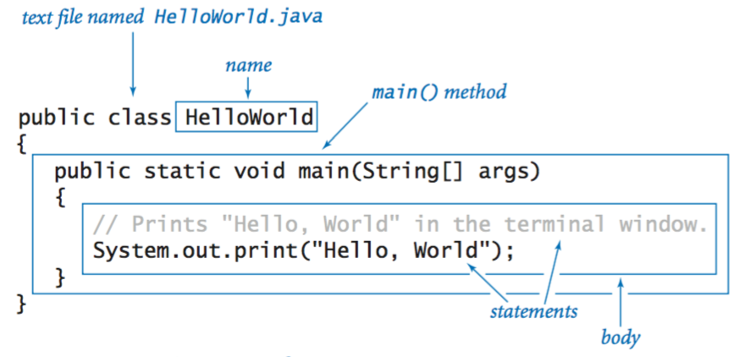
Basic Syntax of Java
Identifiers and Variables
Data Types
Operators
Statements

Slide 6
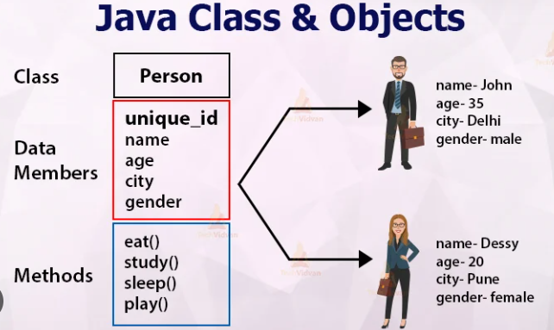
Class and objects
What is a Class?
What is a Object?
Fields, Methods & Constructors

Slide 7

Array, String & Loops
What is Array?
What is String?
Types of Loops

Slide 8
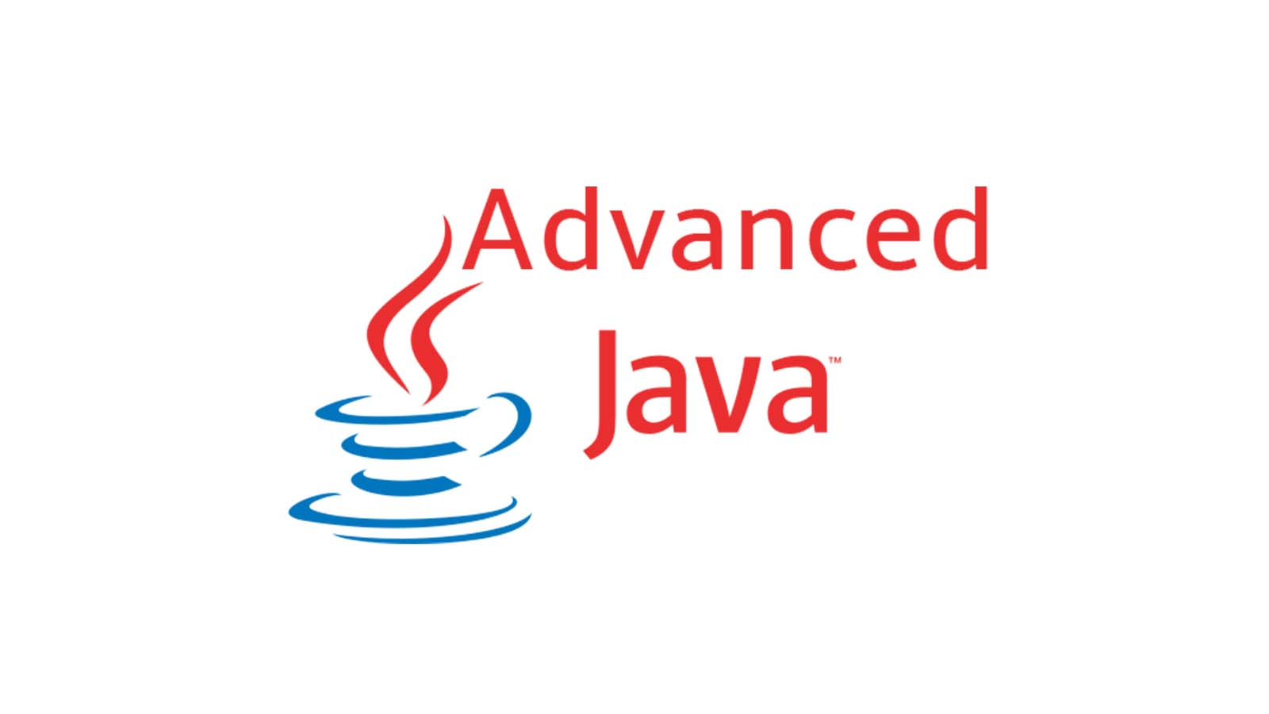
Advance Java Programming
Exception Handling
File Management
Database Connectivity
Networking & Threads
GUI

