Slide 1

Exploring the Basics of Python Programming
-By Skill Shalla

Slide 2
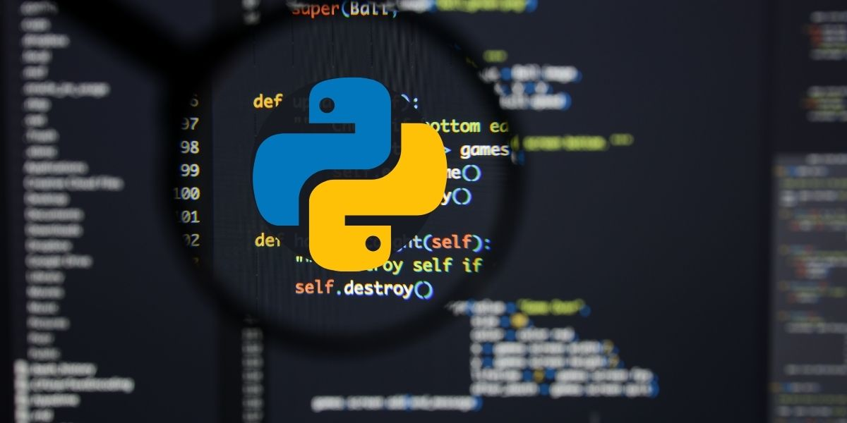
Outline
Introduction to Python
Syntax and Variables
Learning the data structures
Common Python Projects

Slide 3
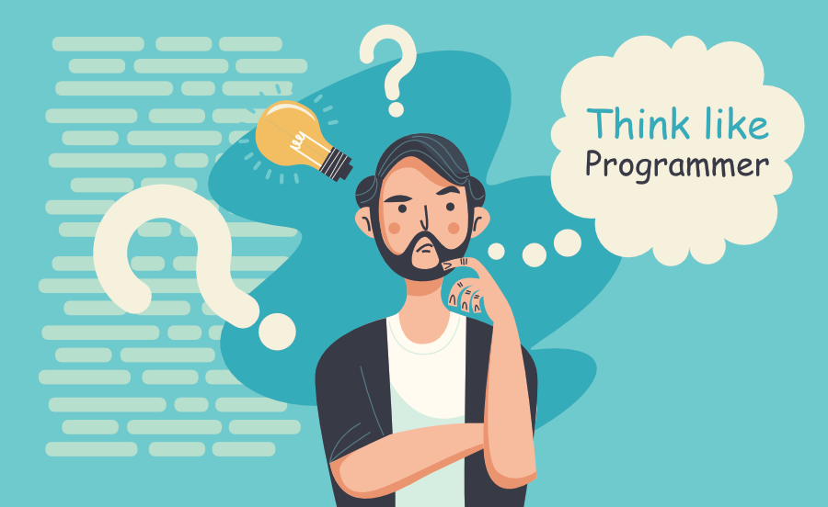
What to keep in mind while starting to learn Python?

Slide 4
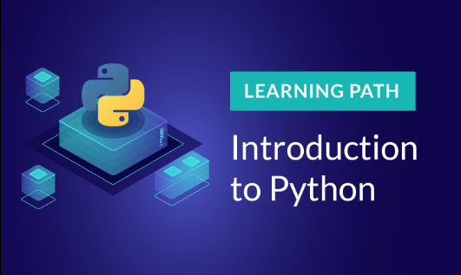
Introduction to Python
What is Python?
Benefits of Python
History of Python
Who uses Python?

Slide 5
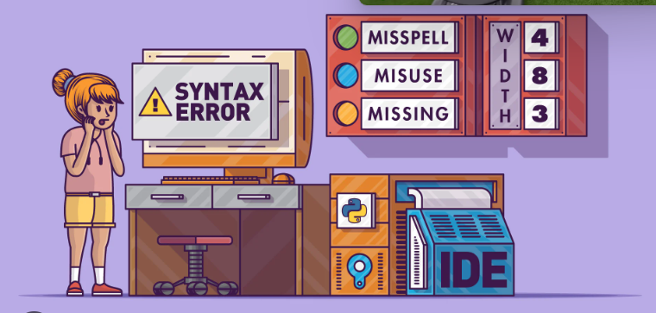
Syntax and Variables
Syntax Rules
Variable types
Naming Variables
Creating Variables

Slide 6
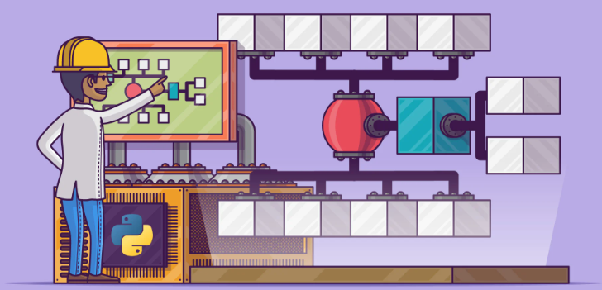
Learning Data Structures
Lists
Tuples
Dictionaries
Sets

Slide 7
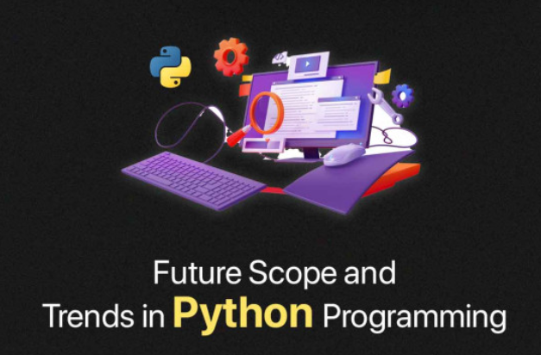
Common Python Projects
Web Development
Desktop Applications
Scripting
Machine Learning

