Slide 1


Paolo Monella
Fuori dalla torre di Babele:
interoperabilità e sistemi grafici pre-moderni
Out of the Tower of Babel : interoperability and pre-modern writing systems
December 4, 2019

Slide 2
In a nutshell

Slide 3
In a nutshell
Digital scholarly editions: diplomatic/normalized
Hjelmslev’s “analysis” as digital modelling for pre-modern writing systems
Open issues
Interoperability through modelling

Slide 4
My focus
European Medieval handwriting
Pre-Gutenberg
  Handwriting
  Early print → imitating handwriting
Alphabetic writing systems
  Latin script (Italian, English...), Greek, Cyrillic...
  No Cuneiform, Arabic, Chinese etc.

Slide 5
Diplomatic/normalized

Slide 6
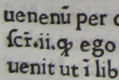
Diplomatic/normalized

Slide 7
Diplomatic/normalized
uenenū

Slide 8
Diplomatic/normalized
uenenū
Diplomatic
Historical documentation
Visualization

Slide 9
Diplomatic/normalized
venenum
uenenū
Diplomatic
Historical documentation
Visualization

Slide 10
Diplomatic/normalized
Normalized
Processing
    Search
    Collation
    NLP (lemma, PoS etc.)
    Statistics (distant reading)...
venenum
uenenū
Diplomatic
Historical documentation
Visualization

Slide 11
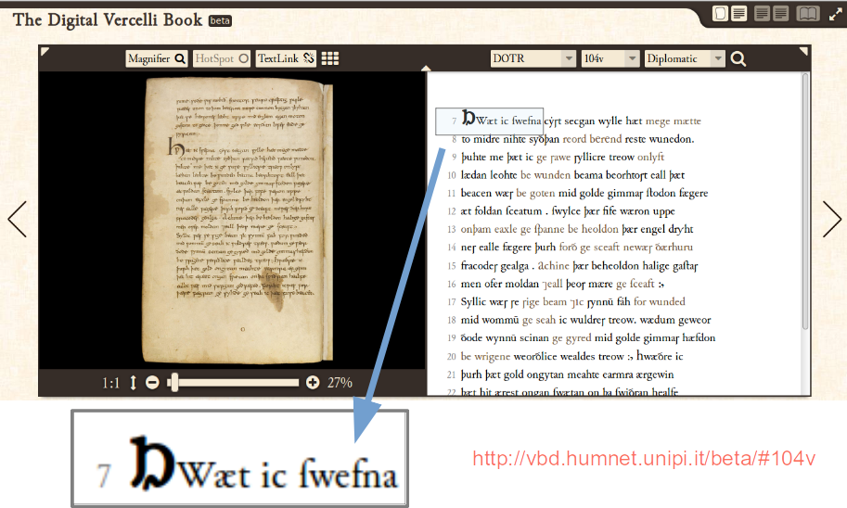
Diplomatic/normalized

Slide 12

Diplomatic/normalized

Slide 13
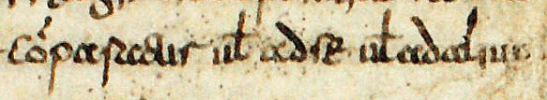
Diplomatic/normalized
Comparatur vel ad se vel ad alium
cỏparaƐur uł adſe uładalium

Slide 14
What’s “normal”?

Slide 15
What’s “normal”?
Comparatur vel ad se vel ad alium
cỏparaƐur uł adſe uładalium

Slide 16
What’s “normal”?
Comparatur vel ad se vel ad alium
cỏparaƐur uł adſe uładalium

Slide 17
What’s “normal”?
Comparatur vel ad se vel ad alium

Slide 18
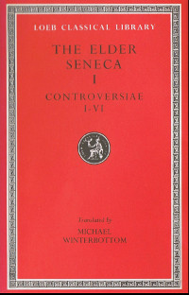
What’s “normal”?
Vel comparatur ad se vel iam ad Valerium

Slide 19
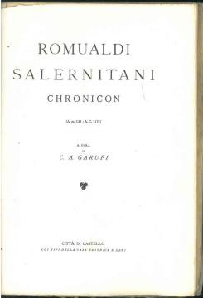
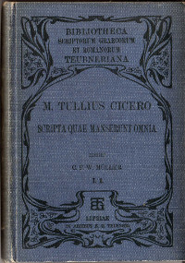
What’s “normal”?
Vel comparatur ad se vel iam ad Valerium
Vel comparatur ad se vel jam ad Valerium
Uel comparatur ad se uel iam ad Ualerium
Vel comparatur ad se uel iam ad Valerium
uel comparatur ad se uel iam ad Valerium

Slide 20
What’s “normal”?
te. Ego / te. ego
u / v / U / V
i / j
Ae / æ
Oe / œ
bonum est / bonum’st
/ bonumst
[punctuation]
[macron / breve]

Slide 21
What’s “normal”?
te. Ego / te. ego
u / v / U / V
i / j
Ae / æ
Oe / œ
bonum est / bonum’st
/ bonumst
[punctuation]
[macron / breve]
Processing
    Search
    Collation
    NLP (lemma, PoS etc.)
    Statistics (distant reading)...

Slide 22
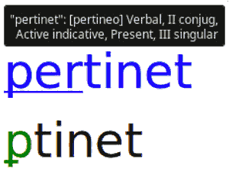
What’s “normal”?
te. Ego / te. ego
u / v / U / V
i / j
Ae / æ
Oe / œ
bonum est / bonum’st
/ bonumst
[punctuation]
[macron / breve]
Processing
    Search
    Collation
    NLP (lemma, PoS etc.)
    Statistics (distant reading)...
My Ursus edition (IX Century)
www.unipa.it/paolo.monella/ursus

Slide 23
What’s “normal”?
Comparatur vel ad se vel ad alium
cỏparaƐur uł adſe uładalium

Slide 24
“Diplomatic”...
Comparatur vel ad se vel ad alium
cỏparaƐur uł adſe uładalium

Slide 25
Modelling
“Gutenberghian” writing systems

Slide 26
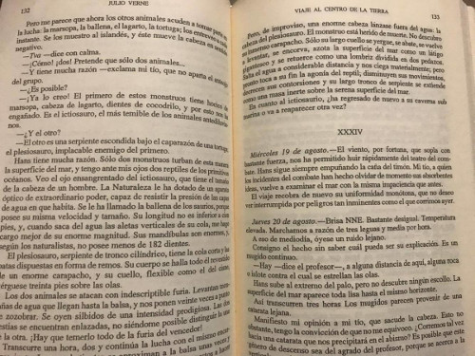
Modelling “Gutenberghian” writing systems

Slide 27
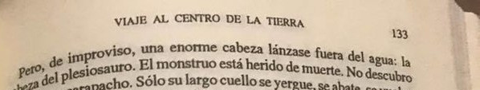
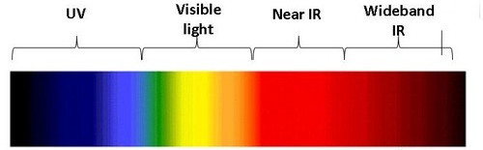
Modelling “Gutenberghian” writing systems
Digital modelling

Slide 28
Modelling “Gutenberghian” writing systems
Pero, de improviso, una enorme cabeza...
Digital modelling

Slide 29



“Gutenberghian” principles
Pero, de improviso, una enorme cabeza...

Slide 30
“Gutenberghian” principles
Pero, de improviso, una enorme cabeza...
1 mark,
1 letter
All marks
are (born)
equal
Sequence
(one dimension)

Slide 31
Modelling pre-modern writing systems

Slide 32
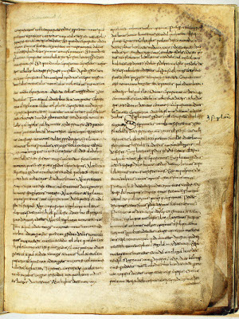
Modelling pre-modern writing systems

Slide 33
Modelling pre-modern writing systems
3 Gutenberghian principles
1 mark,
1 letter
All marks
are (born)
equal
Sequence
(one dimension)

Slide 34



Modelling pre-modern writing systems

Slide 35
Modelling pre-modern writing systems

Slide 36
Modelling pre-modern writing systems
Digital modelling

Slide 37
Modelling pre-modern writing systems
Comparatur vel ad se vel ad alium
cỏparaƐur uł adſe uładalium
Digital modelling

Slide 38
Modelling pre-modern writing systems
Comparatur vel ad se vel ad alium
cỏparaƐur uł adſe uładalium
Ligatures

Slide 39
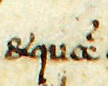
Modelling pre-modern writing systems
et quam
&quam
Ligatures

Slide 40
Modelling pre-modern writing systems
Comparatur vel ad se vel ad alium
cỏparaƐur uł adſe uładalium

Slide 41

Modelling pre-modern writing systems
Comparatur vel ad se vel ad alium ut
cỏparaƐur uł adſe uładalium uσ
Allographs

Slide 42
Modelling pre-modern writing systems
Comparatur vel ad se vel ad alium
cỏparaƐur uł adſe uładalium

Slide 43
Modelling pre-modern writing systems
Comparatur vel ad se vel ad alium
cỏparaƐur uł adſe uładalium
Capitalization?
Allographs

Slide 44
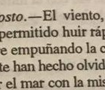
Modelling pre-modern writing systems
Comparatur vel ad se vel ad alium
cỏparaƐur uł adſe uładalium
Capitalization?
Allographs

Slide 45
Modelling pre-modern writing systems
Comparatur vel ad se vel ad alium
cỏparaƐur uł adſe uładalium
Capitalization?
Bari
bari
Allographs

Slide 46
Modelling pre-modern writing systems
Comparatur vel ad se vel ad alium
cỏparaƐur uł adſe uładalium
Capitalization?
ODD
odd
Allographs

Slide 47
Modelling pre-modern writing systems
Comparatur vel ad se vel ad alium
cỏparaƐur uł adſe uładalium
“Alphabet”
Grapheme set

Slide 48
Modelling pre-modern writing systems
Comparatur vel ad se vel ad alium.
cỏparaƐur uł adſe uładalium;
Punctuation
Grapheme set

Slide 49
Modelling pre-modern writing systems
Comparatur vel ad se vel ad alium
cỏparaƐur uł adſe uładalium

Slide 50
Modelling pre-modern writing systems
Comparatur vel ad se vel ad alium
cỏparaƐur uł adſe uładalium
Abbreviations

Slide 51
Hjelmslev’s “analysis” as digital modelling for pre-modern writing systems

Slide 52
Modelling
Comparatur vel ad se vel ad alium
cỏparaƐur uł adſe uładalium
Digital modelling

Slide 53
Modelling
cỏparaƐur uł adſe uładalium

Slide 54
Modelling
cỏparaƐur uł adſe uładalium

Slide 55
System / text
Paradigmatic (langue, system)
Syntagmatic (text, process)
cỏparaƐur uł adſe uładalium

Slide 56
System / text
System
<s>
<t>
Text
cỏparaƐur uł adſe uładalium
<x>
<y>
<z>

Slide 57
Modelling/“analysis”: entities
<s>
<t>
cỏparaƐur uł adſe uładalium
<x>
<y>
Entities
<z>

Slide 58


Modelling/“analysis”: entities
<s>
<t>
cỏparaƐur uł adſe uładalium
<x>
“If [we are] given anything…,
it is the as yet unanalyzed text
in its undivided
and absolute integrity”
(“deduction”, Prol. Ch. 4)
<y>
Entities
<z>

Slide 59
Modelling/“analysis”: entities
<s>
<t>
cỏparaƐur uł adſe uładalium
<x>
<y>
Entities
<z>
Analysis

Slide 60
Modelling/“analysis”: entities
<s>
<t>
cỏparaƐur uł adſe uładalium
<x>
<y>
Entities
<z>
Digital modelling
Analysis

Slide 61
Modelling/“analysis”: entities
<s>
<t>
Text
cỏparaƐur uł adſe uładalium
<x>
<y>
Entities
<z>
Analysis

Slide 62
Modelling/“analysis”: entities
System
<s>
<t>
Text
cỏparaƐur uł adſe uładalium
<x>
<y>
Entities
<z>
Analysis

Slide 63
Graphemes as entities?
<s>
<t>
cỏparaƐur uł adſe uładalium
<x>
<y>
Entities
<z>
Analysis

Slide 64
Graphemes as entities?
<s>
<t>
cỏparaƐur uł adſe uładalium
<x>
“Thus the same linguistic
form may also be manifested
in writing… Here is a graphic
‘substance’… Describing the
actually present expression...
system” (Prol. Ch. 21)
<y>
Entities
<z>
Analysis

Slide 65

Graphemes as entities?
<s>
<t>
cỏparaƐur uł adſe uładalium
<x>
<y>
Entities
<z>
Analysis

Slide 66
Graphemes as entities?
Digital (discrete)
Ligatures
Allographs
    (Capitalization)
Grapheme set
    (Punctuation)
Abbreviations
<s>
<t>
cỏparaƐur uł adſe uładalium
<x>
<y>
Entities
<z>
Analysis

Slide 67

Graphemes as entities?
Digital (discrete)
Ligatures
Allographs
    (Capitalization)
Grapheme set
    (Punctuation)
Abbreviations
<s>
<t>
cỏparaƐur uł adſe uładalium
<x>
<y>
Entities
<z>
Analysis

Slide 68
Chains and paradigms
chain
<s>
<t>
cỏparaƐur uł adſe uładalium
<x>
<y>
paradigm
<z>

Slide 69
Chains and paradigms
chain
<s>
<t>
cỏparaƐur uł adſe uładalium
<x>
“chain”→sequence?
<y>
paradigm
<z>

Slide 70
Classes: chains and paradigms
System
class | components
chain | parts
paradigm | members
<s>
<t>
Text
cỏparaƐur uł adſe uładalium
<x>
<y>
chain
made of parts
paradigm
made of members
<z>

Slide 71

Functions
<s>
<t>
cỏparaƐur uł adſe uładalium
<x>
Function
<y>
<z>

Slide 72
Ligatures

Slide 73
Ligatures
<s>
<t>
cỏparaƐur uł adſe uładalium
<x>
Function
“Ligature”
(entities, parts of a chain)
<y>
<z>

Slide 74
Ligatures
Varieties
<s>
«σ»
<t>
cỏparaƐur uł adſe uładalium
«√»
<x>
<y>
<z>

Slide 75
Ligatures
Varieties:
Solidal
variants
<s>
«σ»
<t>
cỏparaƐur uł adſe uładalium
«√»
<x>
<y>
<z>

Slide 76
Ligatures
Digital (discrete)
Ligatures
Allographs
    (Capitalization)
Grapheme set
    (Punctuation)
Abbreviations
Varieties:
Solidal
variants
<s>
<t>
cỏparaƐur uł adſe uładalium
<x>
<y>
<z>

Slide 77
Ligatures
Digital (discrete)
Ligatures
Allographs
    (Capitalization)
Grapheme set
    (Punctuation)
Abbreviations
Varieties:
Solidal
variants
<s>
<t>
cỏparaƐur uł adſe uładalium
<x>
<y>
<z>

Slide 78
Graphemes/allographs

Slide 79
The commutation test
<s>
<t>
cỏparaƐur uł adſe uładalium
<x>
<y>
<z>

Slide 80
The commutation test
<s>
«σ»
<t>
cỏparaƐur uł adſe uładalium
«√»
<x>
<y>
<z>

Slide 81
The commutation test
<s>
«σ»
<t>
cỏparaƐur uł adſe uładalium
Function
Substitution:
→ No change
in “meaning”
daƐur / daσur
<x>
Function
Commutation:
→ Change
in “meaning”
annus / annys
«√»
<y>
<z>

Slide 82
The commutation test
Variants
Invariants
<s>
«σ»
<t>
cỏparaƐur uł adſe uładalium
Substitution:
→ No change
in “meaning”
<x>
Commutation:
→ Change
in “meaning”
«√»
<y>
<z>

Slide 83
Graphemes / allographs
Invariant → <grapheme> <t>
(class, paradigm,
sincretism)
Variants → «allographs» «σ»
(components, members) «Ɛ»
«√»
Variants
Invariants
<s>
«σ»
<t>
cỏparaƐur uł adſe uładalium
Substitution:
→ No change
in “meaning”
<x>
Commutation:
→ Change
in “meaning”
«√»
<y>
<z>

Slide 84
Graphemes / allographs
Digital (discrete)
Ligatures
Allographs
    (Capitalization)
Grapheme set
    (Punctuation)
Abbreviations
Variants
Invariants
<s>
«σ»
<t>
cỏparaƐur uł adſe uładalium
<x>
«√»
<x>
Substitution:
→ No change
in “meaning”
Commutation:
→ Change
in “meaning”
«√»
<y>
<y>
<z>
<z>

Slide 85
Graphemes / allographs
Digital (discrete)
Ligatures
Allographs
    (Capitalization)
Grapheme set
    (Punctuation)
Abbreviations
Variants
Invariants
<s>
«σ»
<t>
cỏparaƐur uł adſe uładalium
<x>
«√»
<x>
Substitution:
→ No change
in “meaning”
Commutation:
→ Change
in “meaning”
«√»
<y>
<y>
<z>
<z>

Slide 86
Graphemes / allographs
Digital (discrete)
Ligatures
Allographs
    (Capitalization)
Grapheme set
    (Punctuation)?
Abbreviations
Variants
Invariants
<s>
«σ»
<t>
cỏparaƐur uł adſe uładalium
<x>
«√»
<x>
Substitution:
→ No change
in “meaning”
Commutation:
→ Change
in “meaning”
«√»
<y>
<y>
<z>
<z>

Slide 87
Punctuation

Slide 88
Punctuation
“content-form”
(Prol. Ch. 13)
<s>
«σ»
<t>
cỏparaƐur uł adſe uładalium
<x>
Substitution:
→ No change
in “meaning”
<x>
Commutation:
→ Change
in “meaning”
«√»
<y>
<y>
<z>
<z>

Slide 89
Punctuation
“content-form”
(Prol. Ch. 13)
Including larger units, such as
sentences
<s>
«σ»
<t>
cỏparaƐur uł adſe uładalium
<x>
Substitution:
→ No change
in “meaning”
<x>
Commutation:
→ Change
in “meaning”
«√»
<y>
<y>
<z>
<z>

Slide 90
Punctuation
“content-form”
(Prol. Ch. 13)
Including larger units, such as
sentences
Truly I tell you, today you will be with me in paradise
Truly I tell you today, you will be with me in paradise
Substitution:
→ No change
in “meaning”
Commutation:
→ Change
in “meaning”

Slide 91
Punctuation
“content-form”
(Prol. Ch. 13)
Including larger units, such as
sentences
Truly I tell you, today you will be with me in paradise
Truly I tell you today, you will be with me in paradise
Substitution:
→ No change
in “meaning”
Commutation:
→ Change
in “meaning”

Slide 92
Punctuation
<s>
«σ»
<t>
cỏparaƐur uł adſe uładalium ·
<x>
«√»
<x>
«√»
Substitution:
→ No change
in “meaning”
Commutation:
→ Change
in “meaning”
<.>
<y>
<y>
<z>
<z>

Slide 93
Punctuation
Digital (discrete)
Ligatures
Allographs
    (Capitalization)
Grapheme set
    (Punctuation)
Abbreviations
<s>
«σ»
<t>
cỏparaƐur uł adſe uładalium ·
<x>
<x>
«√»
<x>
«√»
«√»
Substitution:
→ No change
in “meaning”
Commutation:
→ Change
in “meaning”
<.>
<y>
<y>
<y>
<z>
<z>
<z>

Slide 94
Punctuation
Digital (discrete)
Ligatures
Allographs
    (Capitalization)
Grapheme set
    (Punctuation)
Abbreviations
<s>
«σ»
<t>
cỏparaƐur uł adſe uładalium ·
<x>
«√»
<x>
«√»
Substitution:
→ No change
in “meaning”
Commutation:
→ Change
in “meaning”
<.>
<y>
<y>
<z>
<z>

Slide 95
Abbreviations

Slide 96
Abbreviations
cỏparaƐur uł adſe uładalium

Slide 97

Abbreviations: one grapheme?
1. One entity
- Whole abbreviation = grapheme (invariant)
<o>
<ô>
<ō>
cỏparaƐur uł adſe uładalium
<p>
<q>

Slide 98
Abbreviations: one grapheme?
<o>
<ô>
<ō>
cỏparaƐur uł adſe uładalium
<p>
Principles: simplicity,
economy, reduction
(Prol. Ch. 6)
“lowest possible number
of elements” (Ch. 13)
<q>

Slide 99
Abbreviations: function
1. One entity
- Whole abbreviation = grapheme (invariant)
2. Two entities (function)
cỏparaƐur uł adſe uładalium
Function
(entities)

Slide 100
Abbreviations: function → ligature?
1. One entity
- Whole abbreviation = grapheme (invariant)
2. Two entities (function)
2A. Ligature (solidal variants in a chain)
cỏparaƐur uł adſe uładalium
Function
“Ligature”
(Solidal variants)

Slide 101
Abbreviations: function → ligature?
1. One entity
- Whole abbreviation = grapheme (invariant)
2. Two entities (function)
2A. Ligature (solidal variants in a chain)
cỏparaƐur uł adſe uładalium
Function
“Ligature”
(Solidal variants)
Solidal: both mandatory

Slide 102
Abbreviations: function → selection?
1. One entity
- Whole abbreviation = grapheme (invariant)
2. Two entities (function)
2A. Ligature (solidal variants in a chain)
2B. Selection (one governs the other)
cỏparaƐur uł adſe uładalium
Function
Selection:
one is optional
one governs the other

Slide 103
Abbreviations: function → selection?
cỏparaƐur uł adſe uładalium
“chain”→sequence?
Function
Selection:
one is optional
one governs the other

Slide 104
Abbreviations: function → complementarity?
1. One entity
- Whole abbreviation = grapheme (invariant)
2. Two entities (function)
2A. Ligature (solidal variants in a chain)
2B. Selection (one governs the other)
2C. Complementarity (interdependence)
cỏparaƐur uł adſe uładalium
Function
Complementarity
(interdependence in a system)

Slide 105
Abbreviations: function → complementarity?
cỏparaƐur uł adſe uładalium
Example of
complementarity
[case + gender + number]
Alt - us nom+masc+sing
Alt - orum gen+m/neu+plur
Alt - arum gen+ fem + plur
Function
Complementarity
(interdependence in a system)

Slide 106
Abbreviations: function → complementarity?
<l>
<m>
<zero>
<n>
<~>
cỏparaƐur uł adſe uładalium
<p>
<¯>
<q>
<^>

Slide 107
Abbreviations
1. One entity
- Whole abbreviation = grapheme (invariant)
2. Two entities (function)
2A. Ligature (solidal variants in a chain)
2B. Selection (one governs the other)
2C. Complementarity (interdependence)
cỏparaƐur uł adſe uładalium

Slide 108
Abbreviations
Digital (discrete)
Ligatures
Allographs
    (Capitalization)
Grapheme set
    (Punctuation)
Abbreviations
cỏparaƐur uł adſe uładalium

Slide 109
Abbreviations
Digital (discrete)
Ligatures
Allographs
    (Capitalization)
Grapheme set
    (Punctuation)
Abbreviations
cỏparaƐur uł adſe uładalium

Slide 110
Open issues

Slide 111
Issues: 1. Abbreviations → functions
1. One entity
- Whole abbreviation = grapheme (invariant)
2. Two entities (function)
2A. Ligature (solidal variants in a chain)
2B. Selection (one governs the other)
2C. Complementarity (interdependence)
cỏparaƐur uł adſe uładalium

Slide 112
Issues: 2. Abbreviations → one:many
cỏparaσur
1:1
cỏparaƐur

Slide 113
Issues: 2. Abbreviations → one:many
comparaσur
2:2 (2 ≠ 2)
cỏparaƐur

Slide 114
Issues: 2. Abbreviations → one:many
praepositio
2:4
p̄positio

Slide 115
Issues: 2. Abbreviations → one:many
perfecta
1:3
ꝑfecta

Slide 116
Issues: 2. Abbreviations → one:many
Alphabemes
(alphabetical letters)
perfecta
1:3
Graphemes
ꝑfecta

Slide 117
Issues: 3. Ligatures
(syntagmatic)

Slide 118

Issues: 3. Ligatures
& (U+0026;
ASCII 38)

Slide 119
Issues: 3. Ligatures
Historical/“etymological”
considerations
& (U+0026;
ASCII 38)

Slide 120
Issues: 3. Ligatures
Historical/“etymological”
considerations
& (U+0026;
ASCII 38)

Slide 121
Issues: 4. Grapheme definition
(paradigmatic)
Full stop
Abbreviation mark
.

Slide 122
Issues: 5. Allograph definition (metasemiology)

Slide 123

Issues: 5. Allograph definition (metasemiology)

Slide 124
Issues: 5. Allograph definition (metasemiology)
Allographs
(variants)
«σ»
cỏparaƐur uł adſe uładalium
«√»

Slide 125
Issues: 5. Allograph definition (metasemiology)
«σ»
«σ»
«σ»
«σ»
«σ»
«σ»
cỏparaƐur uł adſe uładalium
«√»
«√»
«√»
«√»

Slide 126
Open issues
Abbreviations → functions
Abbreviations → one:many
Ligatures
Grapheme definition
Allograph definition (metasemiology)

Slide 127
In the Tower of Babel

Slide 128
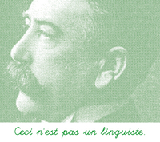
In the Tower of Babel: “diplomatic”
MS A
a b c d e f g h i l m n o p q r s t u z · ;
MS B
a b c d e f g h i j l m n o p q r s t u v z . , ; : !

Slide 129
In the Tower of Babel: “normalized”
OCR from Teubner
a b c d e f g h i l m n o p q r s t u z · ;
OCR from Loeb
a b c d e f g h i j l m n o p q r s t u v z . , ; : !

Slide 130
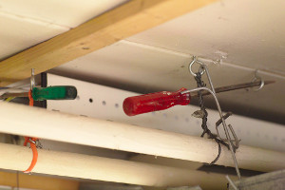
In the Tower of Babel
Disposable home-made solutions (project-specific)
  TEI: theory-agnostic
  Diplomatic: Modelling pre-modern writing systems
  Normalized: Normalization models / software

Slide 131
Out of the Tower

Slide 132

The (long) way out of the Tower
Scholarly discussion on modelling
Documentation on project-specific modelling
  formal (data models, software code, tables)
  prose
Shared models
Reusable software libraries

Slide 133
Is Unicode the short way out (as TEI says)?
Solution for new digital texts
Not enough for pre-modern writing systems
  Ligatures
    & (U+0026; ASCII 38)
    Have I encoded that it is equivalent to “e + t” in that MS?
  Allographs
    ſ (U+017F) / s (U+0073; ASCII 115)
    Have I encoded that they are variants of grapheme <s>?
  Grapheme set
    u (U+0075; ASCII 117)
    Have I encoded whether it “covers” (or not) <u> and <v>?

Slide 134
In a nutshell

Slide 135
In a nutshell
Digital scholarly editions: diplomatic/normalized
Hjelmslev’s “analysis” as digital modelling for pre-modern writing systems
Open issues
Interoperability through modelling

