Slide 1


XSLT
Extensible Stylesheet Language Transformation

Slide 2


From Presentation to Representation
semantic markup
representation
XML
transformation
XSLT
presentation
HTML
CSS
JS
text
appearance
behavior

Slide 3
XSLT
XML dialect itself
declarative transformation language
input=XML
output
XML
XSLT
XML
HTML
SVG
…

Slide 4
Concept
CSS for HTML
XSLT for XML
match a set of nodes (via CSS selectors)
apply
match a set of nodes (via XPath)
transform it using an XML-based template
serialize

Slide 5

XSLT Sample - Overview
TEI XML to HTML

Slide 6
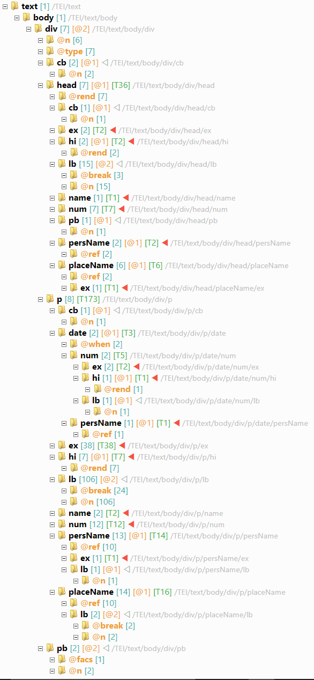
TEI Document
sample TEI document:
teiHeader and facsimile are not directly output
body contains div's
each div may contain:
head: text header
p: text paragraph
cb: column break
pb: page break
text may also contain:
ex(pansion), hi(lite), num(ber), pers(on)Name, placeName,

Slide 7
XSLT Skeleton
XML document
root element = stylesheet from namespace
<?xml version='1.0'?>
<xsl:stylesheet version="1.0" xmlns:xsl="http://www.w3.org/1999/XSL/Transform">
...
</xsl:stylesheet>

Slide 8
XSLT Template
match TEI num element
a template is defined with a template element
input: its match attribute selects the nodes it should apply to, similarly to CSS selectors, using a specialized language named XPath
output
<xsl:template match="tei:num">
<span class="nr">
<xsl:apply-templates/>
</span>
</xsl:template>
output an HTML span element...
... with attribute class = "nr"
span's content is whatever is output by all matching templates

