Slide 1


XSLT
Extensible Stylesheet Language Transformation

Slide 2


From Presentation to Representation
semantic markup
representation
XML
transformation
XSLT
presentation
HTML
CSS
JS
text
appearance
behavior

Slide 3
XSLT
XML dialect itself
declarative transformation language
input=XML
output=any text-based format (TXT, HTML, XML, SVG, RTF...)
XML
XSLT
XML
HTML
SVG
…

Slide 4
Concept
CSS for HTML
XSLT for XML
match a set of nodes (via CSS selectors)
apply formatting properties to it
match a set of nodes (via XPath)
transform it using an XML-based template
serialize it into some output format

Slide 5

XSLT Sample - Overview
TEI XML to HTML

Slide 6
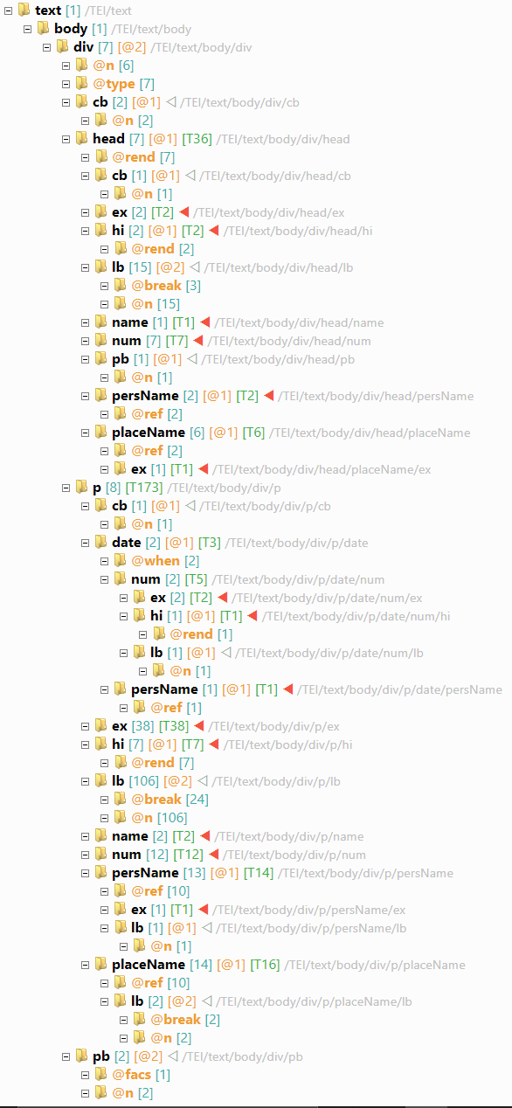
TEI Document
sample TEI document:
teiHeader and facsimile are not directly output
body contains div's
each div may contain:
head: text header
p: text paragraph
cb: column break
pb: page break
text may also contain:
ex(pansion), hi(lite), num(ber), pers(on)Name, placeName, date

Slide 7
XSLT Skeleton
XML document
root element = stylesheet from namespace http://www.w3.org/1999/XSL/Transform
<?xml version='1.0'?>
<xsl:stylesheet version="1.0" xmlns:xsl="http://www.w3.org/1999/XSL/Transform">
...
</xsl:stylesheet>

Slide 8
XSLT Template
match TEI num element
a template is defined with a template element
input: its match attribute selects the nodes it should apply to, similarly to CSS selectors, using a specialized language named XPath
output: its content is the output template
<xsl:template match="tei:num">
<span class="nr">
<xsl:apply-templates/>
</span>
</xsl:template>
output an HTML span element...
... with attribute class = "nr"
span's content is whatever is output by all matching templates

Slide 9

XPath
Query Language for Selecting XML Nodes

Slide 10
XXPath
Query Language for Selecting XML Nodes
What is Xpath language?
Xpath interrogates and navigates XML documents
Navigate around the tree, selecting nodes by a variety of criteria
XSLT uses XPath to find information in an XML document.
A language to describe how to locate a part of an XML document

Slide 11


Directions: Finding a Building
2
target
a direction in 3 steps
tower (test)
3
second
(predicate)
1. axis: go ahead
1
2. test: look at towers
direction
(axis)
3. predicate: stop at 2nd
1
go straight ahead...
3
... stop at the second one.
2
...looking at towers along this path...
Notes:
@Fusi

Slide 12

How XPath works: XPath Node Types
root
In XPath, there are seven kinds of nodes:
element, attribute, text, namespace, processing-instruction, comment, and document nodes.

Slide 13
XML Document Tree: XPath Node Types
processing instruction
root
namespace
<?xml version="1.0" encoding="UTF-8"?>
<TEI xmlns="http://www.tei-c.org/ns/1.0">
<!-- header -->
<teiHeader>
<fileDesc>
<titleStmt>
<title type="main">Li livres du Graunt Caam</title>
element
attribute
text
comment

Slide 14
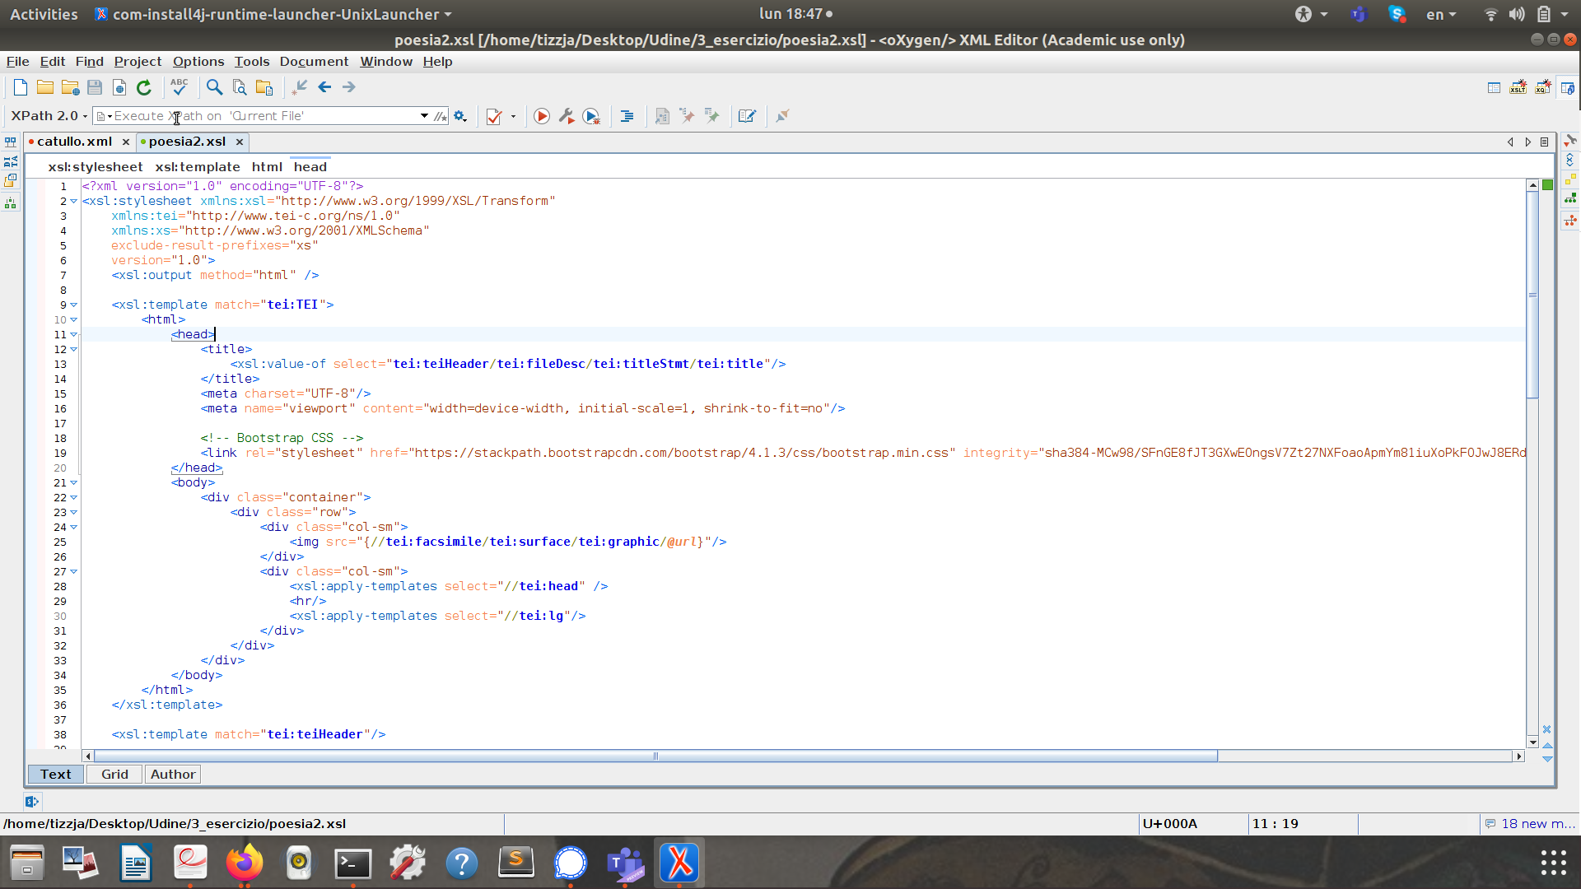
Toolbar in oXygen
Let's open your XML/TEI file!

Slide 15
XPath Expression: Steps
1 or more steps
syntax for each step:
axisname:: (street direction)
nodetest (building type: tower)
[predicate] (second tower)
result:
a set of node(s)
a single value (string, number, or boolean)

Slide 16
XPath Expression
Some xpath expression to remember
nodename | Selects all nodes with the name "nodename"
/ | Selects from the root node
// | Selects nodes in the document from the current node that match the selection no matter where they are
. | Selects the current node
.. | Selects the parent of the current node
@ | Selects attributes

Slide 17
Wild cards
Some xpath expression to remember
* | matches any element node
@* | matches any attribute node
node() | matches any node

Slide 18
Bear in mind:
A bare-bones path expression is similar to filesystem addressing: if the path starts with a solidus (/ aka forward slash), then it represents a path from the root; if it does not start with a solidus then it represents a path from here
/TEI/teiHeader/fileDesc/titleStmt/title

Slide 19
1. Axes
ancestor
attribute
preceding*
..
following*
parent
preceding-sibling
.
self
following-sibling
/
child
//
descendant
* excluded descendants, attribute/namespace nodes

Slide 20
2. Node Test
name (e.g. //div)
@name (e.g. //@n)
wildcard: * = any name

Slide 21
2. Node Test: exercise
name (e.g. //div)
@name (e.g. //@n)
wildcard: * = any name
Let’s retrieve any element <ab>
Let’s retrieve the attribute --

Slide 22

3. Predicate
By Child/Attribute
Operators
[name] = has child
[@name] = has attribute
[@name...] (e.g. [@n="1"])
arithmetic: + - * div mod
comparison: = != < <= > >=
logical: and or

Slide 23
3. Predicate
Node Set Functions
Numeric Functions
count(SET)
last()
local-name() or (SET)
name() or (SET)
namespace-uri() or (SET)
position()... or just [N]
ceiling(N), floor(N)
number() or (ANY)
round(N)
sum(SET)

Slide 24
3. Exercise
1.On the bar of your oXygen
2. On the bar of your oXygen
Retrieve the tag:
//p
Retrieve the attribute:
//placeName/@ref
Retrieve a placeName with a attribute value “Armenia”:
//placeName[@ref="#Armenia"]
Let’s count placeName with a attribute value “Armenia”
How would you do it??

Slide 25

XSLT Sample - Templates

Slide 26
Default Templates
* = any element
any element or root node
/ = root element
XSLT provides a set of default "rules" (template elements) for each node type
a stylesheet essentially overrides these defaults with specialized templates wherever required
<xsl:template match="*|/">
<xsl:apply-templates/>
</xsl:template>
= apply all the matching templates from that element
any text node
any text node or attribute
@* = any attribute
<xsl:template match="text()|@*">
<xsl:value-of select="."/>
</xsl:template>
= copy the text value
get text value of current (matched) node

Slide 27
Sample Template: TEI pb (page break)
output div with attribute class=pn
<xsl:template match="tei:pb">
<div class="pn">
<xsl:choose>
<xsl:when test="@facs">
<xsl:variable name="facs" select="substring(@facs, 2)"/>
<xsl:variable name="fs"
select="/tei:TEI/tei:facsimile/tei:graphic[@xml:id = $facs]"/>
<a href="{$fs/@url}" target="_blank">
<xsl:value-of select="@n"/>
</a>
</xsl:when>
<xsl:otherwise> [<xsl:value-of select="@n"/>] </xsl:otherwise>
</xsl:choose>
</div>
</xsl:template>
when pb has a facs attribute ...
... get its value (minus the # prefix) into a variable named facs ...
... get in fs the graphic element whose ID is equal to facs ...
... and output a link to fs's url attribute = the facsimile image, whose content is the page number.
otherwise, just output the page number without link

Slide 28


Sample Template: TEI pb (page break)
XML TEI
inline: pb with facs
pb matched
image URI got from the graphic matching its @facs
HTML output (linked to CSS)
<pb n="218r" facs="#fol-218r"/>
matching graphic
<facsimile>
<graphic xml:id="fol-218r"
url="https://digital.bodleian.ox.ac.uk..."/>
<graphic xml:id="fol-218v"
url="https://digital.bodleian.ox.ac.uk..."/>
</facsimile>
HTML
CSS
div.pn a {
text-decoration: none;
color: silver;
padding: 2px;
margin: 0 4px;
border: 1px solid silver;
}
<div class="pn">
<a href="https://digital.bodleian.ox.ac.uk..." target="_blank">218r</a>
</div>

Slide 29
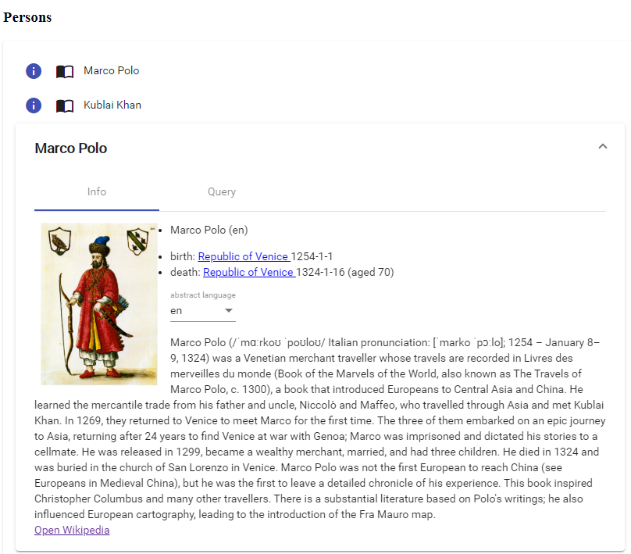
Sample Named Template: Custom Web Element
full, self-contained web app connected to the DBPedia SPARQL endpoint
packed in a custom web element: just add its tag to the page to use it
XSLT must pass the desired data (list of persons/places) picking them from its TEI source

Slide 30
Desired HTML Output
<app-realia-list type="person" json-list= '[{"uri":"http://dbpedia.org/ontology/Marco_Polo", "label":"Marco Polo"},...]'>
</app-realia-list>
the custom web element tag is app-realia-list
its type attribute selects either persons or places
its json-list attribute contains a JSON array of persons, each with its RDF IRI and a label
this list must be collected from the TEI document
each JSON item:
{
"uri": "resource IRI",
"label": "its label"
}

Slide 31
TEI Document: RDF in Header
a foaf:Person
internal TEI ID reference
subject dbo:Marco_Polo
the header contains a xenoData element
this element contains RDF triples for each person and place, with their IRI and rdfs:label
XSLT must collect IRIs and labels for persons and places from this list, and pass them to the custom web element
<xenoData>
<rdf:RDF>
<foaf:Person tei:ref="#MP" rdf:about="dbo: http://dbpedia.org/ontology/Marco_Polo">
<rdfs:label xml:lang="en">Marco Polo</rdfs:label>
</foaf:Person>
...
</rdf:RDF>
</xenoData>
rdfs:label "Marco Polo"@en
dbo:Marco_Polo is a person and has an English label equal to "Marco Polo"

Slide 32
Named Template
a template with name "realia"
receiving 2 parameters named items and type
template not applied by matching nodes, but explicitly called with its name
this allows reusing it for both persons and places
the template is called with some parameters:
type: "person" or "place"
items: a list of foaf:Person nodes selected from the TEI header
<xsl:template name="realia">
<xsl:param name="items"/>
<xsl:param name="type"/>
<app-realia-list>
<xsl:attribute name="type">
<xsl:value-of select="$type"/>
</xsl:attribute>
...
output app-realia-list with type attribute equal to the received parameter

Slide 33
Named Template
...
<xsl:attribute name="json-list">
<xsl:text>[</xsl:text>
<xsl:for-each select="$items">
<xsl:if test="position() &gt; 1">
<xsl:text>,</xsl:text>
</xsl:if>
<xsl:text>{&quot;uri&quot;:&quot;</xsl:text>
<xsl:value-of select="substring-after(./@rdf:about, ': ')"/>
<xsl:text>&quot;, &quot;label&quot;:&quot;</xsl:text>
<xsl:value-of select="./rdfs:label"/>
<xsl:text>&quot;}</xsl:text>
</xsl:for-each>
<xsl:text>]</xsl:text>
</xsl:attribute>
</app-realia-list>
</xsl:template>
output a json-list attribute
content wraps items into []
each item is in {} and has uri and label got from the triples
note that the URI is exracted from a prefix

Slide 34
Calling the Named Template
call the template with name "realia"
with parameter type="person"
when we want to place our custom web element, we just call the named template
parameters are got from the TEI document as specified by XPath
<xsl:call-template name="realia">
<xsl:with-param name="type" select="'person'"/>
<xsl:with-param name="items" select="tei:teiHeader/tei:xenoData/rdf:RDF/foaf:Person"/>
</xsl:call-template>
and parameter items=list of all the foaf:Person nodes in xenoData

Slide 35
Summing it Up: The Root Element Template
match the TEI root element
output HTML declaration
get the title from TEI header
<xsl:template match="/tei:TEI">
<xsl:text disable-output-escaping="yes">&lt;!DOCTYPE html&gt;</xsl:text>
<xsl:variable name="title"
select="/tei:TEI/tei:teiHeader/tei:fileDesc/tei:titleStmt/tei:title"/>
<html>
<head>
...
<title><xsl:value-of select="$title"/></title>
</head>
<body>
<h1><xsl:value-of select="$title"/></h1>
<xsl:apply-templates/>
<hr/>
output HTML root element
output HTML head element with title
output HTML body element with title in h1, and apply all the matching templates

Slide 36
Summing it Up: The Root Element Template
at the bottom add persons and places
<h2>Persons</h2>
<xsl:call-template name="realia">
<xsl:with-param name="type" select="'person'"/>
<xsl:with-param name="items"
select="tei:teiHeader/tei:xenoData/rdf:RDF/foaf:Person"/>
</xsl:call-template>
<h2>Places</h2>
<xsl:call-template name="realia">
<xsl:with-param name="type" select="'place'"/>
<xsl:with-param name="items"
select="tei:teiHeader/tei:xenoData/rdf:RDF/dbo:Place"/>
</xsl:call-template>
</body>
</html>
</xsl:template>
output the web app with persons data from TEI
output the web app with places data from TEI

Slide 37
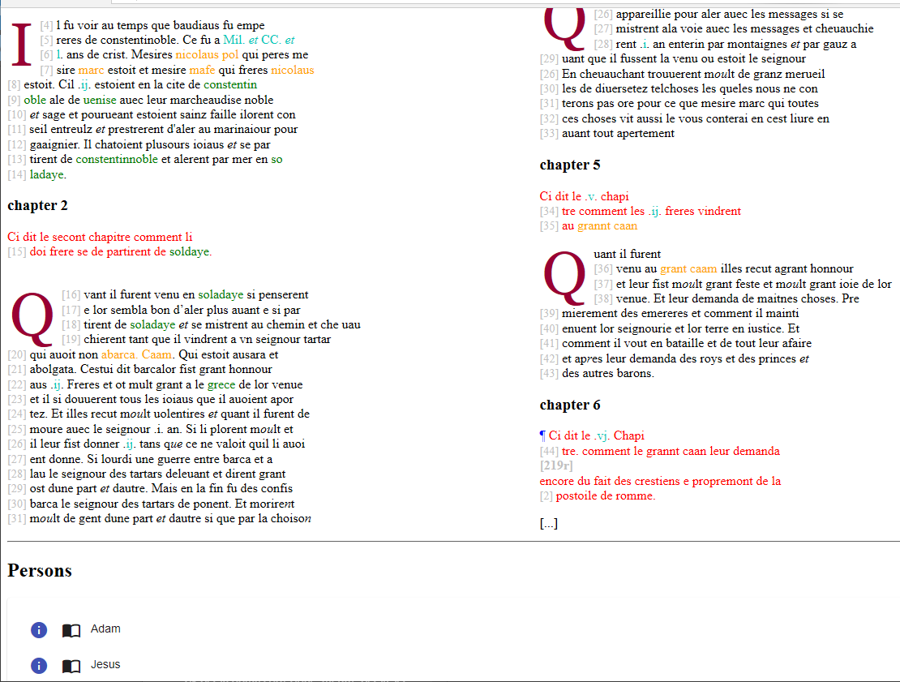
Final Result: HTML, CSS, JS from XML
each text color corresponds to a different TEI element
lines and columns numbers in gray
drop-letters
names and places connected to RDF have tips
fully working web apps for persons and places

Slide 38
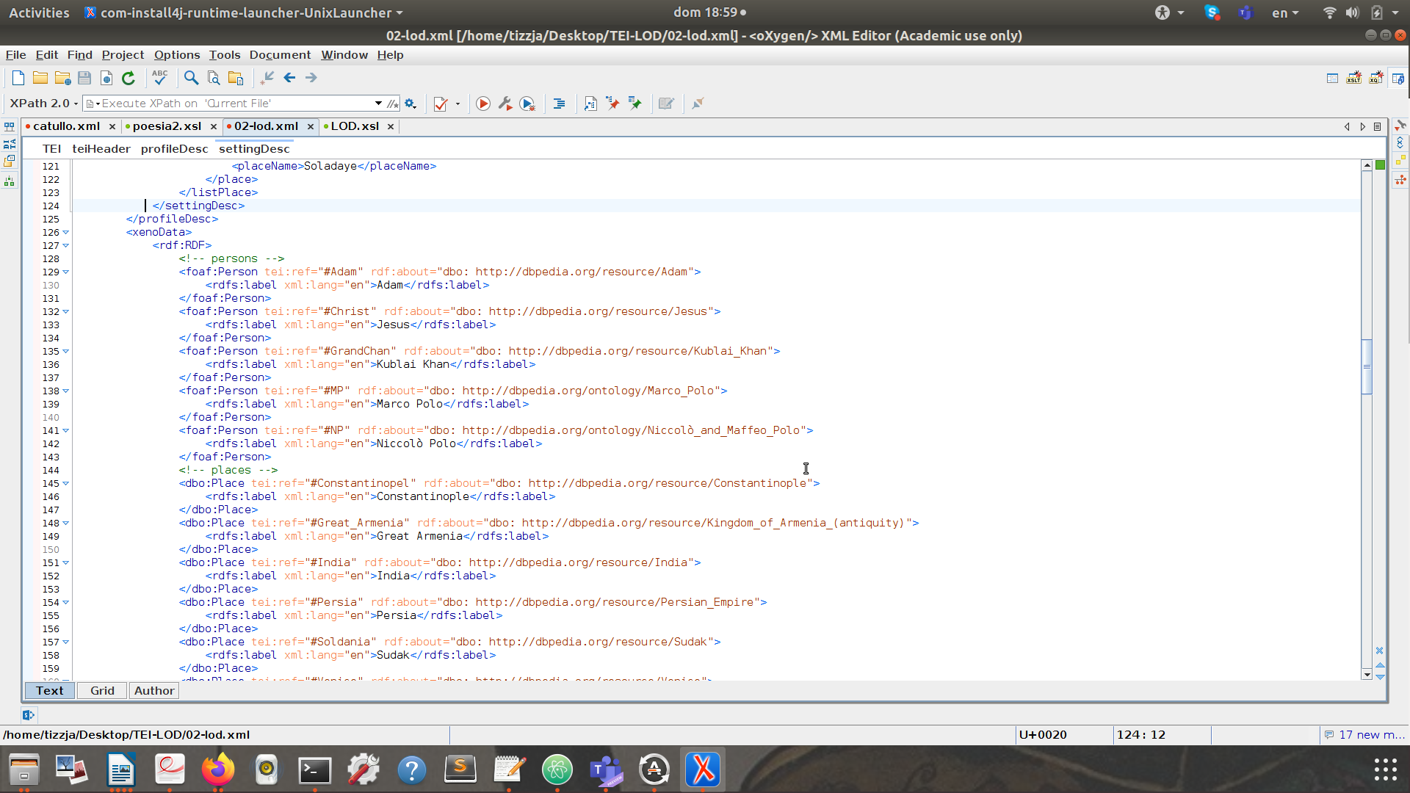
1. How to create a scenario

Slide 39
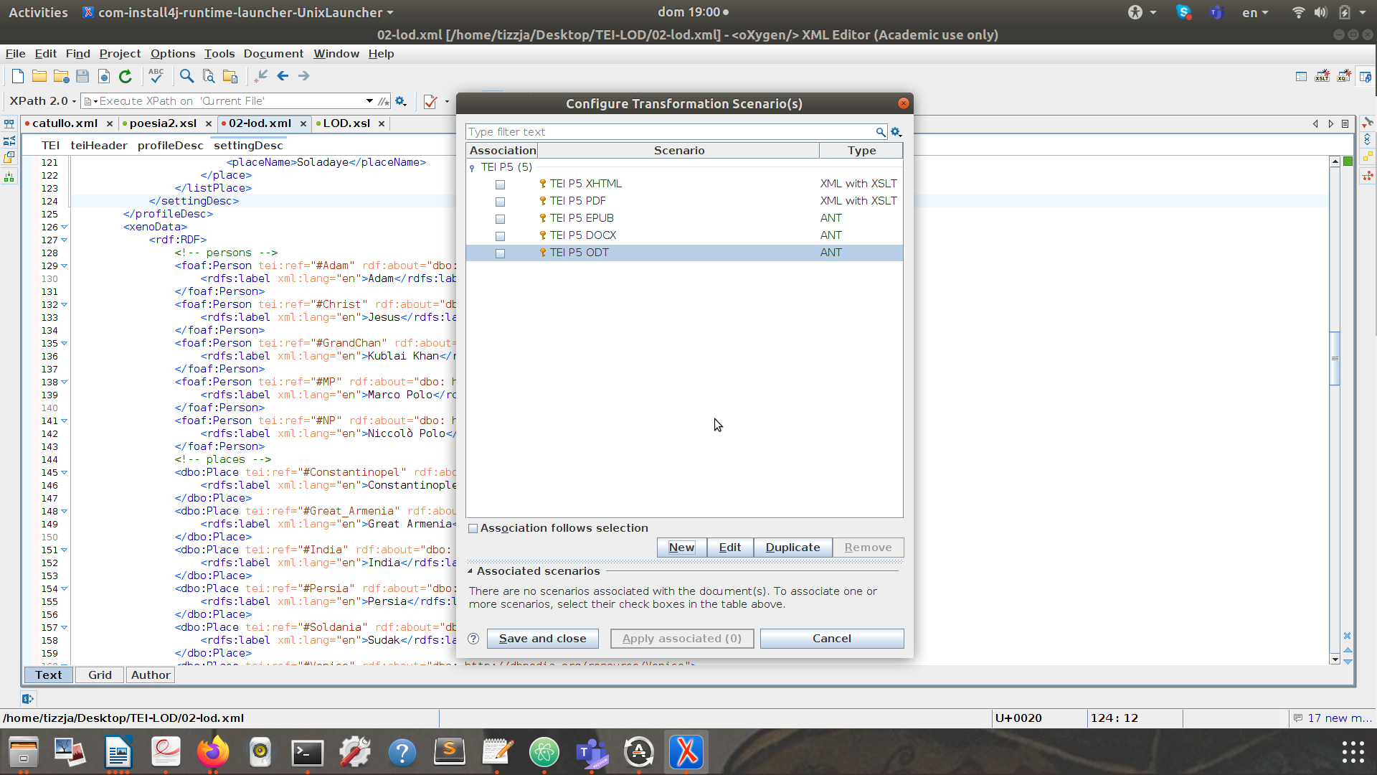
2. How to create a scenario

Slide 40
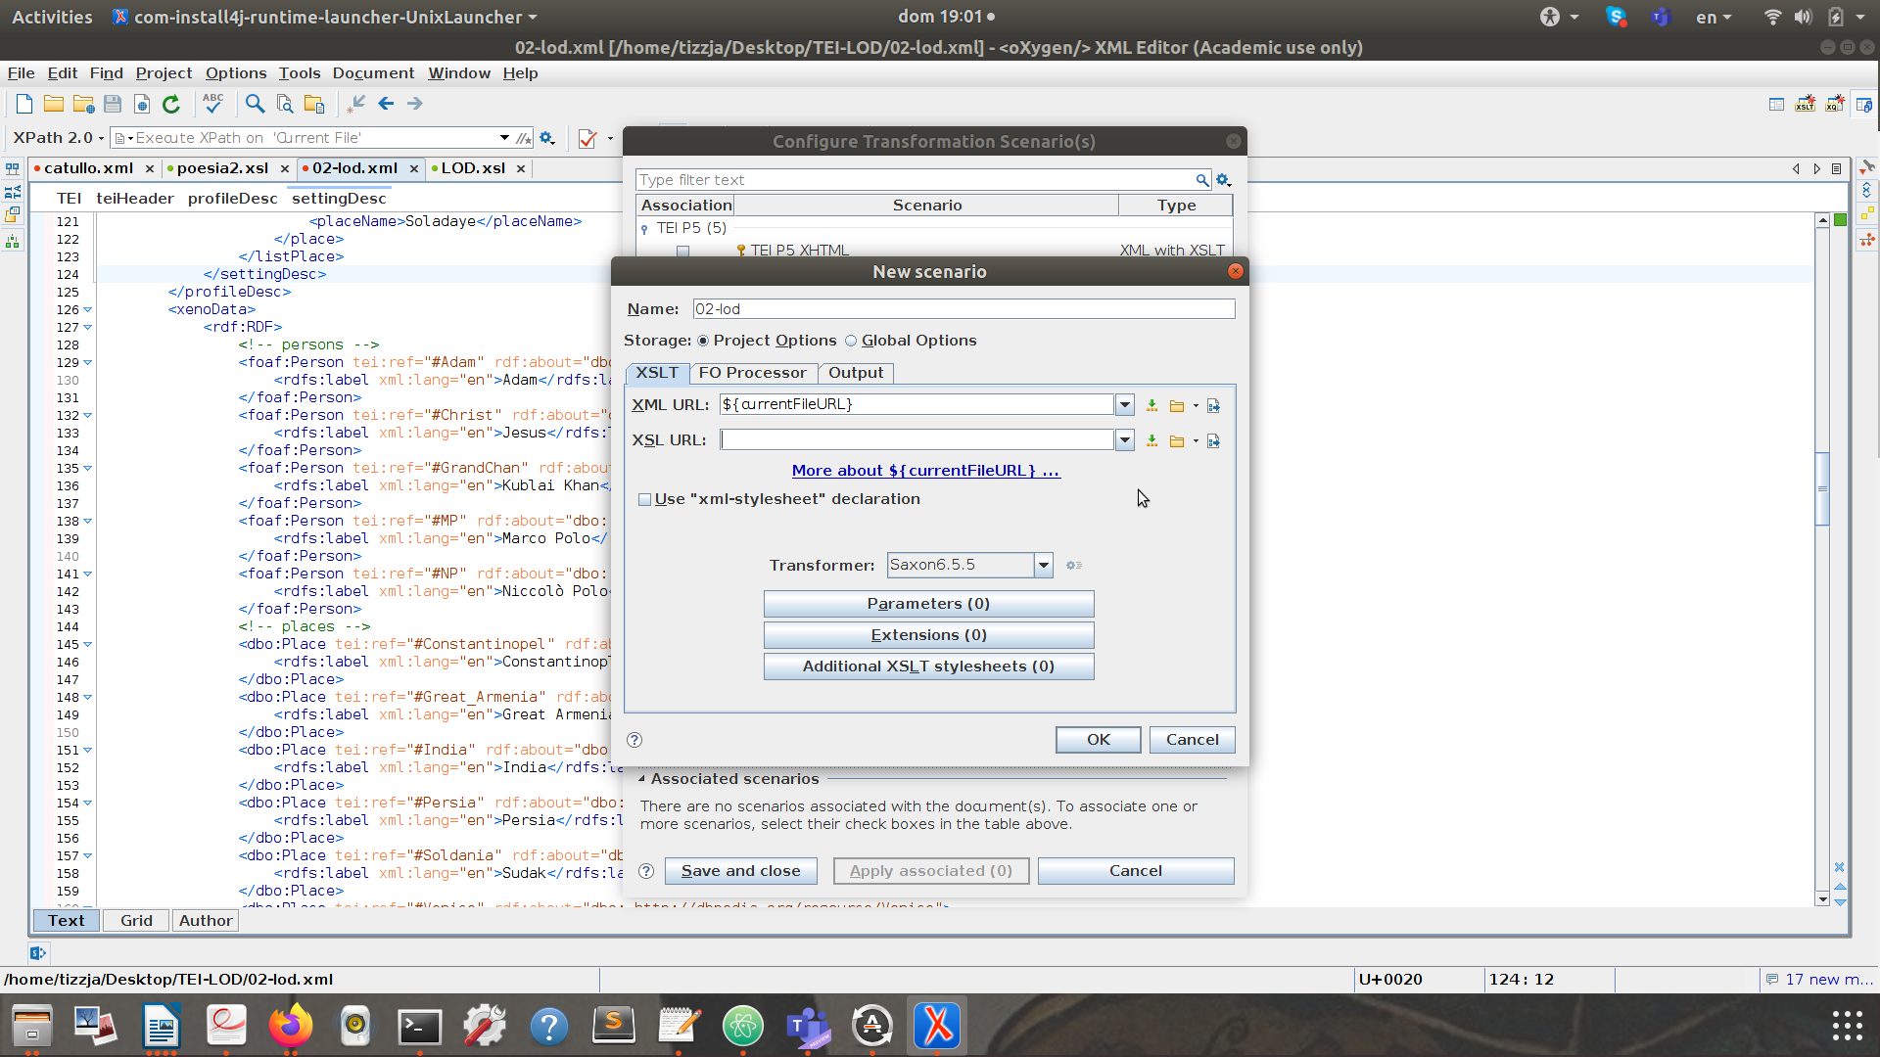
3. How to create a scenario
Choose your
XSLT file
Transformation version 9
Go to “Output”

Slide 41
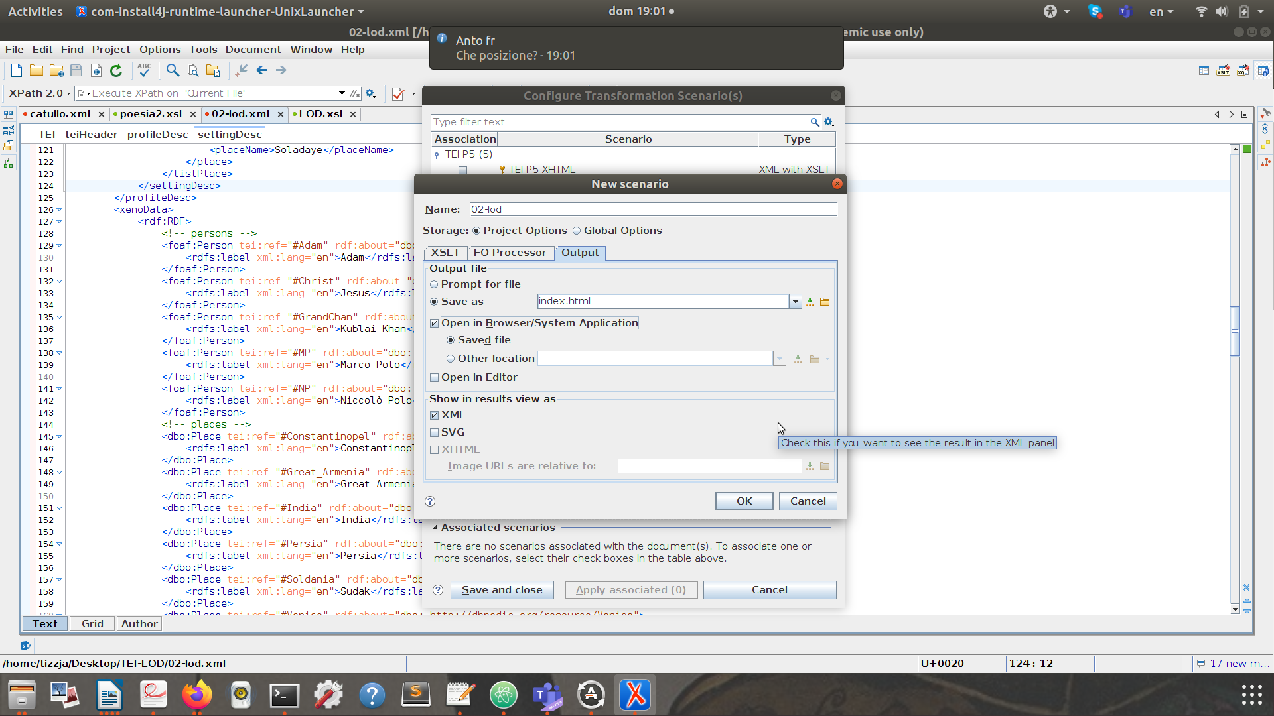
4. How to create a scenario
write the name of your HTML “name.html”
Tick Open in a broswer (if you want to open your file after the transformation)
Click Ok

Slide 42
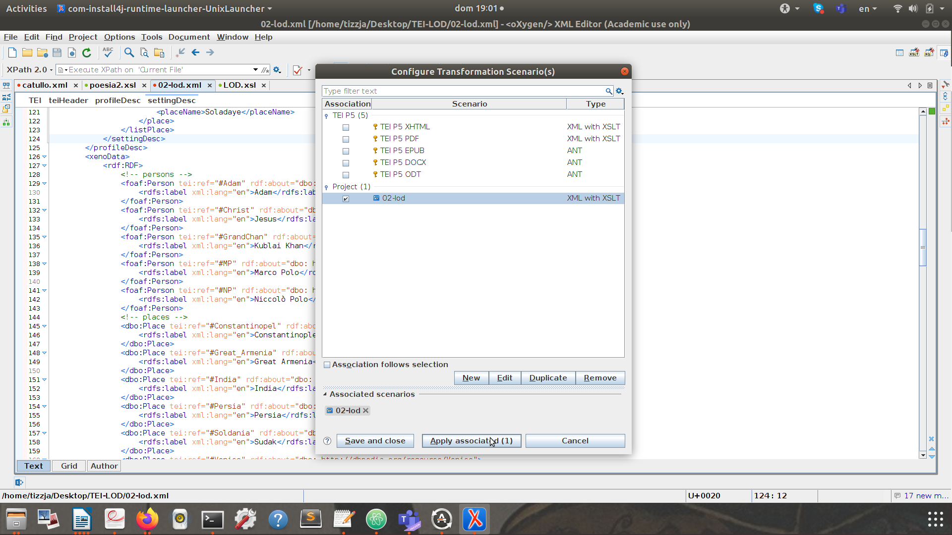
4. How to create a scenario
Check if only your scenario is ticked
Apply scenario

