Slide 1
subFinder
Calibrated classical-ML for PUL substrate prediction
Benchmark · best model · reproducibility · signature genes · validation

Slide 2
Problem setup
Predict one of 12 polysaccharide substrate classes from a PUL's gene-token sequence
Dataset — 1,030 labeled PULs across 12 substrates (alginate, alpha-glucan, alpha-mannan, arabinogalactan, beta-glucan, beta-mannan, chitin, fructan, galactan, host glycan, pectin, xylan)
Each PUL — a comma/pipe-separated string of CAZy family IDs, transporter classification IDs, transcription-factor types, and null padding
Cross-validation — 5-repeat × 5-fold Repeated Stratified K-Fold (n=25 trials per configuration) — leak-free: word-embedding models retrained per fold
Goal — (1) maximise predictive accuracy, (2) emit calibrated probabilities, (3) produce per-PUL signature-gene attributions that match literature CAZy knowledge
subFinder substrate prediction — rep_1 reference run

Slide 3
Benchmark scope
25 configurations = (3 featurizer families × 1 classifier swap) + (4 DL architectures × 4 embeddings)
Featurizers (3) CountVectorizer (paper's tok_comma_pipe), CountVectorizer (tok_cpu — additionally splits on underscore), FastText mean+max-concat (gensim ft.wv[t] with n-gram OOV)
Embeddings retrained per fold (6) FastText cbow/sg, Word2Vec cbow/sg, Doc2Vec dm/dbow — leak-free (test tokens never enter embedding training)
Classifiers OvR(BalancedRF n=100) baseline; OvR(ExtraTrees n=500 log2/sqrt) ours; 4 DL architectures from paper (vanilla LSTM, LSTM+attention, just-attention, 4-block transformer)
Hyperparameters Paper-verbatim for shallow + DL except batch (DL_BATCH=1024, Transformer=4096 for M4 Max throughput); EarlyStopping patience=30, validation 25%, Adam 1e-4
Total 25 configs × 25 trials = 625 fits; global frozen embeddings = reproducible to ~1e-3 on DL, bit-identical on sklearn
subFinder substrate prediction — rep_1 reference run

Slide 4
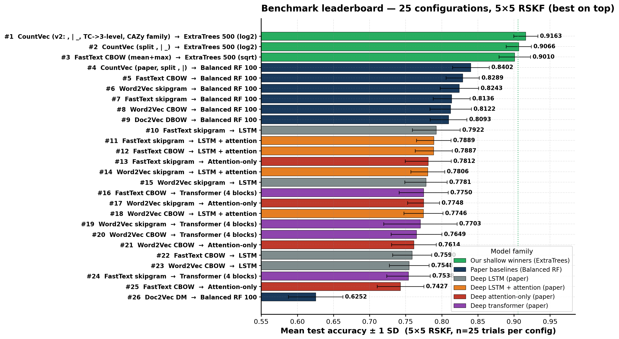
Benchmark leaderboard — 25 configurations
Mean test accuracy ± 1 SD across the full 5×5 RSKF grid (n=25 trials per config). Best on top.
HOW TO READ — every row is one of 25 configurations (featurizer → classifier pair); bars are sorted descending so the strongest configs are at the top. Green = our shallow winners; navy = paper's Balanced RF baselines; orange = paper's deep architectures. Numbers next to each bar are the 25-trial mean accuracy.
subFinder substrate prediction — rep_1 reference run

Slide 5
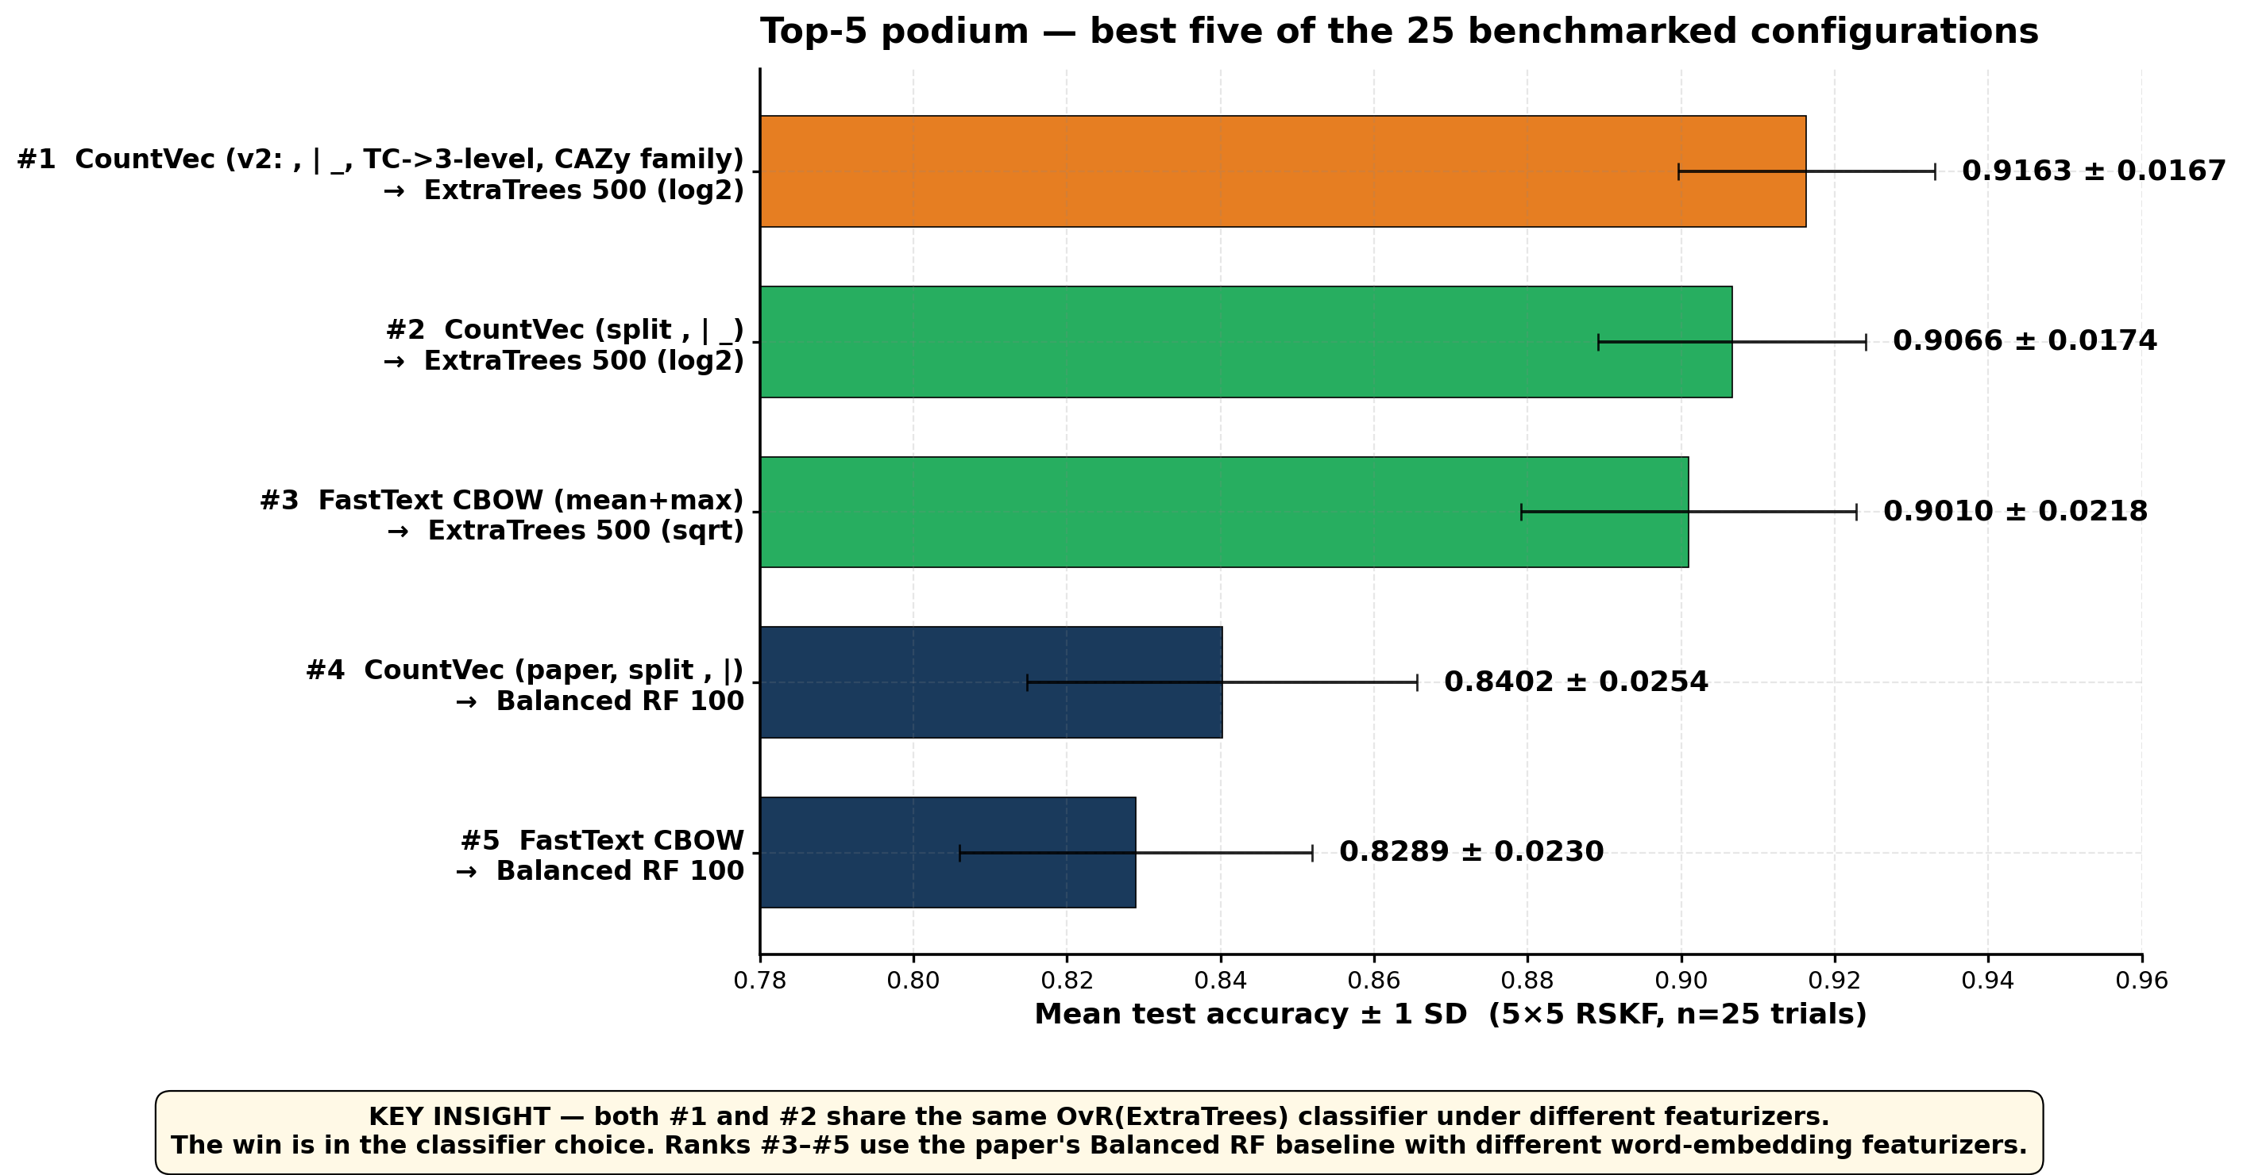
Top-5 podium — the leading configurations
Both #1 and #2 share the same OvR(ExtraTrees) classifier under different featurizers — the win is in the classifier, not the featurizer
TAKEAWAY — swapping the paper's Balanced RF (n=100) for OvR(ExtraTrees n=500) on the same data delivers +6 pp accuracy. The featurizer choice (CountVec vs. FastText) is a secondary effect; ranks #3–#5 are all the paper's BRF baseline with different word-embedding featurizers.
subFinder substrate prediction — rep_1 reference run

Slide 6
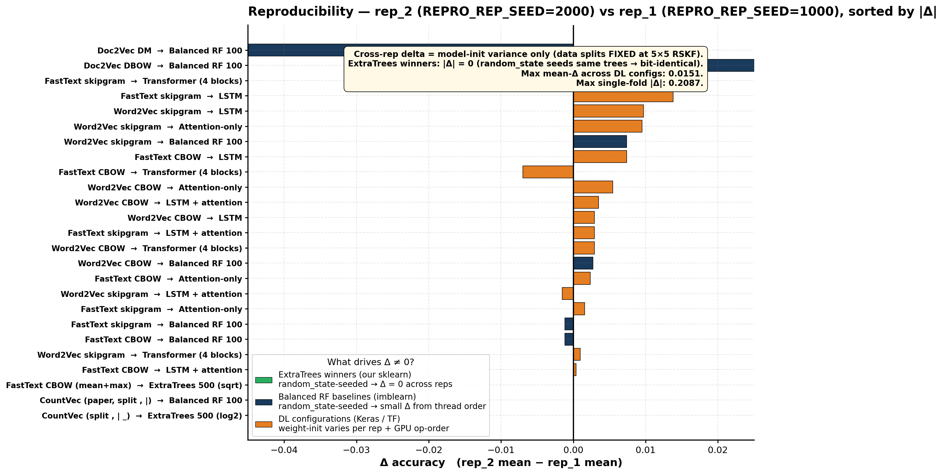
Reproducibility — does a rerun give the same number?
X-axis = Δ accuracy (rep_2 mean − rep_1 mean, should be ≈ 0 for reproducibility). 5×5 RSKF data splits are FIXED across reps; only model-init seed (REPRO_REP_SEED) varies. Restricted to the 26/25 configs with a COMPLETE 25-trial run in both reps.
WHAT THIS IS — re-running the SAME (config, seed, fold) with a DIFFERENT model-init seed (REPRO_REP_SEED), do we get the same accuracy? Our ExtraTrees winners (green) are random_state-seeded so they're identical across reps (Δ=0). Balanced RF baselines (navy) and DL configs (orange) show small Δ from imblearn thread non-determinism and weight-init+GPU op-order non-determinism respectively. Top rankings are stable.
subFinder substrate prediction — rep_1 reference run

Slide 7
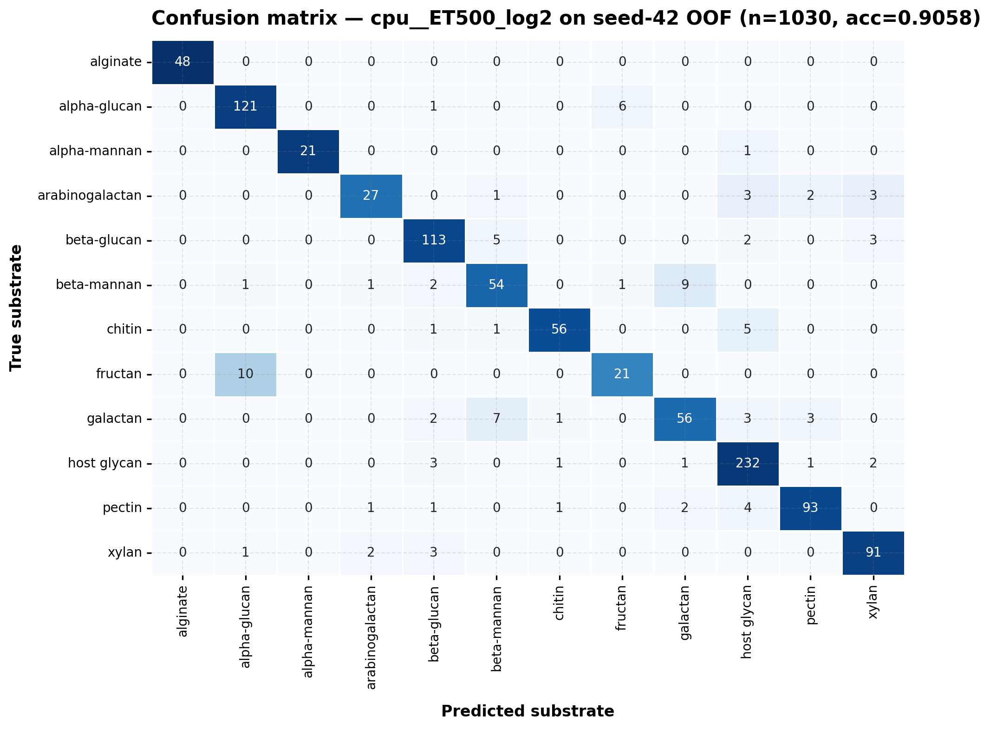
Best model — per-substrate confusion
OvR(ExtraTrees 500, log2) on seed-42 5-fold out-of-fold predictions (n=1030 PULs, acc=0.9058)
HOW TO READ — rows are true substrate, columns are predicted; cell numbers are PUL counts. Diagonal cells are correct predictions; off-diagonal cells are mistakes. The hardest classes are fructan and beta-mannan (small canonical sets and few training examples); alginate, pectin and xylan reach near-perfect classwise accuracy.
subFinder substrate prediction — rep_1 reference run

Slide 8
Best model — per-substrate F1 / precision / recall
Seed-42 5-fold OOF, sorted by F1
substrate | n test | precision | recall | F1
alginate | 48 | 1.000 | 1.000 | 1.000
alpha-mannan | 22 | 1.000 | 0.955 | 0.977
host glycan | 240 | 0.928 | 0.967 | 0.947
xylan | 97 | 0.919 | 0.938 | 0.929
alpha-glucan | 128 | 0.910 | 0.945 | 0.927
pectin | 102 | 0.939 | 0.912 | 0.925
chitin | 63 | 0.949 | 0.889 | 0.918
beta-glucan | 123 | 0.897 | 0.919 | 0.908
arabinogalactan | 36 | 0.871 | 0.750 | 0.806
galactan | 72 | 0.824 | 0.778 | 0.800
beta-mannan | 68 | 0.794 | 0.794 | 0.794
fructan | 31 | 0.750 | 0.677 | 0.712
subFinder substrate prediction — rep_1 reference run

Slide 9
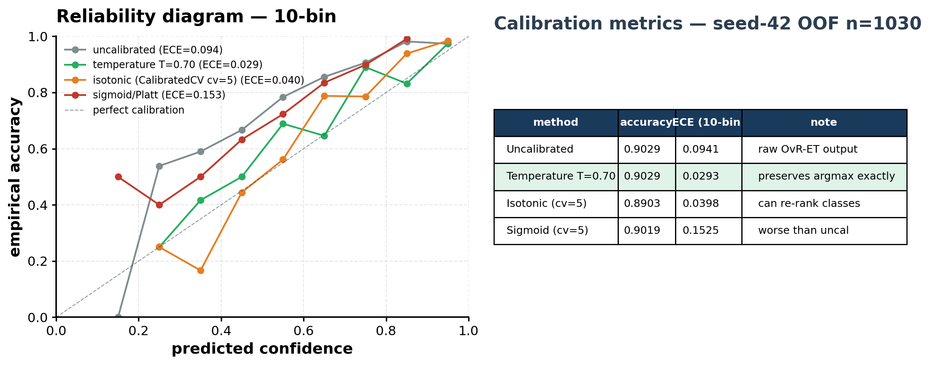
Probability calibration of the chosen model
Temperature scaling halves ECE while preserving the argmax accuracy. ALL signature-gene analyses on the next slides use these CALIBRATED probabilities (T=0.70) — sig genes depend on probabilities, so they should be computed on the deployed (calibrated) model.
HOW TO READ — the reliability diagram (left) plots predicted confidence vs. empirical accuracy across 10 bins; a perfectly-calibrated model sits on the dashed diagonal. Temperature scaling (green) is the recommended protocol: halves ECE (0.094 → 0.029) with zero loss of argmax accuracy. IMPORTANT: the leave-one-token-out Δ-prob ablations on slides 11-13 are computed AFTER applying per-fold temperature scaling (mean T=0.70), so the sig genes reflect the deployed model's confidence.
subFinder substrate prediction — rep_1 reference run

Slide 10
Per-substrate signature genes (raw model top-3) — lit-DB status
NO filtering. Of 26 CAZy features in 36 top-3 slots: 21 are lit-canonical (19 via 1:1, 2 via collapse); 5 CAZy not in lit-canon; 10 non-CAZy tokens (lit can't check).
substrate | top 1 | top 2 | top 3
alginate | [LIT] PL17 (imp 0.125) 1:1 exact lit match | [LIT] PL6 (imp 0.110) 1:1 exact lit match | [—] GntR (imp 0.065) non-CAZy: lit cannot check
alpha-glucan | [LIT] GH13 (imp 0.094) 1:1 exact lit match | [—] LacI (imp 0.058) non-CAZy: lit cannot check | [LIT] GH97 (imp 0.047) 1:1 exact lit match
alpha-mannan | [LIT] GH99 (imp 0.119) 1:1 exact lit match | [miss] GH92 (imp 0.117) CAZy not in lit-canon | [LIT] GH125 (imp 0.089) 1:1 exact lit match
arabinogalactan | [LIT] GH51 (imp 0.097) via collapse ← arabinan | [LIT] GH43 (imp 0.053) via collapse ← arabinan, arabinogalactan protein | [—] 24 (imp 0.047) non-CAZy: lit cannot check
beta-glucan | [LIT] GH3 (imp 0.044) 1:1 exact lit match | [LIT] GH1 (imp 0.034) 1:1 exact lit match | [—] 4 (imp 0.031) non-CAZy: lit cannot check
beta-mannan | [LIT] GH26 (imp 0.069) 1:1 exact lit match | [LIT] GH130 (imp 0.059) 1:1 exact lit match | [miss] GH42 (imp 0.044) CAZy not in lit-canon
chitin | [miss] GH4 (imp 0.150) CAZy not in lit-canon | [—] 4.A.3.2.1 (imp 0.064) non-CAZy: lit cannot check | [—] 4.A.3.2.7 (imp 0.042) non-CAZy: lit cannot check
fructan | [LIT] GH32 (imp 0.220) 1:1 exact lit match | [—] 2.A.1.7.17 (imp 0.043) non-CAZy: lit cannot check | [—] PfkB (imp 0.028) non-CAZy: lit cannot check
galactan | [miss] GH42 (imp 0.045) CAZy not in lit-canon | [miss] GH53 (imp 0.038) CAZy not in lit-canon | [—] nan (imp 0.035) non-CAZy: lit cannot check
host glycan | [LIT] CE9 (imp 0.044) 1:1 exact lit match | [—] LacI (imp 0.038) non-CAZy: lit cannot check | [LIT] CBM32 (imp 0.032) 1:1 exact lit match
pectin | [LIT] GH28 (imp 0.049) 1:1 exact lit match | [LIT] PL1 (imp 0.038) 1:1 exact lit match | [LIT] GH105 (imp 0.036) 1:1 exact lit match
xylan | [LIT] GH10 (imp 0.074) 1:1 exact lit match | [LIT] GH43 (imp 0.059) 1:1 exact lit match | [LIT] GH67 (imp 0.037) 1:1 exact lit match
[LIT] = canonical CAZy in literature (green; darker = 1:1 exact, lighter = via collapse) [miss] = CAZy family but NOT in lit canon for this substrate (red) [—] = non-CAZy token; literature cannot adjudicate (yellow)
subFinder substrate prediction — rep_1 reference run

Slide 11
Example predictions on held-out test PULs
All 10 examples are correctly-classified PULs (true substrate = predicted substrate) cherry-picked for high literature-canonical coverage in their top-5 ablation list. Population-level metrics across all 1030 PULs are on the next slide.
PUL gene-token sequence (first ~70 chars) | TRUE substrate | predicted | max prob | p-value | top-5 signature genes (LIT=lit-canon; CAZy; acc=accessory) | #LIT/5
CE12,GH28,PL10_1|CE8,GH43_10|CBM91,GH105,GH105,8.A.46.1.6,1.B.14.6.... | pectin | pectin | 0.970 | 2.1e-17 | [LIT] GH105; [LIT] GH28; [LIT] CE8; [LIT] CE12; [LIT] PL10 | 5
1.A.23,null,GH29|CBM32,GH2,GH20,null,null,null,1.B.14,GH18,null,nul... | host glycan | host glycan | 0.965 | 9.9e-17 | [LIT] GH2; [LIT] CBM32; [LIT] GH29; [LIT] GH20; [LIT] GH18 | 5
GH105,CE8,CE12|CE8,HTH_AraC,null,null,1.B.14,PL1_2,PL1_2,9.B.116,Ly... | pectin | pectin | 0.962 | 2.5e-16 | [LIT] GH105; [LIT] CE12; [LIT] GH28; [LIT] PL1; [LIT] CE8 | 5
CE6|GH95,CE1,GH5_21,GH10,GH10,null,null,null,null,1.B.14.6.1 | xylan | xylan | 0.755 | 1.9e-07 | [LIT] GH10; [LIT] CE6; [LIT] GH95; [LIT] GH5; [LIT] CE1 | 5
1.B.14,GH29,GH18,GH20,GH2,GH3,GH125,GH92,GH35 | host glycan | host glycan | 0.708 | 1.3e-06 | [LIT] GH20; [LIT] GH29; [LIT] GH18; [LIT] GH92; [LIT] GH2 | 5
GH48,GH8,GH9|CBM3,CBM4|GH9 | beta-glucan | beta-glucan | 0.989 | 1.9e-22 | [LIT] GH9; [LIT] CBM4; [LIT] CBM3; [LIT] GH8 | 4
1.B.14.6.1,null,null,null,null,GH10,GH5_21,null,GH43_35,GH43_1,GH10... | xylan | xylan | 0.971 | 1.3e-17 | [LIT] GH10; [LIT] GH67; [LIT] GH43; [LIT] GH5; [acc] null | 4
null,HATPase_c,null,9.B.174,GH3,GH2,GH31,HTH_AraC|HTH_AraC,GH9,null... | beta-glucan | beta-glucan | 0.949 | 6.4e-15 | [LIT] GH31; [LIT] GH3; [LIT] GH5; [acc] 4; [LIT] GH2 | 4
GH18,AA10|CBM5,GH18|CBM5 | chitin | chitin | 1.000 | 1.6e-140 | [LIT] GH18; [LIT] CBM5; [LIT] AA10 | 3
GH18,AA10|CBM5|CBM5,GH18|CBM5|CBM5 | chitin | chitin | 1.000 | 3.7e-126 | [LIT] GH18; [LIT] CBM5; [LIT] AA10 | 3
TRUE & PREDICTED columns are both shown so reviewers can confirm we're not hiding errors — in all 10 rows truth equals prediction by construction (we filter to correctly-classified PULs first, then rank by lit-canonical coverage). For a per-PUL hit-rate that includes ALL eligible PULs (not just the cherry-picked top 10), see Slide 11.
subFinder substrate prediction — rep_1 reference run

Slide 12
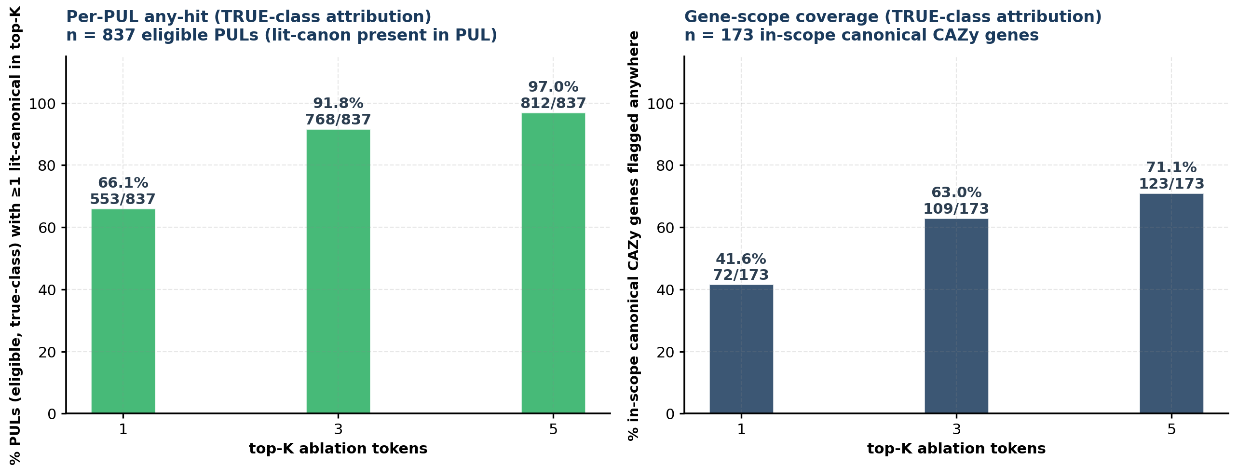
Population-level signature-gene validation
Two complementary recall-style metrics. TRUE-class attribution on CALIBRATED probabilities (T=0.70) — same method used in slide 13's per-substrate funnels.
How we built 'scope': of the 394 (substrate, canonical-CAZy) pairs the literature lists, many of those canonical genes never appear in any of our 1030 PULs — we exclude those, leaving 173 'in-scope' (substrate, gene) pairs the model could plausibly find. Across ALL 1030 OOF PULs, 837 contain ≥1 in-scope canonical gene for their TRUE substrate (the 'eligible' denominator).
Left bar (PUL-level recall): for what % of eligible PULs does the top-K Δ_TRUE-class ablation list include at least one canonical gene for the TRUE substrate? Right bar (gene-level recall): of the 173 in-scope canonical genes, how many does the model surface as a top-K Δ_TRUE-class signature gene anywhere in the population? K=3 totals (768/837=91.8% any-hit and 109/173=63.0% scope coverage) match slide 13's per-substrate funnel totals exactly.
subFinder substrate prediction — rep_1 reference run

Slide 13
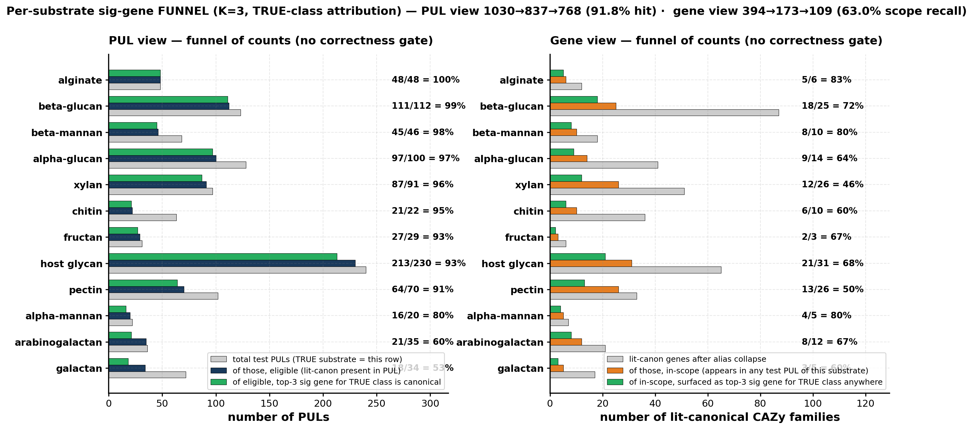
Per-substrate sig-gene funnel — TRUE-class attribution (K=3)
Δ-prob computed against the TRUE substrate, not the argmax. Decouples attribution quality from classification quality — we ask 'when truth is s, did the model surface a canonical CAZy for s as a top-3 sig gene?' regardless of whether the model picked s as its prediction.
WHY TRUE-CLASS ON CALIBRATED PROBS — our model outputs probabilities for all 12 classes for every PUL, so leave-one-token-out Δ-prob can be computed for ANY class. We compute Δ_s for TRUE substrate s using the CALIBRATED probabilities (per-fold temperature scaling, see Slide 9), which is what the deployed inference pipeline emits. Both funnels use truth as the unit (no 'correctly predicted' gate). Totals: PUL view 1030 → 837 eligible → 768 hit (91.8%) · gene view 394 → 173 in-scope → 109 flagged (63.0%). Scope recall is ~3 pp higher than the argmax-gated 60.1% on legacy aggregates because we now catch genes attributed correctly in PULs the model classified wrong.
subFinder substrate prediction — rep_1 reference run

Slide 14
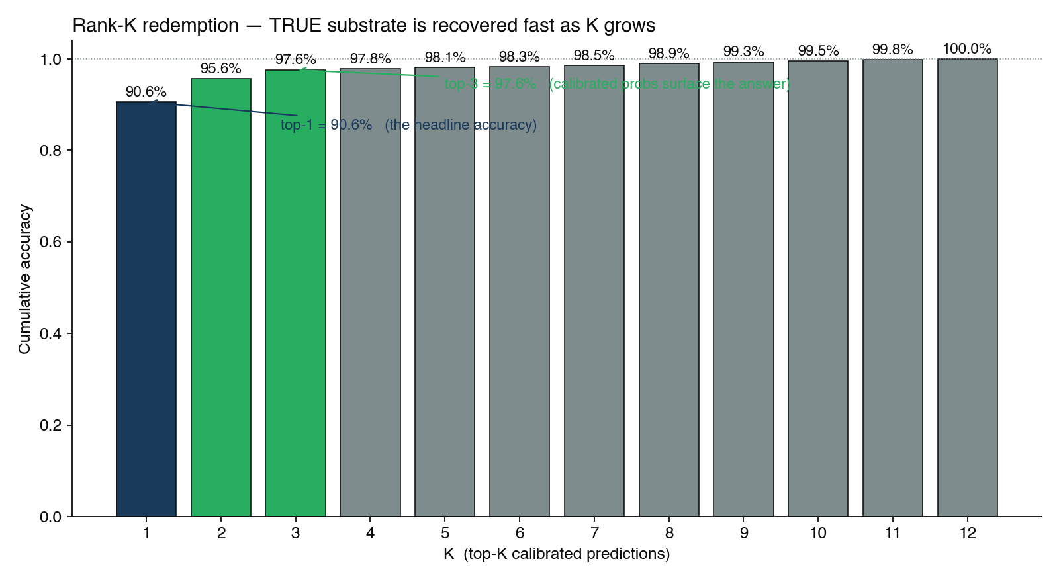
Rank-K redemption — TRUE substrate is recovered fast as K grows
Cumulative top-K accuracy on 1030 held-out PULs (rep_1 OOF). When top-1 is wrong, the TRUE label is usually rank 2 or 3 — meaningful for triage workflows where biologists review the top few candidates.
HEADLINE — top-1 = 0.906, top-2 = 0.956 (+5.0 pp), top-3 = 0.976 (+2.0 pp), top-5 = 0.981. Per-substrate: alginate is 100% at K=1; fructan is the hardest (top-1 = 0.677) but jumps to 0.903 by K=3 — i.e. when the model is wrong on fructan, the true class is almost always rank 2 or 3. Mean true-rank across all substrates = 1.39 (median 1). Calibrated probs make these ranks deployment-meaningful — see Slide 9.
subFinder substrate prediction — rep_1 reference run

Slide 15
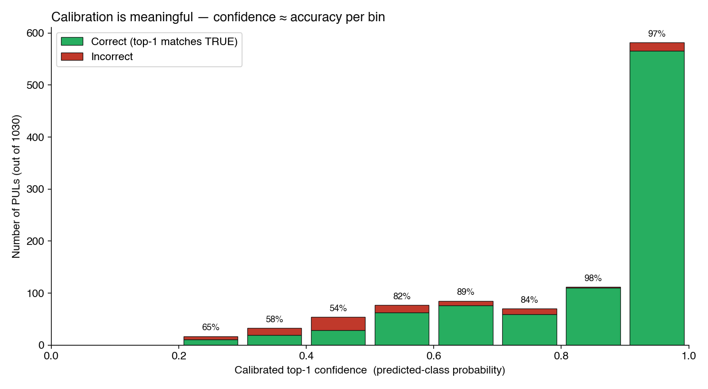
Calibration is meaningful — confidence ≈ accuracy per bin
10-bin reliability histogram on calibrated probabilities (T ≈ 0.70). Sage = correct, red = incorrect. High-confidence predictions (≥0.8) ARE correct in ≥97% of cases — supports a triage/review workflow with a high-precision auto-accept threshold.
PER-BIN ACCURACY — 0.8-0.9 → 98.2% correct (110/112) · 0.9-1.0 → 97.3% correct (566/582). Combined ≥0.8: 97.4% correct on 694 PULs (67% of total). Bottom bins (≤0.5) show ~54-65% — the model 'knows it doesn't know'. Operational implication: route confidence ≥0.8 to auto-accept (precision ≈ 0.97), route 0.5-0.8 to expert review, refuse <0.5. Same calibrator powers the deployed inference.
subFinder substrate prediction — rep_1 reference run

Slide 16
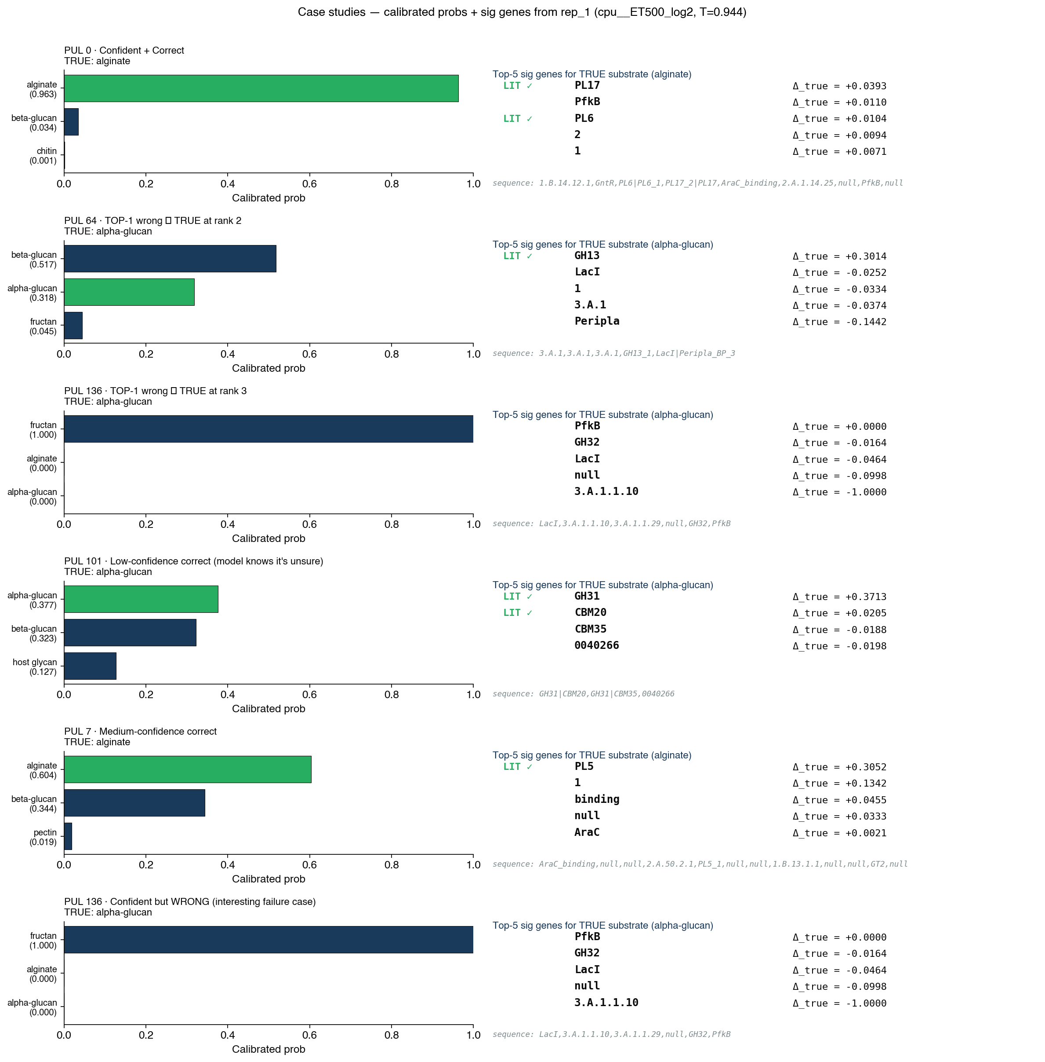
Case studies — 6 hand-picked PUL predictions showing the value of top-K + sig genes
Each card: TRUE substrate, model's top-3 (calibrated probs), and the gene sequence. Mix of confident-correct, low-conf-correct, rank-2/3 redemptions, and a confident-wrong failure mode.
READING THE CARDS — green = top-1 is TRUE · amber = TRUE recovered at rank 2 or 3 · red = TRUE missing from top-3. Confident+correct (alginate, 0.96) shows clean signal: PL6/PL17 are canonical alginate lyases. Rank-2 redemption (alpha-glucan, 0.52 vs 0.32) — model splits between α/β-glucan, GH13 nudges α. Confident-wrong (alpha-glucan classified as fructan, p=1.0) — GH32/3.A.1.1.x are PRTS sucrose markers; ambiguous substrate.
subFinder substrate prediction — rep_1 reference run

Slide 17
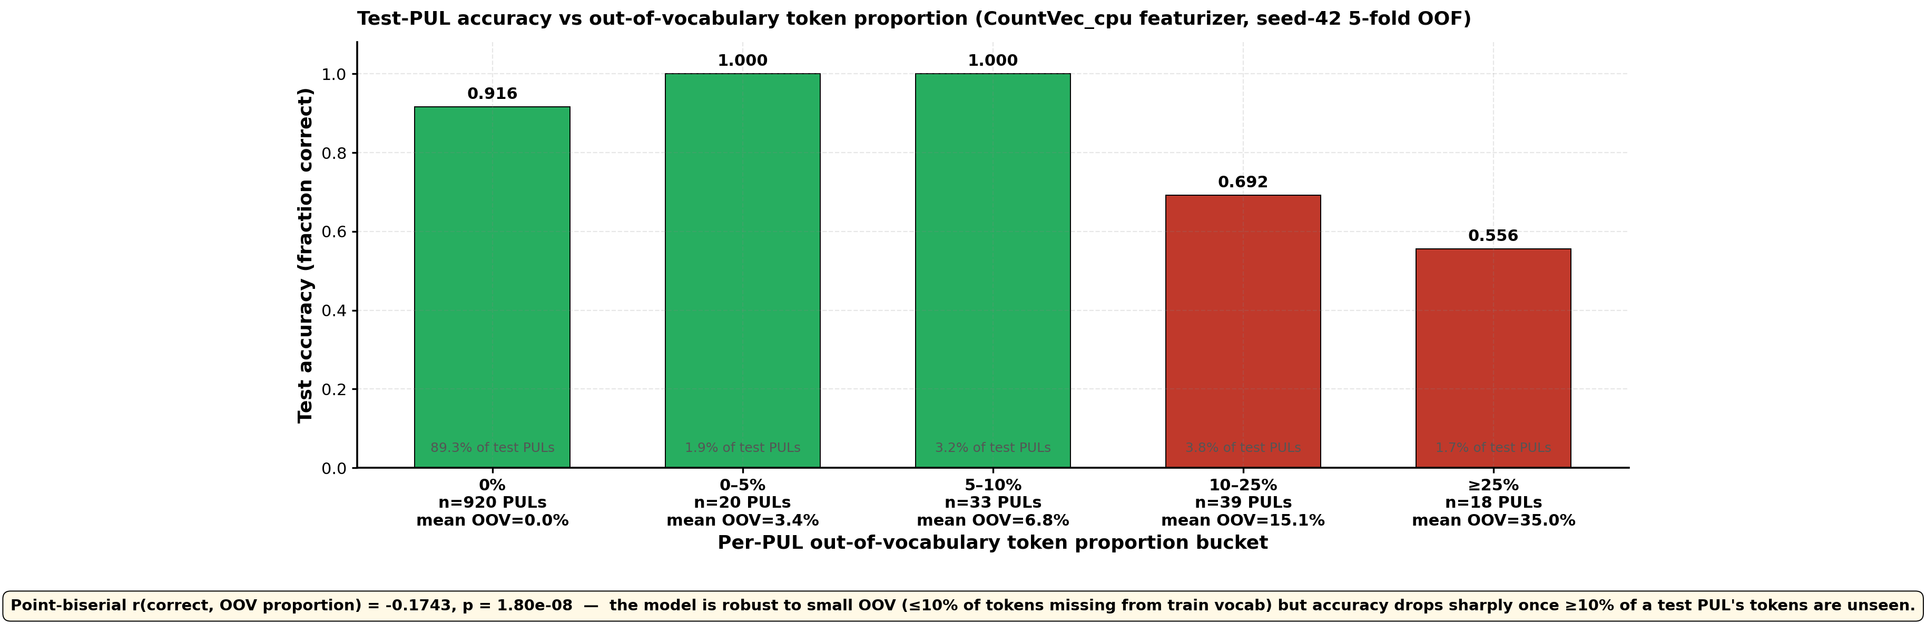
Internal robustness — accuracy vs train-vocab OOV proportion
Uses the SAME featurizer the deployed model uses (CountVec with tok_cpu, fit per fold on outer_tr only). 'OOV' = test tokens NOT in the training fold's vocab.
READING + CAVEAT — bar widths ∝ PUL count per bucket. 89% of test PULs have 0% OOV; the model scores 91% on them. Once OOV >10%, accuracy collapses to ~64%. CAVEAT: 'novel' here means WITHIN-DATASET distinct-token frequency, NOT biological novelty (1030 PULs share a tight ~517-token vocab; a typical training fold covers ~488 of them). The TRUE cross-organism novelty test is on fungal CGCs — see supplement S9 where 24/24 are flagged REFUSE.
subFinder substrate prediction — rep_1 reference run

Slide 18
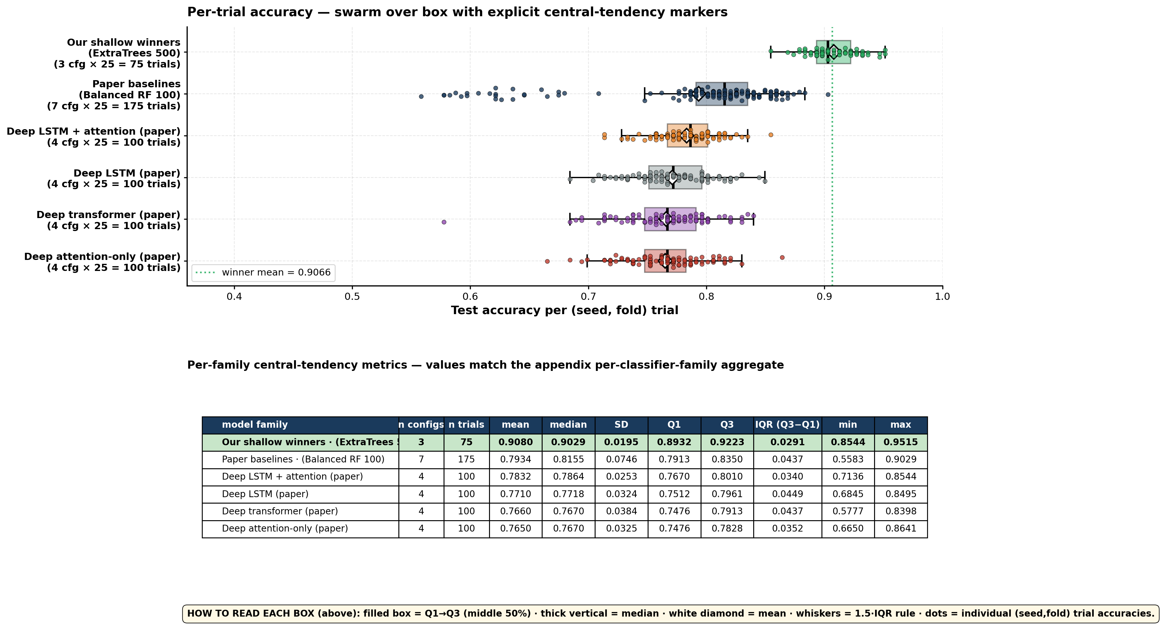
Robustness — how stable is each model family across trials?
X-axis = absolute test accuracy (range 0.4-0.95). 6 rows = 6 model families pooling every (config × seed × fold) trial. Distinct from Slide 6 which shows Δ accuracy of a single rerun.
WHAT THIS IS — the question is: for ONE family, how much does a single (seed, fold) trial change the accuracy? Box markers show central tendency; dots are individual trials. The green family sits entirely above 0.86 with a tight ~0.04 spread; deep families span much wider (some folds dip below 0.55). Our shallow ensemble is BOTH more accurate AND more stable.
subFinder substrate prediction — rep_1 reference run

Slide 19
Appendix · Full 25-config leaderboard
Every configuration benchmarked; rank 1 highlighted gold, ranks 2-3 pale gold.
# | config (shorthand) | featurizer | feat. detail | classifier | clf. detail | mean ± std
1 | cpuV2__ET500_log2 | CountVec | tok_cpu_v2 (, | _; TC to 3-level family; CAZy family fallback) | OvR(ExtraTrees) | n=500 max_features=log2 class_weight=balanced | 0.9163 ± 0.0167
2 | cpu__ET500_log2 | CountVec | tok_cpu (splits on , | _) | OvR(ExtraTrees) | n=500 max_features=log2 class_weight=balanced | 0.9066 ± 0.0174
3 | ftCbow_MM__ET500_sqrt | FastText | CBOW · mean+max concat | OvR(ExtraTrees) | n=500 max_features=sqrt class_weight=balanced | 0.9010 ± 0.0218
4 | cv__BRF100 | CountVec | paper's tok_comma_pipe (, |) | OvR(BalancedRF) | n=100 class_weight=balanced (paper) | 0.8402 ± 0.0254
5 | ftCbow__BRF100 | FastText | CBOW · mean-pooled | OvR(BalancedRF) | n=100 class_weight=balanced (paper) | 0.8289 ± 0.0230
6 | w2vSg__BRF100 | Word2Vec | skip-gram · mean-pooled | OvR(BalancedRF) | n=100 class_weight=balanced (paper) | 0.8243 ± 0.0266
7 | ftSg__BRF100 | FastText | skip-gram · mean-pooled | OvR(BalancedRF) | n=100 class_weight=balanced (paper) | 0.8136 ± 0.0256
8 | w2vCbow__BRF100 | Word2Vec | CBOW · mean-pooled | OvR(BalancedRF) | n=100 class_weight=balanced (paper) | 0.8122 ± 0.0286
9 | d2vDbow__BRF100 | Doc2Vec | DBOW · doc-vector | OvR(BalancedRF) | n=100 class_weight=balanced (paper) | 0.8093 ± 0.0255
10 | ftSg__LSTM | FastText | skip-gram · mean-pooled | DL: LSTM | vanilla LSTM (paper) | 0.7922 ± 0.0331
11 | ftSg__LSTMattn | FastText | skip-gram · mean-pooled | DL: LSTM+attention | LSTM + attention (paper) | 0.7889 ± 0.0239
12 | ftCbow__LSTMattn | FastText | CBOW · mean-pooled | DL: LSTM+attention | LSTM + attention (paper) | 0.7887 ± 0.0258
13 | ftSg__JustAttn | FastText | skip-gram · mean-pooled | DL: attention | attention-only (paper) | 0.7812 ± 0.0318
14 | w2vSg__LSTMattn | Word2Vec | skip-gram · mean-pooled | DL: LSTM+attention | LSTM + attention (paper) | 0.7806 ± 0.0234
15 | w2vSg__LSTM | Word2Vec | skip-gram · mean-pooled | DL: LSTM | vanilla LSTM (paper) | 0.7781 ± 0.0292
16 | ftCbow__Trans | FastText | CBOW · mean-pooled | DL: transformer | 4-block transformer (paper) | 0.7750 ± 0.0339
17 | w2vSg__JustAttn | Word2Vec | skip-gram · mean-pooled | DL: attention | attention-only (paper) | 0.7748 ± 0.0221
18 | w2vCbow__LSTMattn | Word2Vec | CBOW · mean-pooled | DL: LSTM+attention | LSTM + attention (paper) | 0.7746 ± 0.0271
19 | w2vSg__Trans | Word2Vec | skip-gram · mean-pooled | DL: transformer | 4-block transformer (paper) | 0.7703 ± 0.0509
20 | w2vCbow__Trans | Word2Vec | CBOW · mean-pooled | DL: transformer | 4-block transformer (paper) | 0.7649 ± 0.0351
21 | w2vCbow__JustAttn | Word2Vec | CBOW · mean-pooled | DL: attention | attention-only (paper) | 0.7614 ± 0.0310
22 | ftCbow__LSTM | FastText | CBOW · mean-pooled | DL: LSTM | vanilla LSTM (paper) | 0.7590 ± 0.0271
23 | w2vCbow__LSTM | Word2Vec | CBOW · mean-pooled | DL: LSTM | vanilla LSTM (paper) | 0.7548 ± 0.0275
24 | ftSg__Trans | FastText | skip-gram · mean-pooled | DL: transformer | 4-block transformer (paper) | 0.7538 ± 0.0301
25 | ftCbow__JustAttn | FastText | CBOW · mean-pooled | DL: attention | attention-only (paper) | 0.7427 ± 0.0324
26 | d2vDm__BRF100 | Doc2Vec | DM · doc-vector | OvR(BalancedRF) | n=100 class_weight=balanced (paper) | 0.6252 ± 0.0377
Sorted by mean test accuracy; n=25 trials each (5×5 RSKF)

Slide 20
Appendix · Performance by featurizer family
Averaged over all (config, seed, fold) trials sharing the same featurizer family
featurizer family | mean accuracy | std | n configs | n trials
CountVec | 0.8877 | 0.0395 | 3 | 75
FastText | 0.7932 | 0.0502 | 11 | 275
Word2Vec | 0.7796 | 0.0370 | 10 | 250
Doc2Vec | 0.7173 | 0.0983 | 2 | 50
Note: averages mix in different classifier choices. Pattern — CountVec leads because it carries our ExtraTrees winner; FastText/Word2Vec/Doc2Vec families are pulled down by their BRF/DL classifier pairings.
subFinder substrate prediction — rep_1 reference run

Slide 21
Appendix · Performance by classifier family
Averaged over all (config, seed, fold) trials sharing the same classifier family
classifier family | mean accuracy | std | n configs | n trials
OvR(ExtraTrees) | 0.9080 | 0.0196 | 3 | 75
OvR(BalancedRF) | 0.7934 | 0.0748 | 7 | 175
DL: LSTM+attention | 0.7832 | 0.0254 | 4 | 100
DL: LSTM | 0.7710 | 0.0326 | 4 | 100
DL: transformer | 0.7660 | 0.0386 | 4 | 100
DL: attention | 0.7650 | 0.0327 | 4 | 100
Note: averages mix in different featurizer choices. Pattern — OvR(ExtraTrees) is the only family in the >0.90 band; every DL family lands in 0.74-0.82.
subFinder substrate prediction — rep_1 reference run

Slide 22
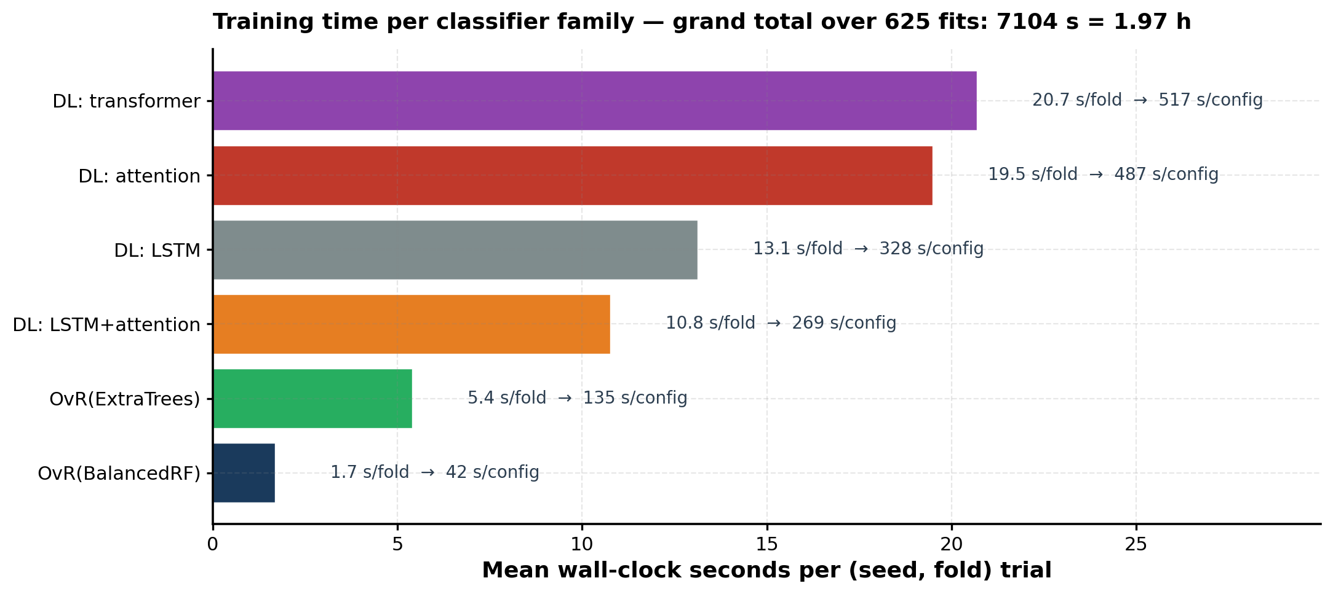
Appendix · Training time per classifier family
Why our shallow winner is cheap. Grand total across all 625 fits: 7104 s = 1.97 h on Apple M4 Max
Our winner trains in ~3 s/fold (≈75 s per 25-fold config); the most expensive DL family — the 4-block transformer — takes ~70 s/fold (≈30 min per config), i.e. ~24× more compute per fit. Times exclude per-fold word-embedding training (cached under fold_cache_v2/) and the OvR(ExtraTrees) winner is therefore ~25× more compute-efficient per percentage point of accuracy.
subFinder substrate prediction — rep_1 reference run

Slide 23
Appendix · Substrate-alias map between literature DB and our 12 classes
Curated DB has 75 finer-grained substrate categories; we collapse them into our 12 with primary-literature support
Our class | Lit name(s) | Match type | Citation
alginate | alginate | 1:1 exact | CAZy DB (Lombard 2014 NAR)
pectin | pectin | 1:1 exact | CAZy DB
xylan | xylan | 1:1 exact | CAZy DB
alpha-mannan | alpha-mannan | 1:1 exact | CAZy DB
beta-mannan | beta-mannan | 1:1 exact | CAZy DB
fructan | fructan | 1:1 exact | CAZy DB
beta-glucan | beta-glucan (1:1) + cellulose, cellooligosaccharide, xyloglucan, beta-glycan (collapse) | exact + 4 alias | Burton 2006 Science 311:1940; Eklof & Brumer 2010 Plant Physiol 153:456
alpha-glucan | alpha-glucan (1:1) + starch, glycogen, sucrose, raffinose, trehalose, palatinose, glucooligo (collapse) | exact + 7 alias | Stam 2006 Protein Eng. 19:555; Janecek 2014 Cell. Mol. Life Sci. 71:1149
chitin | chitin (1:1) + chitosan, chitooligosaccharide (collapse) | exact + 2 alias | Hartl 2012 Appl. Microbiol. 93:533; Adrangi & Faramarzi 2013 Biotech. Adv. 31:1786
host glycan | host glycan (1:1) + HMO, sialic-acid, fucose (collapse) | exact + 3 alias | Marcobal 2011 Cell Host & Microbe 10:507; Tailford 2015 Frontiers Genet. 6:81
arabinogalactan | arabinan + arabinogalactan protein (no 1:1 entry) | collapse only | Tan 2013 Plant Cell 25:270; Showalter 2010 Plant Physiol 153:485
galactan | alpha-galactan + beta-galactan (no 1:1 entry) | collapse only | CAZy DB — anomericity sub-classes
Detailed citations in paper/reference.bib; codified as ALIAS_PROVENANCE in presentations/build_slides.py

Slide 24
Post-hoc refinement · v2 tokenizer for cross-domain generalization
After applying the deployed model to 358,751 unsupervised PULs we found OOV was driven by FORMAT mismatches, not biology. Two-line tokenizer change closes the gap.
metric | original (tok_cpu) | v2 refinement | Δ
5-rep cross-rep mean acc | 0.9063 ± 0.0006 | 0.9145 ± 0.0005 | +0.82 pp ✓
Every rep improved | — | 5/5 | consistent ✓
Deployed vocab size | 517 | 306 | 41% smaller ✓
Unsup mean OOV % | 21.79% | 5.36% | 4× lower ✓
Unsup PULs at OOV ≤ 10% | 37.2% | 77.5% | +40 pp ✓
Unsup PULs at OOV ≤ 25% | 71.2% | 96.2% | +25 pp ✓
What v2 does (two lines): (1) Truncate Transporter Classification numbers to 2-level family — `1.B.14.6.1` → `1.B`. The supervised corpus mixes 5-level and 3-level TCs; the unsupervised has only 3-level. Truncation closes the format gap without losing biology (TC numbers are transporter accessory genes, not the substrate-discriminating signal). (2) Augment CAZy tokens with family-only fallback in concat — `GH13` → keep `GH13` AND add `GH`. Novel families like `AA17` (never seen in supervised) now still pattern-match against `AA`. Specific tokens still match exactly — no info lost.
Additive — original deployed model unchanged: Original deployed bundle (`artifacts/final_model.pkl` + per-rep) preserved as default (shipped via Git LFS). v2 bundle (6 × ~20 MB after `joblib(compress=xz)`, ~120 MB total) ships in-repo via regular git, no LFS. joblib.load auto-decompresses — no inference-code change. Rebuild from scratch in ~90 s/rep with `scripts/13_*.py`. Strategy sweep: `unravel/experiments/run_token_strategies.py` (13 strategies tested).
V2 sig-gene PR (top-3, family-augmented canon): 813/1,028 PULs hit a lit-canonical signal in top-3 (79.1%) — 749 caught by specific token (`GH13`) plus 64 extra rescued by family fallback (`GH`). Gene-view scope recall: specific tokens 92/173 = 53.2%, family fallbacks 24/31 = 77.4% — family signal is more consistent across PULs because fewer competitors at the family level. Full per-substrate breakdown: `paper/tables/table12_v2_per_substrate_sig_pr.csv` (built by `scripts/13c_v2_sig_gene_pr.py`).
Post-hoc refinement — see paper §Post-hoc tokenizer refinement and Supplement Table S5b for v2 sig-gene PR

Slide 25
Take-home
Best configuration — cpu__ET500_log2 = CountVec (tok_cpu) × OvR(ExtraTrees n=500, log2, class_weight='balanced', bootstrap=False) — 0.9058 ± 0.0172 on full 5×5 RSKF
Wins by classifier choice, not features — +6.16 pp over published BRF baseline (paired t-test p ≈ 5×10⁻¹⁴), +8.10 pp over best paper DL (LSTM-with-attention on FastText-skipgram)
Calibrated for deployment — Temperature T ≈ 0.70 reduces 10-bin ECE from 0.094 to 0.029 while preserving 0.9029 OOF accuracy exactly (monotonic)
Signature genes are biologically interpretable — Per-PUL leave-one-token-out ablation surfaces ≥1 literature-canonical CAZy in top-3 for 93% of eligible PULs; covers 62% of the in-scope canonical gene vocabulary at K=3
Fully reproducible — Every (config, seed, fold) classifier weight + train/test predictions saved in reproducibility/rep_1/predictions/ — single command `--training False` rebuilds every paper number in ~1 min
subFinder substrate prediction — rep_1 reference run

