Slide 1
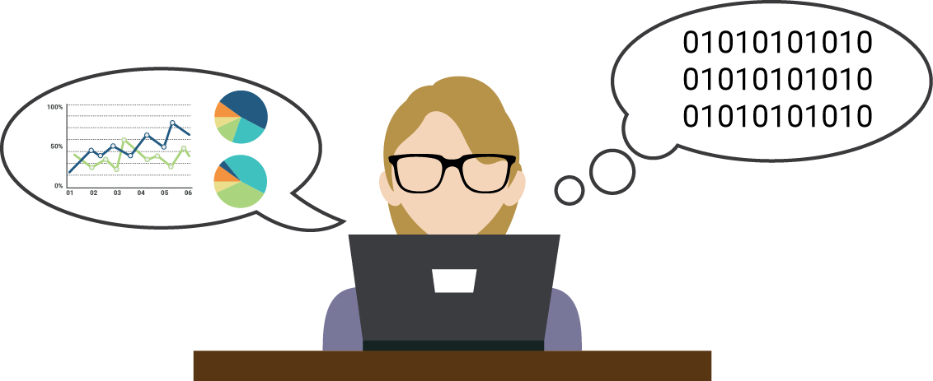
X_Education case Study
Problem Statement
A company named X_education who sells their online courses on the various platform wants a regression model to analyse and increase the Conversion rate of the Contacted students through the data provided while filling the form for their respective courses .
So, through the analyses Company wants to put more focus on that Student profile that most likely to get enrolled therefore as a data analyst we have to put up a Logistic Model for the related problem.
This Photo by Unknown Author is licensed under CC BY-NC

Slide 2
Data cleaning
As we know the Data Cleaning part of an analysis is most important so first we have to tackle with the data cleaning part
Therefore, first of all after inspecting the data we have to do the followings things:
! First we have to replace all the columns having the value “Select” should be replaced by the “nan” values because “Select” shows that student does not any option either because of any reasons So, it should be considered as the Null values.
! Secondly in another step we have to drop all the columns having the null with greater
Than 40%.since it does not add any information to our analysis or may misleads the anaylsis.
! Third, one is to check all the columns having the data imbalance ,many values with less percentage .We have to drop all the columns having the data imbalance since we does not need to see any insights and the other one having many values needs to be regroup with “others” like values to reduce the dummies variables.

Slide 3
Exploratory data analysis :
In our second step in model building we have to put focus on the EDA part of our analysis
since it is important to see the relation ship among the columns and also see the trends in data .
Therefore, as a part of EDA we have do the Data Visualization part like seeing the relationship between the different Categorical columns ,Numerical columns etc because graph plays a significant part in explaining the data easily.

Slide 4
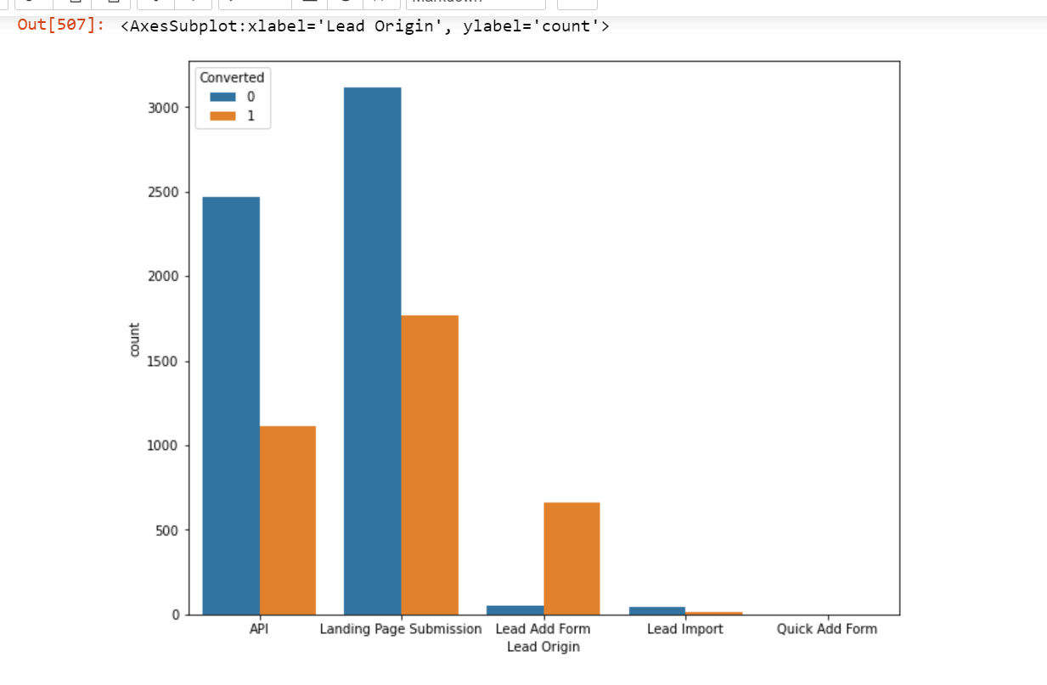
EDA example: IN this we can clearly see that lead add form are the persons having most conversion rate

Slide 5
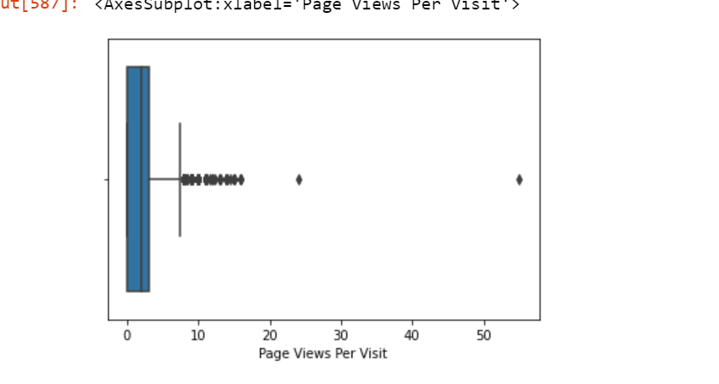
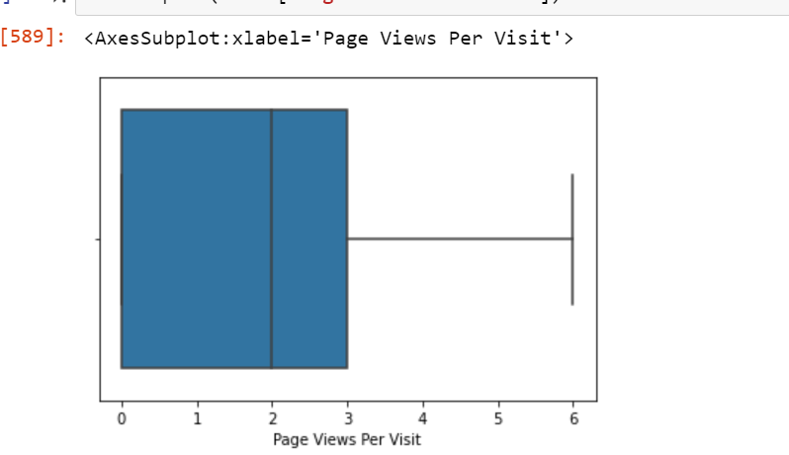
We also find some variables having outliers and treated them too displaying both before and after results

Slide 6
Data preparation
After the Data Cleaning part we have to do the Data Preparation Part .There are several steps that needs to take like :
first we have to drop all the columns that are SALES team generated since we have to operate on the basic data that is provided by the student Since Sales team data is generated
By the sales team after interacting with the student but we have to make the model for Predicting the Students which needs to get preference that why it is an irrelevant data for our analysis.

Slide 7
Model Building (Logistic regression)
In building our model we have to approach the problem with the MIXED approach which means that first we need to select the columns using the RFE then dropping the insignificant columns manually
We have to check the P-values and the VIFs to see the significance of the columns and see the relative relationship between the other columns (if columns found to be collinear then drop the less significant column in prospective of the analysis.
Using the Maximum Likehood model building process we have to build the logistic regression model where the evaluation metrices like Sensitivity and Specificity should be more than the or around 80% and then finding the optimal cutoff.
Finally we have to check the model performance on the test dataset and see how it predict to change or increase the conversion rate(Target Variable)

Slide 8
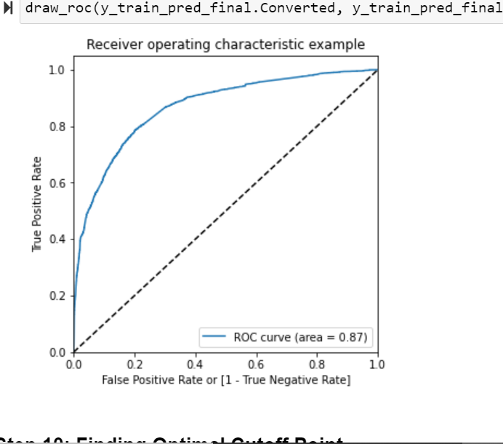
Roc curve of our model

Slide 9
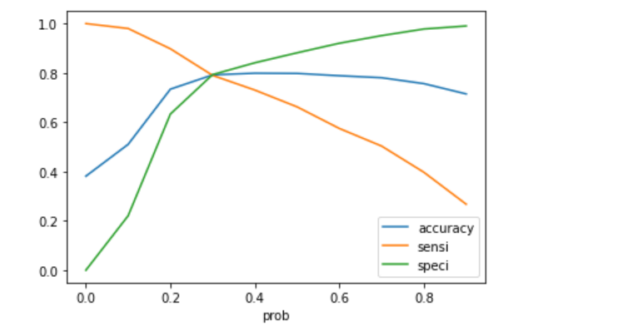
Optimal cut off of our model 0.33 approx. is our optimal cut off which tells us that leads having probability more than 0.33 our are hot leads and less than 0.33 are cold leads

Slide 10
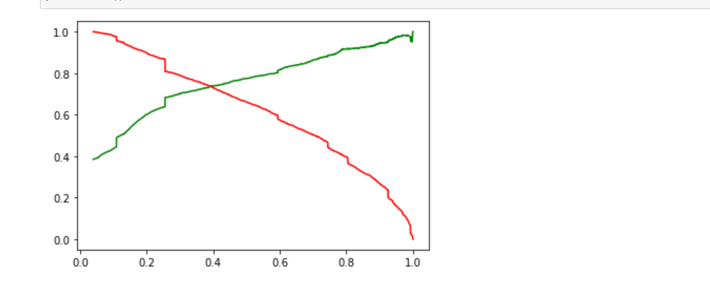
Precision and recall trade off

Slide 11
Optimal cut off :
So, after doing all the Evaluation metrices it is most important task to find the optimal cut-off region for the business related problem. After finding the cut-off region will directly proportional for the performance of the model .in the provided business problem the cut off region supposed to be some where near to the 0.6 where recall and precision will intersect each other.
optimal cut-off region should be monitored carefully since if there is higher cut-off as to be supposed the model will to too much skewed similarly if the cut-off is lower than the supposed region than it will not assess the problem rightly.

Slide 12
Conclusion:
So, after the analysis part there is significant change in the approaching the students. Company on the basis of model would like to prefer the student who have the higher probability of getting enrolled as compare to the other students that will leads in the increase in the efficiency and profit of the company in the long term.

