Slide 1

AI MODE
LOCAL LLM MONITORING · RUNTIME CONTROL
What we can measure from a local inference runtime — and how the host stays awake.
V1 · WORKING DOCUMENT
Metric retrieval · Keep-alive · GPU offload
DRAFT · 11 AUGUST 2026
RAZER

Slide 2
WHAT THIS DOCUMENT COVERS
Three sections and the minutes of the review that closed them.
METRIC RETRIEVAL
What the code tracks · vLLM vs Ollama · Other runtimes
I
What can we actually measure?
03 – 08
KEEP-ALIVE
Requirements · The call sequence · Thread state and the lid · Limits
II
How do we stop Windows going to sleep?
09 – 14
GPU OFFLOAD
Open questions only — no answers in this revision
III
Pending.
15 – 16
MEETING MINUTES
Metrics · Keep-alive · GPU offload — actions taken away
IV
What did the review on 12 August decide?
17 – 18
Two of three sections are answerable today. Metric retrieval and keep-alive are settled questions with named APIs behind them. GPU offload carries no content yet.
02 · WHAT THIS DOCUMENT COVERS
RAZER

Slide 3
METRIC RETRIEVAL
SECTION I
What the monitor reads today, how the two supported runtimes differ, and what else we could add.
vLLM + OLLAMA TODAY
One provider interface · nvidia-smi for everything the runtime will not say
PART I OF III
RAZER

Slide 4
WHAT THE CODE ACTUALLY TRACKS
Every number the monitor puts on screen, and what it means if you are not reading the source.
GPU
GPU busy, memory bandwidth busy, temperature, power draw
Straight from nvidia-smi. How hard the chip is working, how hard its memory is working, how hot it is, and how much electricity it is pulling.
VRAM
VRAM in use against VRAM fitted
Also nvidia-smi, and it counts the whole card — the model, the conversation cache and anything else resident. When it fills, everything slows down.
MODEL
Model size, the part in VRAM, and the GPU/CPU split
A model that does not fit is quietly half-run on the CPU. We report that split as a percentage, with the parameter count, the quantisation and the context length.
QUEUE
Requests running, requests waiting, slots busy
How much work the server has in hand right now, and how much is queued behind it. Waiting work means the machine is saturated, not broken.
CACHE
KV-cache occupancy, prompt reuse, prompts held in RAM
The KV cache is the live conversation the model keeps in VRAM. Reuse is how much of the last prompt it recognised and skipped — speed for free.
SPEED
Prefill and decode rates, with a trend line
Prefill is how fast it reads your prompt; decode is how fast it writes the answer. Both in tokens per second, smoothed, with the last sixty samples drawn.
04 · WHAT THE CODE TRACKS
RAZER

Slide 5
vLLM AND OLLAMA ARE NOT SYMMETRIC
One provider interface, two very different levels of visibility. Each tells us something the other cannot.
vLLM — A METRICS ENDPOINT
OLLAMA — READ THE LOG
Prometheus text on /metrics, read every tick
Server-wide counters: tokens, queue, KV use
Prefix-cache hit rate arrives for free
No metrics endpoint; /api/ps is the whole API
Token timings only reach whoever made the call
So throughput is tailed out of server.log
SO THE SAME FOUR SIGNALS ARRIVE BY DIFFERENT ROUTES
THE SIGNAL
ON vLLM
ON OLLAMA
Throughput
Counters over elapsed time, then smoothed
Parsed from the last finished request in the log
Concurrency and queueing
Requests running and requests waiting, exactly
Busy slots out of -np, inferred from slot log lines
KV cache and prompt reuse
Usage percentage and prefix hit rate, directly
Per-request token counts, plus the RAM prompt cache
Model on GPU, or spilled to CPU
Never spills — it reserves its VRAM once at startup
size against size_vram gives an exact GPU/CPU split
Neither one is strictly better. vLLM reports the server; Ollama alone tells us how much of the model reached the GPU.
05 · vLLM AND OLLAMA
RAZER

Slide 6
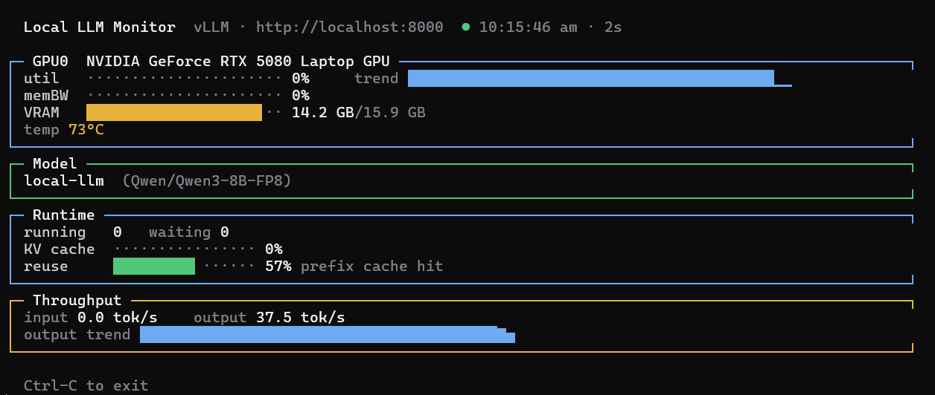
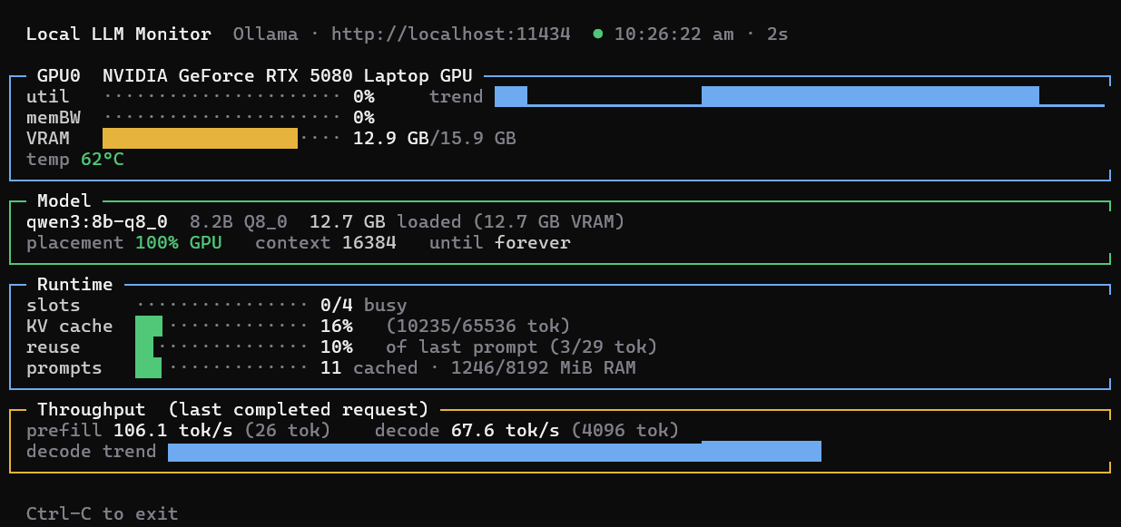
OPEN QUESTIONS — METRIC RETRIEVAL
vLLM MONITOR
OLLAMA MONITOR
06 · OPEN QUESTIONS
RAZER

Slide 7
COULD WE SUPPORT OTHER RUNTIMES?
The provider interface is small. The answer is mostly about what each runtime is willing to tell us.
FOUR CANDIDATES — RANKED BY HOW MUCH NEW CODE EACH ONE NEEDS
llama.cpp / llama-server
Our Ollama log parsers already work — and llama-server serves /metrics too.
A
Straightforward · same log, and real metrics
LM Studio
Model list and load state read cleanly; throughput has to come from its log.
B
Easy · OpenAI-compatible, but no metrics
vLLM-shaped: SGLang, TGI
Same shape as our vLLM provider — largely a rename of counters we read today.
C
Moderate · Prometheus, different names
TensorRT-LLM and friends
Each would need its own collector, and few people here would ever run one.
D
Low value · niche installs, uneven telemetry
WHERE IT ACTUALLY COSTS
WHY EXTENDING STAYS CHEAP
A runtime with no metrics endpoint forces log parsing, and a log format is not an API — it moves between releases without warning.
Each runtime is one class with one read method. The renderer, the GPU collector and the CLI never change.
07 · OTHER RUNTIMES
RAZER

Slide 8
OPEN QUESTIONS — METRIC RETRIEVAL
QUESTIONS — SCOPE
Do we have any target runtimes/hosting platforms in mind?
Llama.cpp
Attempt to unify the metrics collection process using a proxy – still need more investigation on whether it is feasible and beneficial.
would the user be open to proxying their setup through us?
Model Training?
08 · OPEN QUESTIONS
RAZER

Slide 9
KEEP-ALIVE
SECTION II
An unelevated Node process can hold the machine awake. The lid is a separate problem.
KERNEL32 VIA FFI
Power requests need no elevation · The lid needs a power-policy change
PART II OF III
RAZER

Slide 10
KEEP-ALIVE AT A GLANCE
What it costs to hold the machine awake, and where the one real caveat sits.
ELEVATION
WINDOWS
NODE
None
7+
22
Every power-request call runs from a normal desktop process. Reaching them through an FFI binding does not change that.
PowerCreateRequest and PowerSetRequest have shipped since Windows 7. Both are exported by Kernel32.dll.
Koffi needs Node 16 or later. Target a supported LTS — 18 and 20 are both end-of-life.
WHAT WORKS UNELEVATED
WHERE IT MIGHT NOT
PowerCreateRequest and PowerSetRequest — the whole idle-sleep path
SetThreadExecutionState — for a small synchronous program
Changing the lid action writes to the active power scheme
An ACL or Group Policy can refuse it — try unelevated, then check
NOTE
LIDACTION is persistent and affects the machine outside our application. Save the previous AC and DC values and restore them when appropriate.
10 · KEEP-ALIVE AT A GLANCE
RAZER

Slide 11
WHAT EACH REQUIREMENT NEEDS
Three of the four need nothing more than a runtime call. The fourth changes machine policy.
THE RECOMMENDED SEQUENCE
WHY NOT THREAD STATE
PowerCreateRequest, for a handle with a reason
PowerSetRequest while the work is active
PowerClearRequest, then CloseHandle
A continuous execution state is thread-affine
An await may resume on a different thread
A handle has no thread affinity, so it survives
SO THE FOUR REQUIREMENTS SPLIT CLEANLY
THE REQUIREMENT
THE MECHANISM
ELEVATION
Prevent automatic idle sleep
PowerCreateRequest, then PowerSetRequest
Not required
Prevent idle sleep, thread-scoped
SetThreadExecutionState
Not required
Keep the display on
A display-required power request
Not required
Prevent lid-close sleep
Set LIDACTION to 0, on AC and DC
Depends on the power-policy ACL or Group Policy
Only the lid is policy. Everything that prevents idle sleep is a plain unelevated call into Kernel32. Only the lid action touches the power scheme.
11 · WHAT EACH REQUIREMENT NEEDS
RAZER

Slide 12
THREAD STATE, AND THE LID
SetThreadExecutionState still has a place — and the lid needs the power scheme, not an API call.
SETTHREADEXECUTIONSTATE, HONESTLY
CONFIGURING LID-CLOSE BEHAVIOUR
ES_CONTINUOUS | ES_SYSTEM_REQUIRED — system awake, display may sleep
Add ES_DISPLAY_REQUIRED — keeps the display awake as well
Clear with ES_CONTINUOUS alone — and from the same thread that set it
Without ES_CONTINUOUS — resets the idle timer once, then stops mattering
Not a lid answer — and ES_AWAYMODE_REQUIRED is a media flag, not a workaround
Power requests do not override it — the lid is an explicit sleep action
powercfg, SUB_BUTTONS, LIDACTION — set the AC value, the DC value, then activate
AC and DC are separate — plugged in and on battery configure independently
Normally permitted — but an administrator or Group Policy can restrict it
LIDACTION VALUES
THE PHYSICAL CAVEAT
0 do nothing · 1 sleep · 2 hibernate · 3 shut down. We want 0 on both AC and DC — and we save whatever was there before.
A laptop running with its lid closed obstructs its own cooling. Do not leave a closed, running laptop in a bag or any poorly ventilated space.
12 · THREAD STATE, AND THE LID
RAZER

Slide 13
WHAT WE STILL CANNOT GUARANTEE
No application-level request keeps a machine awake in every condition. These win anyway.
USER
The user explicitly selects Sleep
A deliberate action always wins. Our request suppresses the idle timer — it does not override the person at the keyboard.
BATTERY
Critical battery level
Windows will suspend or shut down to protect the machine, and whatever has not yet been written to disk.
BUTTONS
Power-button configuration
The physical power button's action is power-scheme policy, exactly like the lid, and no runtime request changes it.
THERMAL
Thermal protection
Firmware acts to protect the hardware without asking the operating system, let alone our process.
POLICY
System or organisational policy
Group Policy, and hardware or firmware behaviour, both sit above anything the application can ask for.
STANDBY
Modern Standby restrictions
Particularly on battery, where the platform's own rules take precedence over a runtime power request.
13 · WHAT WE CANNOT GUARANTEE
RAZER

Slide 14
OPEN QUESTIONS — KEEP ALIVE
QUESTIONS — SCOPE
Lid Close action change – need to investigate whether most home users will need elevation
Synapse self-update – need to discuss with Platform team
Scheduled maintenance and indexing services (e.g., Windows Search indexer, Defrag) – need to investigate feasibility and impact on affecting Windows services. May cause more problems if user also uses the PC for other tasks. [TBD]
Detect group policy and warn users?
14 · OPEN QUESTIONS
RAZER

Slide 15
GPU OFFLOAD
SECTION III
Reserved. Nothing has been researched or written for this section yet.
OPEN QUESTIONS ONLY
The questions are listed overleaf · Answers come in the next revision
PART III OF III
RAZER

Slide 16
OPEN QUESTIONS — GPU OFFLOAD
WHAT IT IS
WHAT WE CONTROL
WHAT WE DECIDE
What do we mean by offload — a layer split, paging, or both at once?
Which knobs does each runtime actually expose to us at load time?
Who chooses the split — the runtime, the user, or our own policy?
QUESTIONS — SCOPE
Where do we see us positioned – as a monitor or a global arbitrator of system resources?
Are we allowed to “reserve” dGPU resources and then transfer ownership to other applications/runtimes?
Right now changing GPU modes – Dynamic Switching / Dedicated GPU requires a change in BIOS modes pending restart. Is this expectation acceptable for this feature?
Can we control other runtimes? Which runtimes let us change the layer count without a restart?
If we can find this info, is suggesting user a better config/quantization better than trying to control system resources?
16 · OPEN QUESTIONS
RAZER

Slide 17
MEETING MINUTES
SECTION IV
What the review on 12 August agreed, and what each section has to go and find out.
REVIEW OF 2026.08.12
Three topics · Actions carried back into sections I, II and III
APPENDIX · MINUTES
RAZER

Slide 18
MEETING MINUTES – 2026.08.12
MINUTES
Metrics
Look into llama.cpp – do runtimes based on this follow the same method for metric monitoring
What about model training?
Keep Alive
Prevent idle sleep
Ok to update user settings – inform user
Detect group policy and inform user that suppression of lid close action may not take effect
GPU Offload
To investigate on the following:
Nvidia make only iGPU available for Windows scheduling
Apps that need dGPU can do a targeted reservation of dGPU VRAM
18 · MINUTES OF THE MEETING
RAZER

