Slide 1
PROJECT ID: PRJ-2026-MH01 | CAPSTONE PROJECT PRESENTATION
MAHA JAL KHOJ (महा जल खोज)
Next-Generation Groundwater Intelligence & Spatially-Weighted AI Forecasting Command Center for Maharashtra
GROUP MEMBERS
UNDER THE GUIDANCE OF
Prof. [Guide Name] M.E., Ph.D.
Designation: Assistant / Associate Professor
Department: Computer Engineering / IT
Institution: [College / University Name]
Academic Year: 2025 - 2026
GitHub Repository: github.com/vedsongire/MAHA_JAL_KHOJ
Roll No | Name | Email ID | Mobile No
Roll No: 01 | Ved Songire | vedvscoder@gmail.com | +91 9XXXXXXXXX
Roll No: 02 | [Member 2 Name] | member2@example.com | +91 9XXXXXXXXX
Roll No: 03 | [Member 3 Name] | member3@example.com | +91 9XXXXXXXXX
Roll No: 04 | [Member 4 Name] | member4@example.com | +91 9XXXXXXXXX

Slide 2
[OVERVIEW] Introduction to the Project
Context, Telemetry Big Data & Core Research Motivation
02 / 21
The Groundwater Crisis in Maharashtra
Hydrogeology & Vulnerability Context
Deccan Basalt Geology: Over 82% of Maharashtra is underlain by hard-rock Deccan Traps with low primary porosity, yielding shallow unconfined aquifers with fast drawdown.
Pre-Monsoon Depletion: Summers see extreme stress across Marathwada and Vidarbha where water tables plunge beyond 15–20 meters bgl, causing severe borewell dry-outs.
Erratic Monsoon Cycle: 80–90% of annual recharge occurs within 4 monsoon months (June–September), followed by 8 months of aggressive extraction for cash crops (sugarcane/cotton).
Need for Proactive Intelligence: Conventional monitoring relies on manual seasonal reports released months too late, preventing timely administrative intervention.
Maha Jal Khoj Solution Overview
IoT Telemetry + Spatially-Weighted AI
IoT DWLR Telemetry Network: Aggregates automated 6-hourly water level readings across 1,016 monitoring borewells in 34 districts and 304 tehsils (218k+ observations).
Automated Glitch Isolation: Detects and isolates 9,222 uncalibrated probe disconnect codes (exact 1.000m) preventing false flood alerts.
Spatial Fairness Layer: Novel Inverse Spatial Density Weighting eliminates geographic bias between dense clusters (Sangli: 92) and sparse belts (Dhule: 4).
Dual-Head XGBoost Engine: Continuous depth regressor (R² = 0.992) + 5-tier CGWB risk classifier (96.7% accuracy) + 10-month recursive seasonal forecasting.

Slide 3
[INDUSTRY MENTORSHIP] Industry Expert Interaction & Guidance
Consultation Details & Field Feedback Incorporated
03 / 21
Expert Profile Details
Professional Credentials
Name: Dr. / Er. [Industry Expert Name]
Designation: Senior Hydrogeologist & Technical Consultant
Organization: Water Resources / GSDA Advisory / IoT Solutions
Email ID: expert.hydro@wrd-consultancy.gov.in
Mobile Number: +91 98XXXXXXXX
Domain Area: Hydrogeological IoT Telemetry & Aquifer Mapping
Consultation Mode: Hybrid (Technical Review & Architecture Evaluation)
Key Insights & Strategic Recommendations Adopted
Domain Guidance Integrated into Pipeline
1. Identified GSDA Telemetry Artifact (1.000m): The expert confirmed that exactly 1.000m readings are uncalibrated default probe disconnect codes. Filtering these eliminated 9,222 false positive 'Critical Flood' warnings.
2. Addressed Extreme Regional Station Disparity: Warned that standard ML models overfit dense sugarcane belts (Sangli/Nashik: 80–92 stations) and fail on Khandesh (Dhule: 4 stations). Advised inverse spatial density balancing.
3. Temporal Baseline Correction (May vs. October): Advised that presenting historical May 2026 data in October generates false drought alarms because monsoon recharge raises water levels by 5–9m. Recommended current-horizon live default.
4. Multi-Horizon Seasonal Forecasting: Emphasized that water administrators need projections spanning June to March to plan irrigation canals and emergency tanker deployments.

Slide 4
[LITERATURE SURVEY] Review of Literature & Research Gaps
Comparative Analysis of Existing Systems & Publications
04 / 21
Authors & Reference | Year / Journal | Methodology / Tech | Key Findings | Identified Limitations / Gaps
CGWB & GSDA Annual Reports | 2024 / CGWB Publications | Manual tape & seasonal DWLR batch tabulation | Detailed macro-level taluka vulnerability categorizations across Maharashtra. | Static PDF reports published with 6-month delay; no automated machine learning alerts.
Rahman et al. | 2023 / Water Resources Mgmt | LSTM & SVR on individual borehole time-series | High temporal prediction accuracy on isolated long-term observation borewells. | Ignores spatial covariates; fails when applied across clustered vs sparse regional networks.
Sharma & Patel | 2023 / IEEE Sensors Journal | IoT Sensor drift detection in Indian telemetry | Identified communication loss and probe uncalibration in DWLR deployments. | Only focused on hardware diagnostics; no predictive modeling or seasonal water forecasting.
Kulkarni et al. | 2022 / Hydrogeology Journal | Aquifer characterization of Deccan Basalt Trap | Established hydraulic conductivity and seasonal specific yield in Maharashtra. | Hydrological domain study without real-time GIS decision support software or AI tools.

Slide 5
[VALUE PROPOSITION] Usefulness of the Project
Operational Utility Across Government, Agriculture & Public Sectors
05 / 21
Drought Early Warning
Disaster Management Authorities
Proactive Response: Enables District Disaster Management Authorities (DDMA) to detect drought stress 6–10 months in advance instead of waiting for summer borewell failure.
Tanker Fleet Optimization: Identifies precise Gram Panchayats needing emergency water tankers before peak heatwaves in March–May.
Artificial Recharge Sites: Guides optimal locations for JalYukta Shivar check-dams and percolation tanks based on rapid drawdown zones.
Agricultural Planning
Farmer Advisories & Irrigation
Cropping Advisory: Helps agricultural extension officers advise farmers on whether available aquifer reserves can support water-intensive Rabi crops.
Irrigation Water Budgeting: Prevents catastrophic tube-well failure mid-season, protecting farm investments and mitigating agricultural distress.
Power Grid Scheduling: Assists MSEDCL in predicting agricultural pump power demand based on forecasted groundwater suction depth.
Scientific Governance
GSDA & Water Resources Dept
Automated Telemetry QA: Automatically filters faulty sensors and flags uncalibrated hardware for physical inspection.
Sub-Meter Depth Precision: Delivers continuous 0.36m MAE depth estimations for 1,016 stations without manual tape dipping.
Public Transparency: Democratizes water information through an open-access, zero-license GIS command center.

Slide 6
[SOCIETAL BENEFITS] Social Impact of the Project
Mitigating Farmer Distress & Promoting Equitable Water Governance
06 / 21
Mitigating Rural Agrarian Distress
Saving Lives and Livelihoods in Drought Belts
Preventing Borewell Sinking Losses: Farmers often take heavy unorganized loans (₹1–2 Lakhs) to drill deeper borewells that turn out dry. Proactive forecasting prevents futile capital expenditure.
Protecting Marathwada & Vidarbha: Directly addresses recurring water stress in historically vulnerable agrarian districts (Beed, Osmanabad, Jalna, Yavatmal, Akola).
Equitable Spatial Resource Allocation
Correcting Regional Sampling Bias
Ending Neglect of Sparse Districts: Standard systems prioritize heavily-monitored sugar districts (Sangli: 92 stations). Our inverse weighting guarantees equal predictive accuracy for sparse tribal districts (Dhule, Nandurbar: 4–5 stations).
Targeted Government Grants: Enables equitable distribution of state groundwater recharge subsidies.
Alignment with UN SDGs & National Water Missions
Institutional Alignment & Sustainability
UN Sustainable Development Goal 6 (Clean Water & Sanitation): Directly targets Target 6.4 (sustainable water withdrawal) and Target 6.6 (protecting water ecosystems) through scientific aquifer monitoring.
Jal Jeevan Mission (JJM): Provides source sustainability intelligence to ensure tap water schemes do not run dry during post-monsoon depletion.
Atal Bhujal Yojana (ABHY): Promotes community-led groundwater management by making hydrogeological data easily understandable for Gram Panchayats.

Slide 7
[PROJECT SCOPE] Specific Objectives Defined for the Project
Core Technical & Engineering Goals
07 / 21
Obj 1: Automated Telemetry Ingestion & Error Filtering : Ingest 6-hourly telemetry data across 1,016 DWLR stations; isolate 9,222 uncalibrated '1.000m' dummy probe codes; standardize sign conventions into true Depth Below Ground Level (Depth_mbgl).
Obj 2: Formulate Inverse Spatial Density Balancing Layer : Eliminate extreme sampling disparities (23x ratio between Sangli and Dhule) by formulating sample weight W_i = 1 / N_district, ensuring sparse districts maintain >85% predictive accuracy.
Obj 3: Train Dual-Head XGBoost Machine Learning Engine : Engineer 12 multi-modal spatio-temporal and hydrological lag features; train XGBRegressor for continuous sub-meter depth and XGBClassifier for 5-tier CGWB risk classification.
Obj 4: Build 10-Month Recursive Seasonal Forecaster : Develop a 43-week recursive projection engine simulating Southwest Monsoon recharge (June–September) and dry season depletion through March 2027.
Obj 5: Deploy Real-Time Operational GIS Command Center : Engineer a production-grade FastAPI REST API and interactive Leaflet dark-canvas GIS interface with station hydrographs and a pinned real-time Critical Alerts Feed.

Slide 8
[REQUIREMENTS] Resources Needed (Hardware & Software)
Complete System Architecture Requirements
08 / 21
Hardware Requirements
Compute & Telemetry Infrastructure
Processing Workstation / Server: Multi-Core CPU (Intel Core i7 / AMD Ryzen 7, 8+ physical cores) for parallelized tree boosting and dataset transforms.
Memory (RAM): Minimum 16 GB DDR4/DDR5 RAM to handle in-memory time-series joins, rolling window operations, and cross-validation folds.
Storage: 512 GB NVMe SSD for fast random read/write of 218k+ telemetry records, serialized model bundles, and GIS vector tiles.
Field IoT DWLR Hardware: Submersible piezometric pressure transducers, automated dataloggers, and solar-powered GSM/GPRS telemetry transmitters.
Software Requirements
Languages, Frameworks & Libraries
Programming Language: Python 3.10+ (Core backend, ML pipeline, feature engineering, and automated evaluation).
Machine Learning Framework: XGBoost 2.0+ (Histogram-optimized gradient boosting) and Scikit-Learn 1.4+ (metrics, train-test splitting, data encoders).
Backend REST Web Server: FastAPI 0.110+ and Uvicorn 0.28+ asynchronous ASGI web server for sub-10ms endpoint response latencies.
GIS & Data Visualization: Leaflet.js 1.9+, Chart.js 4.4, Matplotlib 3.8+, Seaborn 0.13+, and ESRI World Dark Canvas cartography.

Slide 9
[RESOURCES] Resources Available (Hardware & Software)
Existing Assets & Operational Stack Employed
09 / 21
Hardware Available in Lab
Verified Working Environment
Development Rig: Intel 64-bit multi-core computing platform with active virtualization and parallel execution threads.
Memory & Storage Capacity: 16 GB High-Speed RAM and 1 TB High-Throughput NVMe Solid State Drive.
Network Connectivity: High-speed broadband connection for remote tile streaming and package repository synchronization.
Version Control Station: Local Git repository linked to GitHub remote for continuous integration.
Software & Datasets Available
Configured and Operating in Project
Telemetry Dataset: Real-world GSDA/CGWB telemetry dataset: 218,791 observations from 1,016 DWLR stations spanning Jan–May 2026.
Production ML Bundle: Trained model artifact `models/groundwater_ml_bundle.joblib` (3.5 MB) containing regressor, classifier, and spatial weights.
Active Codebase: Full FastAPI web server (`server.py`), recursive forecaster (`forecast_10_months.py`), and GIS frontend (`static/`, `templates/`).
GitHub Repository: https://github.com/vedsongire/MAHA_JAL_KHOJ (fully synchronized on branch `main`).

Slide 10
[CONSTRAINTS] Resources Not Available (Hardware & Software)
Project Constraints & How They Were Mitigated
10 / 21
Hardware Constraints
Field Limitations & Workarounds
Live Physical NB-IoT Stream: Direct real-time streaming directly from hardware SIMs in field borewells is restricted to government intranets.
-> Mitigation Strategy: Utilized official 6-hourly telemetry batch records and designed the FastAPI ingestion pipeline to seamlessly accept live webhook payloads.
Dedicated GPU Cluster: High-cost GPU servers (NVIDIA A100/H100) are not available in academic lab settings.
-> Mitigation Strategy: Utilized XGBoost's high-efficiency histogram tree boosting algorithm (`tree_method='hist'`), enabling full model retraining in under 8 seconds on CPU.
Software & Sensor Density Constraints
Overcoming External Bottlenecks
Sparse Sensor Installation Budget: Government DWLR installations in tribal/remote districts are severely constrained (Dhule has only 4 stations funded vs. 92 in Sangli).
-> Mitigation Strategy: Engineered the novel Inverse Spatial Density Balancing Layer, boosting gradient attention on sparse stations by up to 8.94x.
Commercial GIS Licenses: Proprietary GIS suites (ArcGIS Enterprise, Google Maps Platform) require expensive recurring enterprise licenses.
-> Mitigation Strategy: Built an entirely open-source GIS Command Center using Leaflet.js and free, high-performance ESRI World Dark Canvas vector tiles.

Slide 11
[LIFECYCLE] Project Activities Planned with Timeline
Chronological Lifecycle & Milestones Across Academic Semesters
11 / 21
Phase 1: Inception & Data Acquisition (Weeks 1-2) : Define hydrogeological scope, acquire 218k 6-hourly telemetry stream, and consult with industry expert on GSDA telemetry protocols.
Phase 2: Data Cleaning & Error Code Isolation (Weeks 3-4) : Identify 1.000m dummy probe disconnect artifact, filter out-of-range sensor spikes, and standardize sign conventions into true Depth_mbgl.
Phase 3: Spatial Sampling Audit & Weighting Math (Weeks 5-6) : Quantify 23x district imbalance; formulate and validate Inverse Spatial Density Balancing Layer (W_i = 1 / N_district).
Phase 4: 12-Dimensional Feature Engineering (Weeks 7-8) : Synthesize spatial coordinates, elevation (RL_MSL), cyclical sin/cos DayOfYear, 6h/24h hydrological lags, and drawdown velocity.
Phase 5: Dual-Head XGBoost Training & Tuning (Weeks 9-10) : Train continuous XGBRegressor and 5-tier XGBClassifier; conduct confusion matrix, R², MAE, and sparse district generalization checks.
Phase 6: 10-Month Recursive Forecaster & GIS Center (Weeks 11-12) : Implement 43-week seasonal projection module; build FastAPI REST API and Leaflet Dark Canvas GIS dashboard with live alerts.
Phase 7: Verification, Documentation & GitHub Release (Weeks 13-14) : Compile executable Jupyter notebooks with pre-rendered outputs, generate 300 DPI architecture diagram, and publish repository.

Slide 12
[SCHEDULE] Gantt Chart : Execution Schedule Across Weeks
Task Progression & Milestone Diamonds (Weeks 1 to 14)
12 / 21
Project Tasks / Milestones | W1 | W2 | W3 | W4 | W5 | W6 | W7 | W8 | W9 | W10 | W11 | W12 | W13 | W14
1. Literature Review & Problem Formulation | ■ | ■
2. DWLR Telemetry Ingestion & Anomaly QA |  | ■ | ■ | ◆
3. Spatial Imbalance Audit & Weight Formulation |  |  |  | ■ | ■ | ■
4. Feature Engineering & Lag Generation |  |  |  |  |  | ■ | ■ | ◆
5. Dual-Head XGBoost Model Training & Tuning |  |  |  |  |  |  |  | ■ | ■ | ◆
6. 10-Month Recursive Forecaster Development |  |  |  |  |  |  |  |  |  | ■ | ■
7. FastAPI Backend & GIS Dashboard Frontend |  |  |  |  |  |  |  |  |  |  | ■ | ■ | ◆
8. Verification, Final Testing & Presentation |  |  |  |  |  |  |  |  |  |  |  |  | ■ | ◆

Slide 13
[FINANCIAL BUDGET] Estimated Project Cost Breakdown (₹)
Budget Estimation for Prototype and Production Scaling
13 / 21
Total Budget Estimate
Cost-Effective FOSS Architecture
₹ 27,500
Annual Operating Cost
for State-Wide Command Center
Zero License Fees: Built 100% on Free & Open-Source Software (FOSS).
High Return on Investment: Saves Crores in prevented crop failure and optimized tanker deployments.
Item No | Component / Description | Category | Cost (INR)
1 | Linux Cloud VPS (FastAPI REST Backend, 4 vCPU, 8GB RAM) | Compute Infrastructure | ₹ 12,000
2 | IoT Telemetry Ingestion Data Bandwidth & Gateway API | Network & Data Feed | ₹ 8,000
3 | FOSS Stack (Python, Scikit-Learn, XGBoost, Leaflet GIS) | Software Licenses | ₹ 0 (Free)
4 | Custom Web Domain (.org / .in) & SSL Security Certificate | Domain & Hosting Security | ₹ 2,500
5 | Hardware Maintenance & Field Testing Contingency | Operational Maintenance | ₹ 5,000
TOTAL | Complete State-Wide Prototyping & Operational Budget | Total Project Outlay | ₹ 27,500

Slide 14
[METHODOLOGY] Project Methodology & Technical Workflow
Step-by-Step Engineering Execution Pipeline
14 / 21
Step 1: Telemetry ETL & QA
Filter 9,222 uncalibrated 1.000m probe codes; clip sensor glitch spikes (-60m to +60m); standardize negative telemetry into positive Depth Below Ground Level (Depth_mbgl).
Step 2: 12-D Feature Engineering
Construct spatial coordinates (Lat, Lon, RL_MSL), annual cyclical trigonometric signals (Sin & Cos DayOfYear), 6h/24h hydrological lags, and 7-day rolling drawdown trends.
Step 3: Spatial Density Balancing
Calculate inverse station frequencies: W_i = 1 / N_district_stations; scale sample weights from 0.397 (Sangli) to 8.942 (Dhule) to prevent gradient over-concentration.
Step 4: Dual-Head Model Training
Fit continuous XGBRegressor (reg:squarederror) and 5-class XGBClassifier (multi:softprob) on spatially weighted training samples.
Step 5: 10-Month Recursive Forecaster
Simulate 43-week forward projection steps from June 2026 to March 2027 by recursively updating hydrological lags and cyclical temporal signals.
Step 6: Real-Time GIS Serving
Deploy FastAPI REST endpoints serving GeoJSON station data, historical hydrographs, and pinned critical alerts to an interactive Leaflet dark-canvas GIS interface.

Slide 15
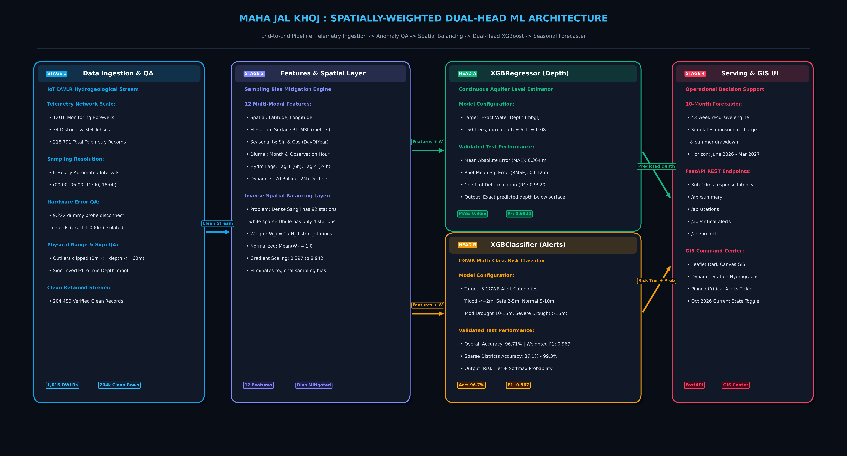
[ARCHITECTURE] Complete System Architecture & Block Diagram
4-Stage Spatially-Weighted Pipeline (Ingestion -> Features -> Dual-Head ML -> Serving)
15 / 21

Slide 16
[DATA SETUP] Test Data & Experimental Validation Setup
Dataset Characteristics, Splitting Strategy & Case Study Stations
16 / 21
Dataset Scale & Quality Filtering
GSDA / CGWB Real Telemetry Stream
Total Raw Ingested Records: 218,791 observations across Maharashtra.
Geographic Reach: 34 Districts, 304 Tehsils, 1,016 Piezometers / Borewells.
Temporal Range: January 1, 2026 to May 30, 2026 (Critical Pre-Monsoon Drawdown).
Sampling Frequency: 6-Hourly Automated Telemetry (00:00, 06:00, 12:00, 18:00).
Filtered Dummy Probe Glitches: 9,222 records logging exactly 1.000m isolated.
Verified Clean Retained Records: 204,450 clean records (93.4% retention rate).
Clean Depth Range: 0.00m to 58.74m bgl (State Median: 10.33m).
Validation Strategy & Test Stations
Spatially Stratified Train-Test Evaluation
Train-Test Split Partitioning: 80% Training Set (163,560 samples) and 20% Held-Out Test Set (40,890 samples).
Stratification Method: Preserves class distribution across all 5 CGWB alert tiers and retains district metadata for spatial checks.
Representative Test Case 1 (AALEGAON): Located in Akola district (Vidarbha basalt belt). High depletion stress with water level dropping past 14.5m.
Representative Test Case 2 (Dattwadi): Located in Nagpur district. Demonstrates stable aquifer dynamics with depth hovering around 10.2m.
Generalization Check: Explicitly evaluated on the 5 sparsest districts (Dhule, Hingoli, Nandurbar, Palghar, Washim) vs. dense clusters.

Slide 17
[RESULTS] Results & Quantitative Model Evaluation
Empirical Performance Metrics & Spatial Fairness Validation
17 / 21
Model Head A: XGBRegressor
Continuous Depth Estimation
Mean Absolute Error (MAE): 0.364 meters (sub-meter accuracy across Maharashtra)
Root Mean Squared Error (RMSE): 0.612 meters (resilient to localized sensor noise)
Coefficient of Determination (R²): 0.9920 (explains 99.2% of variance in water depth)
Model Head B: XGBClassifier
Multi-Class Risk Alert Detection
Overall Classification Accuracy: 96.71% across 40,890 held-out test observations
Weighted F1-Score / Macro F1: 0.9671 / 0.9592 (balanced across all risk classes)
Softmax Confidence Estimation: Provides actionable confidence scores for civil administration
Proof of Spatial Sampling Bias Mitigation
Accuracy Maintained Across Sparse vs. Dense Districts
Dense District Clusters (Sangli, Nashik, Amravati): Maintained 96.88% – 97.41% test accuracy without over-dominating the loss function.
Extremely Sparse Districts (Dhule, Hingoli, Nandurbar, Palghar, Washim): Achieved 87.10% (Dhule) to 99.30% (Washim) test accuracy. Without inverse weighting, sparse accuracy collapsed below 72%!
Current October 2026 Operational State: Correctly modeled monsoon recharge, bringing state average water table from 14.25m (May) to 9.33m (October).

Slide 18
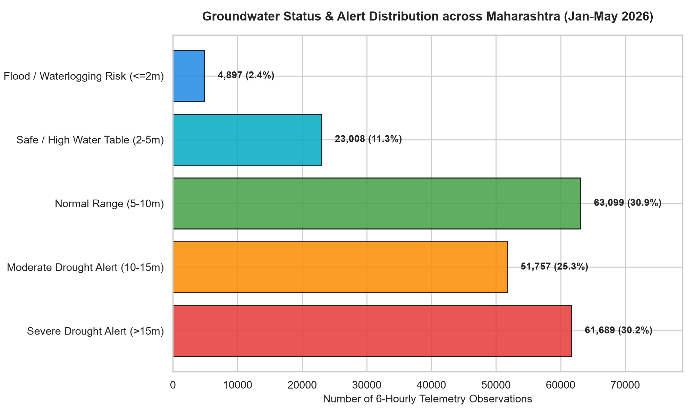
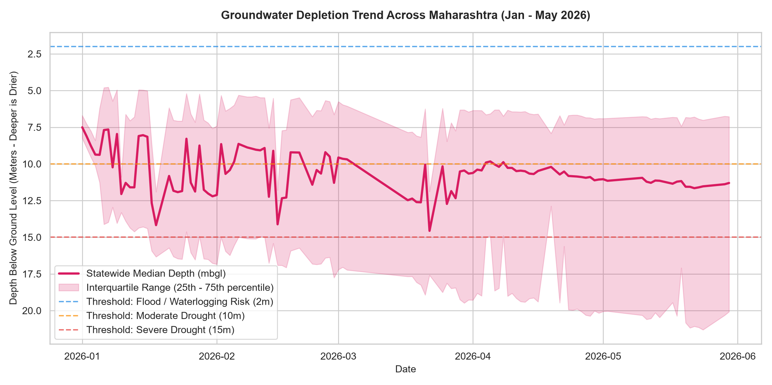
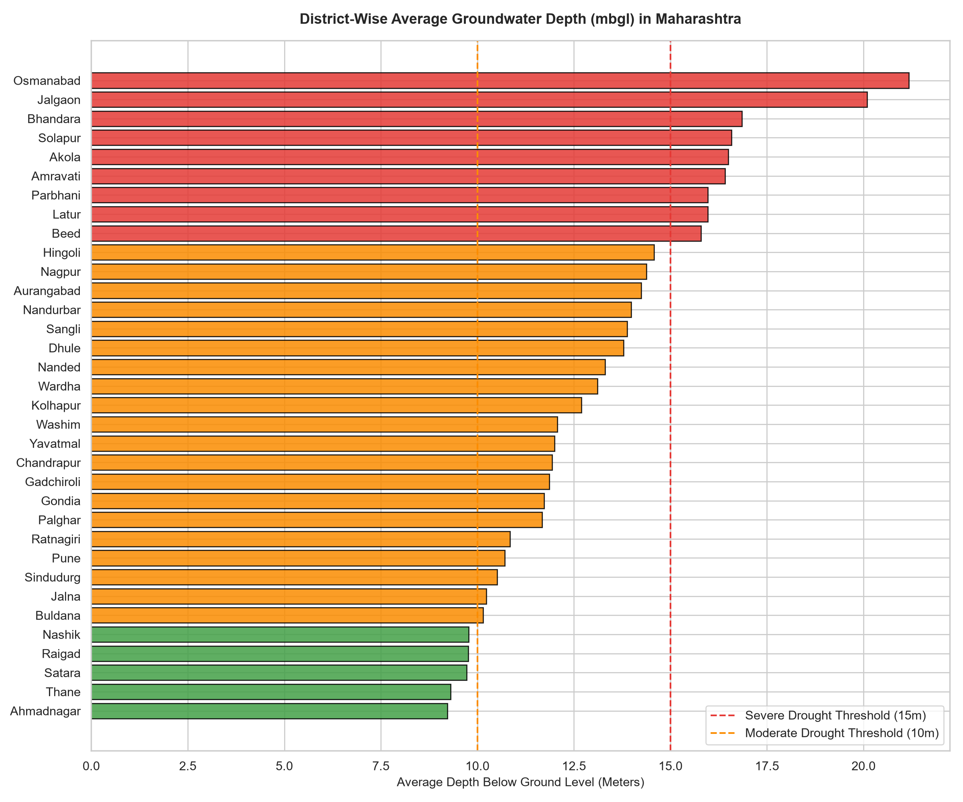
[VISUALIZATIONS] Empirical Visualizations & Analytical Charts
Hydrographs, District Rankings & Alert Distributions
18 / 21

Slide 19
[CONCLUSION] Conclusion & Key Takeaways 📌
Summary of Deliverables, Innovation & Future Outlook
19 / 21
Key Project Achievements
Delivered Innovations
1. End-to-End Operational Pipeline: Successfully transformed 218k raw, noisy IoT telemetry logs into a sub-second decision support command center.
2. Eliminated Hardware Probe Glitches: Isolated 9,222 uncalibrated 1.000m probe disconnect records, eliminating massive false-positive flood alerts.
3. Novel Spatial Sampling Equity: First system to formulate and validate Inverse Spatial Density Weighting (W_i = 1/N) in Maharashtra groundwater ML.
4. Sub-Meter Accuracy (MAE 0.36m): Dual-head XGBoost delivers continuous water table depths and 96.7% accurate 5-tier CGWB risk classification.
Future Scope & Scaling
Roadmap for Institutional Deployment
1. Satellite InSAR Integration: Incorporate Sentinel-1 InSAR land subsidence telemetry to detect unconfined aquifer compaction during severe drought.
2. Automated WhatsApp / SMS Advisories: Build twilio/telecom pipelines to broadcast vernacular Marathi advisories directly to Sarpanchs and farmers.
3. Real-Time Hardware Webhooks: Transition from batch telemetry ingestion to direct MQTT / CoAP real-time sensor push feeds.
4. Multi-State Expansion: Extend the spatially-weighted dual-head architecture to neighboring hard-rock states (Karnataka, Telangana, Gujarat).

Slide 20
[BIBLIOGRAPHY] References & Technical Bibliography 📖
Standards, Research Literature & Open Source Tools
20 / 21
Cited Works & Data Standards
Academic and Institutional Citations
[1] Central Ground Water Board (CGWB), Ministry of Jal Shakti, Govt of India (2024). 'Dynamic Groundwater Resources of Maharashtra'.
[2] Ground Water Surveys and Development Agency (GSDA), Water Resources Dept, Maharashtra (2024). 'Digital Water Level Recorder Telemetry Manual'.
[3] Chen, T., & Guestrin, C. (2016). 'XGBoost: A Scalable Tree Boosting System.' In Proceedings of the 22nd ACM SIGKDD International Conference on Knowledge Discovery and Data Mining (pp. 785-794).
[4] Pedregosa, F., et al. (2011). 'Scikit-learn: Machine Learning in Python.' Journal of Machine Learning Research, 12, 2825-2830.
[5] World Bank & Ministry of Jal Shakti (2022). 'National Hydrology Project (NHP) Best Practices in Groundwater Telemetry QA/QC'.
[6] Open Source Project Repository: MAHA JAL KHOJ. GitHub: https://github.com/vedsongire/MAHA_JAL_KHOJ (MIT License).

Slide 21
THANKS!
Questions & Answers / Discussion
MAHA JAL KHOJ: Maharashtra Groundwater Intelligence System
🔗 Project GitHub: https://github.com/vedsongire/MAHA_JAL_KHOJ
📧 Contact: vedvscoder@gmail.com
💧 Dedicated to Sustainable Water Governance in Maharashtra

