Slide 1

Note: The data and information in this document is reflective of a hypothetical situation and client. This document is to be used for KPMG Virtual Internship purposes only.
Sprocket Central Pty Ltd
Data analytics approach
[Division Name] - [Engagement Manager], [Ved Thakur], [Junior Consultant]

Slide 2
Note: The data and information in this document is reflective of a hypothetical situation and client. This document is to be used for KPMG Virtual Internship purposes only.
Agenda
Introduction
Data Exploration
Model Development
Interpretation

Slide 3
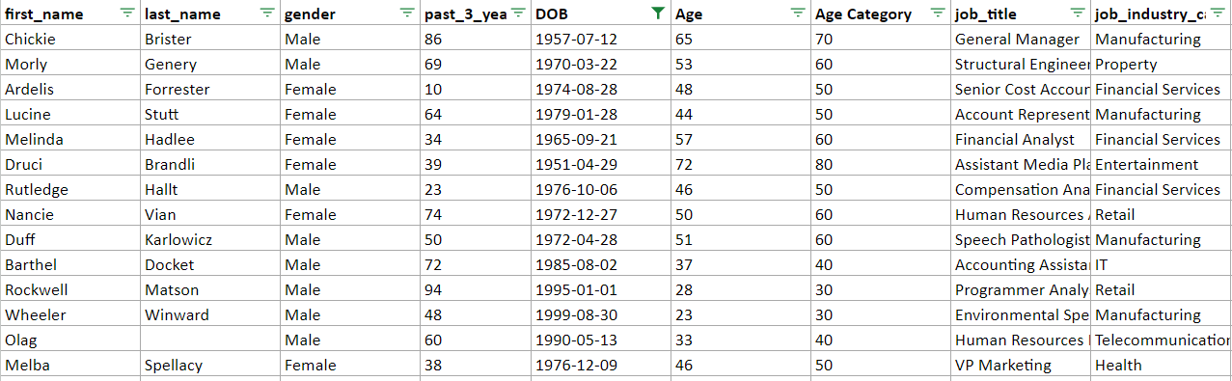
Note: The data and information in this document is reflective of a hypothetical situation and client. This document is to be used for KPMG Virtual Internship purposes only.
Introduction
Analysing which among the new 1000 customers should Sprocket Central Pvt Ltd. focus on
Sprocket Central Pvt Ltd. has requested to analyse the existing 3 datasets (Customer demographic, customer address and transactions) as a labeled dataset, and recommend which of the1000 new customers should be targeted to drive the most value for the organization.
The analysis including activities – i.e. understanding the data distributions, feature engineering, data transformations, modelling, results interpretation and reporting.
New customer list sheet

Slide 4
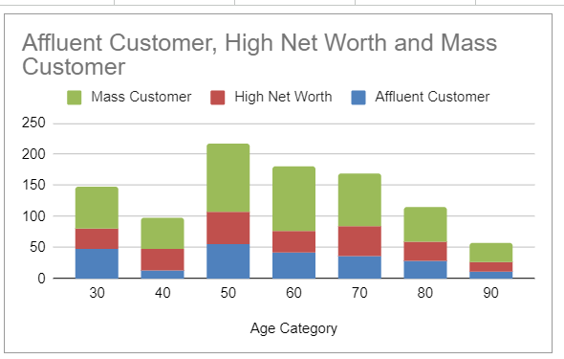
Note: The data and information in this document is reflective of a hypothetical situation and client. This document is to be used for KPMG Virtual Internship purposes only.
Data Exploration
Understanding the correct fields which affects the outcome of our model
Initially the data was cleaned. It was removed of all blank values, garbage value in some columns, etc. The values were also checked for their validity.
Later the tables are merged using consumer id as the primary key.
Once the tables are merged then several fields are analyzed to identify the fields which affect the profit. Several columns are changed into numeric/ categorical values. For instance the age column is changed into categories.
The profit column is calculated from the list price and the selling price columns. Further relationship among various is fields is deduced by first converting them into pivot tables and later using graphs to visualize them.
RFM model was also used for the purpose of exploration to find out, which category of customers must be targeted. For this the recency, frequency and monetary value was calculated
Relationships between fields like Age, purchases of bike vs Gender, cars vs state were derived and also analyzed.
The percentage of people working in a particular industry and also the wealth status of consumers with respect to their age was taken into account.

Slide 5
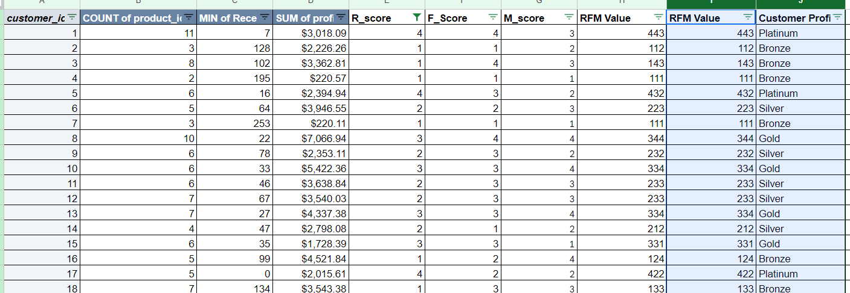
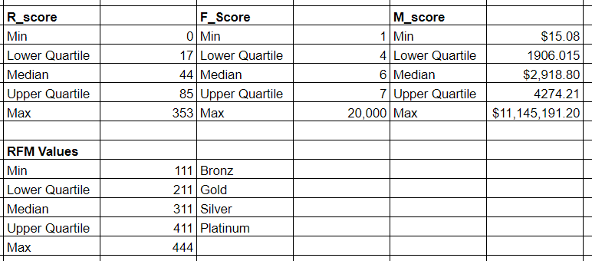
Note: The data and information in this document is reflective of a hypothetical situation and client. This document is to be used for KPMG Virtual Internship purposes only.
Model Development
Model was developed taking into account several fields which displayed peak results and performance in compared to others
RFM model was created for the purpose of identifying target customers based on values of their recency, frequency and monetary value. RFM model’s formula factors were derived using mean, median, and quartile values.
Pivot table were created from various other fields. Later these pivot tables were visualized in form of graphs to gain insightful results

Slide 6
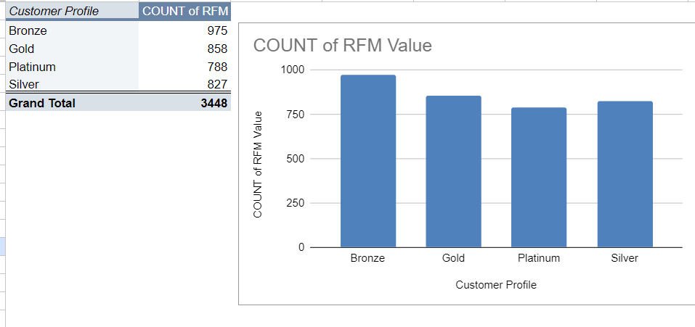
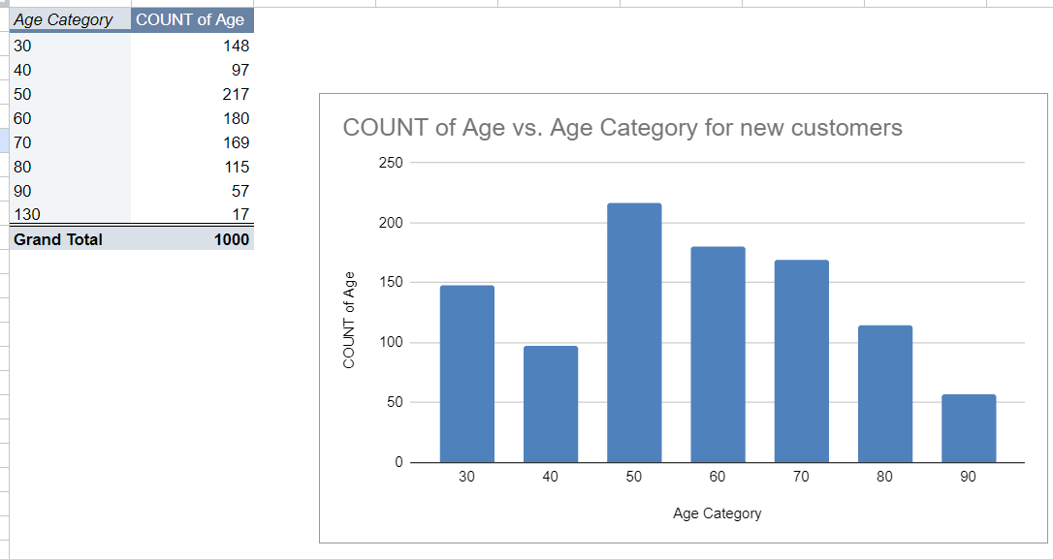
Note: The data and information in this document is reflective of a hypothetical situation and client. This document is to be used for KPMG Virtual Internship purposes only.
Interpretation
Data was interpreted by the use of graphs. Several graphs were created (column chart, pie chart) which assisted in understanding of the data in a better way.
Initially pivot tables were created of the columns which are to be analyzed.
Later these pivot tables were converted in various forms of graphs to better visualize the data and analyze it.
These graphs were analyzed to draw meaningful results and insights from it.

Slide 7
Note: The data and information in this document is reflective of a hypothetical situation and client. This document is to be used for KPMG Virtual Internship purposes only.
Appendix

Slide 8
Note: The data and information in this document is reflective of a hypothetical situation and client. This document is to be used for KPMG Virtual Internship purposes only.
References
https://www.omniconvert.com/blog/rfm-model/#:~:text=The%20RFM%20model%20is%20a,customer%20bought%20from%20your%20store.
https://support.microsoft.com/en-us/office/create-a-pivottable-to-analyze-worksheet-data-a9a84538-bfe9-40a9-a8e9-f99134456576
https://docs.google.com/spreadsheets/d/1yh0VMSCnIq3mbfKTyJsfSkD7TsmiQeQtbhLO8e_cwjA/edit?usp=sharing – Google sheet where all the analysis is done

