Slide 1
Concurrency

Slide 2
Objektif
Di akhir sesi, peserta diharapkan mampu untuk:
Memahami konsep thread
Menggunakan class thread Java
Menggunakan timer

Slide 3
Menu
Process vs thread,
Sub-tasking,
Implementing thread,
Examples
Referensi:
https://docs.oracle.com/javase/tutorial/essential/concurrency/index.html

Slide 4
Multi-programming & multi-processing
If a computer is powered by a single CPU, then it executes one single program. If it is multi-cores, then it is multi-programming.
Operating system schedules several to be run programs in a specific algorithm which makes a CPU do those simultaneously, this is called as multi-processing.

Slide 5
What is thread
A single process may have some sub-tasks to be done to make the process complete.
Traditionally, those sub-tasks are done sequentially from the first to the last.
If the first sub-task takes a very long time to done, the next sub-task must wait. It’s inefficient in terms of time.
To make it efficient, do those sub-task simultaneously using thread.

Slide 6
Example 1
Imagine a library with only one librarian and several visitors at a time. There will be a very long queue.
Remember, a librarian can only serve one visitor at a time. It is inefficient from the visitor’s perspective.
What if the library have several librarian ?

Slide 7
Example 2
Look at your body system, there is million smaller sub-tasks of living.
Your heart is beating, your stomach is digesting, your feet are stepping at a time! But still you have only ONE brain, don’t you ?
There is one single process, living, but there are several sub-tasks.

Slide 8
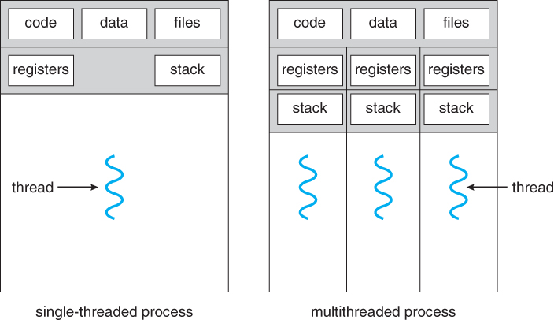
Process vs thread
Processes
A process has a self-contained execution environment. A process generally has a complete, private set of basic run-time resources; in particular, each process has its own memory space.
Processes are often seen as synonymous with programs or applications. However, what the user sees as a single application may in fact be a set of cooperating processes. To facilitate communication between processes, most operating systems support Inter Process Communication (IPC) resources, such as pipes and sockets. IPC is used not just for communication between processes on the same system, but processes on different systems.
Threads
Threads are sometimes called lightweight processes. Both processes and threads provide an execution environment, but creating a new thread requires fewer resources than creating a new process.
Threads exist within a process — every process has at least one. Threads share the process's resources, including memory and open files. This makes for efficient, but potentially problematic, communication.

Slide 9
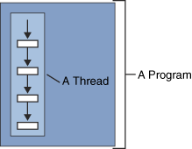
Multithreading
Definisi thread
A thread is a single sequential flow of control within a program

Slide 10
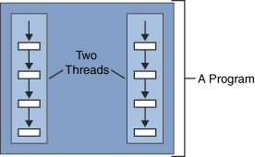
1 Program Banyak Thread
Satu program dapat memiliki banyak alur eksekusi

Slide 11
Sub-task separation
The very first step to do is decomposing a single process into some smaller tasks which are independent one to another.
These sub-tasks might interact one to another to share information.

Slide 12
Contoh Program yang memakai Thread
Web browser
Mendownload halaman web
Menggambar progress
Menampilkan halaman
Menangani input user
Messenger
Menerima input user
Menerima data dari user yang diajak chat
Menampilkan user

Slide 13
Kapan memakai Thread?
Pada aplikasi GUI
Agar aplikasi tidak tampak “hang” ketika melakukan pemrosesan lama (data besar, atau proses memang lama)
Aplikasi yang menangani banyak event dalam satu waktu
Server TCP/IP (Server Web, FTP)
Aplikasi asinkron
Chat

Slide 14
Implementation
Sub-tasks should run simultaneously to increase efficiency. To do this, use thread.
There is two ways to build a thread:
Inheriting the Thread class and override the run() method;
Implementing Runnable interface and override the run() method. This option is better in term of design.
Kapan men-subclass Thread dan kapan mengimplementasikan Runnable ?

Slide 15
Extending vs. Implementing
Mengimplementasikan interface Runnable
Class yang mengimplementasikan interface Runnable bisa extends dari superclass lain
Menurunkan (extend) dari kelas Thread
Subclass dari superclass Thread tidak bisa extends dari class lain lagi.

Slide 16
Thread sederhana
//File name: t1.java
public class T1 extends Thread {
String s; Random r = new Random();
public T1(String str) {
s = str;
}
public void run() {
while (true) {
System.out.println(s);
try { Thread.sleep(r.nextInt(1000)); }
catch (Exception e) {}
}
}
}

Slide 17
Loop dalam thread
Dalam contoh yang diberikan di sini, akan selalu digunakan infinite loop (dengan while (true) ) untuk menunjukan kehidupan thread
Thread tidak harus memakai infinite loop (cukup melakukan pekerjaan yang dibutuhkan sampai selesai)

Slide 18
public class TwoThreadsTest {
public static void main (String[] args) {
new T1("Jamaica").start();
new T1("Fiji").start();
}
}
Akan muncul “Jamaica” dan “Fiji” bergantian
Jalankan program

Slide 19
Thread.sleep(int)
Delay dalam kasus ini agar output lebih terlihat
Agar lebih jelas, delay dibuat random
Delay yang fix akan membuat tampilan Thread berselang seling

Slide 20
Memakai Interface Runnable
import java.util.Random;
public class T2 implements Runnable {
String s;
Random r = new Random();
public T2(String str) {
s = str;
}
public void run() {
while (true) {
System.out.println(s);
try { Thread.sleep(r.nextInt(1000)); } catch (Exception e) {}
}
}
}

Slide 21
public class TwoThreadsTest2 {
public static void main (String[] args) {
new Thread (new T2("Jamaica")).start();
new Thread (new T2("Fiji")).start();
}
}
Perhatikan bahwa Thread perlu diciptakan
Akan muncul “Jamaica” dan “Fiji” bergantian

Slide 22
Contoh Lain: Extending Thread class
public class ExtendingThread extends Thread {
private static int SLEEP_TIME = 500;
public void run() {
boolean isRunning = true;
int loop = 10;
while (isRunning && loop > 0) {
try {
sleep(SLEEP_TIME);
System.out.println("count down: " + loop--);
} catch (InterruptedException _ie) {
isRunning = false;
}
}
}
}

Slide 23
Contoh Lain: Implementing Runnable interface
public class ImplementingRunnable implements Runnable {
private static int SLEEP_TIME = 300;
public void run() {
boolean isRunning = true;
int loop = 10;
char c = 'A';
while (isRunning && loop > 0) {
try {
sleep(SLEEP_TIME);
System.out.println("it is: " + c++);
loop--;
} catch (InterruptedException _ie) {
System.out.println("something is wrong");
isRunning = false;
}
}
}
}

Slide 24
Timer
Selain Thread, Java menyediakan Timer
Timer bisa digunakan untuk menjadwalkan pekerjaan
Tidak perlu membuat thread terpisah
Menyederhanakan kasus tertentu
Apa yang bisa dilakukan oleh Timer bisa dilakukan oleh Thread

Slide 25
Menjadwalkan pekerjaan
Suatu pekerjaan bisa dijadwalkan agar berjalan di suatu waktu di masa depan
Ada “sesuatu” (Timer) di latar belakang yang menghitung sampai waktu yang ditentukan
Menggunakan kelas TimerTask dan Timer di java.util
import java.util.TimerTask;
import java.util.Timer;
Membuat kelas turunan TimerTask

Slide 26
Memakai Timer
public class Reminder {
Timer timer;
public Reminder(int seconds) {
timer = new Timer();
timer.schedule(new RemindTask(), seconds*1000);
}
/* Kelas berikut adalah kelas internal */
/* Kelas ini berisi pekerjaan yang akan dilakukan */
class RemindTask extends TimerTask {
public void run() {
System.out.println("Time's up!");
timer.cancel(); //Terminate the timer thread
}
}

Slide 27
public static void main(String args[]) {
new Reminder(5);
System.out.println("Task scheduled.");
}
}
Jalankan program

Slide 28
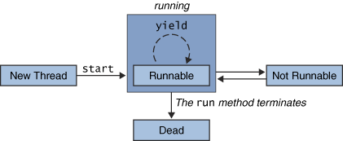
Siklus Hidup Thread
Thread hidup selama method run masih berjalan

Slide 29
Thread bisa berhenti sementara
Thread bisa disuspend karena 3 hal
Menunggu I/O
Membaca dari jaringan atau dari disk
Method sleep dipanggil untuk thread tersebut
Thread akan berhenti selama waktu sleep
Menunggu event karena pemanggilan wait
Akan dijelaskan pada sinkronisasi thread

Slide 30
Thread Priority/Scheduling
Thread bisa diberi prioritas berbeda
dari konstruktor
dengan method setPriority()
Thread yang lebih tinggi prioritasnya lebih sering dieksekusi.
Umumnya berarti akan lebih cepat selesai

Slide 31
Problem: synchronization [1]
Remember the previous library example ?
When a visitor ask for borrowing a book, a librarian log the transaction on a log book for future tracing purpose.
What will happen, if there are several librarians serve some visitors at a time, and keep in mind that they must log the transaction at the same time as it is a simultaneous ?

Slide 32
Problem: synchronization [2]
There is only one log book but several requests to write transaction log.
If those librarian log the transaction at once, some might be lost because of overwritten.
This is called a critical section, when a resource is accessed by several different tasks at once.
A synchronization mechanism is required.

Slide 33
Synchronization
To deal with the problem, Java provides a synchronized keyword which handles the critical section and manage which task can hold the privilege to access the resource when other tasks wait.
We may set a method as a critical section by giving it a synchronized keyword, a part (a block) of a method, or even a variable.

Slide 34
E O F
“Multi-threading is like thinking,
walking and talking at the same time.”

