Slide 1
Cookies, session & page redirection
Presented by TNT

Slide 2
Menu
Web stateless,
Cookies,
Session,
Page redirection.

Slide 3
Web stateless
Web technology runs on HTTP protocol over the TCP/IP, this situation makes each request has no relation, stateless.
Web server assumes each request is a single independent request & no state is persisted.
In contrast, there is a need to store certain information related to the interaction between the web and its client.

Slide 4
Cookie: overview
The requirement of storing client’s information (state) is solved through cookies, a mechanism to maintain state on the client’s side.
Cookie is a pair of string (name => value)which is stored persistently on the client side.
An URL is associated with each cookie, used by the client to determine if it should send the cookie to the server during the request.

Slide 5
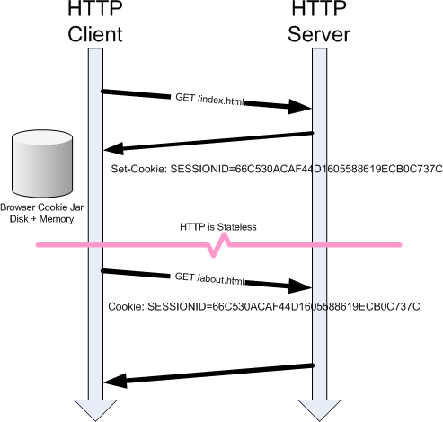
How Cookie works?

Slide 6
Cookie: syntax
bool setcookie (
string $name
[, string $value
[, int $expire = 0
[, string $path
[, string $domain
[, bool $secure = false
[, bool $httponly = false ]]]]]]
);

Slide 7
Cookie: concern & limitation
Concern & limitation :
a browser is restricted to 300 cookies, 20 per server (domain) with 4 KB maximum size.
Stored in the client disk, cookies become vulnerable to be stolen. Thus, it is a good practice to avoid storing private & sensitive information in it.
Cookie is sent as a part of the HTTP header, thus it must be sent before any other text.

Slide 8
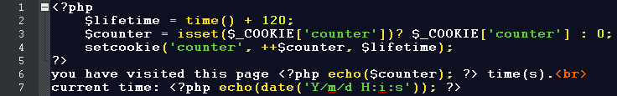
Cookie in detail [1]
name: as the cookie identifier,
value: could be anything but keep in mind 4 KB at max for each domain.
expire: when the cookie will be expired (in seconds format), until the browser closes is the default. use the time and mktime functions.

Slide 9
Cookie in detail [2]
path: directory where the cookie available.
domain: the domain or sub-domain which the cookie available for.
secure: will the cookie be sent over the secure protocol (https).
httponly: if only HTTP may access the cookie, JavaScript will not be able to access the cookie.

Slide 10
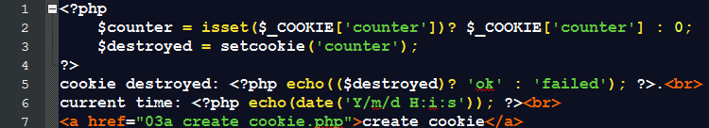
Cookie: destroy
To remove a cookie, use the setcookie() function with just cookie name and no value.

Slide 11
Session: overview [1]
Is another option to store information due to the stateless-ness of the web technology.
Session lives in the server’s memory, with no limit in term of number & size.
Logically, session offers a better security and faster in processing, why ?

Slide 12

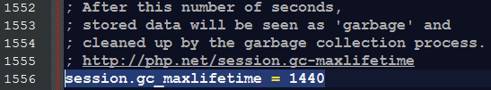
Session: overview [2]
To use session, you have to start it:
Using the session_start function (local), or
Set the php.ini to start session automatically (affects the entire web).
Register the session with identifier and value.
The session variable is ready to use.

Slide 13
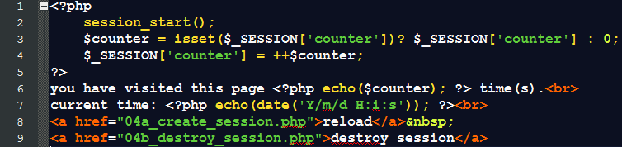
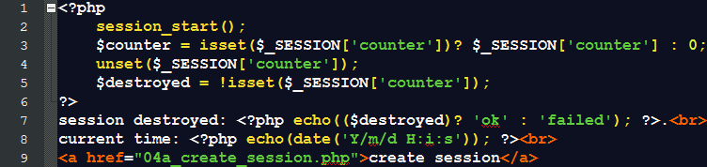
Session: create, use & destroy
To create session, use the $_SESSION variable.
To destroy a session, use the unset() function.

Slide 14
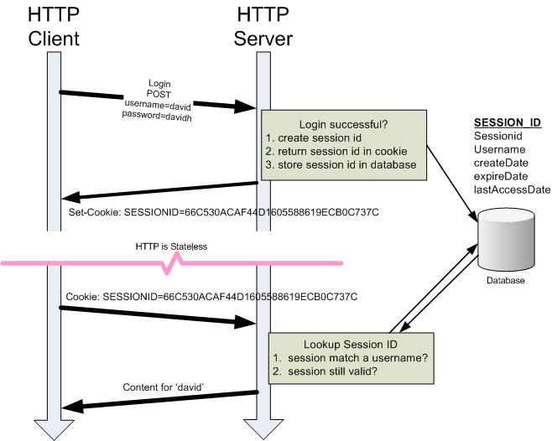
How Cookies and Session work?

Slide 15
Page redirection
Is a mechanism to send the client (browser) to another resource (like: page, site, or document).
Mostly doesn’t have any output.
Achieved by using :
PHP’s header() function or
JavaScript.

Slide 16
Page redirection: header()
void header ( $url [,
$replace = true [,
$http_response_code]] );
This function must be called right before any actual output is sent, either by normal HTML tags, blank lines in a file, or from PHP.

Slide 17
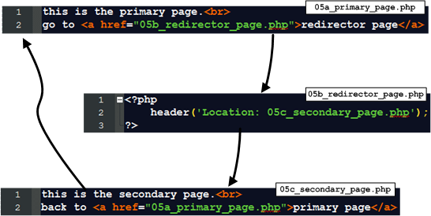
Page redirection: header()

Slide 18
Page redirection: JavaScript
Mostly preferred.
Browser’s JavaScript may be disabled.
<SCRIPT LANGUAGE='JavaScript'>
document.location=“another_page.php”
</SCRIPT>
.

Slide 19
Task
What are the differences between Stateful and Stateless?
When does the best time we use cookies?
Is it okay to store any particularly sensitive information by using cookies? Explain!
If your answer is yes in the previous question, how to handle that problem?

Slide 20
E O F
“Every program has (at least) two purposes: the one for which it was written
and another for which it wasn't.” ― Alan Jay Perlis

