Slide 1
Stages in Snowflake by Janardhan Bandi

Slide 2
Agenda
What is a Stage?
Stage Types
External Stages
Internal Stages
Data load from Stages

Slide 3
What is a Stage?
A stage specifies where data files are stored (i.e. “staged”) so that the data in the files can be loaded into a table.
Stage is a location of files, that can be internal or external to snowflake

Slide 4
Stage Types
External Stages
Internal Stages
User Internal Stage
Table Internal Stage
Named Internal Stage

Slide 5
External Stages
An external stage is the external cloud storage location where data files are stored.
Loading data from any of the following cloud storage services is supported regardless of the cloud platform that hosts your Snowflake account:
Amazon S3
Google Cloud Storage
Microsoft Azure

Slide 6
External Stages
An external stage is a database object created in a schema.
This object stores the URL to files in cloud storage.
Also stores the settings used to access the cloud storage account (Storage Integration Object).
Create stages using the CREATE STAGE command.
CREATE OR REPLACE STAGE MYDB.external_stages.sample_stage
url='s3://bucketsnowflakes3';

Slide 7
Internal Stages
3 Types of Internal Stages:
User Stage
Table Stage
Named Internal Stage

Slide 8
User Stage (@~)
A user stage is allocated to each user for storing files.
To store files that are staged and managed by a single user but can be loaded into multiple tables.
User stages cannot be altered or dropped.
This option is not appropriate if multiple users require access to the files.

Slide 9
Table Stage (@%)
A table stage is available for each table created in Snowflake.
Table stages have the same name as the table.
e.g. a table named mytable has a stage referenced as @%mytable
To store files that are staged and managed by one or more users but only loaded into a single table.
Table stages cannot be altered or dropped.
Note that a table stage is not a separate database object, rather it is an implicit stage tied to the table itself.

Slide 10
Named Internal Stage (@)
A named internal stage is a database object created in a schema
To store files that are staged and managed by one or more users and loaded into one or more tables.
Create stages using the CREATE STAGE command (similar to external stages)
CREATE OR REPLACE STAGE MYDB.internal_stages.sample_stage

Slide 11
Staging Data Files from a Local File System
Linux or macOS:
put file:///data/data.csv @~/staged;
put file:///data/data.csv @%mytable;
put file:///data/data.csv @my_stage;
Windows:
put file://c:\data\data.csv @~/staged;
put file://c:\data\data.csv @%mytable;
put file://c:\data\data.csv @my_stage;
Listing Files:
list @~;
list @%mytable;
list @my_stage;

Slide 12
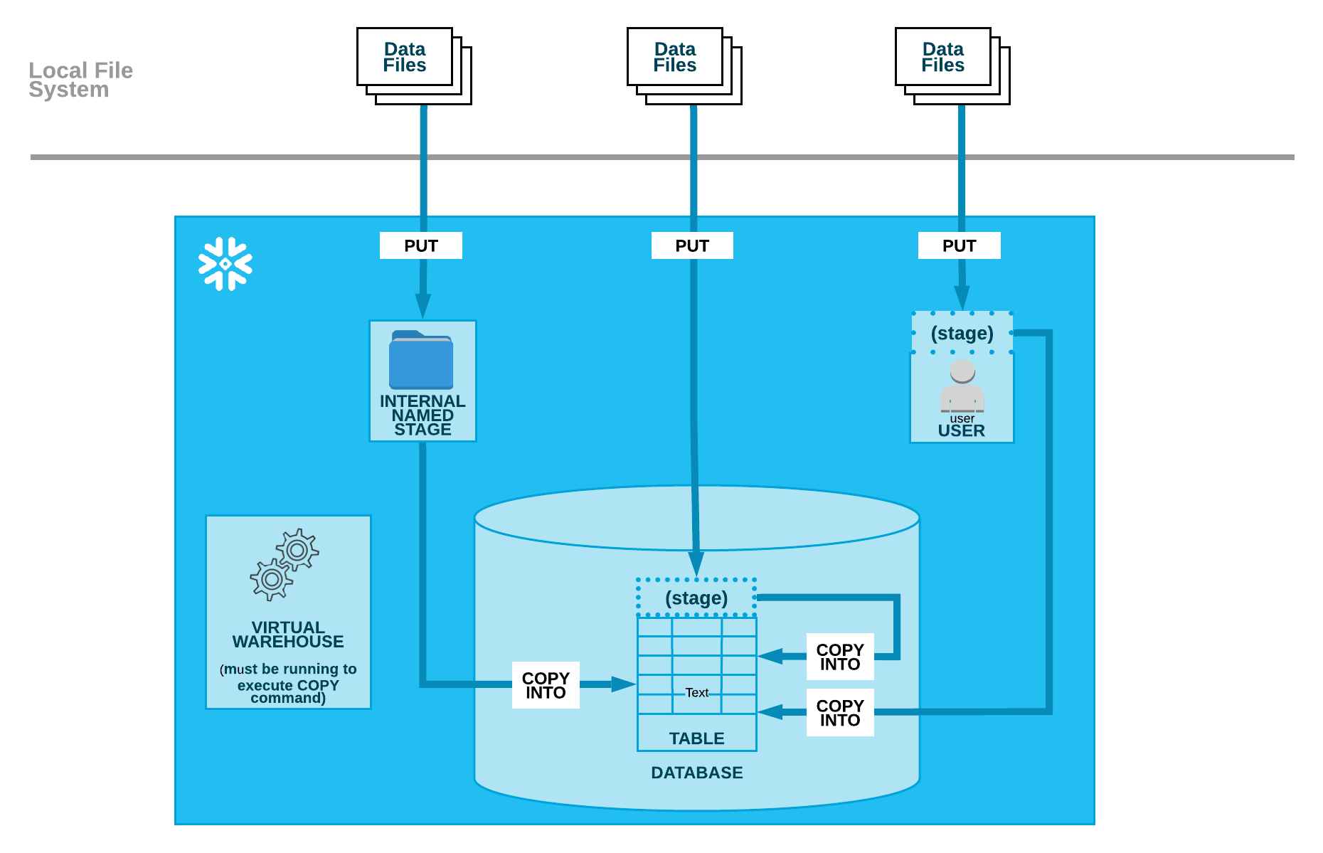

Slide 13
AWS
SF
IAM
External Stage
S3
Storage Integration
Copy

Slide 14
Copying data from Internal stage
User Stage:
To Load all files prefixed with staged in your user stage,
copy into mytable from @~/staged
file_format = (type = csv field_delimiter = '|' skip_header = 1);
Table Stage:
To load all files in the stage for the customer table,
copy into mytable from @%customer
file_format = (format_name = my_csv_format);

Slide 15
Copying data from Internal stage
Named Stage:
To load all files from the my_stage named stage,
copy into mytable from @my_stage;
Note that a file format does not need to be specified because it is included in the stage definition.

Slide 16
Thank You

