Slide 1

CAPSTONE PROJECT JAVA
RENTAL CAR
FLEET MANAGER
V. Sai Charan (2620040062)
V.S.R.V Sathwik (2620040073)
Notes:
This project presents the operational role of a rental car fleet manager, from procurement and maintenance to logistics, finance and technology.

Slide 2

ABSTRACT
A fleet manager connects the whole rental business.
A Car Rental Fleet Manager is the operational backbone of a rental business, connecting logistics, financial planning, asset management and customer experience.
The manager keeps the fleet optimized, well-maintained, cost-effective and aligned with market demand.
Key responsibilities include fleet procurement and lifecycle management, preventive maintenance, safety, vehicle allocation between branches, financial planning and cost control.
Fleet Management Software and telematics help monitor GPS location, fuel levels, vehicle usage, diagnostics and maintenance records while supporting compliance with registration, insurance, emissions and transport requirements.
Smart asset management turns vehicle inventory into a profitable service.
Notes:
Frame the fleet manager as the operational backbone. The role connects vehicles, people, costs, customer demand and compliance into one operating system.

Slide 3






REAL-WORLD CONTEXT · JAVA RENTAL MANAGEMENT
END-TO-END LIFECYCLE OF A RENTAL CAR
The full vehicle journey, with our Java project focused on the rental loop.
Java project scope: rental management
Vehicle acquisition
Maintenance & inspection
Search cars, check availability, rent a car, return it, and calculate rental cost.
Purchase or lease enters the fleet.
Service and check roadworthiness.
Outside the current program
Vehicle purchasing, maintenance, and end-of-life disposal are real-world context—not managed by this Java project.
Available for rental
Customer rental
Ready cars are listed for customers.
Search, check availability, and rent.
Rental loop: available → rent → return → available.
The project manages the customer rental transaction, not the entire fleet operation.
Vehicle return
Inspect / maintain
Record the car coming back.
Check condition before the next use.
Next rental or end of life
Acquisition → service → available → rent → return → inspect → repeat or retire
Notes:
Use the full lifecycle as context, then narrow the audience's attention to the rental-management stage: searching, availability, renting, returning, and rental-cost calculation. Purchasing, maintenance, and disposal are outside the current Java program.

Slide 4


JAVA PROJECT · RENTAL FLEET MANAGER
WHY A COMPUTERIZED SYSTEM IS NEEDED
01
Manual management is difficult. Managing multiple rental cars by hand can be confusing and error-prone.
02
Availability must be clear. Staff need an efficient way to know which cars are available, rented or unavailable.
01
03
Updates take time. Searching for cars and updating rental status manually slows down daily operations.
04
One organized system helps. A computerized system can simplify these operations and keep information organized.
PROBLEM STATEMENT
Rental operations become harder to manage as the number of cars grows.
Notes:
Managing a growing rental fleet manually makes it difficult to track availability, find the right car quickly and keep rental status current. This project addresses that problem with a computerized system that organizes these operations.

Slide 5

02 · OBJECTIVES
RENTAL CAR FLEET MANAGER
01
02
03
Manage vehicle information
Search for cars quickly
Track car availability
Keep car details organized and up to date.
Find the right vehicle with fast search.
See which cars are ready to rent.
04
05
06
Rent and return vehicles
Calculate rental costs
Update Vehicle Status
Manage each rental from checkout to return.
Generate accurate charges for every rental.
Automatically update a car’s availability after renting or returning it.
Notes:
Introduce the six core objectives of the Java Rental Car Fleet Manager: organize vehicle information, find and track cars, manage rentals and returns, calculate charges, and keep vehicle status current automatically.

Slide 6


03 · JAVA IMPLEMENTATION
03
JAVA IMPLEMENTATION
Java Concepts Used in Rental Car Fleet Manager
Notes:
This section introduces the Java implementation behind the rental car fleet manager, connecting core Java concepts to the system's practical design.

Slide 7
JAVA IMPLEMENTATION
JAVA CONCEPTS USED — CO1, CO2 & CO3
CO1
CO2
CO3
Programming Fundamentals
Control Structures
Methods & Arrays
if-else / else-if
for loop
do-while loop
Relational and logical operators
switch statement
User-defined methods
1D arrays
Passing arrays to methods
Data Types — int, double, String, boolean
Algorithm
Flowchart
Notes:
Explain the implementation in three layers: foundational data and logic, the control structures that guide decisions and repetition, and reusable methods working with arrays. The slide intentionally focuses only on concepts used in the current Java implementation.

Slide 8
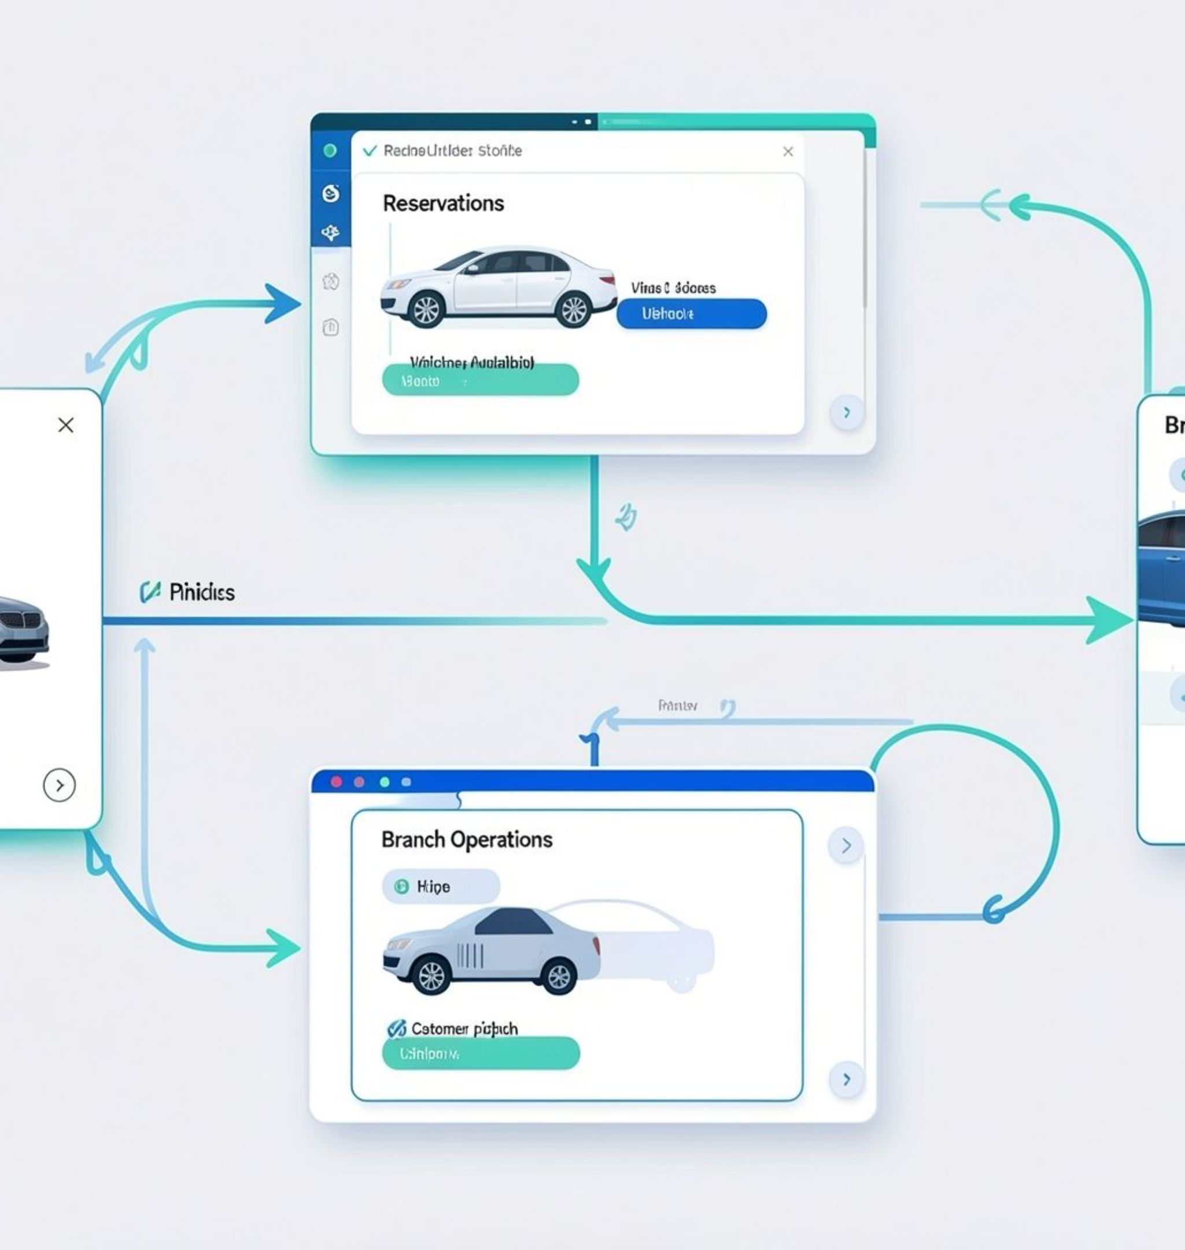

04 · SYSTEM WORKFLOW
04
SYSTEM WORKFLOW
How the Rental Car Fleet Manager Works.
Notes:
Allocation is the connection between demand and vehicle availability. The manager uses reservation patterns to move vehicles between branches, airports and urban hubs without creating shortages elsewhere.

Slide 9

JAVA PROJECT · RENTAL CAR FLEET MANAGER
SYSTEM WORKFLOW
Start
↓
Display Main Menu
↓
User Selects an Operation
↓
Display Cars / Search Car / Rent Car / Return Car
↓
Validate Input & Check Availability
↓
Update Car Status
↓
Display Result
↓
Return to Main Menu
↓
Exit when the user selects 5
Car availability is updated after every rental or return.
Notes:
Walk through the Java application's menu-driven flow: the user selects an operation, the system validates input and availability, updates the car status, displays the result, and returns to the main menu. Selecting 5 exits the program.

Slide 10



05 · CONCLUSION
Conclusion
Rental Car Fleet Manager simplifies basic car-rental operations.
Users can display, search, rent, and return cars.
Car availability updates automatically after rental and return.
Demonstrates Java concepts from CO1, CO2, and CO3.
05
Future Scope
CONCLUSION & FUTURE SCOPE
Database integration for larger fleets
GUI-based rental management
Online booking and customer management
Payment integration
Real-time fleet tracking
Practical Java concepts applied to rental car operations.
Notes:
Conclude by connecting the Java concepts to a practical rental car management system, then distinguish the proposed future improvements from the functionality already implemented.

