Slide 1

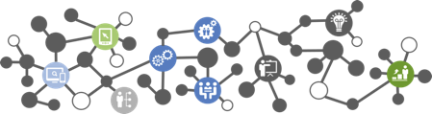
Cloud Bootcamp
June 6, 2017

Slide 2
Agenda
What is Cloud Computing?
Evolution of Cloud Computing
Cloud Computing Architecture
Fundamental Cloud Services
Cloud Computing Deployment Models
Why learn about Cloud?
Conclusion

Slide 3
What is Cloud Computing
Cloud computing is Internet-based computing, whereby shared resources, software, and information are provided to computers and other devices on demand, like the electricity grid.
Cloud computing is a paradigm shift following the shift from mainframe to client-server in the early 1980s. Details are abstracted from the users, who no longer have need for expertise in, or control over, the technology infrastructure “in the cloud” that supports them.
According to Wikipedia – A style of computing in which dynamically scalable and often virtualized resources are provided as a service over the Internet.

Slide 4
Evolution of Cloud Computing
1950s: It was a gradual evolution that started with mainframe computing.
1970s: The concept of virtual machines (VMs) was created.
1990s: Telecom companies started offering virtualized private network connections.
2002: Amazon launches Amazon Web Services (AWS)
2006: Google Docs, Amazon Elastic Compute Cloud (EC2)
2008: Google App Engine Launched
2009: Microsoft Azure
2009: Cloud Foundry was originally conceived by VMWare
Grid Computing: Solving large problems with parallel computing
Utility computing: Offering computing resources as a metered service
SaaS: Network-based subscriptions to applications
Cloud computing: Anytime, anywhere access to IT resources delivered dynamically as a service
Notes:
The target is networked servers, but it's a great general-purpose language.
SPDY (pronounced speedy)^{[1]} is an open networking protocol developed primarily at Google for transporting web content.^{[1]} SPDY manipulates HTTP traffic, with particular goals of reducing web page load latency and improving web security. SPDY achieves reduced latency through compression, multiplexing, and prioritization.
The name "SPDY" is a trademark^{[5]} of Google and is not an acronym.^{[6]}

Slide 5
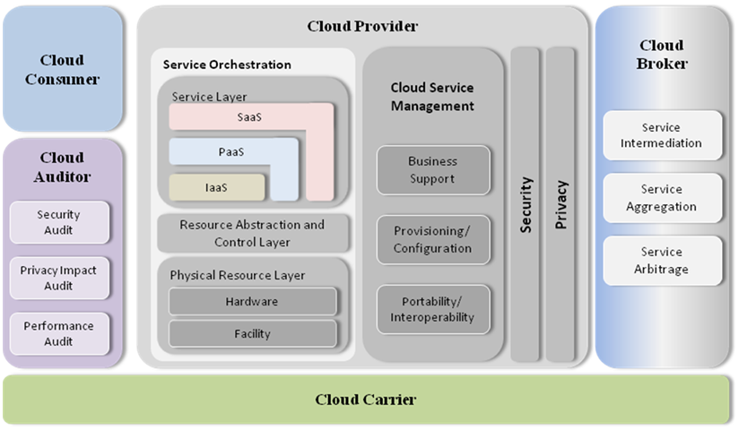
Cloud Computing Architecture
Notes:
Go is a programming language designed by Google to help solve Google's problems.
- Go was designed by and for people who write—and read and debug and maintain—large software systems.
- Go's purpose is not research into programming language design, but to make its designers' programming lives better
- GO is a small language, it is lightweight, readable. It is structurally typed and object oriented, that means, objects that implements set of methods satisfy any interface that specifies those methods. Interfaces are specified implicitly and this gives lots of opportunities to de-couple primitives. In GO you can write straight-forward code, the way you would in synchronous style, but you would get performance benefits in asynchronous model. So, you don’t need to break you code up in callbacks. Finally, it is not written for language academics, it is written for working programmers. It was released in 2012

Slide 6
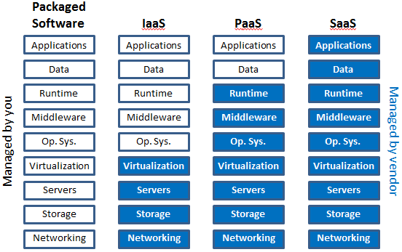
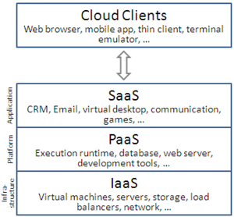
Fundamental Cloud Services
Notes:
GO has extensive line of libraries. It covers everything from compression to http, formats, cryptography
In GO, package is a unit of code. Package contains types, functions, variable and constant declaration. They can vary from being very small, ex. Errors package has just 1 declaration, to a very large, ex. http has > 100 declarations. Packages basically help in making GO a flexible and convenient way to encapsulate GO code. Public, private boundary is at the package level. Case determines visibility. For ex. Foo is exported and foo (beginning with lower case f) is not. So, by looking at the case anywhere in the code, you can determine if it is an external part of public interface or a point of implementation detail
Io package provides primitive io interface
net/http implements server and a client. If you have used Chrome, you have used this package.

Slide 7
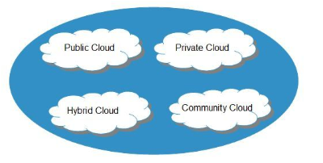
Cloud Computing Deployment Models
Notes:
Java is a fantastic language for large-scale, large-team enterprise projects. However, Java requires a fair amount of overhead to spin-up and deploy a new application, and its verbose nature can make it a poor fit for small projects or one-off utility tasks.

Slide 8
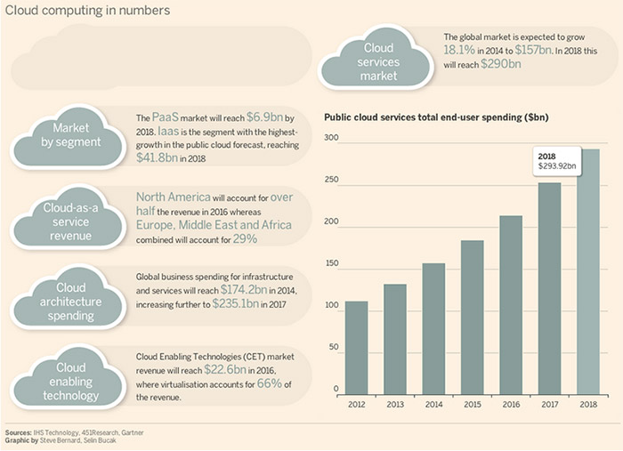
Why learn about Cloud Computing
Notes:
Michael Cook, a GO developer compared GO and Java
A total of 1800 EPUB3 files were processed, varying in size from about 100KB to 5MB, with most word counts being between 30,000 and 500,000, all of which was performed on a Macbook Air.
This report shows the user CPU time, system CPU time, the sum of the user and system CPU times, and the elapsed real time. The unit of time is seconds.
Nobody really expected the Java warmup penalty to be so severe! Java is certainly a fast language, but because of the simplicity of this test, the JVM just didn’t have enough time to optimize the code.
but to get a better comparison, he updated the Java and Go programs to iterate and process the ebooks natively, and you can see the results in the second table
- As you can see for simple tasks like this, Java is actually many times slower, but once you give it a good chunk of work to do, it can really fly.
- My conclusion is that for small tasks - image resizing would fall into this category - especially when you have large numbers of files that you’ll be calling individually from your web app then Go is very much the better choice than Java.

Slide 9
Why learn about Cloud Computing
Cloud Computing is changing your job….
It’s creating new jobs as well…
The link between business and IT is growing ever tighter
Certifications are the key to the doors of the Cloud Computing Industry.

Slide 10
Conclusion
Pros
Lower upfront costs and reduced infrastructure costs.
Easy to grow your applications.
Scale up or down at short notice.
Only pay for what you use.
Everything managed under SLAs.
Overall environmental
Cons
Higher ongoing operating costs.
Greater dependency on service providers.
Risk of being locked into contracts
Risk of stoppage in product support
Potential privacy and security
Dependency on a reliable Internet connection.

