Slide 1
Docker
July 21, 2017

Slide 2
Agenda
History
Containers vs. Virtual Machines
Docker containers
Docker basic concepts
Installing Docker on Windows
Installing Docker on Mac OS
Run Hello World (Existing image)
Run Hello World (create new image)
Swarm Mode Theory

Slide 3
History
In 1990s, deploying a new application needed new hardware
Issues were
Procurement lead times
Upfront capex
Ongoing opex
Then came VMWare, with its Hyperization-Virtualization model using Hypervisors multiple applications could be deployed on a single server
Each operating system runs on a VM that is a slice of the physical server resources (Slice of CPU, Memory and Disk Space)
Each OS needed individual licenses for the OS
Each OS then needs time for maintenance, for example applying OS patches, upgrades etc.
Then came containers, which run on one OS, which addressed most of the issues that came with VMWare

Slide 4
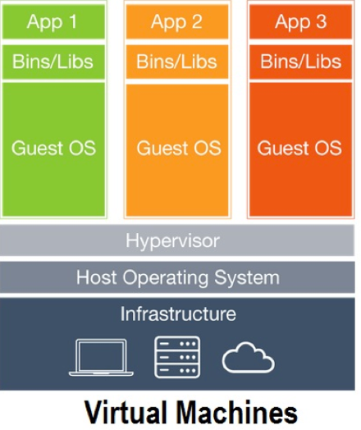
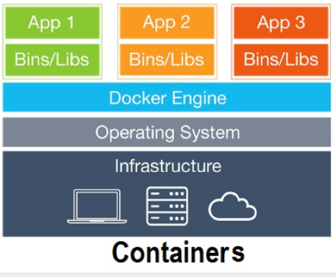
Containers vs. Virtual Machines
Containers do not bundle a full operating system and thus are more light weight than VMs
Containers include only libraries and settings to make the software work as needed
Consume lesser space than a OS
Can deploy more apps
Faster start ups, apps can spin up usually in less than a second
VMs slice and dice physical server resources where as the containers slice and dice the operating system resources like process name space, network stack and file system hierarchy

Slide 5
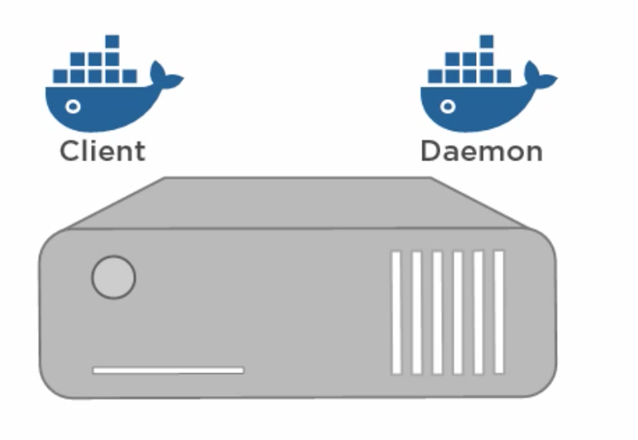
Docker containers
Docker is one of the world’s leading software container platforms
Docker automates the repetitive tasks of setting up and configuring development environments,
This is a huge advantage to developers as they can focus on building great software
Onboarding new team members becomes easier
A standard Docker install gives you the client and the daemon on the same host
Images – These are like templates, an image can be used to start a new container
Containers – These are running images

Slide 6
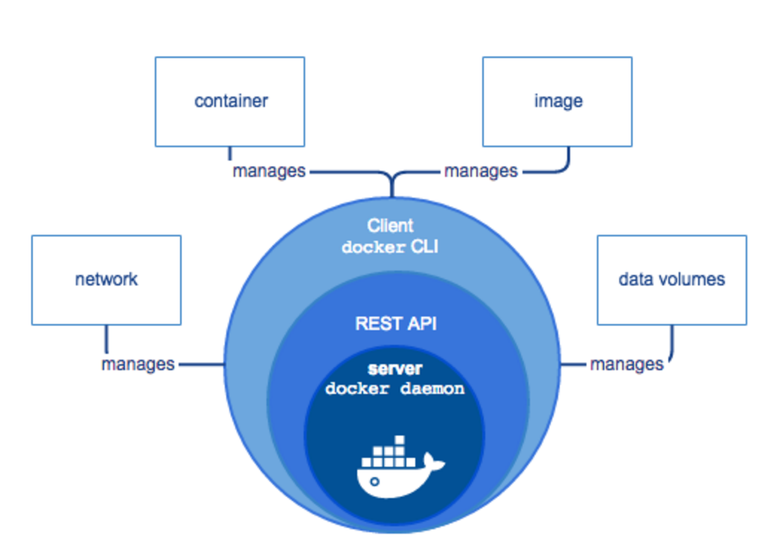
Docker containers
The CLI uses the Docker REST API to control or interact with the Docker daemon through scripting or direct CLI commands. Many other Docker applications use the underlying API and CLI.
The daemon creates and manages Docker objects, such as images, containers, networks, and volumes.

Slide 7
Installing docker on windows
Requirements
Windows 10
64 bit only
Installation
Turn on the windows feature Hyper-V ON
Restart Windows
Hyper-V not running – Restart and enter the BIOS mode on your machine and turn on the Hardware-assisted virtualization and data execution protection
For Windows 10 click on the link below to download the installer
https://download.docker.com/win/stable/InstallDocker.msi
Download the Docker installation file
Double click on InstallDocker.msi
Accept the term and Conditions and continue with installation
Once the installation is complete, Docker starts automatically , the whale in the notification area indicates a successful install and that docker is running
Open a Command prompt and type <docker version>

Slide 8
Installing docker on MAC
Requirements
Mac hardware from 2010 or later
OS X 10.3.3 or newer
Installation
Click on the link below to download the installer
https://download.docker.com/mac/stable/Docker.dmg
Download the Docker installation file
Complete the installation by dragging the installer into the Application folder
Open a terminal window and type <docker version>

Slide 9
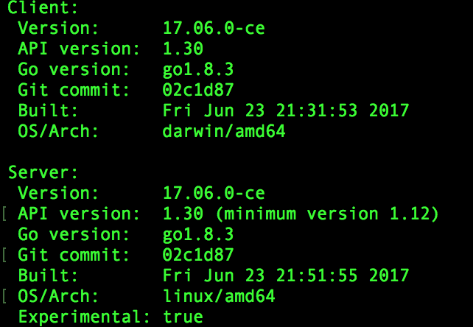
Exercise1: basic commands
Open a terminal window and enter the following commands
docker version
docker info
docker images
docker ps -a

Slide 10
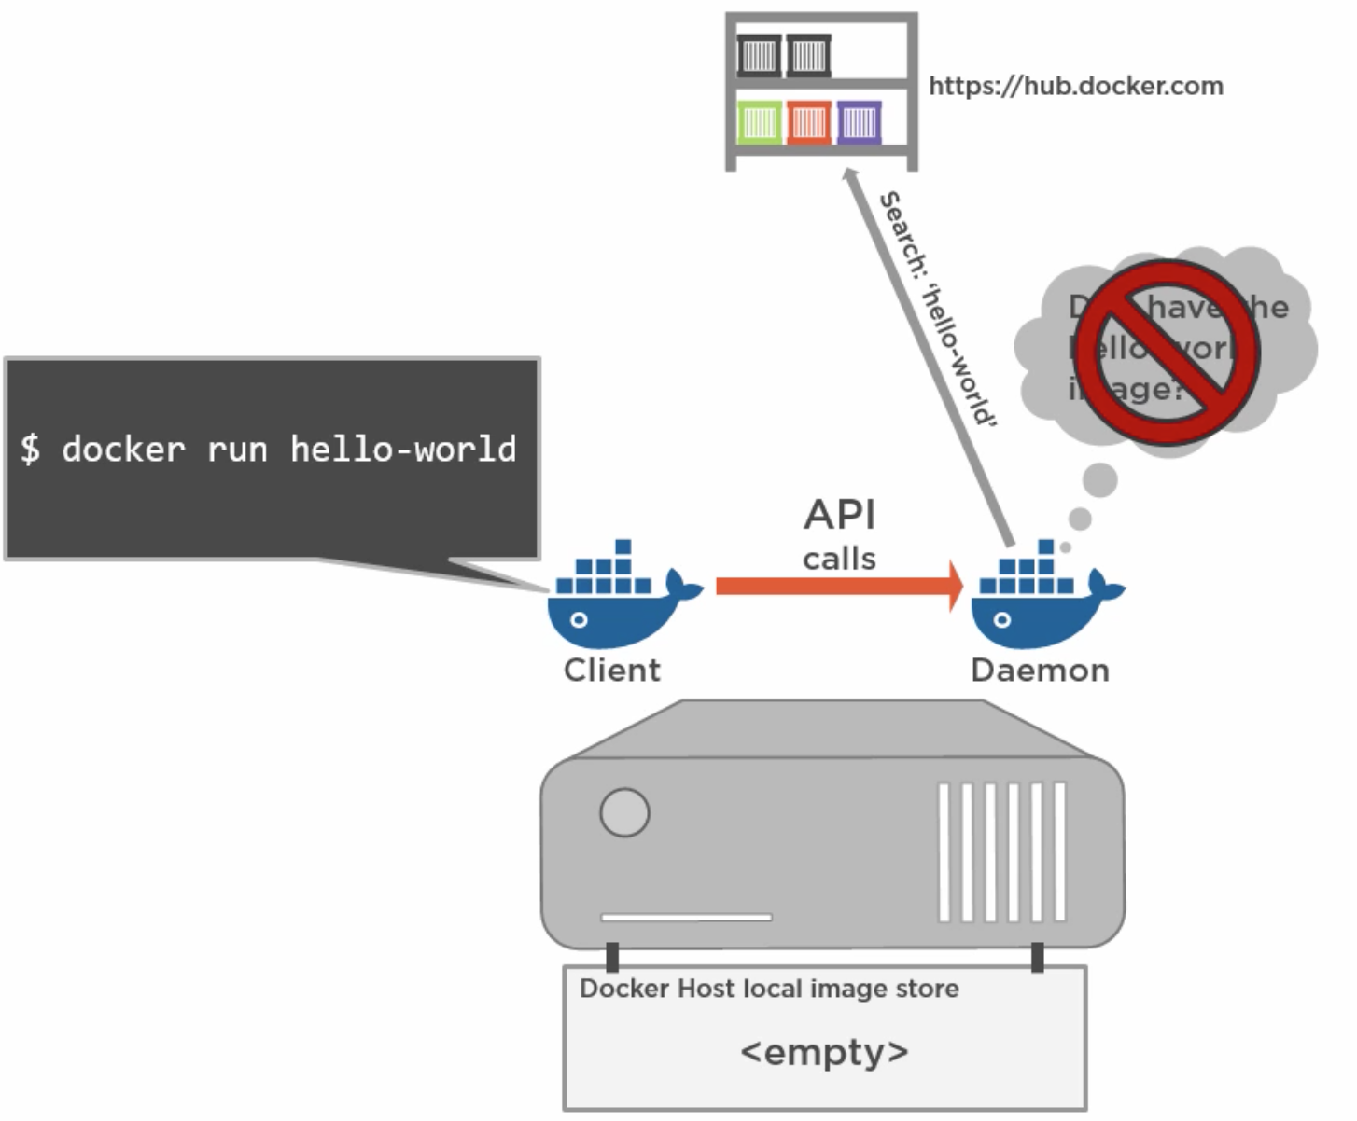
Exercise2: Run hello world!! (Existing image)
<docker run hello-world>

Slide 11
Exercise3: Run hello world!! (create a new image)
git clone https://github.com/aprashanth/DockerWorkshop.git
cd DockerWorkshop
docker build --tag "my-first-container:latest" .
docker run my-first-container:latest
Open another terminal window
docker ps -a
docker stop container <container id>
docker ps –a
Docker rm container <container id>

Slide 12
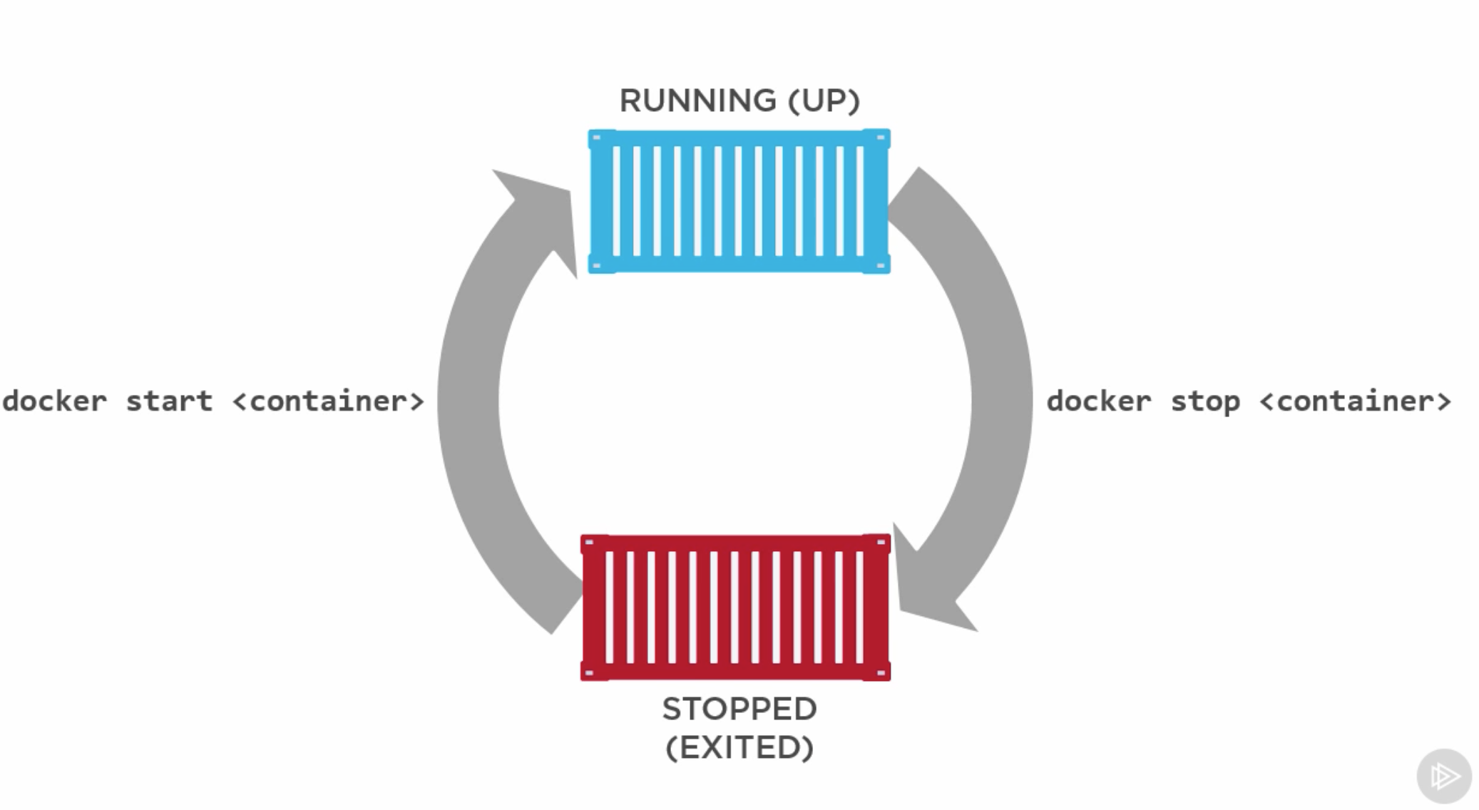
Docker container life cycle

Slide 13
Other useful Docker commands
docker info // Prints the information
docker images //Lists all the images available
docker run <image name> //Creates a container using the image name
docker ps //Lists all the containers
docker ps -a //Lists all the containers including the one that has been stopped to terminated
docker pull <image name> //Pulls an image from the hub
docker rmi <image name or image id> //Removes an image from the local repo
docker start <container> //starts a container
docker stop <container> //stops a container
docker rm <container> //removes a container
docker stop $(docker ps -aq) //stops all the containers returned by docker ps command in a quite mode
docker rm $(docker ps -aq) //removes all the containers returned by docker ps command in a quite mode

Slide 14
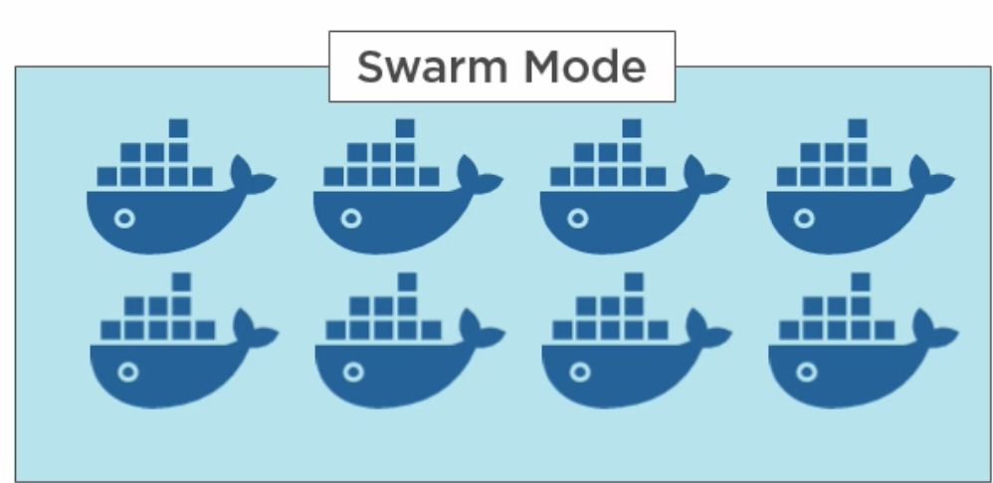
Swarm mode theory
Swarm is new in Docker 1.12 which is true native clustering
A collection of docker engines collected into a cluster is called a swarm
Engines in a swarm run in swarm mode
A swarm consists of one or more Manager nodes and one or more worker modes
Even though there can be more than one manager for redundancy and high availability, there is always one leader
Manager nodes also act as a worker node
Worker nodes just accept tasks from their managers and execute them
Services is a new concept introduced along with Swarm mode

