Slide 1
APPLE DEFECT DETECTION
Attention mechanisms for apple defect detection
A controlled comparison in YOLOv8n
Baseline SE CBAM Coordinate Attention
Ved Waghela and Manish Gadia
COMPSCI 764 research project
University of Auckland
Manish Gadia
1
Notes:
PRESENTER: Manish
TARGET: 25 seconds
SPEAKING SCRIPT
Hello, we are Manish Gadia and Ved Waghela. Our project compares attention mechanisms for apple surface defect detection. We ask whether adding attention to the same YOLOv8n detector improves localisation enough to justify its computational cost. I will explain the problem and our approach, and Ved will present the experiments and findings.
DELIVERY CUE
Introduce both names. Emphasise that this is a comparison of existing attention mechanisms.
SOURCES
Study results: baseline/runs/final_evaluation/aggregate.json, test_results.json and ANALYSIS_NOTES.md. Reference numbering follows the written report.

Slide 2
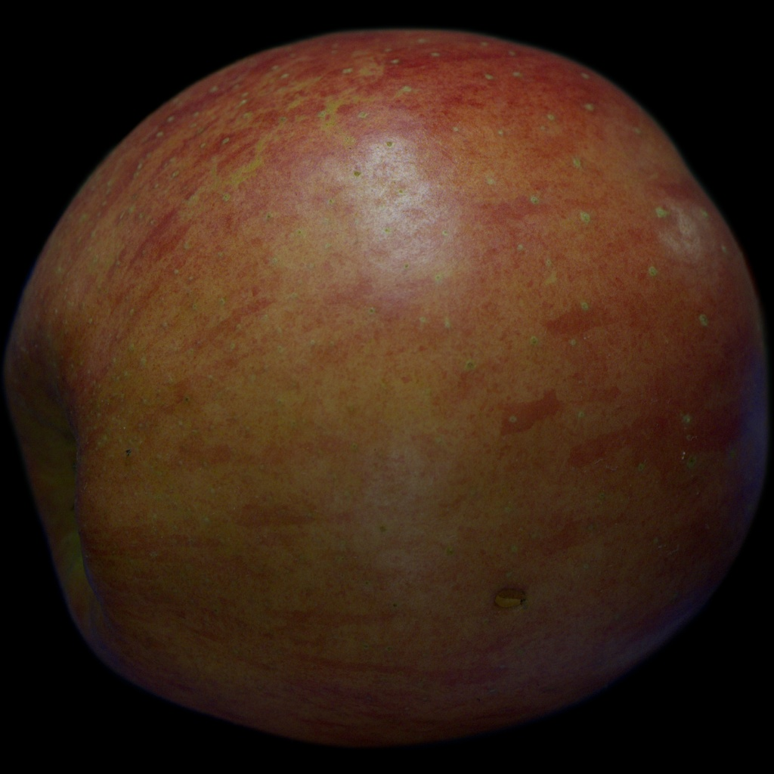
APPLE DEFECT DETECTION
Subtle defects can resemble normal peel texture
Where is the defect?
Small, low-contrast damage
Natural texture and colour variation
Uncertain defect boundaries
Our output: defect boxes and classes
SSDA example [3]. Scope: scratch and pest damage.
Manish Gadia
2
Notes:
PRESENTER: Manish
TARGET: 60 seconds
SPEAKING SCRIPT
Consider this apple. A large damaged patch may be easy to notice, but a weak scratch can blend into normal peel texture. Colour variation and reflections also make it difficult to decide exactly where a defect starts and ends. This matters because an automated inspection system needs useful evidence about damaged regions, rather than only a label for the entire fruit. Our task therefore predicts bounding boxes and defect classes. It differs from classifying an apple as good or bad. In this project, we focus on scratches and pest damage in the SSDA dataset. Reliable localisation could support later inspection or grading decisions, although we do not evaluate a complete commercial grading system. The challenge we investigate is whether feature reweighting helps an existing detector distinguish these subtle regions.
DELIVERY CUE
Point at a subtle region in the image. Explain localisation before introducing model terminology.
SOURCES
[1] Rojas Santelices et al. (2025). Fruit inspection survey. Sensors. https://doi.org/10.3390/s25051524
[2] Han et al. (2024). HAFREE apple defect detector. IEEE Access. https://doi.org/10.1109/ACCESS.2024.3504399
[3] Nguyen (2024). Surface Subtle Defects Apple dataset v1.0.0. https://doi.org/10.5281/zenodo.10957715
Study results: baseline/runs/final_evaluation/aggregate.json, test_results.json and ANALYSIS_NOTES.md. Reference numbering follows the written report.

Slide 3
APPLE DEFECT DETECTION
Existing detectors and attention mechanisms
Apple-defect detection
HAFREE targets subtle apple defects [2].
YOLOv8n provides our compact baseline [10].
Module | Mechanism | Intuition
SE [4] | Weights feature channels | Which learned features matter?
CBAM [5] | Weights channels and locations | Which features, and where?
Coordinate [6] | Retains height and width information | Where along each direction?
Manish Gadia
3
Notes:
PRESENTER: Manish
TARGET: 65 seconds
SPEAKING SCRIPT
Existing work already addresses apple-defect detection. HAFREE is a detector designed around subtle apple defects, and its associated dataset gives us a relevant test setting. For our own comparison, we use the compact YOLOv8n implementation. Attention is also an established idea, so our contribution is not to invent a new attention module. Squeeze-and-Excitation, or SE, summarises each feature channel and learns how strongly to weight it. CBAM adds spatial weighting after channel weighting, allowing different image locations to receive different emphasis. Coordinate Attention preserves directional information through separate height and width summaries. These mechanisms provide different ways to alter the feature representation. Published improvements in other settings do not tell us which is best in our configuration, because datasets, training budgets and insertion points can differ. That motivates a matched comparison.
DELIVERY CUE
Define a feature channel as a learned feature map. Avoid claiming these modules have never been compared before.
SOURCES
[2] Han et al. (2024). HAFREE apple defect detector. IEEE Access. https://doi.org/10.1109/ACCESS.2024.3504399
[4] Hu et al. (2018). Squeeze-and-Excitation Networks. CVPR. https://doi.org/10.1109/CVPR.2018.00745
[5] Woo et al. (2018). CBAM. ECCV. https://doi.org/10.1007/978-3-030-01234-2_1
[6] Hou et al. (2021). Coordinate Attention. CVPR. https://openaccess.thecvf.com/content/CVPR2021/html/Hou_Coordinate_Attention_for_Efficient_Mobile_Network_Design_CVPR_2021_paper.html
[10] Ultralytics (2025). Software release v8.3.203. https://github.com/ultralytics/ultralytics/releases/tag/v8.3.203
Study results: baseline/runs/final_evaluation/aggregate.json, test_results.json and ANALYSIS_NOTES.md. Reference numbering follows the written report.

Slide 4
APPLE DEFECT DETECTION
Research question and working hypothesis
Which attention module offers the best detection
performance versus computational cost?
Hypothesis
Selective feature weighting may improve subtle-defect localisation.
Spatial information may help, but adds execution cost.
Contribution: a matched comparison at one fixed insertion point
Manish Gadia
4
Notes:
PRESENTER: Manish
TARGET: 65 seconds
SPEAKING SCRIPT
Our question is which attention module offers the best trade-off between detection performance and computational cost when added to this YOLOv8n backbone. The working hypothesis is that selective feature weighting can help the detector separate weak damage from surrounding texture. Because a defect occupies a particular location, we also expect spatially informed mechanisms to be plausible candidates. However, more attention operations can increase execution time, and improved features do not guarantee improved detection. We therefore compare a baseline, SE, CBAM and Coordinate Attention under matched settings. This is an experimental application of existing approaches, rather than a new architecture family. We deliberately narrow the project to detection and measured forward cost. We do not claim robustness to changes in lighting or blur, because those experiments are outside our completed evaluation.
DELIVERY CUE
Stress the connection between local defects and spatial information. Present the hypothesis as something tested, not a proven explanation.
SOURCES
[4] Hu et al. (2018). Squeeze-and-Excitation Networks. CVPR. https://doi.org/10.1109/CVPR.2018.00745
[5] Woo et al. (2018). CBAM. ECCV. https://doi.org/10.1007/978-3-030-01234-2_1
[6] Hou et al. (2021). Coordinate Attention. CVPR. https://openaccess.thecvf.com/content/CVPR2021/html/Hou_Coordinate_Attention_for_Efficient_Mobile_Network_Design_CVPR_2021_paper.html
Study results: baseline/runs/final_evaluation/aggregate.json, test_results.json and ANALYSIS_NOTES.md. Reference numbering follows the written report.

Slide 5
APPLE DEFECT DETECTION
One attention insertion point in the backbone
Input image
640 x 640
Backbone
C2f layer 6
Attention
None / SE / CBAM / CA
Remaining
backbone
128 channels
40 x 40 feature map
Existing stride-16 connection
Detection head
Defect boxes and classes
Neck
Feature fusion
Simplified path; other multiscale connections omitted
Same COCO starting weights and unchanged detection head
The study tests one placement, not the optimal placement.
Manish Gadia
5
Notes:
PRESENTER: Manish
TARGET: 55 seconds
SPEAKING SCRIPT
We insert one attention module after the output of C2f layer six in the backbone. With a 640-pixel input, this stage contains 128 channels at a spatial resolution of 40 by 40, corresponding to stride sixteen. The modified output feeds both the following backbone stages and the existing connection to the neck. The detection head and task remain unchanged. We use the same COCO-pretrained starting weights for the shared architecture and check that the custom modules survive checkpoint saving and loading. This placement retains spatial detail while keeping the comparison manageable. We did not search all possible placements, so our findings apply to this particular configuration. Ved will now explain how we evaluated the four models and what we found.
DELIVERY CUE
Trace the attention output into the following backbone and the existing neck connection, then give the handover and pause. Handover target: 4 minutes 30 seconds.
SOURCES
[10] Ultralytics (2025). Software release v8.3.203. https://github.com/ultralytics/ultralytics/releases/tag/v8.3.203
Study results: baseline/runs/final_evaluation/aggregate.json, test_results.json and ANALYSIS_NOTES.md. Reference numbering follows the written report.

Slide 6
APPLE DEFECT DETECTION
A matched evaluation across 12 training runs
710 images
4 models x 3 seeds x 50 epochs
1,512 defect boxes
Scratch and pest damage
Shared input, optimiser and augmentation
Validation selects each checkpoint
Held-out test evaluates final performance
Partition | Images
Training | 500
Validation | 106
Test | 104
Similarity and capture-time grouping
reduces obvious cross-split overlap [3].
Ved Waghela
6
Notes:
PRESENTER: Ved
TARGET: 55 seconds
SPEAKING SCRIPT
Thank you, Manish. We used 710 SSDA images containing 1,512 boxes. Our grouped partition contains 500 training, 106 validation and 104 test images. We group related images using similarity and capture-time information to reduce obvious overlap between partitions. This is a precaution, not a guarantee that every physical apple is independent. We trained four models with seeds forty-two, forty-three and forty-four, giving twelve runs of fifty epochs each. All runs share the same input size, optimiser and augmentation policy. Validation performance selects each saved checkpoint, and the held-out test split provides the final comparison. Our primary metric is mean average precision across IoU thresholds from point five to point nine five, which rewards detection and increasingly precise localisation.
DELIVERY CUE
Define IoU as overlap between predicted and annotated boxes. Do not call mAP image-classification accuracy.
SOURCES
[3] Nguyen (2024). Surface Subtle Defects Apple dataset v1.0.0. https://doi.org/10.5281/zenodo.10957715
[10] Ultralytics (2025). Software release v8.3.203. https://github.com/ultralytics/ultralytics/releases/tag/v8.3.203
Study results: baseline/runs/final_evaluation/aggregate.json, test_results.json and ANALYSIS_NOTES.md. Reference numbering follows the written report.

Slide 7
APPLE DEFECT DETECTION
CBAM has the highest mean test mAP50-95
+1.41 pp
CBAM versus baseline
Positive gain in all three seeds
Three seeds support a descriptive
comparison, not a significance claim.
Baseline
SE
CBAM
Coordinate
Dots: seeds Diamonds: means Lines: sample SD, not confidence intervals
Mean test AP (%) | Baseline | SE | CBAM | Coordinate
Across 3 seeds | 40.70 | 41.58 | 42.11 | 41.52
Ved Waghela
7
Notes:
PRESENTER: Ved
TARGET: 65 seconds
SPEAKING SCRIPT
This chart shows mean test mAP across the three seeds. CBAM reaches 42.11 percent, compared with 40.70 for the baseline, 41.58 for SE and 41.52 for Coordinate Attention. The CBAM improvement is 1.41 percentage points. Importantly, its paired improvement over baseline is positive for all three seeds, rather than depending on one particularly successful run. The small dots show the individual seeds, the diamonds show the means, and the vertical lines show sample standard deviations. CBAM has the smallest observed variation here, while SE has the largest, but three runs are too few to establish population stability or statistical significance. The ranking also depends on the metric. Coordinate Attention has the highest mean AP at IoU point five, by a small margin. Our main conclusion therefore concerns the stricter primary metric, rather than every possible definition of detection performance.
DELIVERY CUE
Pause on 42.11 and 40.70. Say percentage points, not percent improvement. Point to the individual seeds and explain that the SD lines are not confidence intervals.
SOURCES
Study results: baseline/runs/final_evaluation/aggregate.json, test_results.json and ANALYSIS_NOTES.md. Reference numbering follows the written report.

Slide 8
APPLE DEFECT DETECTION
The accuracy gain carries a measurable cost
~8% slower
CBAM: 7.113 ms
Baseline: 6.586 ms
SE adds ~1.3% latency
with a smaller mean AP gain.
RTX 2050, FP32, batch 1. Forward-only timing excludes preprocessing and NMS.
Ved Waghela
8
Notes:
PRESENTER: Ved
TARGET: 55 seconds
SPEAKING SCRIPT
The trade-off becomes clearer when we plot performance against median forward latency. CBAM has the highest primary detection score, but its forward pass takes about 7.113 milliseconds, compared with 6.586 for baseline. That is approximately eight percent more time. SE has a smaller measured overhead of about 1.3 percent, together with a smaller average detection gain. We measured fused FP32 models at batch size one on an RTX 2050, with warm-up and three timing blocks. These timings exclude preprocessing, data transfer and non-maximum suppression, so they are not end-to-end application throughput. CBAM is therefore an accuracy-oriented candidate for this setting. A deployment with stricter latency requirements could reasonably choose another model.
DELIVERY CUE
Explain that upper-left is desirable. Do not translate forward latency directly into real-world grading speed.
SOURCES
Study results: baseline/runs/final_evaluation/aggregate.json, test_results.json and ANALYSIS_NOTES.md. Reference numbering follows the written report.

Slide 9
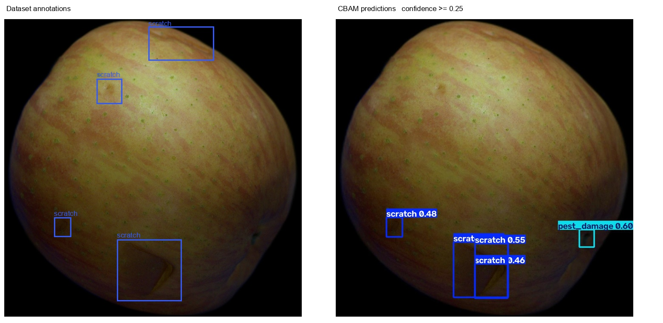
APPLE DEFECT DETECTION
Scratches remain difficult despite the mean gain
Dataset annotations
CBAM predictions
Upper scratches
missed
Lower damage
overlapping boxes
Class AP50-95
Scratch 32.94%
Pest damage 51.28%
Missed upper scratches and overlapping lower boxes remain.
Fixed test example [3]. CBAM seed 42, confidence 0.25. Class scores are three-seed means.
Ved Waghela
9
Notes:
PRESENTER: Ved
TARGET: 50 seconds
SPEAKING SCRIPT
A higher average score does not mean that every defect is detected. On this fixed test image, the left panel shows annotations and the right shows CBAM predictions. Some upper scratches are missing, while lower damage has overlapping predictions. There is also a prediction near the right edge without a corresponding annotation, which we cannot resolve biologically from the model output alone. Across the test set, CBAM achieves 32.94 percent AP for scratches and 51.28 for pest damage. Scratches remain the harder class. This example illustrates a failure pattern, rather than estimating how frequently it occurs. We also did not inspect attention maps, so we cannot claim that the model demonstrably learned to focus on damaged peel.
DELIVERY CUE
Point to upper misses, then lower overlapping boxes. Avoid changing thresholds while explaining the example.
SOURCES
[3] Nguyen (2024). Surface Subtle Defects Apple dataset v1.0.0. https://doi.org/10.5281/zenodo.10957715
Study results: baseline/runs/final_evaluation/aggregate.json, test_results.json and ANALYSIS_NOTES.md. Reference numbering follows the written report.

Slide 10
APPLE DEFECT DETECTION
A conditional benefit from CBAM attention
Best mean primary score in our setting
+1.41 percentage points at approximately 8% higher forward latency
Limits
Next experiments
One small dataset and one insertion point
Three seeds and no healthy-image negatives
No illumination or blur robustness tests
Verify fruit-identity splits and add negatives
Compare insertion points at equal budgets
Measure end-to-end deployment latency
Ved Waghela
10
Notes:
PRESENTER: Ved
TARGET: 45 seconds
SPEAKING SCRIPT
To conclude, CBAM provides the strongest mean primary detection score in our fixed YOLOv8n configuration. Its gain is modest and comes with a measurable latency cost. This supports it as a candidate for this dataset and placement, not as a universally best attention mechanism. Our main limitations are the small dataset, uncertain physical-fruit independence, three training seeds and the absence of healthy-image negatives. The next priorities are stronger identity-based splits, healthy negatives and equal-budget placement comparisons. Deployment work would also need complete camera-to-decision timing. The practical contribution is a reproducible comparison that shows both the benefit and the remaining errors. Thank you.
DELIVERY CUE
Finish the spoken content at approximately 9 minutes. Advance to references without reading every entry.
SOURCES
Study results: baseline/runs/final_evaluation/aggregate.json, test_results.json and ANALYSIS_NOTES.md. Reference numbering follows the written report.

Slide 11
APPLE DEFECT DETECTION
References
[1] Rojas Santelices et al. (2025). Fruit inspection survey. Sensors.
[2] Han et al. (2024). HAFREE apple defect detector. IEEE Access.
[3] Nguyen (2024). Surface Subtle Defects Apple dataset v1.0.0.
[4] Hu et al. (2018). Squeeze-and-Excitation Networks. CVPR.
[5] Woo et al. (2018). CBAM. ECCV.
[6] Hou et al. (2021). Coordinate Attention. CVPR.
[10] Ultralytics (2025). Software release v8.3.203.
AI assistance: slide structure, drafting and formatting support.
Presenter review and understanding remain essential.
Reference numbers match the report
11
Notes:
Reference slide. Do not read each entry aloud. Sources are linked and use the report numbering. Generative AI assisted slide structure, drafting and formatting. Both presenters should review and personalise their section before recording. Dataset images: SSDA v1.0.0, CC BY 4.0, https://doi.org/10.5281/zenodo.10957715. All experimental values come from the project evaluation records.

