Slide 1

FRAUD LENS:
Harshit Jain 22106040
Vedant Gandre 22106011
Devansh Mane 22106062
Project Guide
Prof. Sumeet Shingi
An AI-Powered System for Detecting and Preventing E-Commerce Refund Abuse

Slide 2
Outline
Introduction
Literature Survey of the Existing Systems
Limitations of the Existing Systems
Problem Statement
Proposed System Design
Framework/Algorithm
Technologies Stack for Proposed System
Details of Database / Input to the System
Implementation(Partial)
Conclusion
References

Slide 3
Introduction
1.1 Problem Domain and Real-Time Observations
E-commerce has grown rapidly, offering convenience to millions of customers. However, it has also led to increasing cases of refund abuse, where customers misuse return and refund policies. Common practices include false non-delivery claims, returning counterfeit or damaged products, and repeatedly exploiting flexible return policies.
1.2 Motivation
Refund abuse results in huge financial losses for businesses and erodes trust between retailers and customers. Observations that motivated this project include:
Rising fraud incidents despite existing controls.
Genuine customers facing stricter policies due to a minority of abusers.
The lack of scalable, AI-driven systems that adapt to evolving fraud tactics.
1.3 Objectives
This project aims to:
Detect refund abuse in real time using AI and behavioral analytics.
Minimize false positives to protect genuine customers.
Provide actionable insights for businesses to prevent losses.
Build a scalable and adaptive fraud detection system.

Slide 4
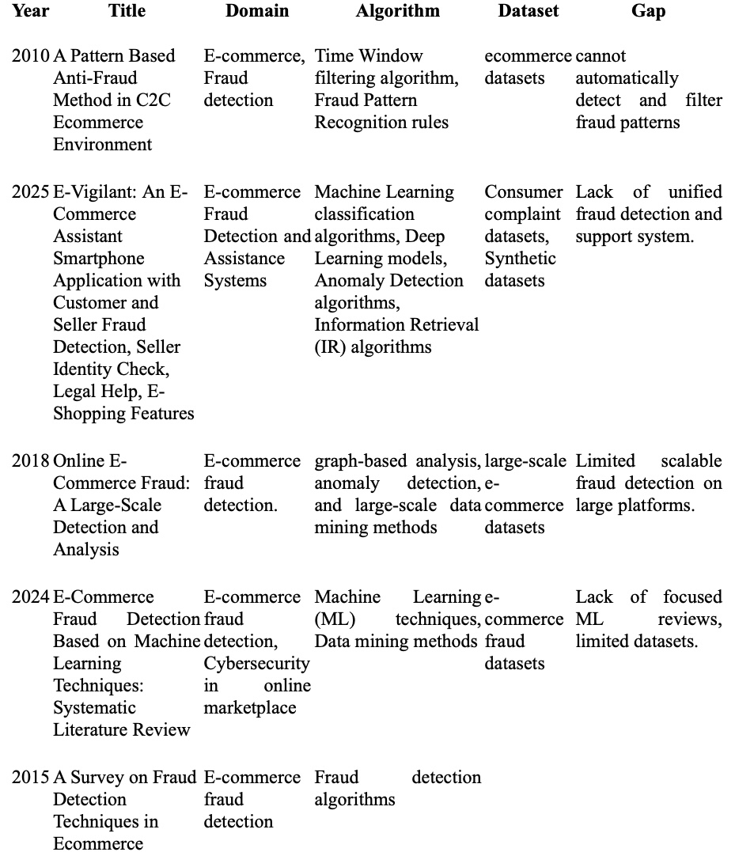
Literature Survey of the Existing Systems

Slide 5
Limitations of Existing Systems
Limitations of Current Fraud Detection Systems (like Fraud Lens)`
Data Dependency: Requires large, high-quality labelled data, which is often scarce or imbalanced.
Adaptability: Struggles to keep up with evolving fraud tactics.
Accuracy Issues: Prone to false positives (hurting customers) and false negatives (missing fraud).
Scalability: Real-time processing of massive data streams demands heavy infrastructure.
Resource-Intensive: High costs, expertise, and maintenance limit adoption, especially for SMEs.
Consequences: Financial losses, reduced trust, poor customer experience, reputational damage, limited deployment in large marketplaces, and restricted use by smaller businesses.

Slide 6
Problem Statement
The e-commerce industry faces significant challenges in managing and detecting fraudulent refund activities. Manual monitoring, time-consuming investigations, and the lack of intelligent automation hinder platforms from efficiently identifying and preventing refund abuse. This often results in financial losses, reduced trust among stakeholders, and compromised customer experiences. As refund fraud schemes evolve rapidly, existing systems struggle to adapt, creating a pressing need for scalable, AI-powered solutions to detect and mitigate refund abuse in real time.

Slide 7
Technology Stack for Proposed System
Python
HTML
XGBoost
FuzzyWuzzy
Flask

Slide 8
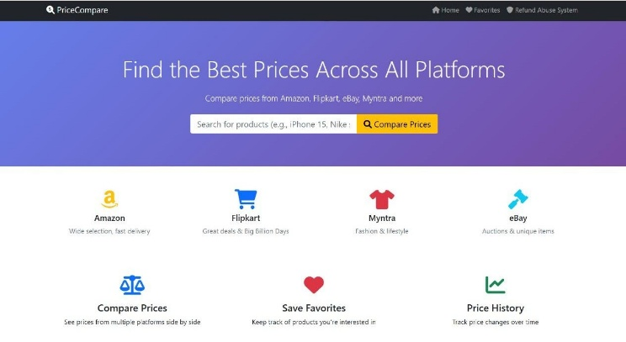
Implementation

Slide 9
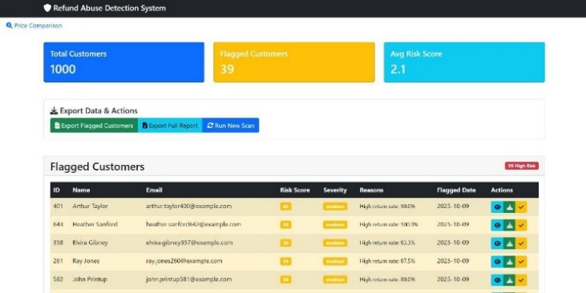
Implementation

Slide 10
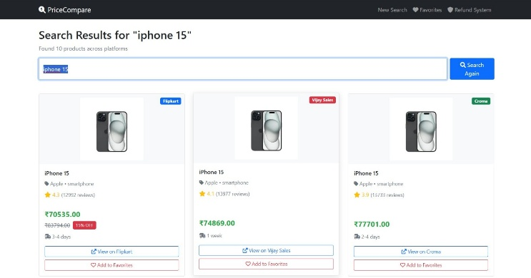
Implementation

Slide 11
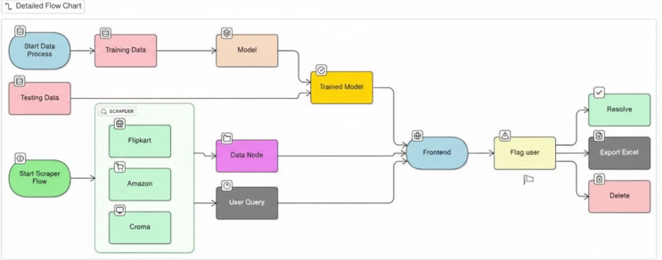
Block Diagram

Slide 12
Thank You...!!

