Slide 1
CUSTOMER CHURN ANALYSIS
ABC Communications Ltd.
AnalystLab Africa — Week 1 Data Analytics Project
Prepared by: Veronica Wanjiku Gika

Slide 2

Why Customer Churn Matters
Customer churn erodes ABC Communications’ return on its customer acquisition investment. Marketing, onboarding, and retention costs are only recovered over a customer’s lifetime, when a customer leaves early, that investment is never fully repaid, and the company must spend again just to replace the lost revenue.
In telecom specifically, churn is a continuous risk rather than a single decision point, shaped by contract length, service bundling, and how long a customer has already stayed.
27%
of ABC’s customers have churned
1,869 of 7,043 customers lost — roughly 1 in 4
Year

Slide 3




Data Quality Steps Taken
Fixed 11 blank TotalCharges values (all new customers with 0 tenure) — set to 0
Verified SeniorCitizen coding (0/1) retained for correlation analysis
Confirmed 3-category service fields (Yes / No / No internet service) reflect real distinct customer types
Dataset Overview & Data Quality
7,043
Customer records
21
Attributes per customer
11
Records with missing billing data (identified & corrected)
0
Duplicate customers found

Slide 4
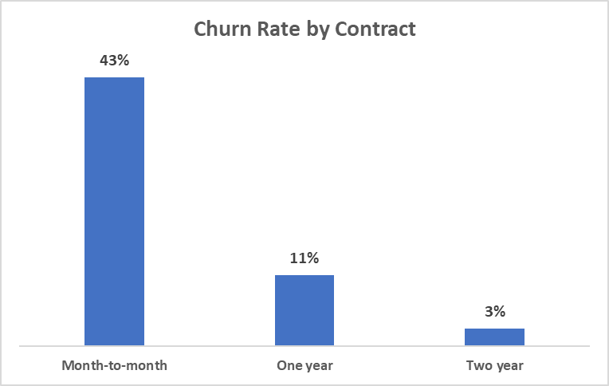

Driver 1: Contract Length
higher churn risk on month-to-month vs. two-year contracts
15x
Month-to-month: 43% churn
One-year contract: 11% churn
Two-year contract: 3% churn
No contractual lock-in means near-zero switching friction
Strongest actionable lever in the dataset

Slide 5
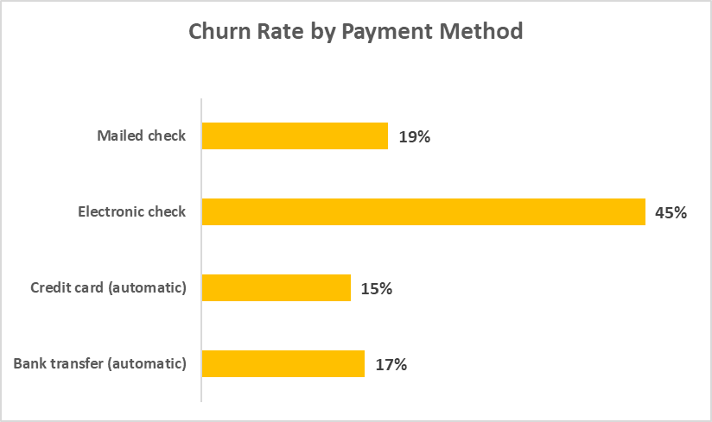
Driver 2: Payment Method
higher churn for electronic check vs. automatic payment
2.8x
Electronic check: 45% churn
Mailed check: 19% churn
Bank transfer (automatic): 17%
Credit card (automatic): 15%
Automatic payments remove recurring re-engagement moments

Slide 6
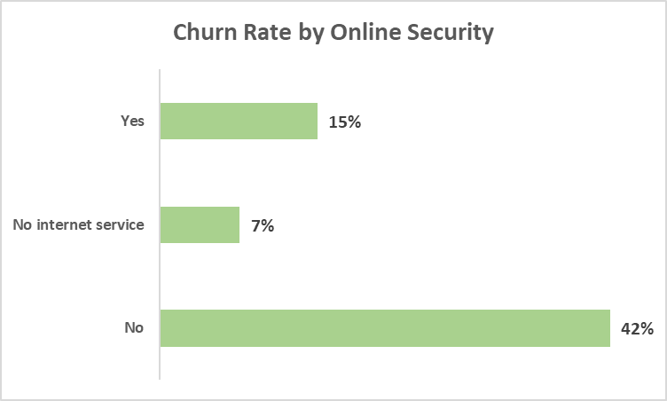
Driver 3: Service Add-Ons
higher churn for customers without online security
2.9x
No security (has internet): 42% churn
Has security: 15% churn
No internet service (phone-only): 8% churn
Add-on adoption signals stronger engagement
49% of customers currently lack this add-on

Slide 7
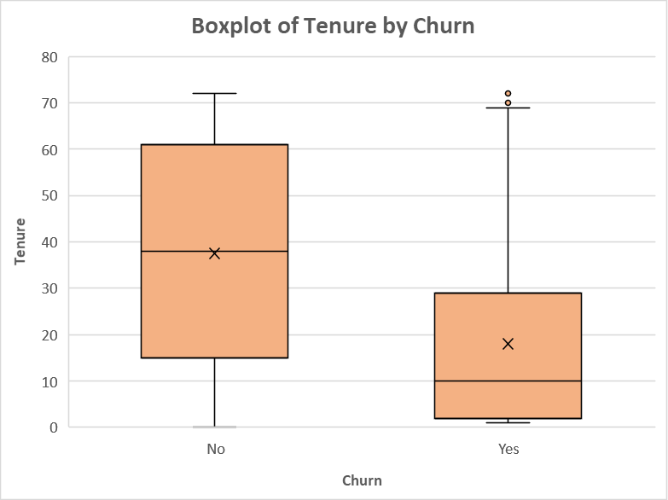
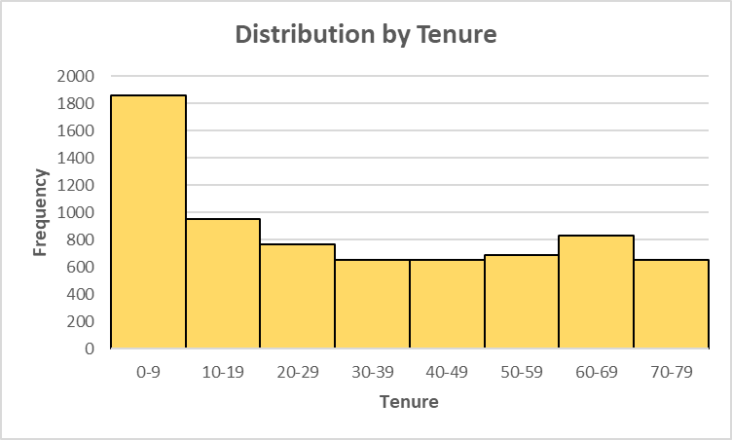
Driver 4: Customer Lifecycle & Tenure

Slide 8
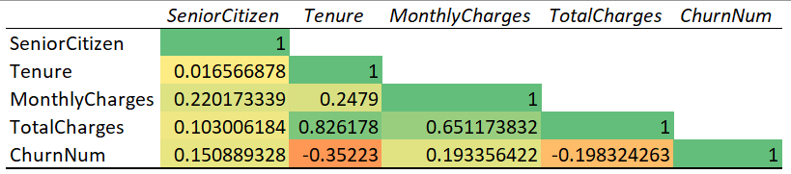
Driver 3: Service Add-Ons
Tenure’s correlation with churn - the strongest numeric predictor in the dataset
-0.35x
Longer-tenured customers are meaningfully less likely to churn
TotalCharges (-0.20) largely re-expresses tenure (0.83 correlation between the two); not an independent driver
MonthlyCharges (0.19) and SeniorCitizen (0.15) show weaker relationships
Tenure should anchor any predictive retention model
No security (has internet): 42% churn
Has security: 15% churn
No internet service (phone-only): 8% churn
Add-on adoption signals stronger engagement
49% of customers currently lack this add-on

Slide 9
Dataset Overview & Data Quality
of customers are on month-to-month plans, a large, structurally unprotected revenue base.
churn rate for manual-payment customers — a friction point actively costing ABC revenue.
most churn happens before month 12, undermining the return on every acquisition dollar spent.
35%
Leaky bucket
55%

Slide 10
Recommendations
Incentivize month-to-month customers to migrate toward one- or two-year contracts (loyalty discounts, bundled pricing).
Offer simplified, bundled service packages and dedicated support for senior customers; validate the driver with a short survey.
Proactively offer or bundle online security with internet plans, nearly half of customers currently lack this add-on.
Launch a structured 90-day onboarding program with check-ins and loyalty milestones at 6 and 12 months.
Run a targeted campaign moving manual-payment customers to autopay, using a bill credit or fee waiver as incentive.

Slide 11
Thank You
Full report, workbook, and data available on GitHub
https://github.com/veeanalyst/telco-churn-analysis

