Slide 1
Data Storytelling & Statistical Validation
ApexPlanet Data Analytics Internship – Task 4
By - Manisha Gurugubelli
Offer ID - APSPL2644081

Slide 2
Business Objective
The objective of this project is to analyze customer sales data, identify meaningful business insights, validate findings using statistical testing, and present actionable recommendations to support data-driven decision-making.
Objectives
Analyze customer purchasing behavior.
Identify important sales trends and patterns.
Validate findings using statistical analysis.
Present business recommendations based on data.

Slide 3
Dataset Overview
Dataset Summary
📊 Records: 1,000
📋 Features: 17
✅ Missing Values: None
📅 Time Period: Sales Transaction Data
Key Variables
Customer Details
Product & Category
Quantity
Total Sales
City
Gender
Order Date
Data Status
✔ Cleaned and ready for analysis

Slide 4
Business Story
The organization wants to better understand customer purchasing behavior and identify the factors that influence revenue generation.
Previous analysis (Tasks 1–3) revealed valuable insights through exploratory data analysis and an interactive Power BI dashboard. These insights highlighted revenue trends across different cities, product categories, and customer segments.
To strengthen these findings, statistical validation was performed to determine whether customer gender has a significant impact on average order value.
This enables data-driven business decisions rather than relying on assumptions.

Slide 5
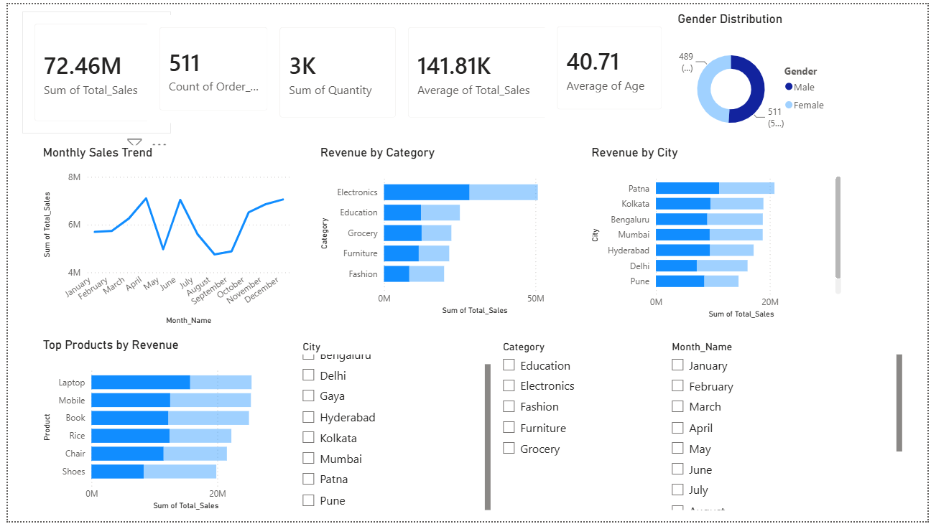
Key Business Insights
Key Business Insights
Monthly sales exhibit clear trends across the year.
Revenue varies significantly between different product categories.
Certain cities contribute a larger share of total revenue.
Some products consistently generate higher sales.
Customer demographics provide useful segmentation information.
Interactive Power BI dashboards enable efficient business monitoring

Slide 6
Hypothesis Testing
Statistical Validation
Business Question
Does customer gender significantly affect the average order value?
Null Hypothesis (H₀)
There is no significant difference in the average order value between male and female customers.
Alternative Hypothesis (H₁)
There is a significant difference in the average order value between male and female customers.
Statistical Test Used
Independent Two-Sample T-Test
Significance Level
α = 0.05 (95% Confidence Level)

Slide 7
Statistical Results
Statistical Results
Test Used: Independent Two-Sample T-Test
• T-Statistic: 0.682
• P-Value: 0.495389
• Significance Level (α): 0.05
Conclusion:
• Since the p-value (0.495389) is greater than 0.05, we fail to reject the null hypothesis.
• There is no statistically significant difference in the average order value between male and female customers.

Slide 8
Business Conclusion
Business Conclusion
The statistical analysis indicates that customer gender does not significantly influence average order value.
Although male customers have a slightly higher average order value than female customers, the difference is not statistically significant.
Business decisions should therefore focus on variables with stronger business impact, such as:
Product Category
Customer Location
Seasonal Trends
Promotional Campaigns
Customer Purchasing Behavior

Slide 9
Recommendations
Based on the analysis, the following recommendations are proposed:
Focus marketing campaigns on high-performing product categories.
Increase promotional efforts in cities with higher revenue potential.
Analyze customer age groups for additional segmentation opportunities.
Continue monitoring seasonal sales trends to improve inventory planning.
Use statistical validation before implementing business strategies.

Slide 10
Thank You

