Slide 1
Vitea Flow
Life Powered Together — an offline-first
health companion for Mauritius.
Notes:
Introduce Vitea Flow and Team ByteMe. Highlight that this is an offline-first health ecosystem purpose-built for the reality of connectivity and healthcare in Mauritius.

Slide 2
TEAM BYTEME · THE PROBLEM & SOLUTION
Healthcare is fragmented. We fixed it.
Patients across Mauritius juggle paper slips, erratic connectivity, and scattered clinic hours.
TODAY · FRAGMENTED
TOMORROW · VITEA FLOW
Disconnected Care
One Offline-First Companion
Missed medication and appointment schedules without reliable reminders.
Struggling to find open clinics and pharmacies with verified hours across districts.
Heavy cloud apps that fail as soon as mobile data drops or runs out.
Unified tracking, active alarms, facility mapping, fitness, and smart guidance.
Works entirely without data — zero network dependency for daily wellness.
Tailored specifically for Mauritian users, local geography, and lifestyle habits.
Notes:
Walk through the friction points patients face today across Mauritius, then present Vitea Flow as the cohesive offline bridge connecting reminders, discovery, and daily habits.

Slide 3
DAILY CYCLE
The daily loop keeps health routines moving
Four synchronized pillars that reset at midnight Mauritius time with a live progress bar.
01
02
03
04
Health Log & Trends
Medicine Reminders
Appointments
Daily Routines
Direct scheduling and visits against 106 verified Mauritian facilities stored completely on-device.
Progress bars that update in real time and automatically reset at midnight local Mauritius time.
Weight, water intake, sleep duration, and step counts tracked across rolling seven-day trend views.
Daily or one-time alerts with sound, vibration, dialogs, and persistent local notification history.
Notes:
Emphasize how the loop automates continuity: from morning medication alerts to tracking sleep and steps, culminating in an automatic midnight reset aligned to Mauritius time.

Slide 4



INTELLIGENT HARDWARE & AI
A coach, not just a tracker
On-device machine learning and phone sensors turn ordinary hardware into an interactive trainer.
AI Health Coach
Live Squat Counter
Steps & 4-7-8 Breathing
Delivers practical nutrition, sleep, and activity advice built around Mauritian ingredients and meals. Includes a resilient local rules fallback when mobile signal drops.
Real-time computer vision pose detection through the phone camera. Accurately tracks knee angles to count valid repetitions without sending video frames off the device.
Passive step measurement powered directly by phone accelerometer sensors, coupled with an interactive 4-7-8 guided breath pacer for daily stress reduction.
Notes:
Demonstrate how Vitea Flow goes beyond passive data logging to provide active, localized guidance and real-time computer vision workout verification.

Slide 5
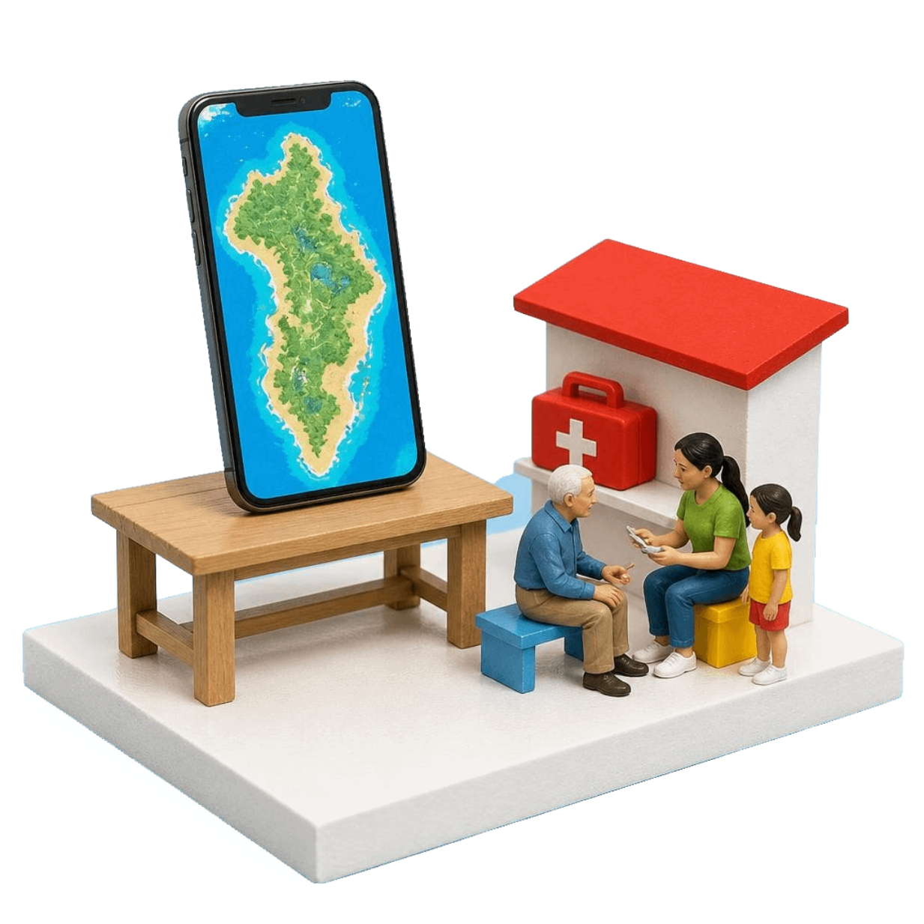
VALIDATION & ARCHITECTURE
Hyper-local, genuinely installable
Built with lightweight web standards, wrapped into a signed standalone Android APK.
106 Local Facilities Embedded. Public regional hospitals, private clinics, Area Health Centres (AHCs), and licensed pharmacies sourced from OpenStreetMap.
Smart Proximity & 100m Arrival. Nearest-first sorting across 10 km and island-wide scopes, verified opening hours, and an automated GPS banner within 100 m.
Surprise Card Validation. We drew a surprise prompt, selected an elder family member as trusted user, and validated their real-world medical routine.
Vanilla JS · Leaflet · Groq AI · Signed APK (TWA)
Notes:
Explain the engineering stack: vanilla web tech bundled into a lightweight Trusted Web Activity APK. Detail the surprise card user testing with an elder family member.

Slide 6
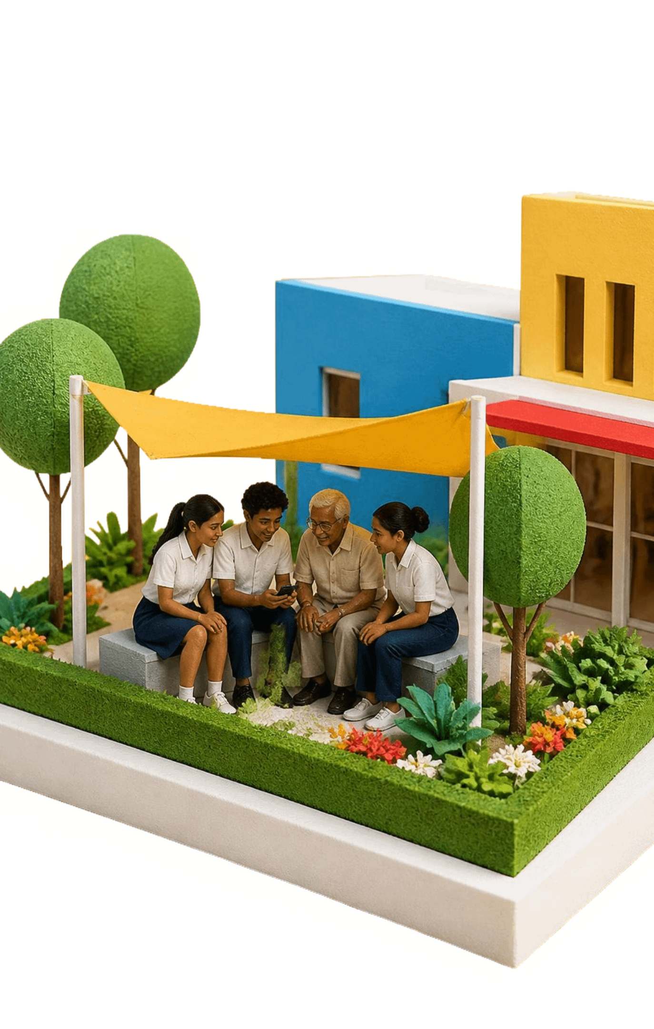
IMPACT & LIVE DEMO
Health for everyone
A zero-cost, private health companion for every student, parent, and elder across Mauritius.
Privacy-Respecting & Prepaid-Ready: Zero subscription fees; absolute on-device data retention; minimal data consumption on prepaid mobile connections.
Roadmap to Play Store: Finalizing Google Play Store production packaging; implementing background wake-lock alarms for deep-sleep notification reliability.
Live Demonstration: Interactive showcase: Live Groq-powered AI Coach with Mauritian context, real-time camera squat counter, and 100m GPS arrival detection.
Notes:
Close by reiterating the mission of Team ByteMe: equitable, privacy-first healthcare access. Transition immediately into the live demo of the AI Coach, pose detection, and GPS arrival banner.

