Slide 1
Software Defect estimation using machine learning algorithms Internal guide: Ms. S.Vidya
Submitted by:
Mandi Akif Hussain(9917004070)
N. kedharnath(9917004191)
R. Veeharika reddy(9917004123)

Slide 2
Abstract
This system is to evaluate the capability of machine learning algorithms in software defect prediction and find the best category while comparing seven machine learning algorithms within the context of NASA dataset obtained from public PROMISE repository

Slide 3
Existed Systems:
Most of the existed studies on software defect prediction are limited in performing comparative analysis of all the methods of machine learning. Some of them used few methods and provides the comparison between them and others just discussed or proposed a method based on existing machine learning techniques by extending them.

Slide 4
Proposed System
So the proposed system includes SVM, Multilayer Perceptron,Run Bagging algorithm, Naive Bayes algorithm,Random Forest algorithm,Multinomial NB and Radial Basis Functions to solve the class imbalance problem which causes a reduction in the performance of defect prediction.The Data set has been trained and splitted according to the constraints and using Metrics the accuracies has been defined in order to measure the defect estimation capability of various algorithms proposed.

Slide 5
Advantages of Proposed System
Performance measures are used to evaluate the accuracy of a prediction model.
No need of Manual effort to find the defects
Advance measures can be taken on selection of algorithm
Provides Better results.
Identify defects in the early stage of the project which in turn results in Customer
loyalty and increase in company profit.

Slide 6
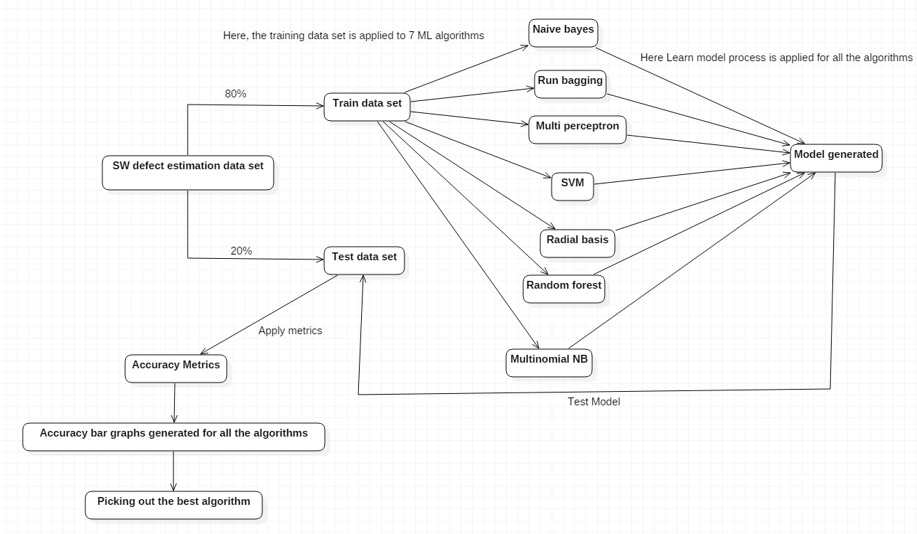
System Architecture

Slide 7
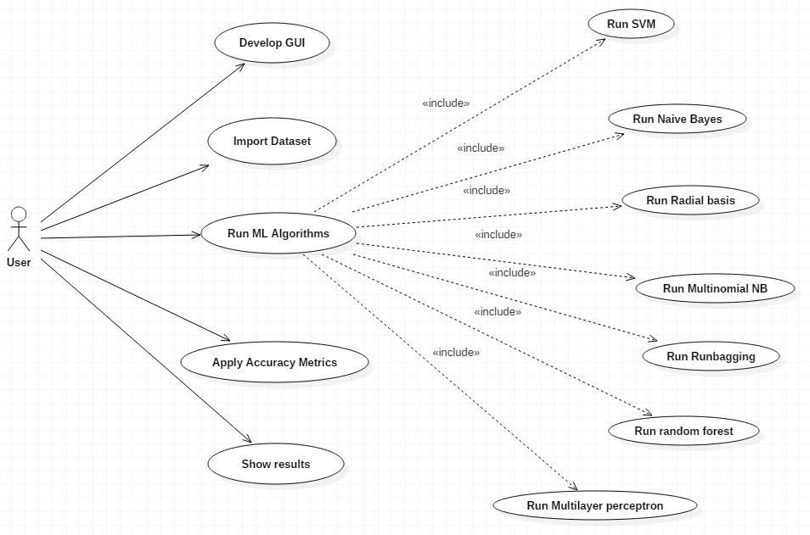
UML Diagram
Use Case

Slide 8
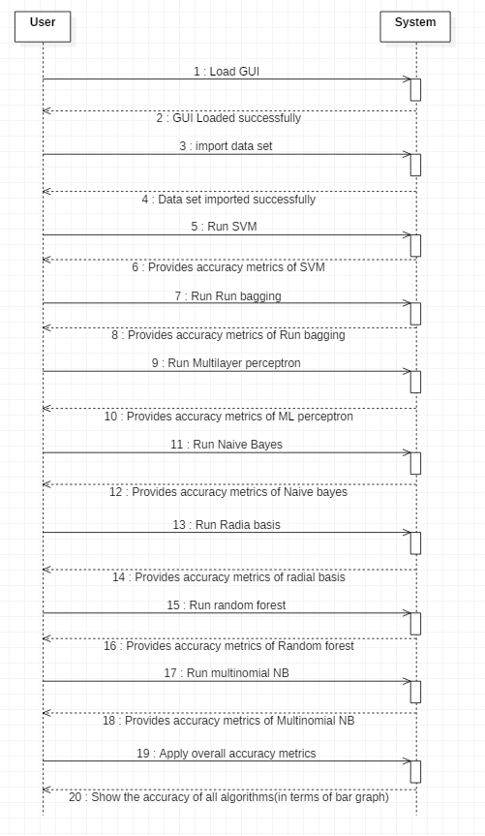
Sequence Diagram

Slide 9
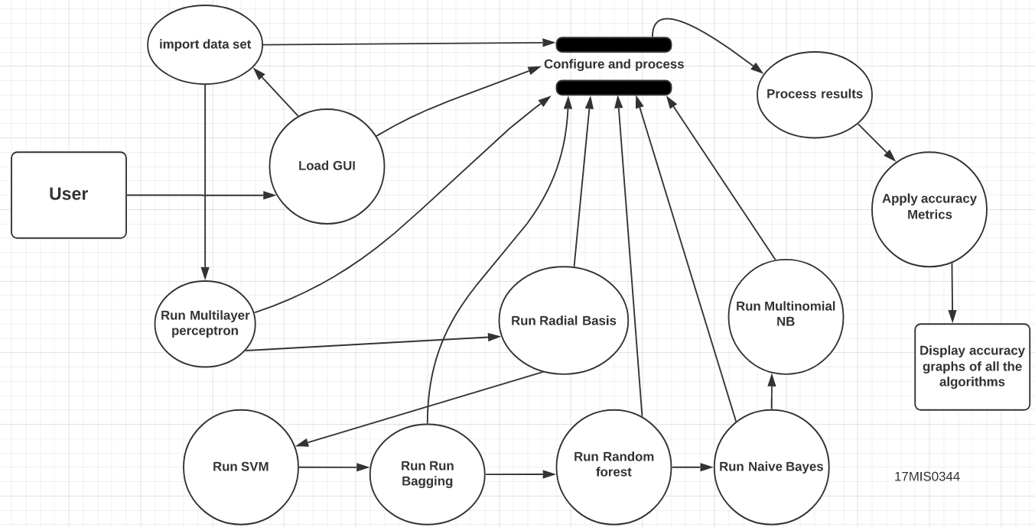
DFD

Slide 10
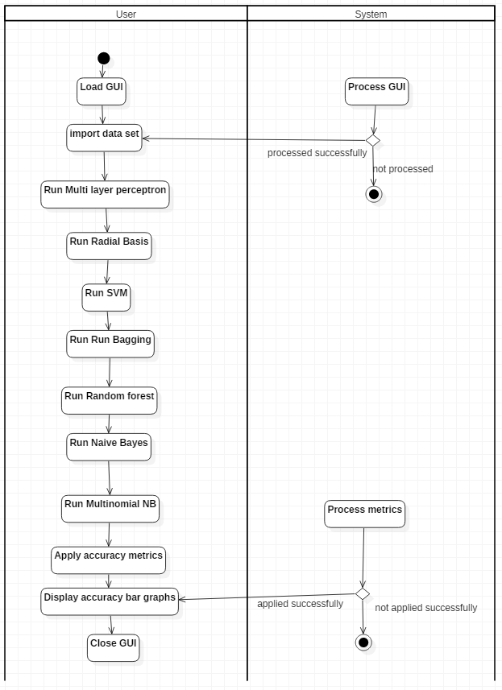
Activity Diagram

Slide 11
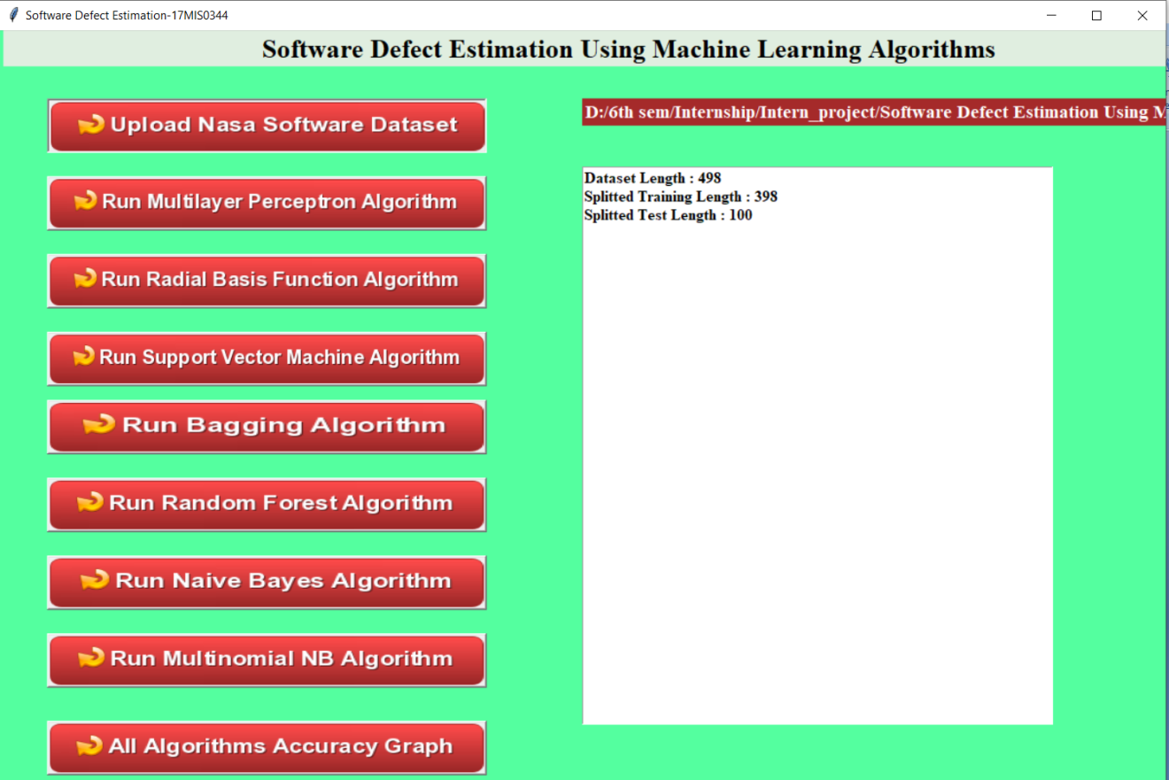
Results
Loading data set

Slide 12
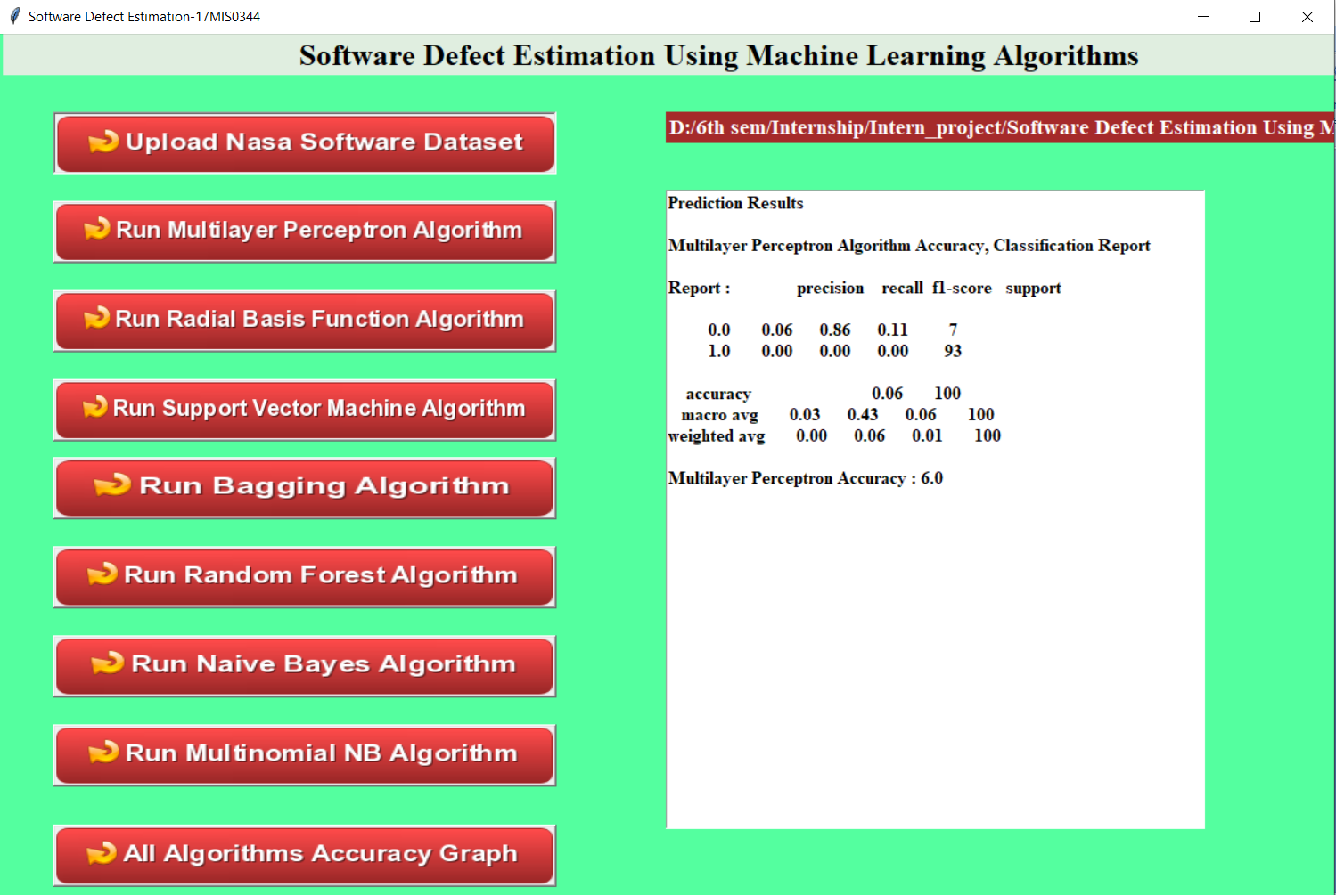
Run Multilayer Perceptron

Slide 13
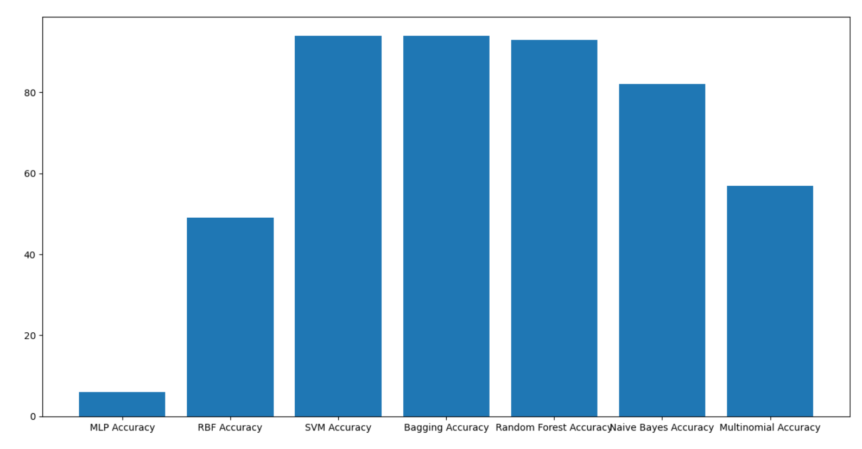
On running all the algorithms we will find the classification report of all the algorithms
(Comparison of Accuracies (i.e what % of defects are identified))

Slide 14
Discussion
The above graph shows the % of defects identified by the algorithm. For Example on taking svm’s result i.e 94%,it indicates that the svm algorithm has identified 94% of the defective data and that positions are displayed by me in the console, like wise all the algorithms will provide defect estimation % so that we can pick up a best one from those and by the positions displayed in the console we can rectify those defects and deploy good quality product.

Slide 15
Conclusion
In this project, seven machine learning algorithms are used to predict defectiveness of software systems before they are released to the real environment and/or delivered to the customers and the best category which has the most capability to predict the software defects are tried to find while comparing them based on software quality metrics which are accuracy, precision, recall and F-measure. I carried out this project with NASA dataset which is CM1.This dataset is obtained from public PROMISE repository. The results of this project indicate that tree-structured classifiers in other words ensemble learners which are SVM and Run Bagging have better defect prediction performance compared to its counter parts. Especially, the capability of Bagging in predicting software defectiveness is better. When applied to all datasets, the overall accuracy, precision, recall and F-Measure of Bagging is 0.94,1.00,0.97,93. Utilizing these techniques enables them to save software testing and maintenance costs by identifying defects in the early phase of project life cycle and taking corrective and preventive actions before they become fail.

Slide 16
References
[1] Biffl, S. (2000). Using inspection data for defect estimation. IEEE Software, 17(6), 36-43.
[2] Bibi, S., Tsoumakas, G., Stamelos, I., & Vlahavas, I. (2008). Regression via Classification applied on software defect estimation. Expert Systems with Applications, 34(3), 2091-2101.
[3] Petersson, H., & Wohlin, C. (1999, November). An empirical study of experience-based software defect content estimation methods. In Proceedings 10th International Symposium on Software Reliability Engineering (Cat. No. PR00443) (pp. 126-135). IEEE.
[4] Wahono, R. S. (2015). A systematic literature review of software defect prediction. Journal of Software Engineering, 1(1), 1-16.
[5] Yalçıner, B., & Özdeş, M. (2019, September). Software Defect Estimation Using Machine Learning Algorithms. In 2019 4th International Conference on Computer Science and Engineering (UBMK) (pp. 487-491). IEEE.

Slide 17
Thank you

