Slide 1
GENERAL AWARENESS
ON
HIV/AIDS
Presented by:
WeHELP
In Association with its
MEDICAL TEAM

Slide 2
TRANSMISSION ROUTES OF HIV/AIDS
BLOOD EXPOSURE
Needle exposure
Transfusion of blood, plasma, packed cells, platelets
Needle injury (occupational)
SEXUAL
Homosexual
Heterosexual
PERINATAL
Pregnancy
Intrapartum & Postpartum (via breastfeeding)

Slide 3
FACTORS INVOLVED IN HIV TRANSMISSION
There are three factors involved:
Sexual transmission
Vertical transmission
Parenteral transmission

Slide 4

RISKS INVOLVED IN VARIOUS TRANSMISSION
SEXUAL TRANSMISSION:
  Oral Sex
  Vaginal Intercourse
  Anal Intercourse
VERTICAL TRANSMISSION:
  Breast Feeding
  Mother to Child (limited risks)
PARENTERAL TRANSMISSION:
  Blood Transfusion
  Injection used for Medi-care

Slide 5

FACTS REGARDING SEXUAL HIV TRANSMISSION
Most common mode of aquisition of HIV
More partners involved tends to more risks involved
Closely related with ulcer diseases
Women more exposed to risk than men due to 3 reasons
  High concentration of virus
  Empowerment to condom use
  Biological reasons

Slide 6

SYMPTOMS RELATED TO HIV
FEVER – will have constant or frequent fever for a month’s time.
CHRONIC DIARRHOEA - continued for a month’s time
WEIGHT LOSS - reduction to about 10% of total body weight

Slide 7
HIV in Body Fluids
Blood
18,000
Semen
11,000
Vaginal
Fluid
7,000
Amniotic
Fluid
4,000
Saliva
1
Average number of HIV particles in 1 ml of these body fluids

Slide 8

TYPES OF HIV TESTING
Compulsory Testing
Mandatory Testing
Voluntary Anonymous Testing
Unlinked Anonymous Testing
Voluntary Confidential Testing

Slide 9
HIV Testing
EIA/ELISA
Test
Negative
Positive
No HIV Exposure
Low Risk
HIV Exposure
High Risk
Repeat
Positive
Negative
Repeat ELISA
Every 3 months
for 1 year
Run IFA
Confirmation
Positive
Repeat every
6 months for continued
High risk behavior
Indeterminate
Negative
Positive
End Testing
Repeat at
3 weeks
Repeat at
2-4 months
Negative
HIV
+

Slide 10

GUIDELINES FOR HIV TESTING
Mandatory testing must be carried out in all Blood Banks & Organ Donation Settings.
Mandatory testing is to be carried out only in Blood Bags and not on Blood Donors.
Mandatory testing should not be carried out in Hospitals for providing care to the patients.
Anonymous Unlinked testing to be carried out for Sero-surveillance studies.
All Centers for HIV diagnosis must adopt voluntary confidential testing accompanied with pre and post testing counseling.

Slide 11


LABORATORY DIAGNOSIS ON HIV
Virus Isolation
Detection of:
  Antigen
  Anti-HIV antibodies
  Viral nucleic acid

Slide 12


EXPLANATION OF HIV TEST
Postive test???
  Serum sample tested thrice with different tests.
  Antibodies to HIV are present
Negative test???
  Antibodies to HIV not detected
  The individual is not infected
  The individual is infected but has not produced antibodies to HIV (Usually antibodies develop 2-8 weeks after infection)

Slide 13
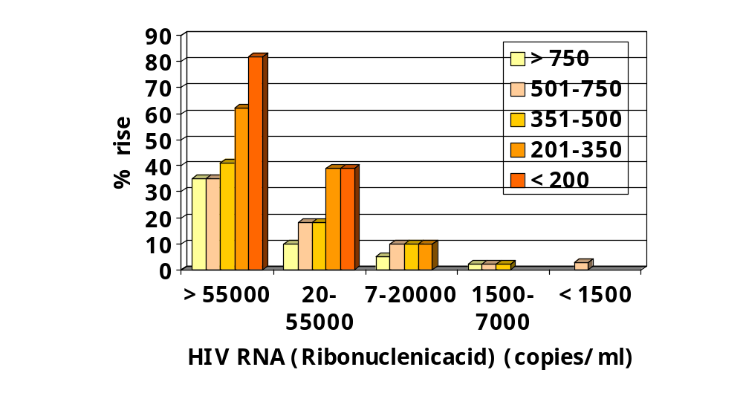
DEVELOPMENT OF AIDS WITHIN THREE YEARS WITHOUT ARV (Antiretroviral)

Slide 14


RECOMMENDED STRATEGY FOR HIV TESTING
TO BE USED IN BLOOD BANKS
  A Single ELISA test is sufficient
  Positive ELISA discard the blood bag
TO BE USED FOR SURVEILLANCE PURPOSES ONLY
  Two ELISA tests or one ELISA and one RIA (Rapid immunoassay) is to be used. If both tests are positive, sample is positive.
USED FOR DIAGNOSTIC PURPOSE
  Three ELISA and for RIA from different Companies using different antigens to be employed.

Slide 15

HIV Risk Reduction
Avoid unprotected sexual contact
Use barriers such as condoms and dental dams
Limit multiple partners by maintaining a long-term relationship with one person
Talk to your partner about being tested before you begin a sexual relationship
Contd…..

Slide 16

HIV Risk Reduction
Avoid drug and alcohol use to maintain good judgment
Don’t share needles used by others for:
  Drugs
  Tattoos
  Body Piercing
Avoid exposure to blood products

Slide 17
THANK YOU
For further details :
WeHELP
Email: info@whowehelp.org
Url: www.whowehelp.org

