Slide 1
DF
DataOps Innovation Hackathon 2026 · Problem Statement 2
DocForensics
AI-Powered Document Forensics & Contextual Intelligence System
OCR tells you what a document says. DocForensics tells you whether to believe it, and shows you exactly where to look.
Presented by veekshanag8-beep
B.Tech CSE
github.com/veekshanag8-beep/Document-Forensics-and-Contextual-Intelligence-System
Notes:
Introduce the project in one line: we turn document processing from extraction into investigation.

Slide 2
OCR extracts text. It does not establish trust
Loan and KYC files are verified field by field, so the most damaging manipulations slip through
Altered fields
Hidden contradictions
Manipulated artefacts
A salary figure retyped over the original, a value pasted into a scan. OCR reads the forged value perfectly.
Each document looks fine alone. Only together do the name, date of birth, income and bank credits disagree.
Copied signatures, edited PDFs, spliced images. Visible only in how the file and pixels were produced.
What is needed: a system that understands structure, examines visual characteristics, correlates documents and explains every anomaly with evidence.
DocForensics · DataOps Innovation Hackathon 2026
2
Notes:
Three classes of manipulation that field-level OCR validation misses.

Slide 3
Three independent lenses, one corroborated verdict
Each document is examined three ways. When independent methods agree on a field, confidence rises
File & pixel forensics
Corroborated anomaly
1
How was this file and image produced? Hidden text, fonts, revisions, scanner noise, ELA, signatures.
Visual forensics AND contextual logic both point at the same field, so we raise confidence and say exactly why.
Internal logic
2
Do the values inside the document make sense? Arithmetic, check digits, age vs DOB, running balances.
Observation
Inconsistency
Cross-document
3
Potential manipulation
Does it agree with every other document? Name, DOB, ID, address, income, salary credit, account.
Never "fraud": a status ladder plus a human reviewer for every consequential decision.
DocForensics · DataOps Innovation Hackathon 2026
3
Notes:
Core idea: independence of evidence. A visual signal alone can be noise; a logic error alone can be a typo; together on the same field they are strong evidence.

Slide 4
End-to-end investigation pipeline
Ten stages, live progress, each one audit-logged
1
2
3
4
5
Submission
Classification
OCR & extraction
Structure
Visual forensics
SHA-256, originals immutable
4 types + unknown, confidence
PDF text layer or RapidOCR
fields, tables, sections
PDF + scan + signature
6
7
8
9
10
Contextual checks
Cross-document
Investigation
Evidence
Dossier
arithmetic, checksums, dates
entity matching + graph
link & corroborate findings
crops, annotated pages
HTML / PDF / JSON + audit
Row 1: understand the documents Row 2: investigate them
DocForensics · DataOps Innovation Hackathon 2026
4
Notes:
Mirrors the required flow in the problem statement exactly.

Slide 5
Architecture
Lightweight, offline-capable, explainable by design
Investigation Console
FastAPI service
Forensic pipeline
Evidence store
HTML / JS, no build step
upload, live progress
viewer, graph, reviews
REST API
background worker per case
dossier rendering
ingest, extract, forensics
context, cross-document
correlate, explain
SQLite + files
hash-chained audit log
reviewer decisions
OCR
RapidOCR (PaddleOCR models, ONNX)
Matching
rapidfuzz entity resolution
PDF
PyMuPDF: text layer, fonts, drawings, metadata
LLM
Claude (optional) writes the narrative from structured findings only
Vision
OpenCV + NumPy: ELA, noise residuals, geometry
Data
synthetic generator with ground truth for evaluation
DocForensics · DataOps Innovation Hackathon 2026
5
Notes:
The LLM never decides a status; it only narrates. That limits hallucination and prompt-injection risk.

Slide 6
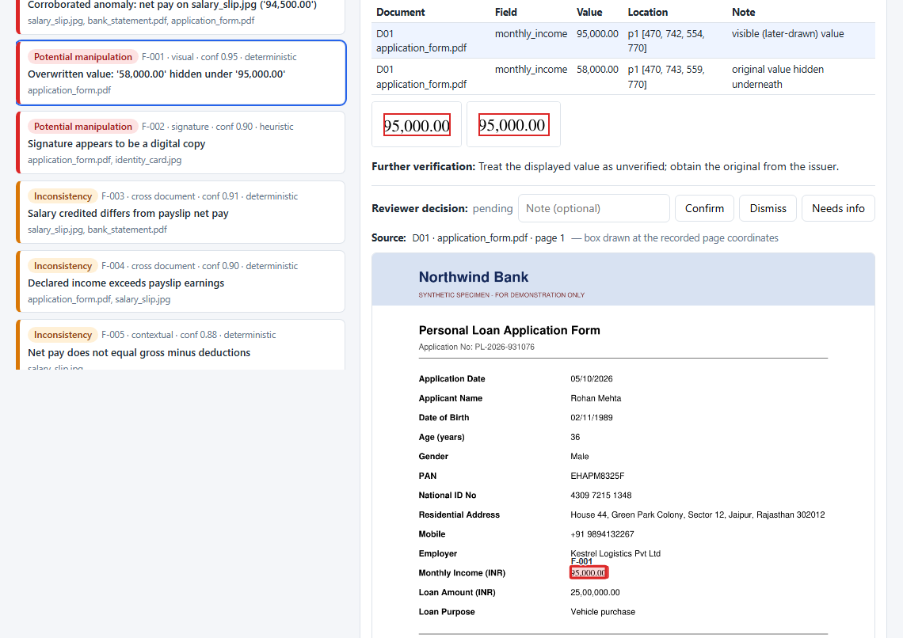
Visual forensic analysis
Looking at how the document was made, not just what it says
▸ Overwritten text: a value typed over a white box; the original still sits in the PDF text layer
▸ Typography: a font or size used nowhere else on the form
▸ Revision metadata: incremental saves, editor software, modified after creation
▸ Scanner-noise map: a digitally pasted patch has no sensor noise
▸ Error Level Analysis: inserted content recompresses differently
▸ Text geometry: baseline, height and alignment outliers
▸ Signatures: missing ink, or a pixel-identical copy (0.97 vs 0.19-0.59 for real ones)
Original 58,000 found hidden under the displayed 95,000 (deterministic evidence)
DocForensics · DataOps Innovation Hackathon 2026
6
Notes:
Deterministic checks (hidden text) are reported with high confidence; statistical ones (ELA) are downgraded to observations unless strong.

Slide 7
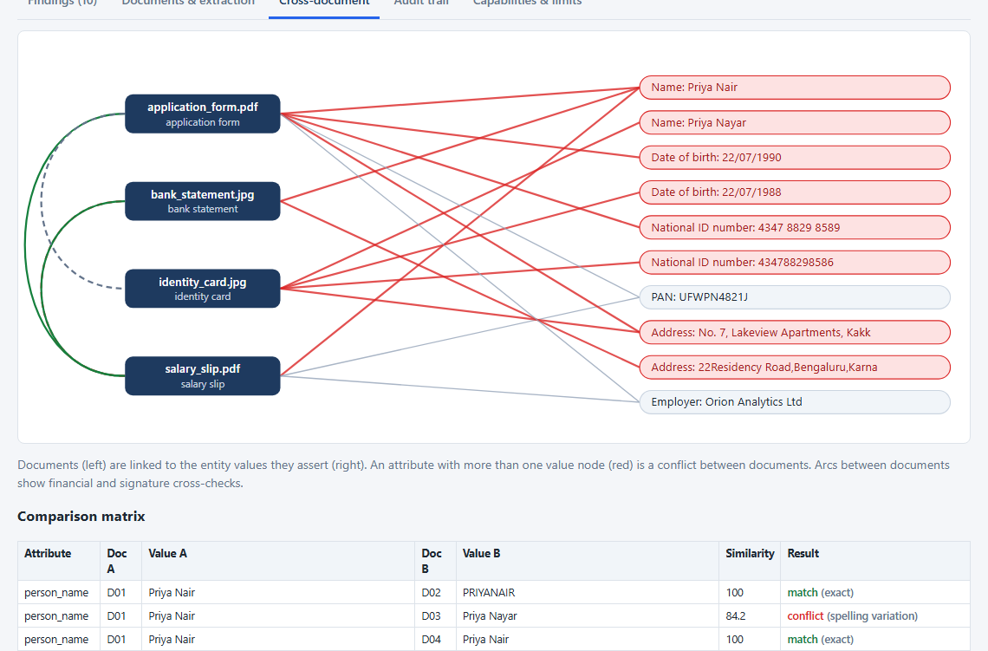
Contextual intelligence across documents
The largest scoring criterion, handled by reasoning, not keywords
Within a document
▸ Verhoeff check digit on ID numbers; PAN / IFSC format
▸ Stated age vs date of birth
▸ Payslip: components, then gross - deductions = net
▸ Running balance: pinpoints the single wrong figure
Across documents
▸ Name, DOB, ID, PAN, address (PIN-aware), employer
▸ Declared income vs payslip gross
▸ Payslip net pay vs bank salary credit
▸ Tolerates 'Pvt Ltd' variants; flags real conflicts
Entity graph: red nodes are values that conflict between documents
DocForensics · DataOps Innovation Hackathon 2026
7
Notes:
Example reasoning: when components add up but net pay does not, the system names net pay as the figure that does not fit.

Slide 8
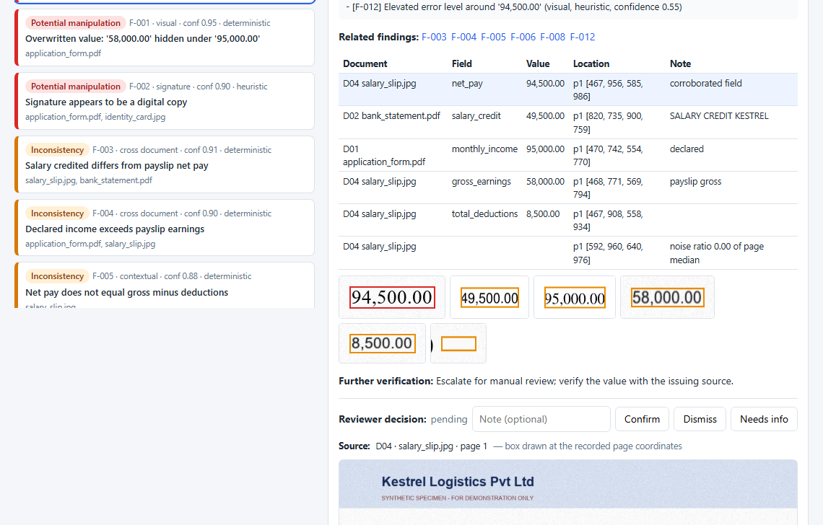
Explainable, evidence-backed findings
Every finding answers: what, where, how sure, and why it matters
Status
observation / inconsistency / potential manipulation
Basis
deterministic fact or heuristic signal
Confidence
per finding; corroboration combines them
Evidence
document, field, value, page + pixel box, crop
Explanation
plain-language reasoning with the numbers
Next step
what a human should verify, and with whom
DocForensics · DataOps Innovation Hackathon 2026
8
Notes:
Show the corroborated anomaly: three independent findings on the same Net Pay field.

Slide 9
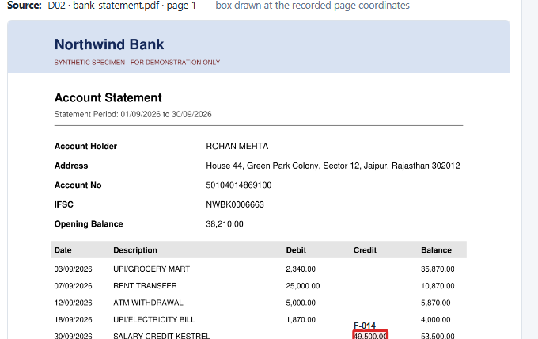
Traceability, audit and human oversight
Inspired by ISO/IEC 27037 / 27042 and NIST SP 800-86
1
Integrity
originals hashed (SHA-256) at intake and re-verified in the dossier
2
Traceability
every evidence item carries page + pixel coordinates; one click jumps to the region
3
Audit trail
each action hash-chained, so editing the log breaks the chain
4
Oversight
reviewers confirm / dismiss / request info; logged and reported
DocForensics · DataOps Innovation Hackathon 2026
9
Notes:
Judges' checklist: trace selected findings back to original locations, demonstrate potential vs confirmed.

Slide 10
Results on the demonstration dataset
Genuine and manipulated synthetic documents with a ground-truth key
17/17
planted anomalies detected
0
false positives (genuine case clean)
12
documents across 3 cases + 2 failure files
~20 s
per 4-document case on a laptop CPU
Honest caveat: the data is synthetic and thresholds were tuned on it. These numbers prove each capability works end to end, not real-world accuracy.
DocForensics · DataOps Innovation Hackathon 2026
10
Notes:
Mention that the evaluation script regenerates these numbers from scratch: scripts/evaluate.py.

Slide 11
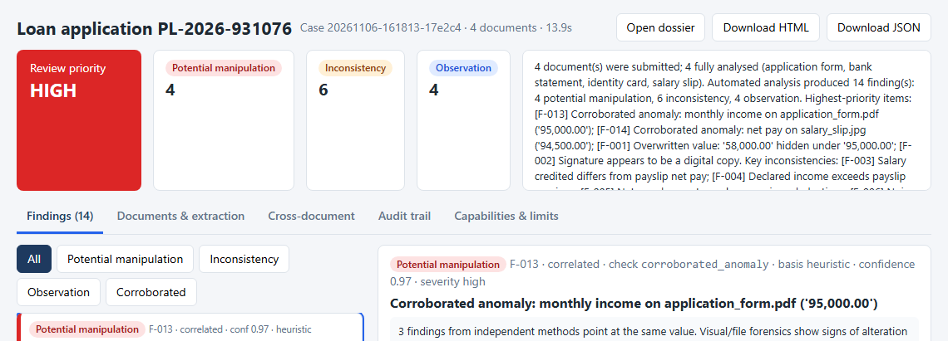
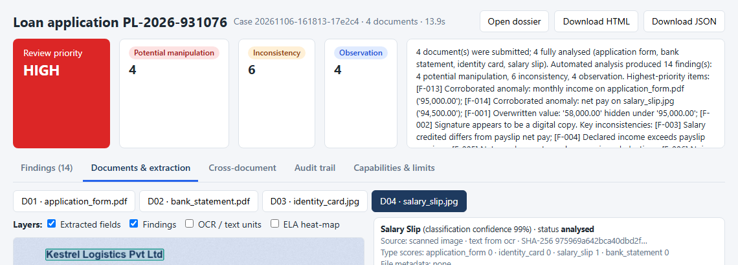
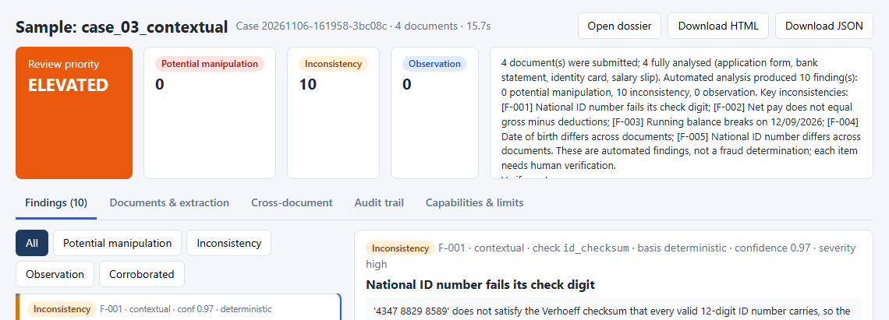
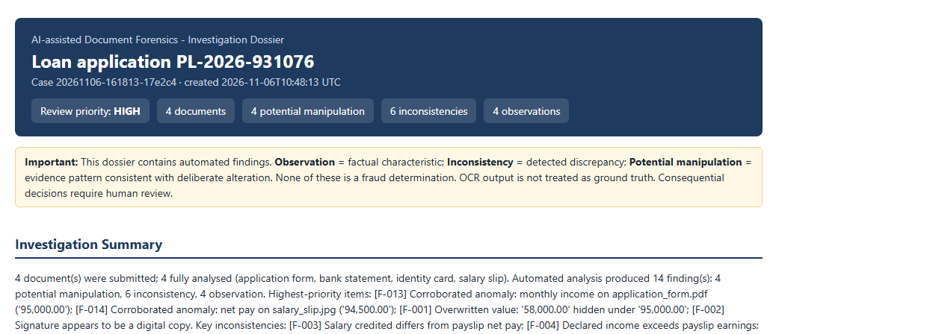
The investigation console
Upload, follow progress live, inspect evidence, review, export the dossier
Summary and prioritised findings
Structured extraction + overlays
Contextual case: 10 inconsistencies
Investigation dossier
DocForensics · DataOps Innovation Hackathon 2026
11
Notes:
Switch to the live demo here if time allows.

Slide 12
Responsible by design
Built around the safety and integrity requirements of the problem statement
Safeguards
Known limitations
▸ Only synthetic documents (fictional people and organisations)
▸ OCR output is never treated as ground truth
▸ No finding is labelled fraud; statuses + basis + confidence
▸ Human reviewer for every consequential decision
▸ LLM sees structured findings only, never decides a status
▸ Corrupted / unsupported files fail safely, honestly reported
▸ Thresholds calibrated on synthetic data only
▸ Handwriting OCR is weak; English only
▸ Signature check detects copies, not skilled forgeries
▸ ELA / noise can be fooled by re-scanning or heavy compression
▸ Four document schemas; others classified 'unknown'
▸ Full list with false-positive sources in docs/LIMITATIONS.md
DocForensics · DataOps Innovation Hackathon 2026
12
Notes:
Being explicit about limits is part of the evaluation (safe failure, honest capability reporting).

Slide 13
How we address the judging criteria
Criterion | Points | What we built
OCR & Information Extraction | 15 | Text layer + OCR, field confidence, fragment repair, tables
Document Understanding | 15 | Classification, label-value layout, sections, missing / duplicate fields
Visual Forensic Analysis | 15 | Hidden text, fonts, revisions, noise, ELA, geometry, signatures
Contextual Intelligence | 20 | Arithmetic, checksums, cross-document entities, graph, corroboration
Evidence & Traceability | 10 | Pixel boxes, crops, annotated pages, SHA-256, audit chain
AI Reasoning & Explainability | 10 | Reasoned explanations, culprit detection, optional Claude narrative
Technical Implementation | 10 | Modular pipeline, REST API, safe failure, evaluation script
Innovation | 5 | Corroboration across independent methods, tamper-evident audit
DocForensics · DataOps Innovation Hackathon 2026
13
Notes:
Map every 100-point criterion to concrete features.

Slide 14
What's next
1
Calibrate on real data
authorised real samples to tune thresholds and measure true accuracy
Thank you
2
Learned models
Source code
github.com/veekshanag8-beep/
Document-Forensics-and-Contextual-
Intelligence-System
Run it: setup.ps1, then run.ps1
LayoutLM / Donut for extraction; trained splice and copy-move localisation
3
More documents
utility bills, tax returns, multilingual and handwritten forms
4
Integration
API hooks into loan-origination and KYC workflows
From extraction to investigation: contextual, evidence-driven and explainable.
DocForensics · DataOps Innovation Hackathon 2026
14
Notes:
Close with the tagline and invite questions.

