Slide 1
Palaeoclimate Stability and Modern Biodiversity
Team Name : ERPB
Mani Bhavana (2024101053)
Charishma (2024101097)
Mokshitha (2024101059 )
Veekshita Sai (2024102026)

Slide 2
Problem Statement
Are present biodiversity-rich regions disproportionately associated with long-term climatic stability?
Biodiversity is unevenly distributed across the world, and one possible explanation is that regions with greater long-term climatic stability may have allowed species to persist and diversify over time. This project investigates whether present day biodiversity rich regions are disproportionately associated with stable past climate conditions by comparing palaeoclimate data with modern species richness records.

Slide 3
Objectives
Measure modern species richness from GBIF occurrence records on a common grid.
Measure climatic stability since the Last Glacial Maximum (LGM) from PaleoClim and
WorldClim temperature layers.
Test whether richness and stability are related, after controlling for sampling effort and latitude.
Check whether the two palaeoclimate sources agree with each other.
Find cells that are both rich and stable (possible refugia) and cells that are rich but not
stable.
Check that the result is robust to grid size (2° and 5°).
Remaining: add precipitation, IUCN ranges and the Copernicus DEM.

Slide 4
Data Given
Dataset | What we use | Resolution / size | Status
PaleoClim | BIO1 (mean annual temperature): Current, Late Holocene, LGM | 10 arc-min rasters | Done
WorldClim palaeoclimate | BIO1: Present, Mid-Holocene, LGM (CCSM4 simulation) | 10 arc-min rasters | Done
GBIF | Species occurrence records (speciesKey, latitude, longitude) | 18,000 raw, 17,396 clean records, 6,080 species | Done
IUCN | Species range maps | - | Planned
Copernicus DEM | Elevation (proxy for refugia) | - | Planned
BIO1 is the standard WorldClim variable for mean annual temperature. Rasters are in °C x 10 and are converted to °C.
The GBIF files are a sampled download, not the full GBIF archive, and they mix all taxonomic groups.

Slide 5
Data: GBIF Records and Cleaning
Region file | Records (sampling cap)
Africa | 5,000
Asia | 5,000
Europe | 5,000
North America | 1,000
South America | 1,000
Oceania | 1,000
Total raw | 18,000
Cleaning steps
Renamed decimalLatitude / decimalLongitude to lat / lon;
speciesKey is the species ID.
Dropped rows with missing species or coordinates.
Dropped duplicates, out-of-range coordinates and (0, 0) points.
After cleaning | Value
Clean records | 17,396
Unique species | 6,080
Caps differ by continent, so Africa, Asia and Europe are sampled more heavily than the other three.
GBIF richness here means "observed richness in this sample". It is not true biodiversity.

Slide 6
Methodology
1. Richness
Divide the world into 5° x 5° cells. Richness = number of unique species in a cell (GBIF). 375 cells have records.
2. Stability
From BIO1 at three time slices, compute stability metrics for each record location (lower value = more stable).
3. Cell values
Sample the climate rasters at the 17,396 GBIF points and average per cell: 375 cells (PaleoClim), 374 cells (WorldClim).
4. Filter
Keep only cells with at least 10 GBIF records, because cells with few records give unreliable richness. This leaves 188 cells.
5. Statistics
Spearman correlation() between richness and stability. Partial Spearman controlling for sampling effort (log records per cell) and absolute latitude. Quartile comparison, dataset agreement, hotspot map.
Repeat the full analysis at 2° (264 cells) and at 5° (188 cells).
6. Robustness

Slide 7
Methodology: How Stability Is Measured
Metric | Definition | Meaning
LGM change | |BIO1 present - BIO1 LGM| | Main measure. Large value = climate changed a lot since the ice age
Holocene change | |BIO1 present - BIO1 Holocene| | Small everywhere (max about 2.4 °C), so adds little
Instability | SD of BIO1 across the 3 time slices | Second stability measure, used as a check
Lower value = more stable climate.
Time slices: PaleoClim = Current, Late Holocene, LGM. WorldClim = Present, Mid-Holocene (about 6 ka), LGM.
Spearman correlation: ρ = 1 − [ 6 Σ dᵢ² ] / [ n (n² − 1) ], where dᵢ = rank of richness − rank of stability in cell i, and n =
188 cells
Partial Spearman: rank richness, stability, log(records) and |latitude|. Regress each ranked variable on log(records) and
|lat|, then take the correlation of the residuals: partial ρ = Spearman( e_richness, e_stability )

Slide 8
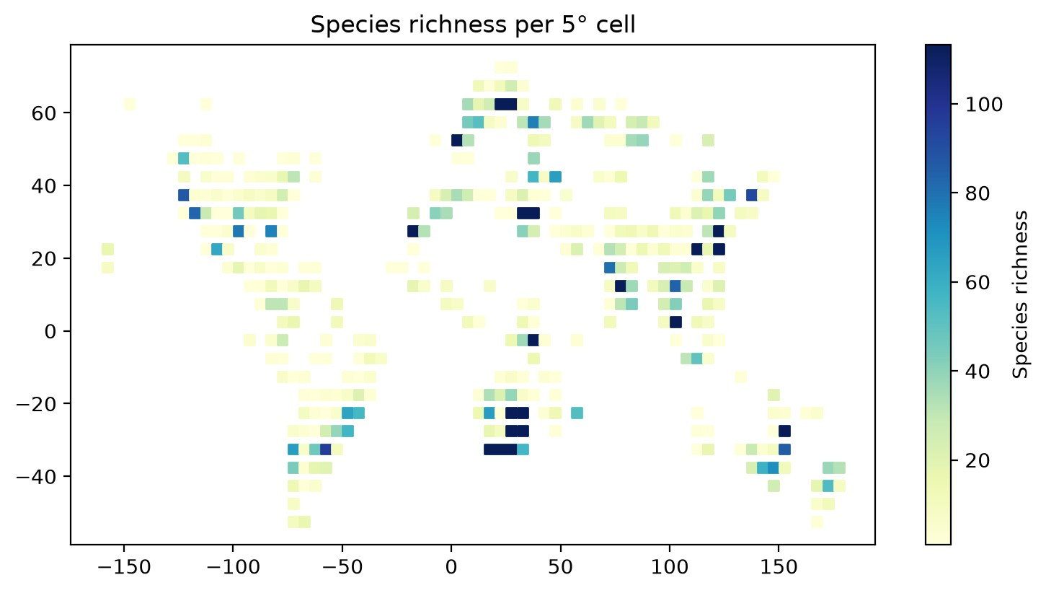
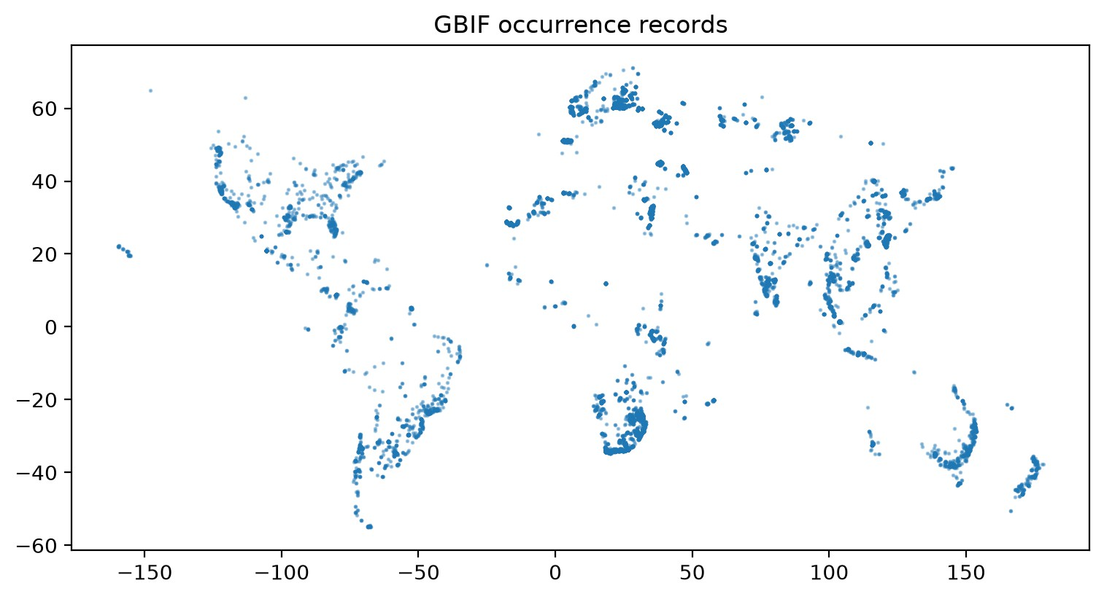
Results: GBIF Species Richness
Measure | Value
Grid cells with records | 375
Richness per cell: median / mean / max | 9 / 26.6 / 453
Records per cell: median / mean / max | 10 / 46.4 / 1,757
Cells with at least 10 records | 188
Cells with at least 20 records | 125
Records are denser in North America, Europe, South Africa, India and eastern Australia.
187 of 375 cells have fewer than 10 records.

Slide 9
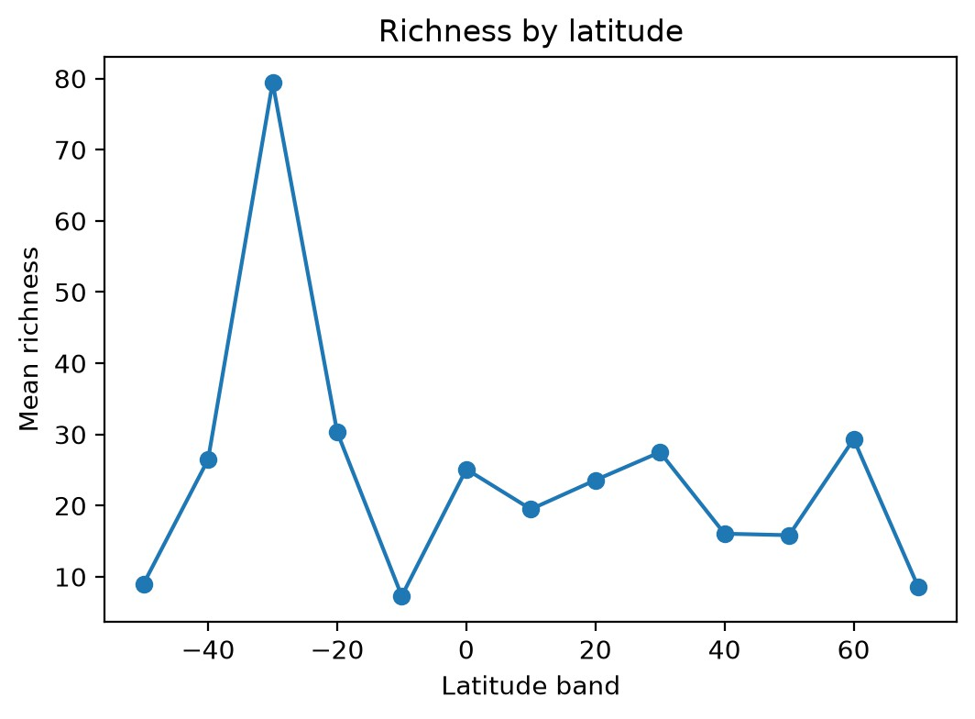
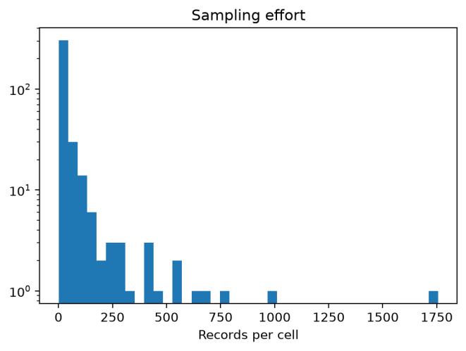
Results: Richest Cells and Sampling Effort
Cell centre (lat, lon) | Richness | Records | Region
-27.5, 32.5 | 453 | 619 | NE South Africa / S Mozambique
-32.5, 17.5 | 451 | 756 | Western Cape, South Africa
-22.5, 32.5 | 437 | 662 | Kruger / S Mozambique
-27.5, 27.5 | 373 | 556 | Interior South Africa
22.5, 122.5 | 312 | 422 | Taiwan
2.5, 102.5 | 289 | 445 | Peninsular Malaysia / Singapore
-32.5, 27.5 | 240 | 351 | Eastern Cape, South Africa
-32.5, 22.5 | 224 | 302 | Southern South Africa
27.5, -17.5 | 195 | 301 | Canary Islands
27.5, 122.5 | 170 | 224 | East China coast
Mean richness by latitude band
Six of the 10 richest cells are in South Africa.
The single peak near 30°S (about 80 species) comes from these South African cells. There is no clean tropical peak, which points to a sampling effect.
Records per cell (log scale)

Slide 10
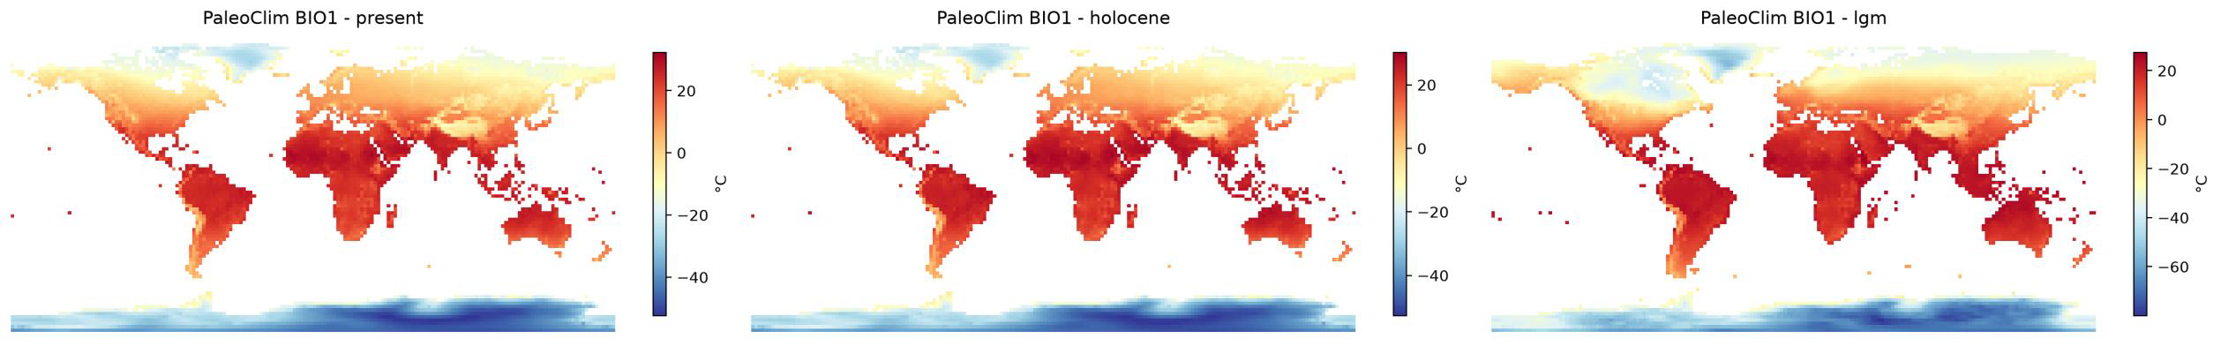
Results: PaleoClim BIO1 at Three Time Slices
Present
Late Holocene
Last Glacial Maximum
Global BIO1 (°C) | Min | Max | Mean
Present | -52.3 | 32.2 | -2.78
Late Holocene | -52.6 | 30.1 | -3.48
LGM | -79.9 | 27.3 | -15.07
LGM is the coldest period and the Holocene is close to present, as expected.
Global means are low because Antarctica and Greenland are included. They are plain grid averages, not area-weighted, so they are not true global means.

Slide 11
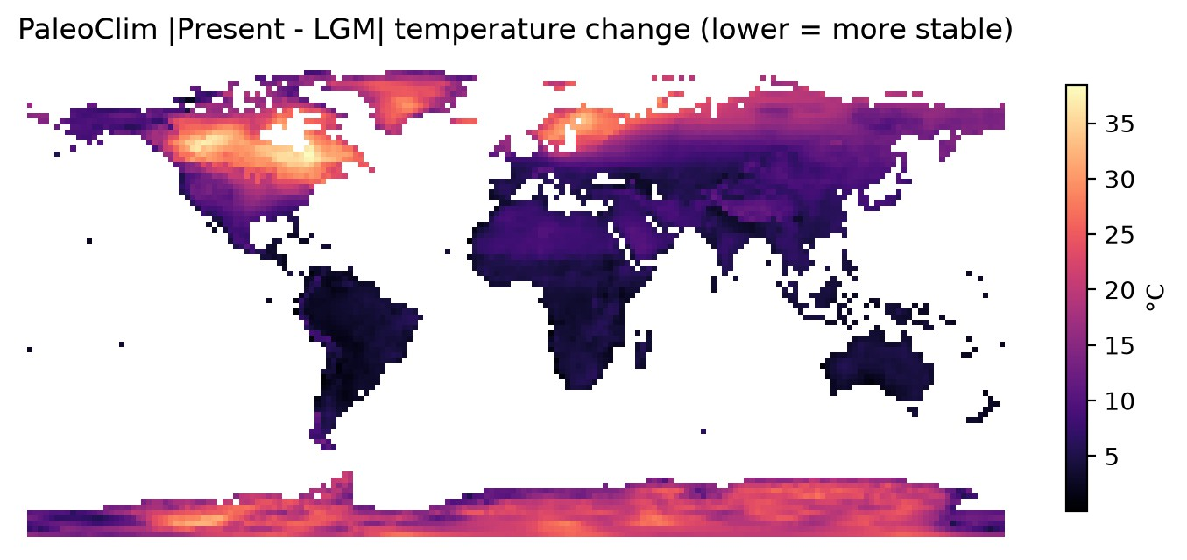
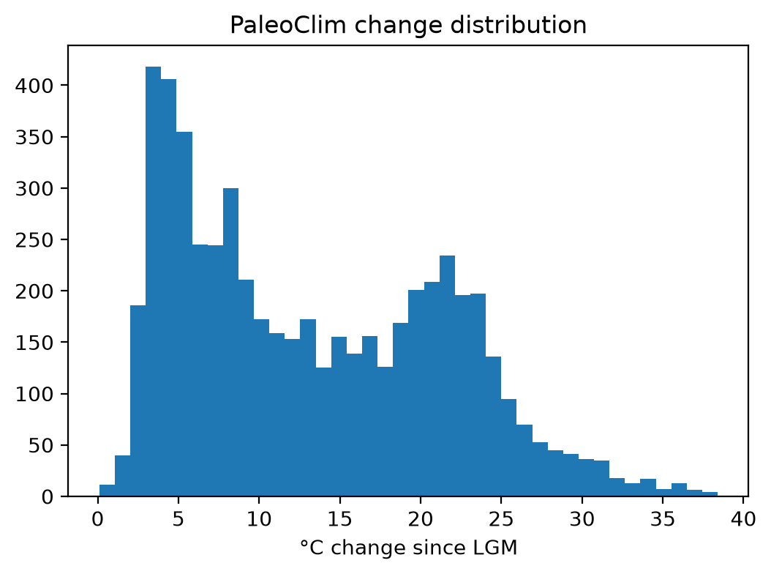
Results: PaleoClim Stability
|Present - LGM| change (lower = more stable)
Global change distribution
Across 375 GBIF cells | Min | Median | Mean | Max
LGM change (°C) | 0.10 | 4.70 | 7.29 | 33.92
Late Holocene change (°C) | 0.00 | 0.60 | 0.64 | 2.22
Instability, SD (°C) | 0.53 | 2.56 | 4.07 | 19.50
Stable cells (change < 10 °C): 307 (82%). Moderate (10-
20 °C): 34. Unstable (> 20 °C): 34.
Biggest change (30-35 °C) is in ice-covered northern
North America and Eurasia. Tropics change least.
LGM change vs |latitude|: Spearman rho = 0.52.

Slide 12
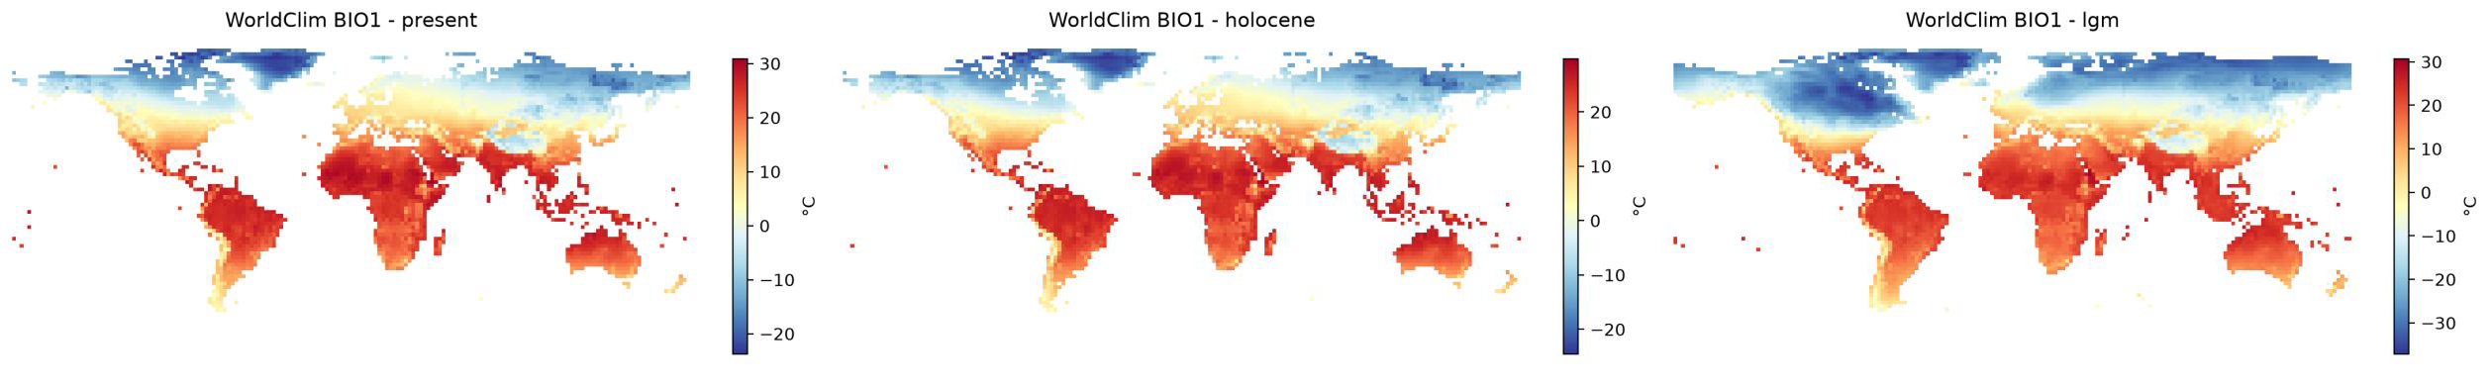
Results: WorldClim BIO1 at Three Time Slices
Present
Mid-Holocene (CCSM4)
Last Glacial Maximum (CCSM4)
Global BIO1 (°C) | Min | Max | Mean
Present | -23.7 | 30.8 | 8.15
Mid-Holocene | -24.5 | 29.7 | 7.09
LGM | -37.1 | 30.6 | -2.03
Ordering is correct: LGM coldest, mid-Holocene slightly cooler than present.
Antarctica is not in these rasters, so means are higher than
in PaleoClim.
The past climate here comes from one climate model (CCSM4).

Slide 13
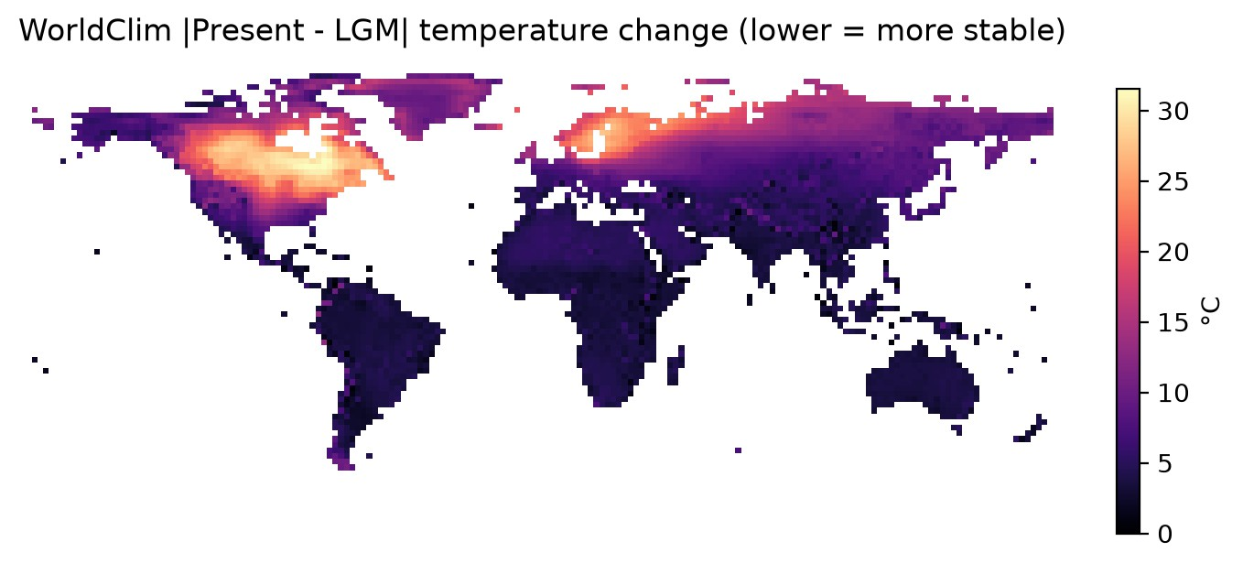
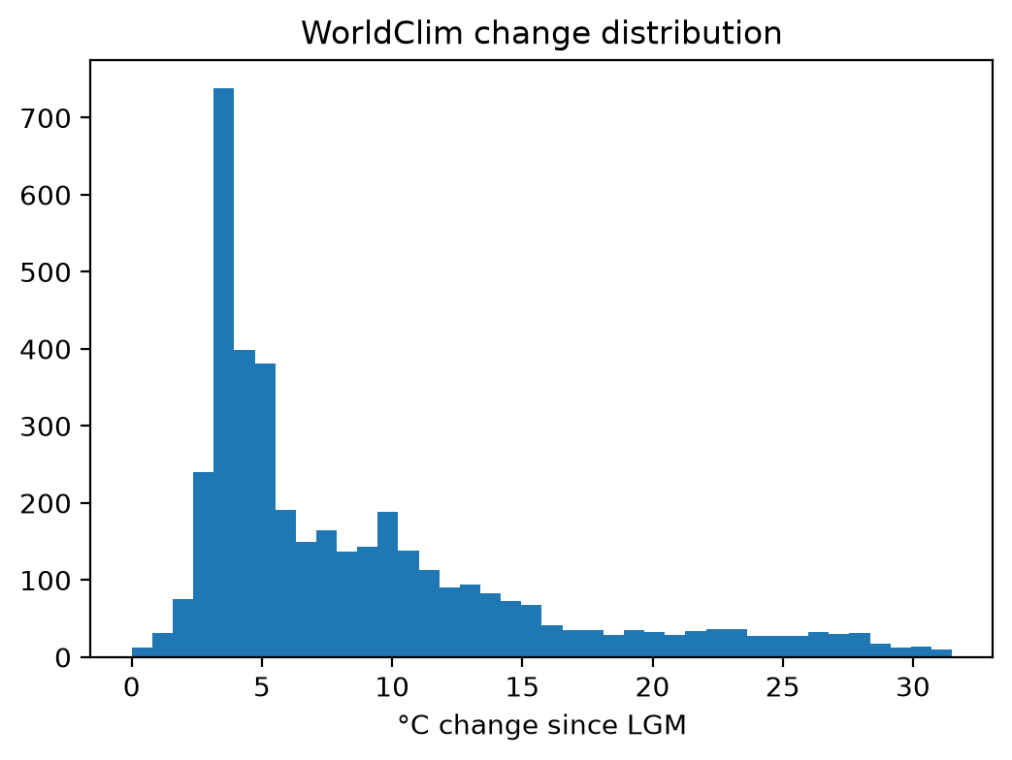
Results: WorldClim Stability
|Present - LGM| change (lower = more stable)
Global change distribution
Stable cells (change < 10 °C): 314 (84%). Moderate: 31.
Unstable (> 20 °C): 29.
Same pattern as PaleoClim: largest change under former
ice sheets, smallest in the tropics.
LGM change vs |latitude|: Spearman rho = 0.69.
Across 374 GBIF cells | Min | Median | Mean | Max
LGM change (°C) | 1.60 | 3.85 | 6.47 | 27.60
Mid-Holocene change (°C) | 0.00 | 0.78 | 0.83 | 2.43
Instability, SD (°C) | 0.82 | 2.02 | 3.55 | 15.65

Slide 14
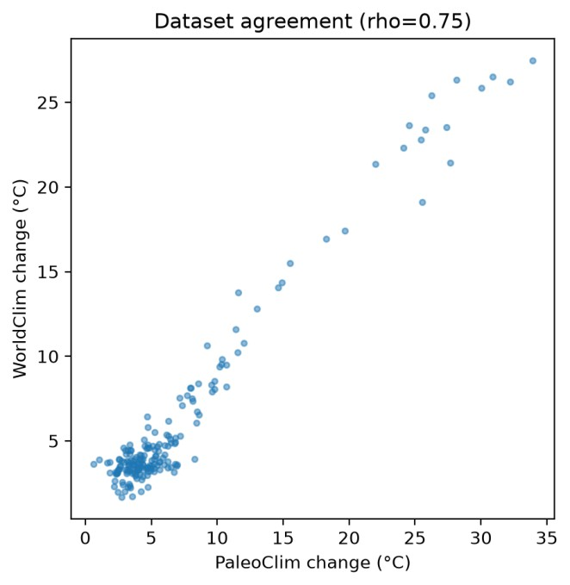
PaleoClim vs WorldClim: Do the Two Sources Agree?
 | PaleoClim | WorldClim
Source | CHELSA-based reconstruction | CCSM4 climate model simulation
Mid / late Holocene slice | Late Holocene | Mid-Holocene (about 6 ka)
Cells with climate values | 375 | 374
Mean LGM change (°C) | 7.30 | 6.47
Max LGM change (°C) | 33.9 | 27.6
Unstable cells (> 20 °C) | 34 | 29
LGM change vs |latitude| (rho) | 0.52 | 0.69
Agreement on the 188 analysed cells
Spearman rho between the two LGM change values: 0.75 on the 188 analysed cells and 0.78 on all shared cells. The two sources rank cells similarly.
PaleoClim shows larger change at high latitudes.

Slide 15
Integration: Cells Used in the Analysis
Step | Cells
GBIF cells with records | 375
After merging with PaleoClim and WorldClim | 374
Cells with at least 10 GBIF records (analysed) | 188
Richness = unique species per 5° cell. Stability = LGM change and instability (SD across slices).
Control variables: log(records per cell) for sampling effort, and |latitude|.
Latitude is controlled because stability depends strongly on it (rho = 0.52 and 0.69).

Slide 16
Results: Richness vs Climatic Stability
Dataset | Stability metric | n | Spearman rho | p | Partial rho | Partial p
PaleoClim | LGM change | 188 | -0.053 | 0.468 | -0.207 | 0.004
PaleoClim | Instability | 188 | -0.046 | 0.530 | -0.212 | 0.003
WorldClim | LGM change | 188 | 0.011 | 0.880 | -0.114 | 0.120
WorldClim | Instability | 188 | 0.029 | 0.696 | -0.102 | 0.163
Without controls, rho is about zero (-0.053 to 0.029, p > 0.46). There is no raw relationship.
After controlling for sampling effort and latitude, PaleoClim gives a weak negative relationship (partial rho about -0.21, p <= 0.004): richer cells are slightly more stable.
WorldClim has the same direction but is not significant (partial rho -0.10 to -0.11, p > 0.12).
A partial rho of about -0.2 means stability explains only a small share of richness.

Slide 17
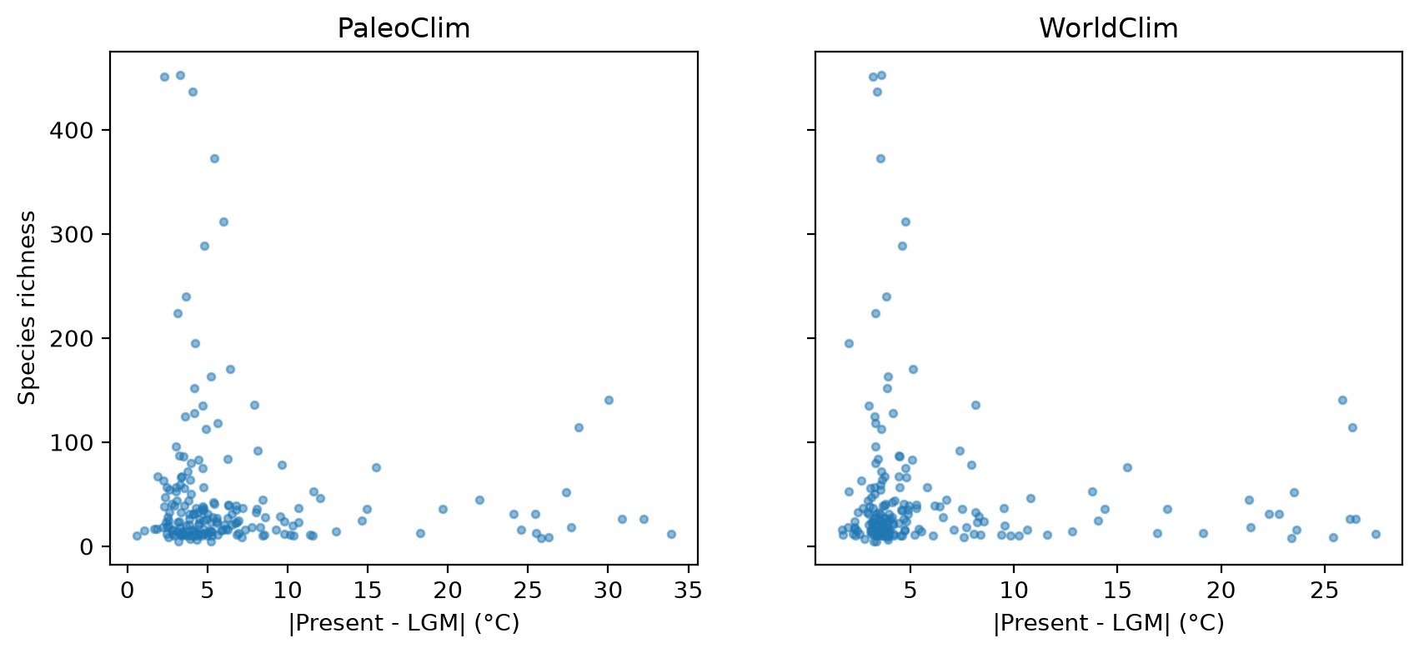
Richness vs LGM Temperature Change
The richest cells (over 250 species) all have small LGM change, about 2-6 °C.
But many low-richness cells also have small change, so a stable climate alone does not give high richness.
Cells with large change (over 20 °C) all have low richness (below about 140 species).
Both datasets show the same shape.

Slide 18
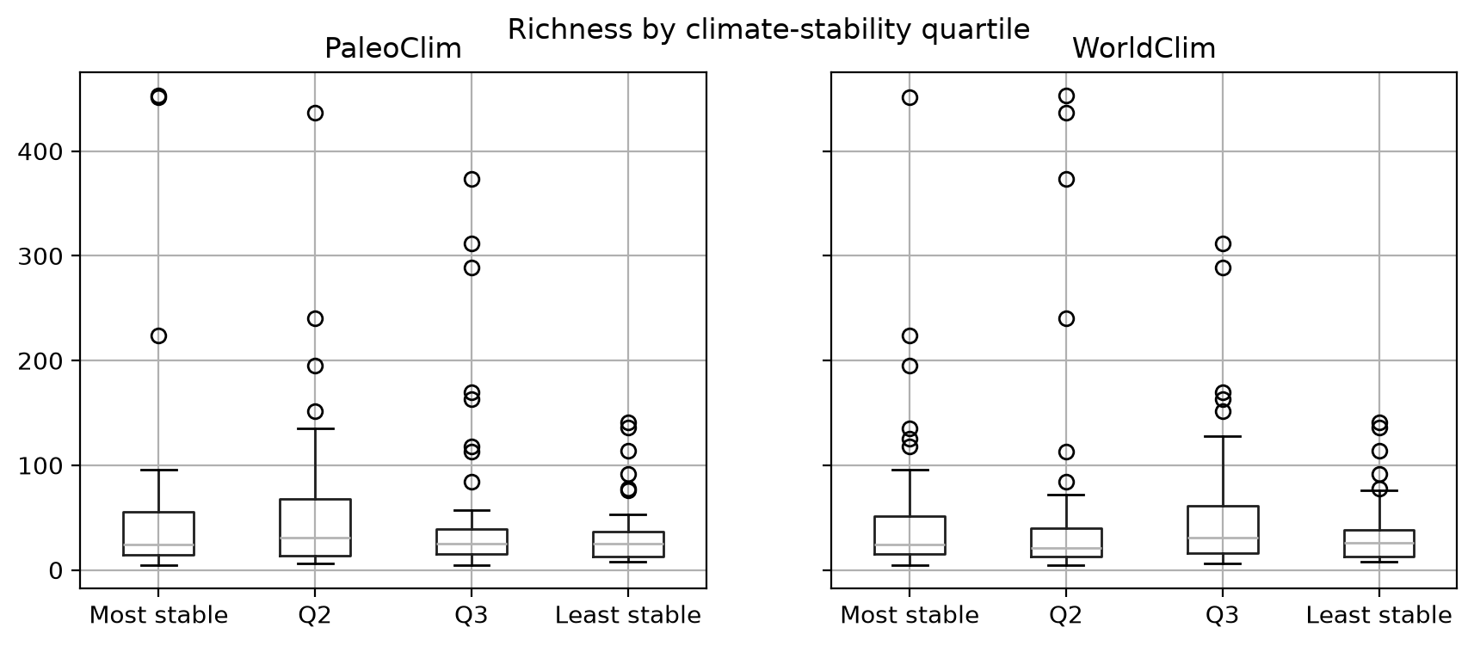
Richness by Stability Quartile
Mean richness | Most stable | Q2 | Q3 | Least stable
PaleoClim (mean) | 54.0 | 56.5 | 53.9 | 34.3
PaleoClim (median) | 24 | 31 | 25 | 25
WorldClim (mean) | 51.7 | 57.4 | 54.8 | 34.7
WorldClim (median) | 24 | 21 | 31 | 26
The least stable quartile has the lowest mean richness (about 34 vs 52-57) in both datasets.
The three more stable quartiles are similar to each other.
Medians are close in all quartiles, so the means are pulled up by a few very rich cells.
47 cells in each quartile

Slide 19
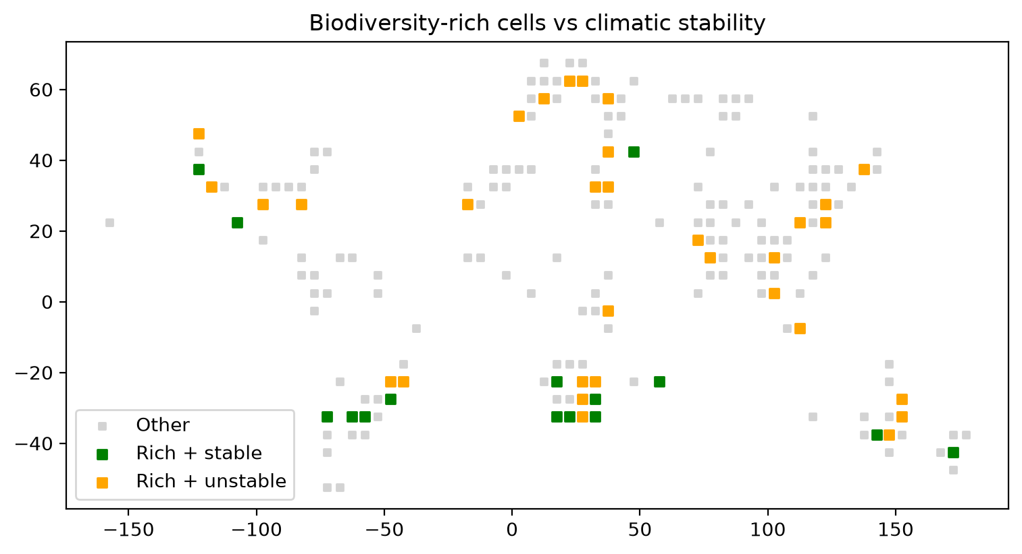
Hotspots: Rich and Stable vs Rich but Not Stable
Group | Cells
Rich + stable | 15
Rich but not in most-stable quartile | 32
All rich cells (top 25%) | 47
Rich + stable cells are mostly in the southern hemisphere: South Africa, southern South America, Australia and New Zealand.
The stable quartile is only 25% of all cells, so 15 of 47 (32%) is slightly above chance.
Rich cells are not restricted to stable areas.

Slide 20
Robustness Check: 2° vs 5° Grid
 | 2° grid | 5° grid
Cells after merge | 889 | 374
Cells analysed | 264 | 188
Partial rho, PaleoClim LGM change | -0.209 (p = 0.001) | -0.207 (p = 0.004)
Partial rho, WorldClim LGM change | -0.176 (p = 0.004) | -0.114 (p = 0.120)
Dataset agreement rho | 0.718 | 0.75
Rich + stable / rich + not stable cells | 17 / 50 | 15 / 32
The PaleoClim result is almost identical at both grid sizes, so it is robust to cell size.
The WorldClim result weakens and loses significance at 5°. Part of this is the smaller sample.
The direction (negative partial rho) is the same in every case.

Slide 21
Fastovich et al. (2024)
Legacies of millennial-scale climate oscillations in contemporary biodiversity in eastern North America
Research paper link: https://pmc.ncbi.nlm.nih.gov/articles/PMC10999273/
What this paper suggested
Tested 13 palaeoclimate estimates (simulations and proxy reconstructions) against modern richness of amphibians, birds, mammals, reptiles and trees.
For some taxa the strength and direction of the relationship changed between estimates, so results should not rest on a single palaeoclimate source.
The reason behind our approach
We used two palaeoclimate sources (PaleoClim and WorldClim) instead of one.
We checked that they agree on which cells are stable (rho = 0.75) and reported results separately for each dataset.
The result did differ by source: significant in PaleoClim, not significant in WorldClim.

Slide 22
Rakotoarinivo et al. (2013)
Palaeo-precipitation is a major determinant of palm species richness patterns across Madagascar
Research paper link: https://pmc.ncbi.nlm.nih.gov/articles/PMC3619483/
What this paper suggested
Used LGM climate reconstructions to explain palm richness in Madagascar, and found a palaeoclimate signal even after controlling for modern environment.
Estimates differed between reconstructions (MIROC3.2 gave a weaker, negative effect than CCSM3), and precipitation mattered more than temperature.
The reason behind our approach
We measured stability as change between the LGM and present, and controlled for sampling effort and latitude before testing it.
We noted that our WorldClim past climate comes from a single model (CCSM4), so model bias is possible.
Precipitation is listed as future work, because this paper shows it can matter.

Slide 23
Xu et al. (2019)
Palaeoclimate and woody plant diversity in China (LGM-to-present anomalies)
Research paper link: https://link.springer.com/article/10.1007/s11442-019-1650-x
What this paper suggested
Palaeoclimate explained only about 1.1% of woody plant richness in China.
Its effect largely overlapped with current climate, but it was more influential for phylogenetic structure.
The reason behind our approach
Because modern climate and history overlap, we controlled for |latitude| and sampling effort.
We expected only a weak link, and found one: partial rho about -0.21 in PaleoClim.
Single taxonomic groups and other diversity measures are listed as future work.

Slide 24
Scheiter et al. (2026)
The Effects of Biome Stability During the Quaternary on Plant Diversity
Research paper link: https://onlinelibrary.wiley.com/doi/abs/10.1002/ece3.73884
What this paper suggested
Modelled biome stability across 2,605 time slices over the last 2.6 million years.
Stability matched richness in tropical rainforests, but globally the overlap between stable biomes and richness hotspots was weak.
The reason behind our approach
We compared rich and stable cells (15) with rich but not stable cells (32).
From this paper, we found hotspots are not limited to stable areas.
Our conclusion is also similar: support for the stability hypothesis is weak.

Slide 25
Magneville et al. (2025)
Echoes of the Past: Long-Term Climate Stability Shapes Functional and Phylogenetic Diversity in Euro-Mediterranean Forests
Research paper link: https://onlinelibrary.wiley.com/doi/abs/10.1111/geb.70177
What this paper suggested
Found past temperature stability to be the main driver of diversity across five taxonomic groups.
Past climate stability was assessed alongside present climate, habitat, disturbance and land use.
The reason behind our approach
We used temperature (BIO1) and LGM-to-present change as our stability measure.
We found the least stable (glaciated) cells have the lowest richness, matching a stability effect.
Using single taxa and other drivers is listed as future work.

Slide 26
Key Observations
There is no raw relationship between richness and climatic stability (rho about 0).
After controlling for sampling effort and latitude, PaleoClim shows a weak link: richer cells are slightly more stable (partial rho about -0.21). WorldClim has the same direction but is not significant.
The clearest pattern is at the bottom end: the least stable (glaciated, high-latitude) cells have the lowest richness.
Among the other cells, stability does not separate richness well.
PaleoClim and WorldClim agree on which cells are stable (rho = 0.75).
15 cells are rich and stable and 32 are rich but not in the most stable quartile, so hotspots are not limited to stable climates.
Richness is strongly tied to sampling effort: the richest cells are also the best sampled, mainly in South Africa.

Slide 27
Limitations
GBIF data is a sample with uneven effort across regions, and richness is partly a sampling artefact. All taxonomic groups are mixed.
Temperature only (BIO1). Precipitation is not used yet.
Stability is estimated from only 3 time slices.
WorldClim palaeoclimate comes from a single model (CCSM4), so model bias is possible.
5° cells average over wide climate gradients, which hides small local refugia.
Only 188 cells are analysed at 5°, so the tests have less power than at 2°.
These are associations, not proof of cause.

Slide 28
Work Done So Far
Climatic stability is only weakly linked to modern species richness. There is no raw relationship (ρ ≈ 0), but after controlling for sampling effort and latitude, richer cells are slightly more stable in PaleoClim (partial ρ ≈ −0.21, p = 0.004), with the same direction in WorldClim but not significant. The least stable, glaciated cells have the lowest richness, yet many stable cells are also species-poor, so stability seems to limit richness rather than drive it. Overall, support for the hypothesis is weak and dataset-dependent.

Slide 29
Future Implementations
Integrate IUCN range maps for range-based richness that is less affected by
sampling effort.
Add Copernicus DEM to use elevation as a refugia proxy and control variable.
Expand climate metrics to include precipitation and variability, not temperature alone.
Improve GBIF richness using the full download, rarefied richness and single taxonomic groups.
Apply spatial and regression models to account for spatial autocorrelation and test the link more reliably.

