Slide 1

Statistical Methods:
Introduction
Christian Veelken
christian.veelken@cern.ch

Slide 2

Random Experiment
Particle production is a quantum process
A characteristic feature of quantum processes is that the outcome of an experiment cannot be predicted with certainty, but exhibits an element of randomness, even if the initial conditions of the experiment are fully known
Even though the outcome of a single experiment is random, it is possible to test the laws of physics by performing experiments, provided that the experiment is repeated sufficiently often
Christian Veelken Statistical Methods: Introduction 2

Slide 3
Probability
For experiments with a finite set of outcomes:
(A is an observable of type boolean or integer)
Number of experiments with outcome A
Probability for observing outcome A
Number of repetitions of the experiment
Christian Veelken Statistical Methods: Introduction 3

Slide 4
Probability Density
For experiments with a infinite set of outcomes:
(A is an observable of floating-point type)
Probability for observing an outcome that is within the interval [a,b]
Probability density
Christian Veelken Statistical Methods: Introduction 4

Slide 5
Statistical Methods
Statistical methods provide a framework to quantify the level of agreement between theory and experimental data:
If data agrees with the predictions of the theory → accept theory
If data does not agree with the predictions → reject theory
Given a theory, we need a probabilistic model that tells us what
we expect to see in the data and to what extent deviations of the data from that expectation are still in agreement with the theory,
taking into account:
Statistical fluctuations of the data
Systematic uncertainties
(detector calibration, free parameters of the theory, …)
A theory makes a prediction for the probability P(A), it does not predict a specific outcome of a single experiment with certainty!
Christian Veelken Statistical Methods: Introduction 5

Slide 6
Example
Higgs boson production at the LHC
Number of expected Higgs boson events
Luminosity
(amount of proton-proton collisions recorded by CMS detector)
Cross section
Cross section = 48.5 pb (gluon fusion process at 13 TeV center-of-mass energy)
where 1 pb = 10⁻³⁶ cm²
Luminosity = 2 ∙ 10³⁴ cm⁻²
→ N_{exp} = 0.97
Christian Veelken Statistical Methods: Introduction 6

Slide 7
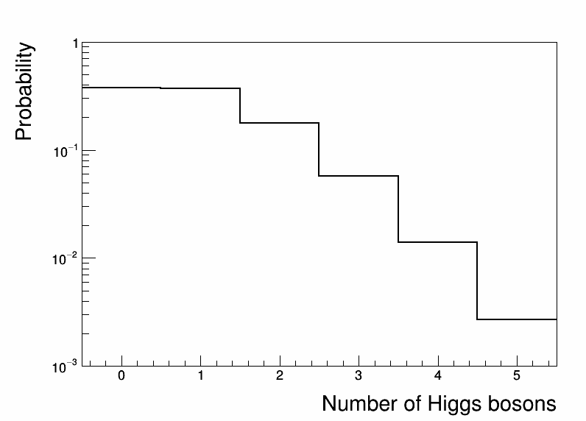
Example
The actual number of events with Higgs bosons is not 0.97, but either 0, 1, 2, 3, … (an integer number)
The probability to observe N_{obs} Higgs bosons
is given by the Poisson distribution
reject theory
accept theory
What happens if we observe 0, 1, 2, or 3 Higgs bosons ?
→ We would take these outcomes as confirmation of the theory
If we observe 4 or more Higgs bosons ?
→ We would probably reject the theory
(and ask our theory colleagues to develop a new theory,
which explains why the Higgs boson production cross section is enhanced)
Christian Veelken Statistical Methods: Introduction 7

Slide 8
Outline of Section on Statistical Methods
Generation of random numbers on a computer
☞ Exercise
Maximum likelihood fitting
☞ Exercise (with toy Monte Carlo)
Treatment of nuisance parameters (systematic uncertainties)
Computation of discovery significances and of exclusion limits
Statistical tools in use by CMS Ram
☞ Exercise
Christian Veelken Statistical Methods: Introduction 8

