Slide 1

Statistical Methods:
Results of 1st exercise
Christian Veelken
christian.veelken@cern.ch

Slide 2
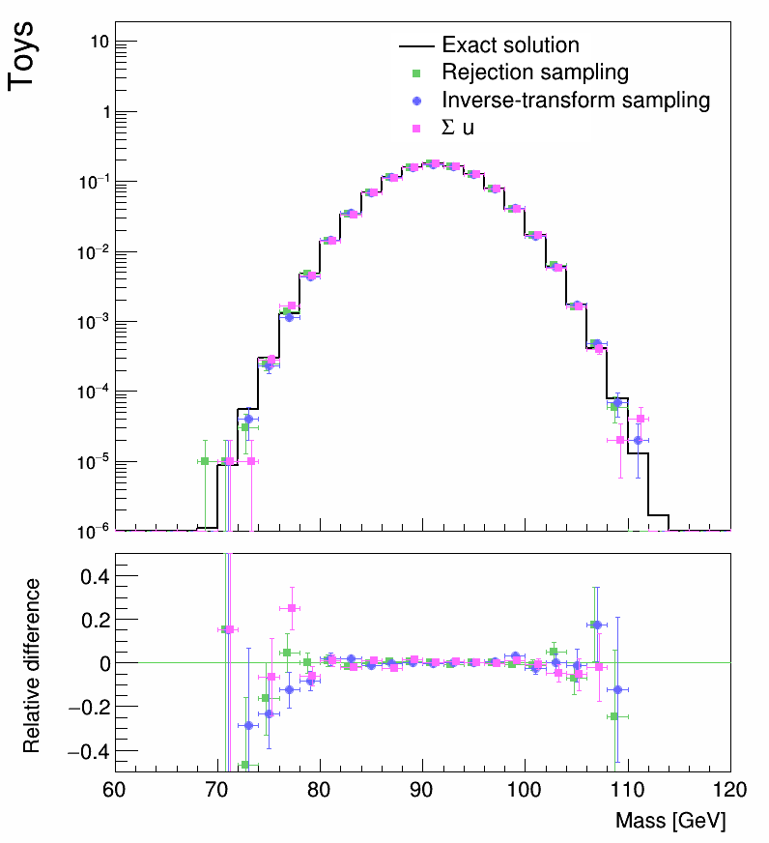

Distributions generated by Random Sampling
The distributions generated with rejection sampling and inverse transform sampling agree with the distribution expected in the limit of infinite toys (shown in black) within statistical uncertainties.
This can best be seen by looking at the distance of the points from the horizontal line at 0 and comparing this distance to the size of the error bars.
Christian Veelken Results of 1st Exercise 2

