Slide 1

Statistical Methods:
Results of 2nd exercise
Christian Veelken
christian.veelken@cern.ch

Slide 2
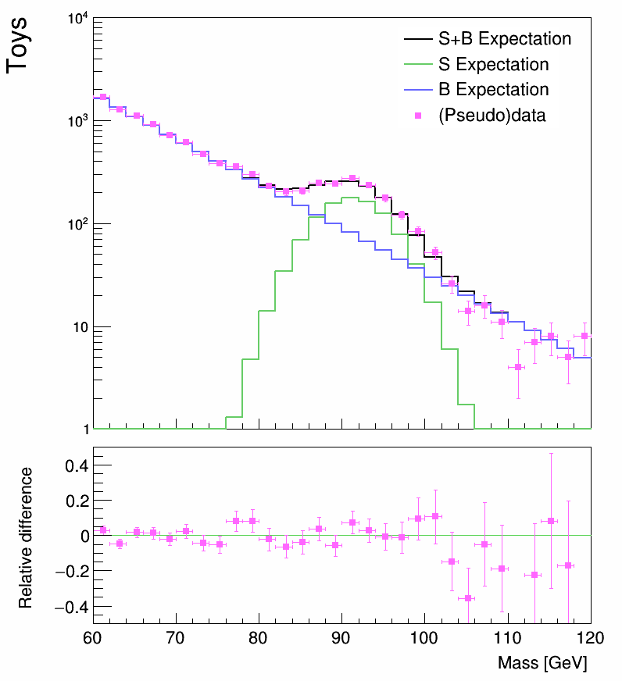

Distribution generated by Rejection Sampling
The distribution generated with rejection sampling (shown in pink) agrees with the distribution expected in the limit of infinite toys (shown in black) within statistical uncertainties (represented by the error bars).
Christian Veelken Results of 2nd Exercise 2

Slide 3
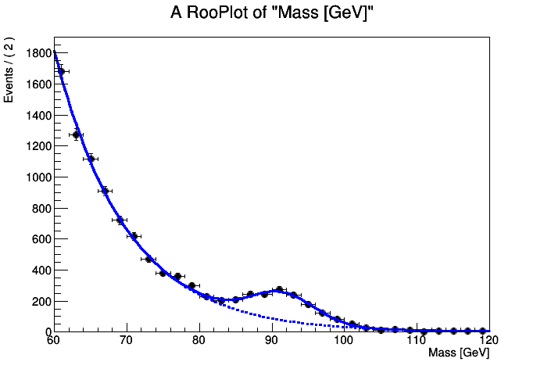

“Postfit” Plot
The signal + background distribution (solid blue line), obtained for the values of the parameters N_{S} , $μ$ , $σ$ , N_{B} , and $λ$ determined by the fit, agrees well with the pseudo data (black points).
Christian Veelken Results of 2nd Exercise 3

Slide 4
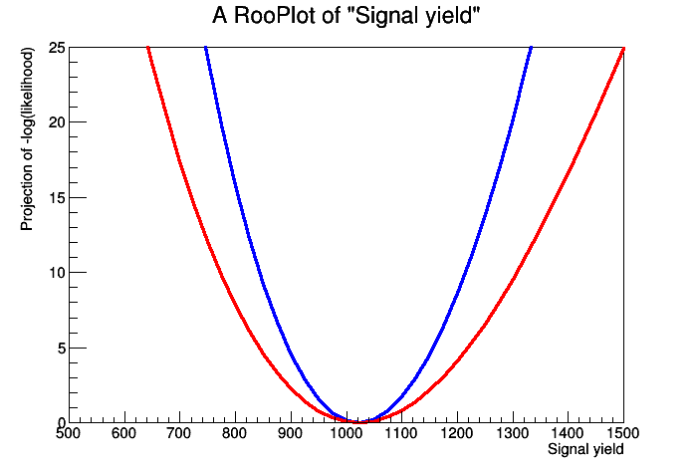

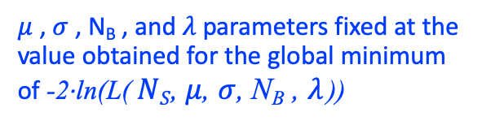


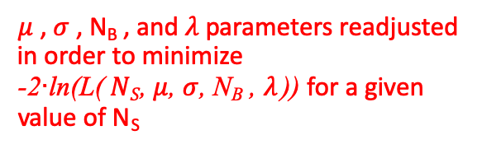
Likelihood as Function of N_{S}
$μ$ , $σ$ , N_{B} , and $λ$ parameters fixed at the value obtained for the global minimum of -2∙ln(L($NS\text{,} μ$, $σ$, N_{B} , $λ$ ))
$μ$ , $σ$ , N_{B} , and $λ$ parameters readjusted in order to minimize
-2∙ln(L($NS\text{,} μ$, $σ$, N_{B} , $λ$ )) for a given value of N_{S}
1$σ$
$$r=1025 ±50$$
$r=1025 ±75$
Christian Veelken Results of 2nd Exercise 4

Slide 5
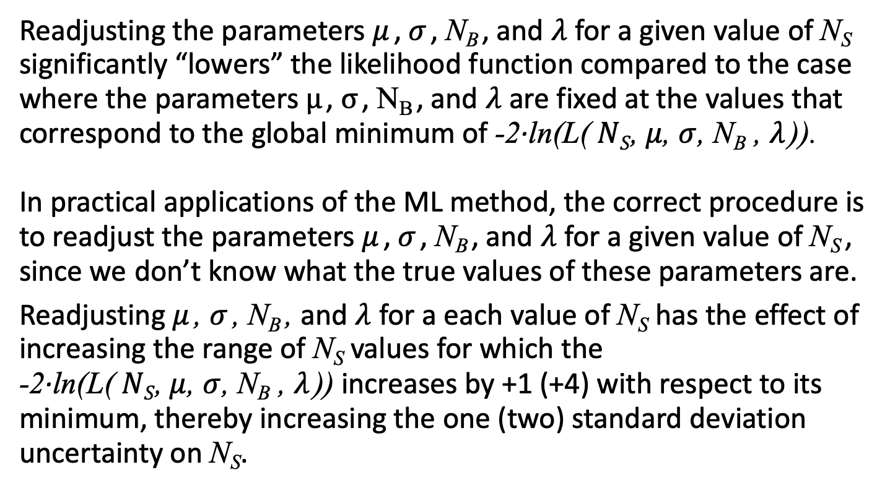
Likelihood as Function of N_{S}
Readjusting the parameters $μ$ , $σ$ , N_{B} , and $λ$ for a given value of N_{S} significantly “lowers” the likelihood function compared to the case where the parameters $μ$ , $σ$ , N_{B} , and $λ$ are fixed at the values that correspond to the global minimum of -2∙ln(L($NS\text{,} μ$, $σ$, N_{B} , $λ$ )).
In practical applications of the ML method, the correct procedure is to readjust the parameters $μ$ , $σ$ , N_{B} , and $λ$ for a given value of N_{S} ,
since we don’t know what the true values of these parameters are.
Readjusting $μ$ , $σ$ , N_{B} , and $λ$ for a each value of N_{S} has the effect of increasing the range of N_{S} values for which the
-2∙ln(L($NS\text{,} μ$, $σ$, N_{B} , $λ$ )) increases by +1 (+4) with respect to its minimum, thereby increasing the one (two) standard deviation uncertainty on N_{S}.
Christian Veelken Results of 2nd Exercise 5

Slide 6
Bonus Part 1
Left plot: The distribution of N_{S} values determined in the 1000 toy Monte Carlo (MC) experiments has a mean close to 1000, the value of N_{S} that we used as input to the toy MC experiments. This demonstrates that the procedure used to determine N_{S} is unbiased.
Right plot: The distribution of pulls is approximately Gaussian with a mean close to 0 and a width close to 1. The latter demonstrates that the uncertainties on N_{S} estimated by RooFit are reliable.
Christian Veelken Results of 2nd Exercise 6

