Slide 1

Statistical Methods:
Results of 3rd exercise
Christian Veelken
christian.veelken@cern.ch

Slide 2
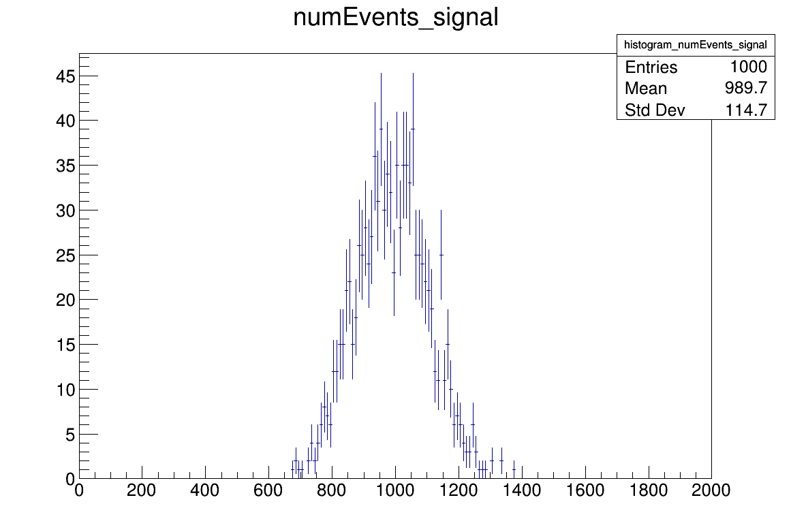

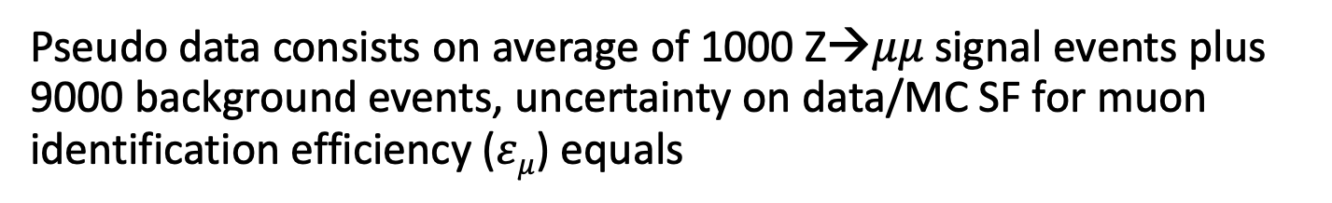
Distribution of N_{S} values obtained by ML fit
Pseudo data consists on average of 1000 Z→$μμ$ signal events plus 9000 background events, uncertainty on data/MC SF for muon identification efficiency ($εμ$) equals
0%
5%
The systematic uncertainty on the muon identification efficiency has the effect of significantly increasing the variance of the N_{S} values obtained by the ML fit
Christian Veelken Results of 3rd Exercise 2

Slide 3
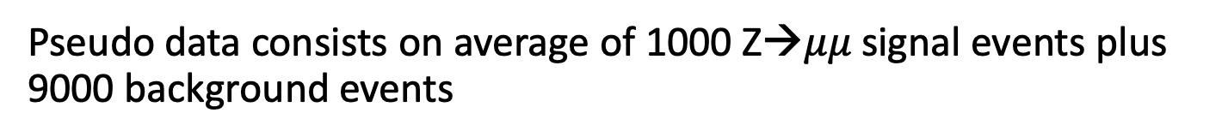
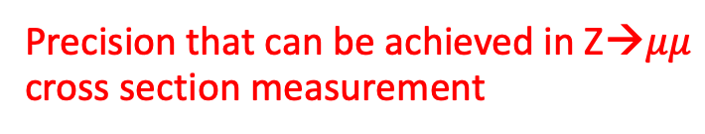
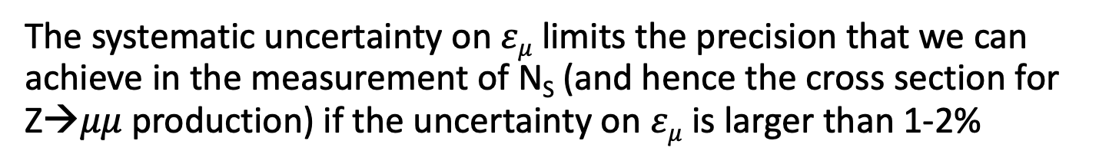
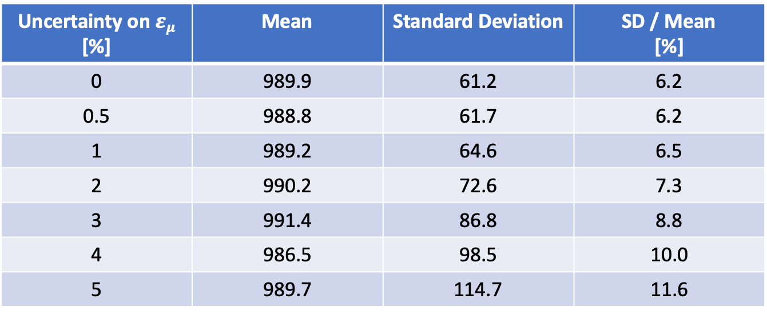
Mean and SD of N_{S} Values
Pseudo data consists on average of 1000 Z→$μμ$ signal events plus 9000 background events
Precision that can be achieved in Z→$μμ$ cross section measurement
Uncertainty on $εμ$ [%] | Mean | Standard Deviation | SD / Mean [%]
0 | 989.9 | 61.2 | 6.2
0.5 | 988.8 | 61.7 | 6.2
1 | 989.2 | 64.6 | 6.5
2 | 990.2 | 72.6 | 7.3
3 | 991.4 | 86.8 | 8.8
4 | 986.5 | 98.5 | 10.0
5 | 989.7 | 114.7 | 11.6
The systematic uncertainty on $εμ$ limits the precision that we can achieve in the measurement of N_{S} (and hence the cross section for Z→$μμ$ production) if the uncertainty on $εμ$ is larger than 1-2%
Christian Veelken Results of 3rd Exercise 3

Slide 4
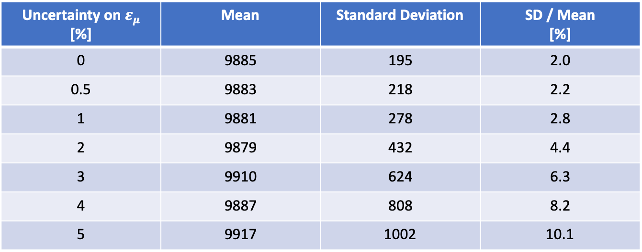
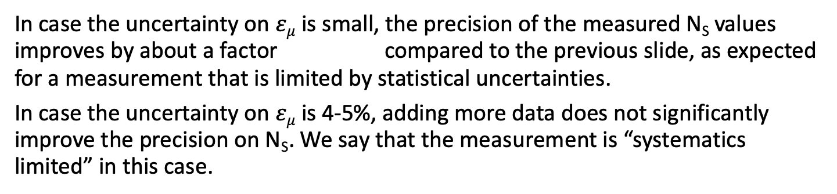
Mean and SD of N_{S} Values
Pseudo data consists on average of 10000 Z→$μμ$ signal events plus 90000 background events
Uncertainty on $εμ$ [%] | Mean | Standard Deviation | SD / Mean [%]
0 | 9885 | 195 | 2.0
0.5 | 9883 | 218 | 2.2
1 | 9881 | 278 | 2.8
2 | 9879 | 432 | 4.4
3 | 9910 | 624 | 6.3
4 | 9887 | 808 | 8.2
5 | 9917 | 1002 | 10.1
In case the uncertainty on $εμ$ is small, the precision of the measured N_{S} values improves by about a factor compared to the previous slide, as expected for a measurement that is limited by statistical uncertainties.
In case the uncertainty on $εμ$ is 4-5%, adding more data does not significantly improve the precision on N_{S}. We say that the measurement is “systematics limited” in this case.
Christian Veelken Results of 3rd Exercise 4

Slide 5
A Word on Nuisance Parameters
As the name suggest, nuisance parameters really are a nuisance for the purpose of measuring the parameter that we are interested in!
Nuisance parameters make the measurement of the POI more complicated and degrade the precision of the measurement.
In practice, a substantial amount of work is often necessary in order to reduce systematic uncertainties, which would otherwise limit the precision that our measurements can achieve.
Christian Veelken Results of 3rd Exercise 5

