Slide 1

Statistical Methods:
Template Fits
Christian Veelken
christian.veelken@cern.ch

Slide 2

Outline
Introduction
Treatment of shape uncertainties
Template morphing
Horizontal template morphing
Vertical template morphing
Treatment of statistical uncertainties in shape templates
Christian Veelken Statistical Methods: Template Fits 2

Slide 3
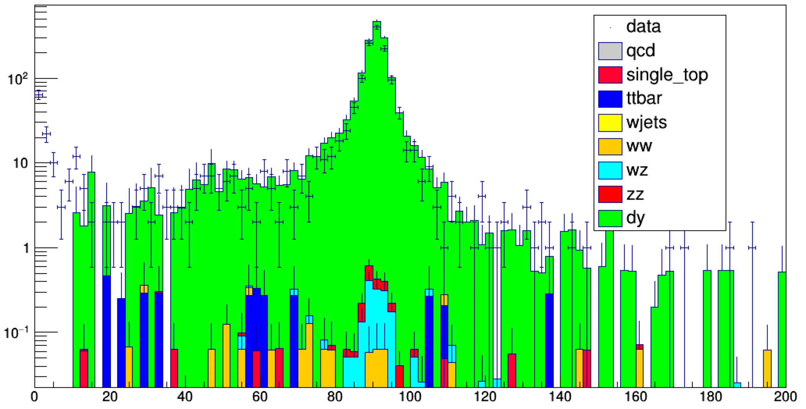

Introduction
In practical applications of the
ML method we often do not know which analytic function is appropriate to model the signal and the different backgrounds.
Events
m$μμ [GeV]$
In this case, we resort to the Monte Carlo simulation to model the shape of the distributions for signal and background in the observable that we are fitting.
The histograms for the signal and for the different backgrounds are called shape templates. We interpret them as probability density functions. The latter are piece-wise constant functions (also called step functions).
Christian Veelken Statistical Methods: Template Fits 3

Slide 4
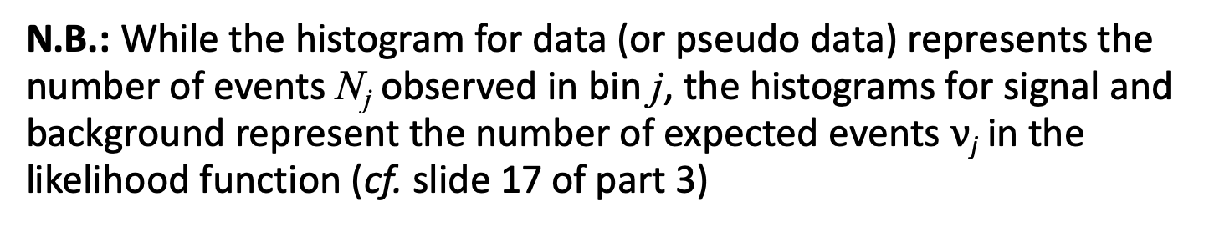

Introduction
Mathematically,
with coefficients $α$_{i} and where A_{i} are intervals on the x-axis and
is the indicator function of A_{i} , defined by
N.B.: While the histogram for data (or pseudo data) represents the number of events N_{j} observed in bin j, the histograms for signal and background represent the number of expected events $ν$_{j} in the likelihood function (cf. slide 17 of part 3)
https://en.wikipedia.org/wiki/Step_function
https://root.cern.ch/doc/master/classRooHistPdf.html
Christian Veelken Statistical Methods: Template Fits 4

Slide 5
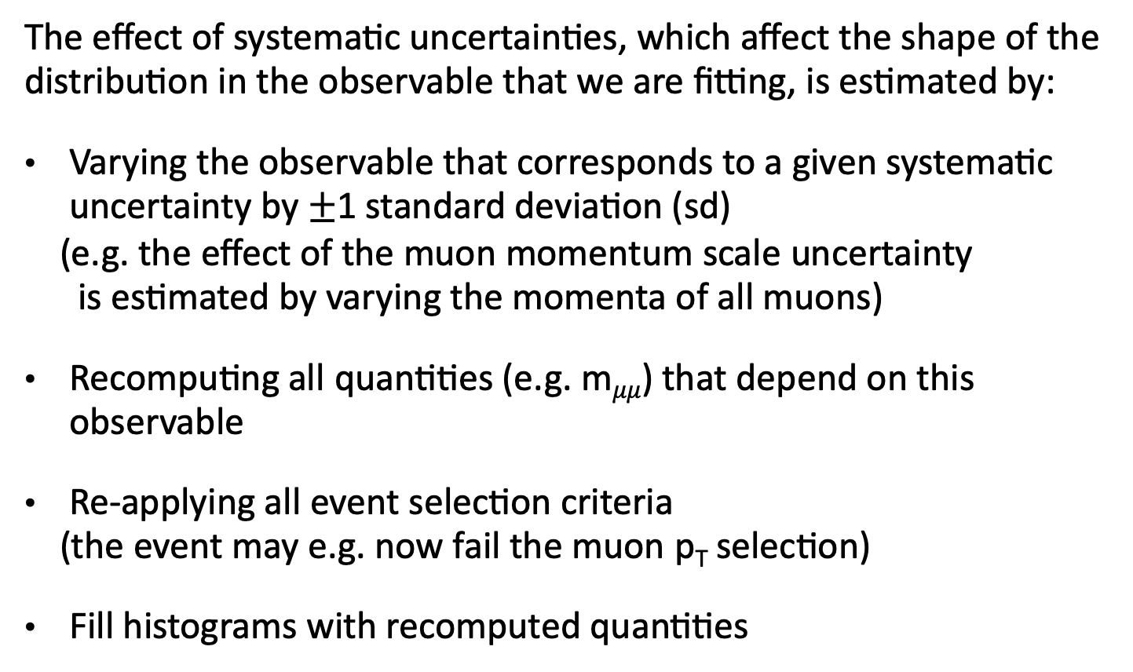
Treatment of Shape Uncertainties
The effect of systematic uncertainties, which affect the shape of the distribution in the observable that we are fitting, is estimated by:
Varying the observable that corresponds to a given systematic uncertainty by $±$1 standard deviation (sd)
(e.g. the effect of the muon momentum scale uncertainty
is estimated by varying the momenta of all muons)
Recomputing all quantities (e.g. m$μμ$) that depend on this observable
Re-applying all event selection criteria
(the event may e.g. now fail the muon p_{T} selection)
Fill histograms with recomputed quantities
Christian Veelken Statistical Methods: Template Fits 5

Slide 6
Treatment of Shape Uncertainties
N.B.: In case k shape uncertainties are relevant for the analysis, we need to run the analysis 2∙k + 1 times (once for the nominal value and two times for each shape uncertainty; once for the +1 sd variation and once for the -1 sd variation)
Christian Veelken Statistical Methods: Template Fits 6

Slide 7
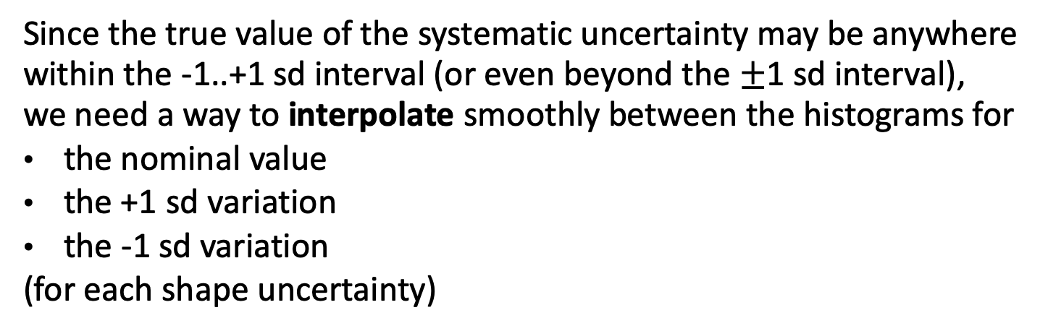
Template Morphing
Since the true value of the systematic uncertainty may be anywhere within the -1..+1 sd interval (or even beyond the $±$1 sd interval),
we need a way to interpolate smoothly between the histograms for
the nominal value
the +1 sd variation
the -1 sd variation
(for each shape uncertainty)
We also need a way to aggregate the effects of different shape uncertainties.
This interpolation of shape templates is called template morphing.
The two algorithms, which allow us to do this, are called
Vertical template morphing
Horizontal template morphing
Christian Veelken Statistical Methods: Template Fits 7

Slide 8
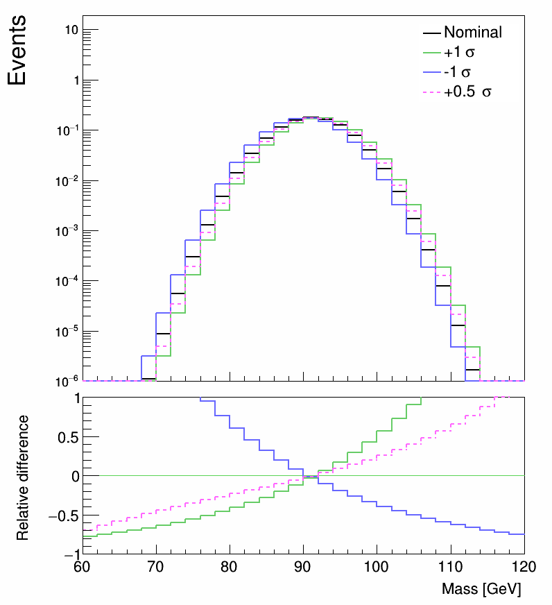
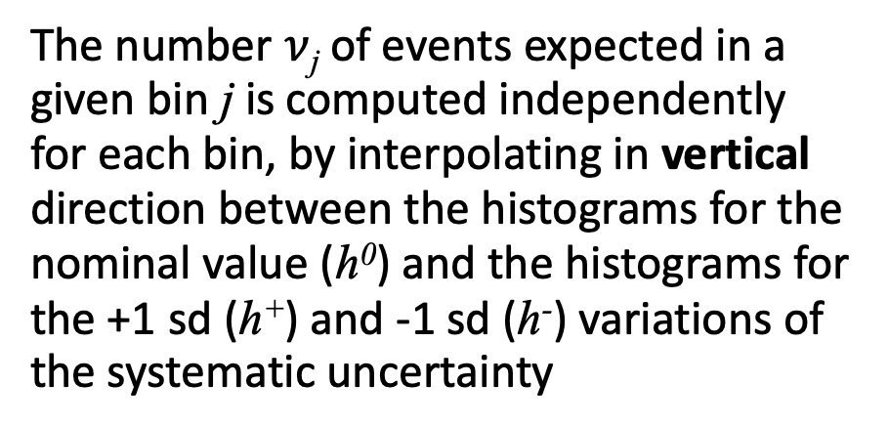
Vertical Template Morphing
The number $ν$_{j} of events expected in a given bin j is computed independently for each bin, by interpolating in vertical direction between the histograms for the nominal value (h⁰) and the histograms for the +1 sd (h⁺) and -1 sd (h⁻) variations of the systematic uncertainty
/home/veelken/public/PhyStat-101/verticalTemplateMorphing.C
http://inspirehep.net/record/891252
Christian Veelken Statistical Methods: Template Fits 8

Slide 9
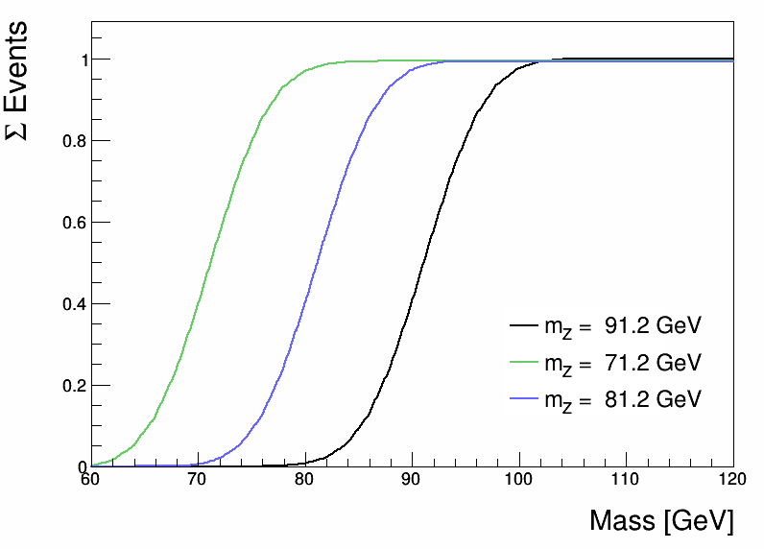
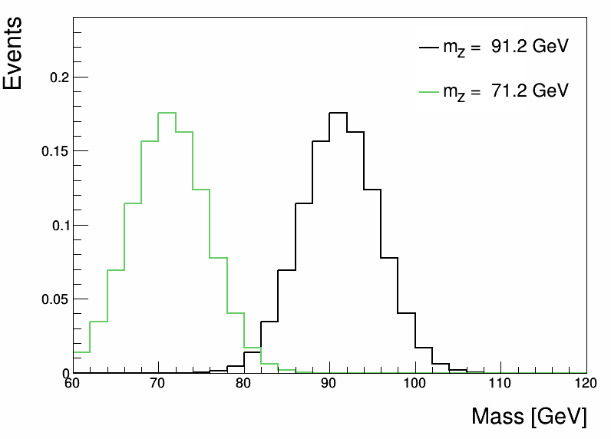
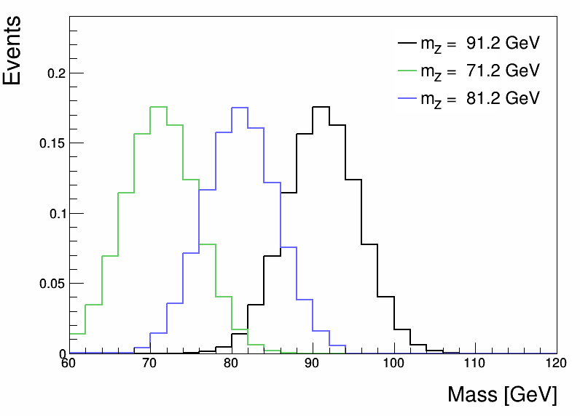
Horizontal Template Morphing
The algorithm is based on three steps:
1) Integrate the probability distribution functions (PDF) numerically
2) Interpolate the cumulative distribution function (CDF) in horizontal direction
3) Obtain the interpolated PDF by numerically computing the derivative of the interpolated CDF
CDF
Numeric integration
Numerical differentiation
PDF
PDF
/home/veelken/public/PhyStat-101/horizontalTemplateMorphing.C
http://inspirehep.net/record/501018
https://root.cern.ch/doc/master/classRooIntegralMorph.html
Christian Veelken Statistical Methods: Template Fits 9

Slide 10
Comparison of Template Morphing Methods
Vertical Template Morphing
+ Works for two (and more) dimensions
+ Effect of many systematic uncertainties can be aggregated easily
- Does not work well for large horizontal shifts of PDFs
Horizontal Template Morphing
+ Works well for large horizontal shifts of PDFs
- Difficult to aggregate effect of multiple systematic uncertainties
- Needs some work to generalize to more than one dimension
Vertical template morphing is the default method for template morphing in CMS
Horizontal template morphing is used for one particular application: to interpolate signal distributions in searches for new particles, for mass points for which we have no dedicated Monte Carlo samples
Christian Veelken Statistical Methods: Template Fits 10

Slide 11
Statistical Uncertainties in Shape Templates
Background processes in particular may have large cross sections,
which would require Monte Carlo (MC) samples containing billions of events in order to match the luminosity of the data.
We often need to use MC samples with less event statistics.
In this case, event weights are applied to simulated events in order to match the luminosity of the data.
The histograms for backgrounds that are modelled using MC samples with limited event statistics may exhibit sizeable statistical fluctuations. The statistical fluctuations of the shape templates need to be accounted for in the likelihood function, as they may otherwise cause a bias in the ML fit.
https://root-forum.cern.ch/t/result-of-fitting-roohistpdf-depends-on-stat-precision/8883
Christian Veelken Statistical Methods: Template Fits 11

Slide 12
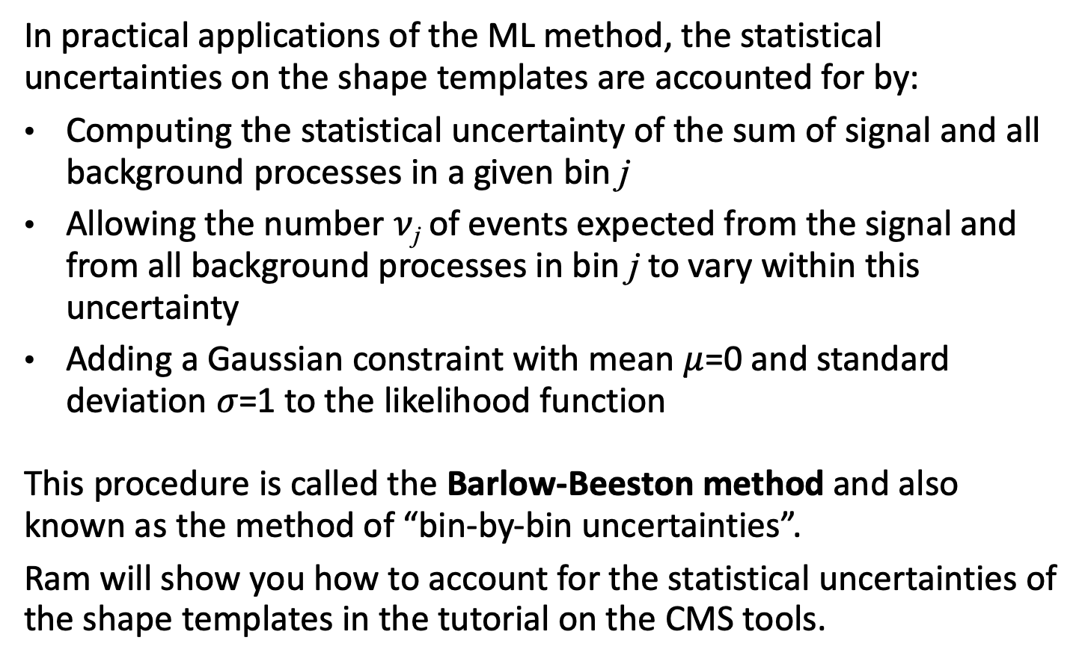
Statistical Uncertainties in Shape Templates
In practical applications of the ML method, the statistical uncertainties on the shape templates are accounted for by:
Computing the statistical uncertainty of the sum of signal and all background processes in a given bin j
Allowing the number $ν$_{j} of events expected from the signal and from all background processes in bin j to vary within this uncertainty
Adding a Gaussian constraint with mean $μ$=0 and standard deviation $σ$=1 to the likelihood function
This procedure is called the Barlow-Beeston method and also known as the method of “bin-by-bin uncertainties”.
Ram will show you how to account for the statistical uncertainties of the shape templates in the tutorial on the CMS tools.
http://inspirehep.net/record/35053
Christian Veelken Statistical Methods: Template Fits 12

