Slide 1
Course
Technologies learned [Spark, HDFS, Hive, Kafka, Basic Linux SSH, PySpark, RDD, DF, Spark SQL,
AWS, S3, Spark streaming, Glue, Glue catalog,
Redshift, RDS, Presto, Athena, Parquet
DataBricks, Jupyter, spark-submit
Spark Cluster [master, 2 workers]
KSQL/Kafka Streaming, EMR

Slide 2
AWS
Big Data Engineering
Data Lake/S3 buckets
On-Premise/AWS
Client Setup
PoS
Producer
Kinesis
Raw Data Zone/Layer
Receive data as is
No analysis
No validation
No Filtering
No data loss
Data can be incorrect
..
Try not to design schema
Transaction
System
Producer
Kinesis
OLTP
Glue/CSV publish

Slide 3
Use Case
Movie DataSet
Problem statement
Solution [to find top/popular movies using number of voting, rating average]

Slide 4
Ecommerce Data-use case
Ecommerce portal
Problem Statements
Solutions
Order processing
Country wise/top performing countries
Kafka, Kafka Streaming,
Spark, Spark Streaming

Slide 5
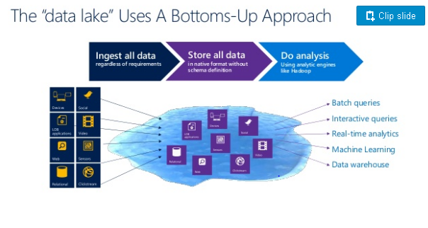
Logical Architecture
https://www.slideshare.net/jamserra/data-lake-overview

Slide 6
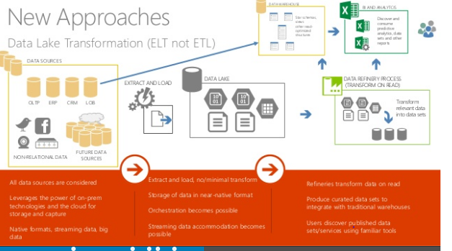
https://www.slideshare.net/jamserra/data-lake-overview

Slide 7
Data
eng
Data
scientist
Data
eng
Data
eng
Data Lake
Application Layer/
Analytics zone
Data optimized for
Big data system
Like Spark/EMR
To load and process
the data
Parquet
ORC
No more CSV/XML/
No more text/json
Partitioned
Dept/year/month/day
Data Lake
Data Lake
Raw Layer
Arrival zone
Landing Zone
Unclean
unclassified
Data Lake
Clean layer/Raw Data
Clean Zone
Bring semi structure
Glue Catalog
Glue Tables
Classify CSV/JSON/
Avro/XML/Grok
…
Filtered raw data
Metrics/measurement
Km -> miles
Kg -> pounds
Round off the values
Filtered out good/bad
Sales/invoics/order/
transactions
Sandbox
Aggregated data
Daily/Weekly/monthly
Hourly
Reports
Active warehouse
Parquet/
Spark Tables
To redshift/OLTP
Glue/EMR
Glue
Glue
Athena
Spectrum
EMR
AI/ML

Slide 8
Sandbox
Layer - Datalake
Aggregated Data
Analytics data
Analyzed
Reports
QuickSight
OLAP
Redshift
Glue/JDBC
PowerBI
ML/AI
OLTP
PG/MySQL/Oracle
..
Glue/JDBC

Slide 9
Book Marking
Data is collected everyday
And stored into raw/clean/processed zone
A spark/Glue job is scheduled every day to process the data
Every day, data is growing
Should I process all day data or process newly landed data, incremental approach?

Slide 10
Book Marking
File1
File2
File3 marked as processed for t hat speicifc job
Every job, there will be book marking
Data
2021
202101
20210101
file1
file2
file3
Glue job
File1
File2
File3
Processed 2:00 /Jan 02/2021

Slide 11
Create Kinesis Stream
Create Kinesis firehouse without transformation
Kinesis firehouse should write back to s3/folder name (invoices-raw) on every 5 minutes
Write a glue job with book marking enabled, that picks the data from s3 (invoices-raw) and add a filter, that picks only UnitPrice > 0. Then Write back to s3 location but via Glue catalog (invoices-clean folder), ensure there is gluedb glue-table for same)
Write a Glue Job that picks data from invoices-clean, convert to parquet format, write back to s3 bucket application layer (invoices-application)
Write a Glue job that picks data from invoices-application, perform simple sum of all items in the invoice (Sum of UnitPrice * Quantity) and write the results back into Sandbox layer (invoices-sandbox is the folder name)
Write a glue job that picks data from sandbox layer invoics-sandbox, write tback redshift
Write a glue job that picks data fro sandbox layer, inovices-sandbox, write back to RDS

Slide 12
Spark Batch Analytics
Pyspark, .py file
Consume data from S3 as input
Use HDFS as temp storage
Spark Stream – Spark-Submit
Output
DataLake (Sandbox)
OLTP – JDBC - PG
OLAP – JDBC - Redshift
Application Layer
Analytic Zone
EMR

Slide 13
Replications: 3
Core Node
HDFS DataNode
Worker
Task-1
Core Node-2
HDFS DataNode
Worker
Task-2
Master
Node
Core Node-3
HDFS DataNode
Worker
Task-…N
Secondary
Master
Node - Standby
Core Node-4
HDFS DataNode
Worker
Elastic, range
From min to max
instances
Core Node-5
HDFS DataNode
Worker

Slide 15
Kinesis Lambda Dynamo DB

Slide 16
Inventory Data Update
Inventory Data is maintained in the DynamoDB, where as each product “StockCode”, the stock/book keeping data stored in DynamoDB.
StockCode is a partition/primary key, [optionally DynamoDB may have Quantity as sort key)
Will have one more attrbute called Quantity [either as sort key or normal attribute]

Slide 17
Inventory Table
StockCode | Quantity
85123A | 100
84406B | 120
When the item/stockcode is purchased, invoice-stream kinesis stream shall have
Order..
For every invoice item, reduce the quantity, even if it is damaged !! Item
successfully bought or damaged (UnitPRice in negative) Abs()
This work done in lambda, so that dynamodb updated
CurrentStock = dynamocdb.get_item(StockCode)
Item = {
“StockCode”: invoice[“StockCode”],
“Quantity” : CurrentStock.Quantity - invoice[“Quantity”]
}
Dynamodb.putitem(Item )

Slide 18
Procurement Team
Procurement team keep buying stocks and pushing the quantity up..
Lambda code in python
Add up 10 to stock
Dynamo
DB
Kinesis
Producer
simulate
update
{
“StockCode”: “85123A”,
“Quantity”: 10
}
StockCode | Quantity
85123A | 110
84406B | 120
StockCode | Quantity
85123A | 100
84406B | 120

Slide 19
Lambda
Trigger
Invoice-stream
kinesis
Kinesis
Invoice
Producer
Dynamo
DB
Procurement-stream
kinesis
Kinesis
Procurement
Producer
Lambda
Trigger

