Slide 1

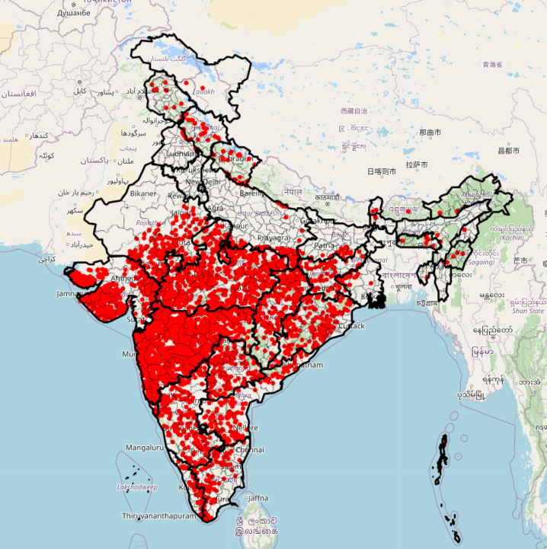


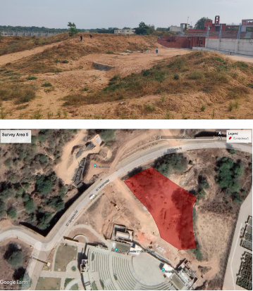
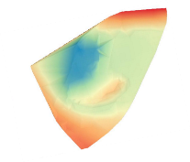
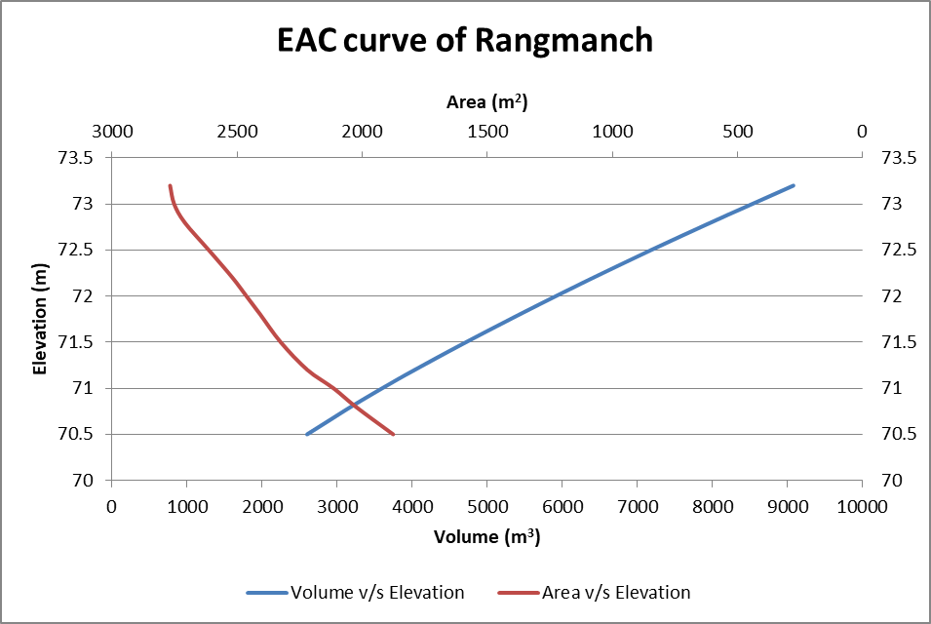

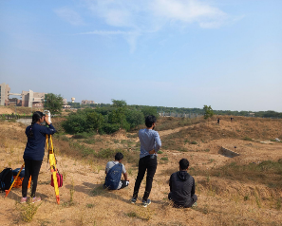

UG Research Showcase
Satellite based monitoring of small to medium sized reservoirs
Introduction
Functions of Reservoirs
Reservoir Monitoring
Water Storage
Water Level Gauge
Flood Control
Manual
Installation cost
Lack of compatibility
Hydropower Generation
Recreation
Bathymetric Survey
Domestic & Industrial Water Supply
Difficulty in operation and management
Negligence of operator
Agriculture
Figure. Dams of India (GeoID)
Satellite based measurements
Low temporal and spatial resolution
Local cloudiness
Gap in time series
Inability of optical sensors to see through the clouds
Figure. Field work for data Collection
Objective
Proper monitoring systems for small and medium-sized reservoirs are crucial for managing water resources effectively.
The traditional method of monitoring reservoirs has become cumbersome and less efficient, hence the need for an advanced system.
A satellite-based monitoring system using high spatio-temporal satellite data is a viable solution for estimating the reservoir capacity, area, and elevation.
A1, V1
A2, V2
A1 = A2, V1 ≠ V2
Figure. Issue in Water monitoring
The objective is to develop a satellite-based monitoring system that uses high spatio-temporal satellite data to monitor small to medium-sized reservoirs.
This system will provide accurate and reliable information for managing water resources and aid in identifying potential issues before they become critical. The implementation of this system will assist in efficient water management and help ensure that small and medium-sized reservoirs are monitored effectively.

Slide 2
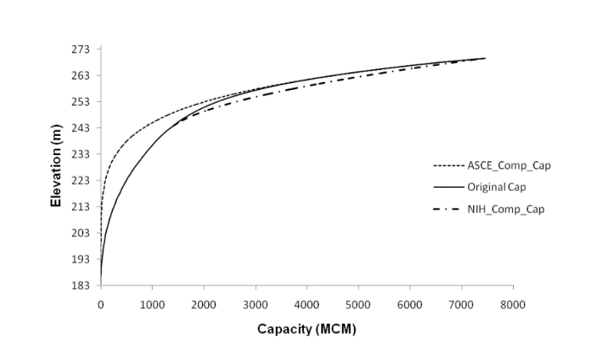
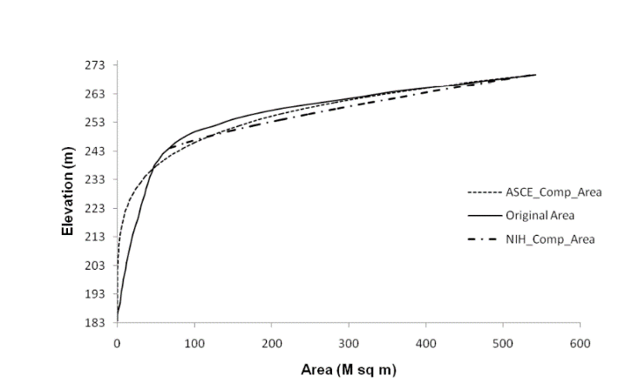
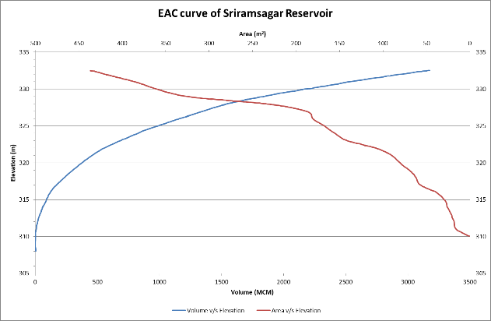
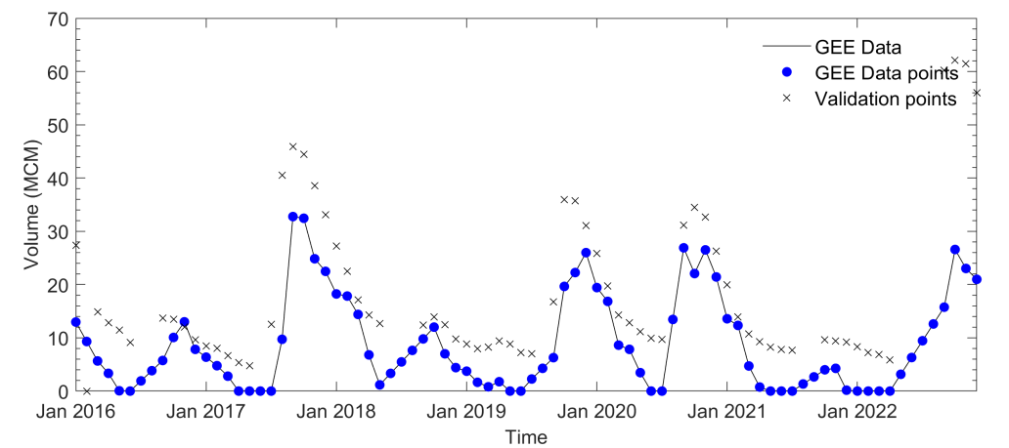
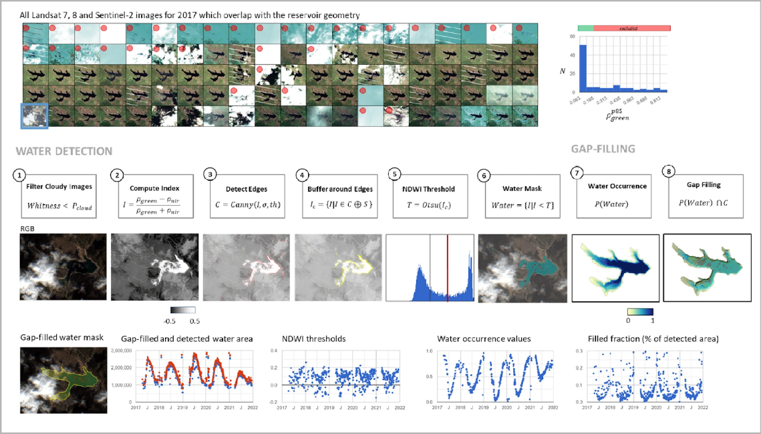
Data & Methodology
Collection of Elevation-Area-Capacity Data
Data Digitization using MATLAB
(Singh, 2013)
Validation using India-WRIS Data
Monitoring Satellite based Area using GEE
Guhai Reservoir
Figure. Methodology
(Donchyts et al., 2022)
Table. Detailed properties of selected Reservoirs
Reservoir Name | Latitude | Longitude | River | District | State | Area (Km²) | Volume at FRL (MCM) | R1: X = Area and Y = Elevation | R2: X = Elevation and Y = Volume
Dharoi Dam | 24.0043 | 72.8537 | Sabarmati | Mehsana | Gujarat | 5475 | 907.83 | -0.0023x² + 0.4384x + 167.41 | 2.2765x² - 777.75x + 66427
Guhai Dam | 23.7004 | 73.0517 | Guhai | Sabarkantha | Gujarat | 17.13 | 57.04 | -0.0196x² + 1.0677x + 162.2 | 0.8105x² - 265.49x + 21740
Mazam Dam | 23.4836 | 73.3544 | Mazum | Aravalli | Gujarat | 13.1 | 44.08 | -0.063x² + 1.8969x + 145.11 | 0.4098x² - 119.67x + 8734.3
Meshwo Dam | 22.80083 | 72.66333 | Meshwo | Sabarkantha | Gujarat | 11.16 | 214.59 | -0.1167x² + 2.8x + 145.6 | 0.2881x² - 84.847x + 6248.3
Srisailam Dam | 16.0869 | 78.8965 | Krishna | Mahabubnagar | Andhra Pradesh | 616 | 8724.88 | -0.0427x² + 3.2397x + 209.17 | 0.2086x² - 88.97x + 9459.7
Sriramasagar Dam | 18.9686 | 78.3411 | Godavari | Nizamabad | Telangana | 451 | 3172 | -0.0001x² + 0.1001x + 311.71 | 8.8224x² - 5541.7x + 870216
Singur Dam | 17.7507 | 77.9297 | Manjira | Sangareddy | Telangana | 142 | 847 | -0.0008x² + 0.2278x + 506.79 | 3.5457x² - 3604x + 915772
Lower Manair Dam | 18.3997 | 79.1311 | Manair | Karimnagar | Telangana | 81 | 680.648 | -0.0028x² + 0.4809x + 258.43 | 1.7953x² - 937.44x + 122363
Musi Dam | 17.2567 | 79.4985 | Musi | Nalgonda | Telangana | 25.25 | 52.3 | -0.0226x² + 1.1274x + 181.57 | 0.7521x² - 275.08x + 25146
Bendsura Dam | 11.67 | 75.9578 | Kabini | Wayanad | Kerala | 12.77 | 13.125 | -2.1486x² + 11.024x + 551.18 | 0.0759x² - 83.86x + 23177
Dimbhe Dam | 19.1147 | 73.7221 | Ghod | Pune | Maharashtra | 18 | 383.117 | -0.1178x² + 4.9829x + 665.61 | 0.1711x² - 229.95x + 77267
Ekrukh Dam | 17.7403 | 75.915 | Adela | Solapur | Maharashtra | 18.4251 | 67.86 | -0.0116x² + 0.7845x + 454.22 | 9.2649x² - 5828.6x + 916718
Gangapur Dam | 20.0481 | 73.6798 | Godavari | Nashik | Maharashtra | 22.31 | 208.12 | -0.0495x² + 2.1206x + 589.64 | 0.3914x² - 463.54x + 137261
Warasgaon Dam | 18.3816 | 73.5285 | Mose | Pune | Maharashtra | 24.2 | 361 | -0.0864x² + 4.1533x + 590.54 | 0.2037x² - 243.18x + 72564
Wan Akola Dam | 21.1831 | 76.7725 | Wan | Akola | Maharashtra | 4,391 | 599 | -2.0958x² + 20.508x + 359.98 | 0.0414x² - 30.357x + 5562.9
Manar Dam | 18.8381 | 77.3166 | Mnar | Nanded | Maharashtra | 2.559 | 138.39 | -0.0111x² + 0.7697x + 379.97 | 1.0277x² - 783.81x + 149450

Slide 3

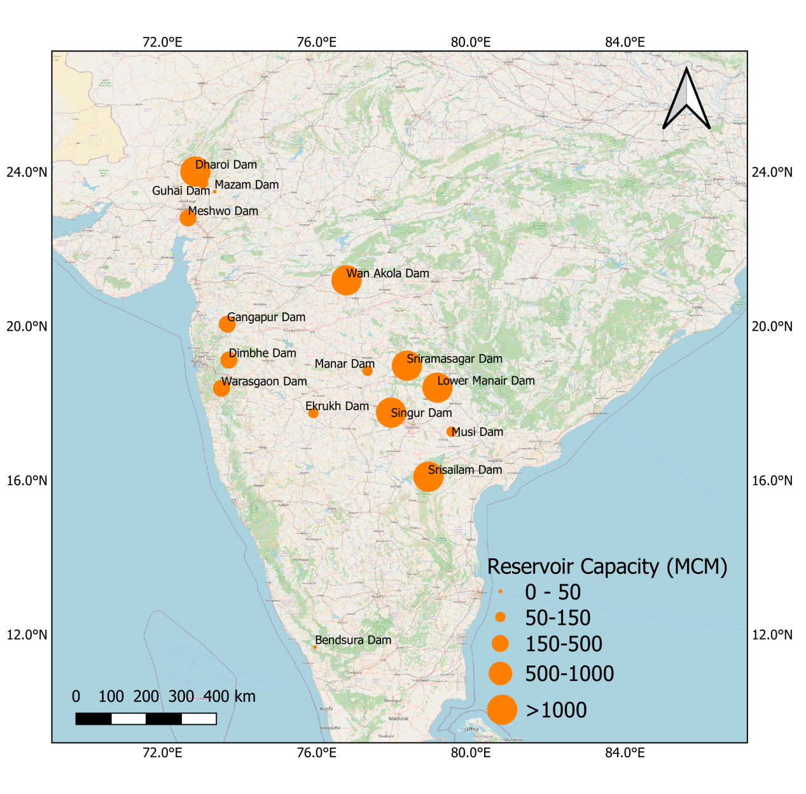

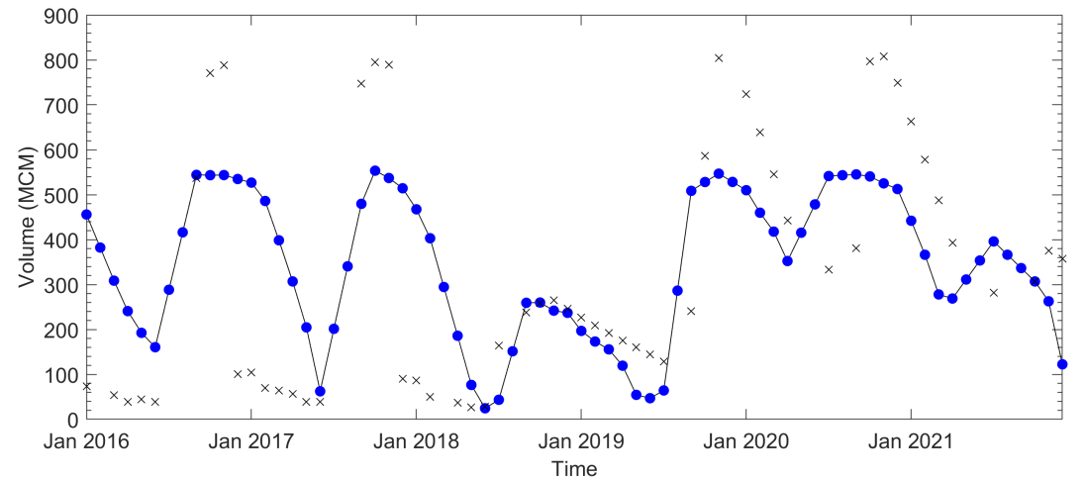
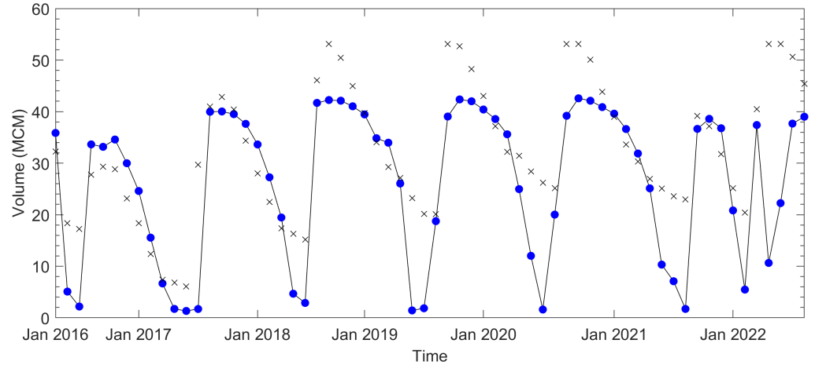
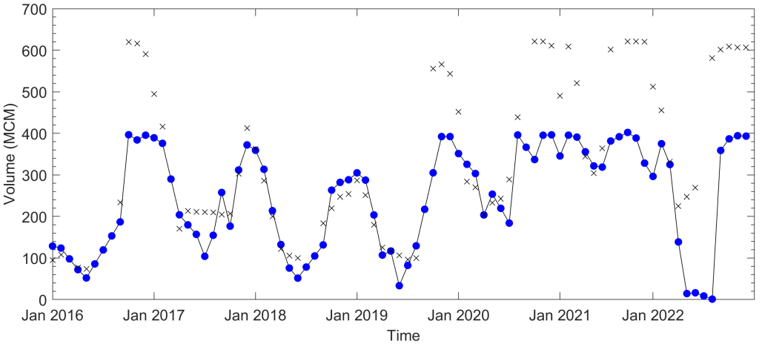
Prepared by: Veena K
Faculty Guide: Prof. Vimal Mishra
Mentor: Hiren Solanki
Results
A scientific study was conducted to observe reservoir storage in 16 different dams from 2016 to 2022, using Google Earth Engine.
Reservoir volume was obtained from the Elevation-Area-Capacity relationship and validated for four different reservoirs using India Wris data.
However, generalizing the Elevation-Area-Capacity relationship with a second-degree polynomial was found to be inefficient.
The constructed volume data captured normal storage conditions well, but high and low storage values were underestimated and overestimated, respectively.
Figure: Study Area
a) Guhai reservoir
b) Dharoi reservoir
c) Meeshwo reservoir
d) Lower Manair reservoir
Figure: Reconstructed volume time series for four different dams and its validation with India-WRIS data

Slide 4
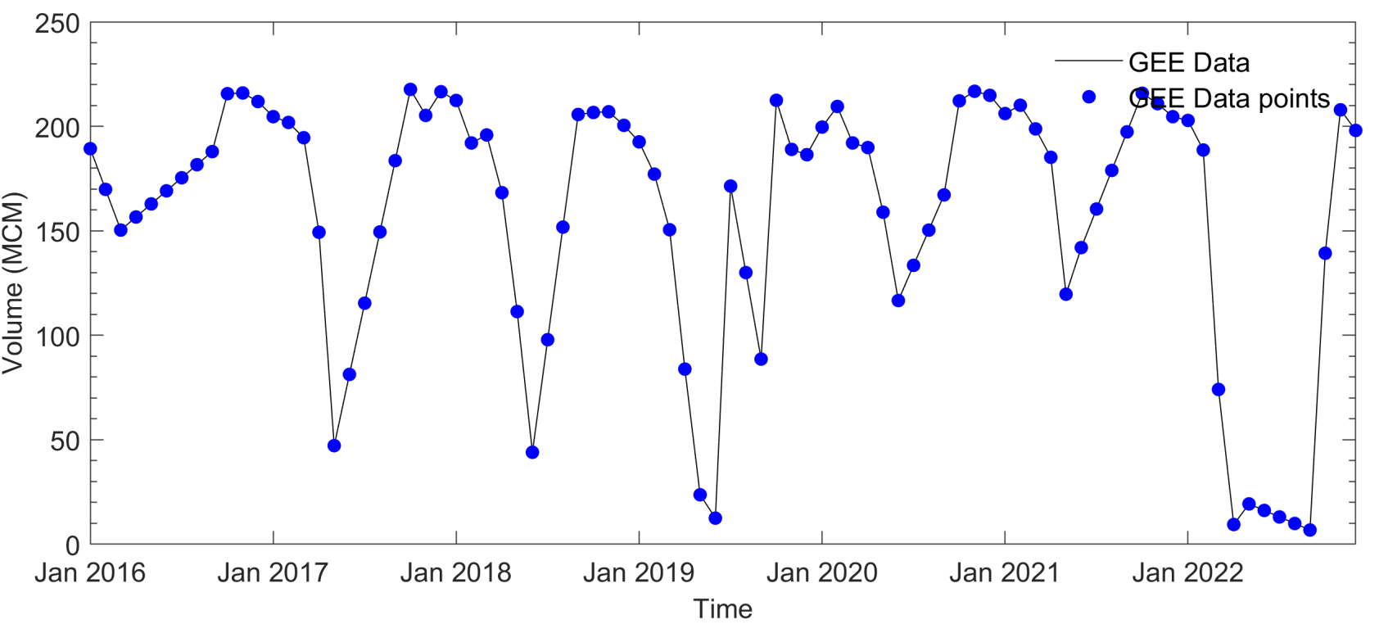
Additionally, the methodology developed in the study was used to construct a time series from 2016 to 2022 of reservoir volume for Dhimbe dam.
Although the validation dataset is not available in the public domain, this methodology can help determine the dynamics of remote and small-sized reservoirs.
Dhimbe reservoir
Conclusion
In conclusion, the study demonstrated that small to medium-sized reservoirs can be monitored at a high spatiotemporal scale using Sentinel-2 data, which can aid in mitigating drought and flood-like conditions at the village level.
The analysis was performed using GEE, a cloud-based satellite data analysis service, which can help expand the study region to the national level with minimum time.
While the results hold good validation for normal conditions, validation for high and low storage is poor and can be improved using the exact area-elevation relationship.
References
Singh, R. D., et al. Mathematical Representation of Elevation-Area-Capacity Curves for Indian Reservoirs. National Institute of Hydrology, 2013.
Donchyts, G., Winsemius, H., Baart, F. et al. High-resolution surface water dynamics in Earth’s small and medium-sized reservoirs. Sci Rep 12, 13776 (2022).https://doi.org/10.1038/s41598-022-17074-6

