Slide 1
Location Prediction in Brooklyn for Coffee Shop
(Capstone Project Report)

Slide 2
Introduction
This project aims to predict suitable neighborhood in Brooklyn, NY for a coffee shop. It is done by finding no. of existing coffee shops and most trending venues. It is required to explore, segment, and cluster the neighborhoods in the city of Brooklyn and find out location with no or less number of coffee shops.

Slide 3
Data Acquisition and Data wrangling
Dataset exists on the web. New York Neighborhood data has a total of 5 boroughs and 306 neighborhoods. In order to segment the neighborhoods and explore them, we will essentially need a dataset that contains neighborhoods for Brooklyn
Using goopy library get the list of the latitude and longitude Brooklyn Slice the original data frame and create a new data frame of the Brooklyn neighborhoods with their latitude and longitude Using Foursquare explore all neighborhood in data frame. Use Foursquare and goopy data to map top 5 venues for Brooklyn neighborhoods and clustered in groups

Slide 4
Methodology
Data collection
Data understanding & Preparation
Modeling
Exploratory analysis
Evaluation

Slide 5
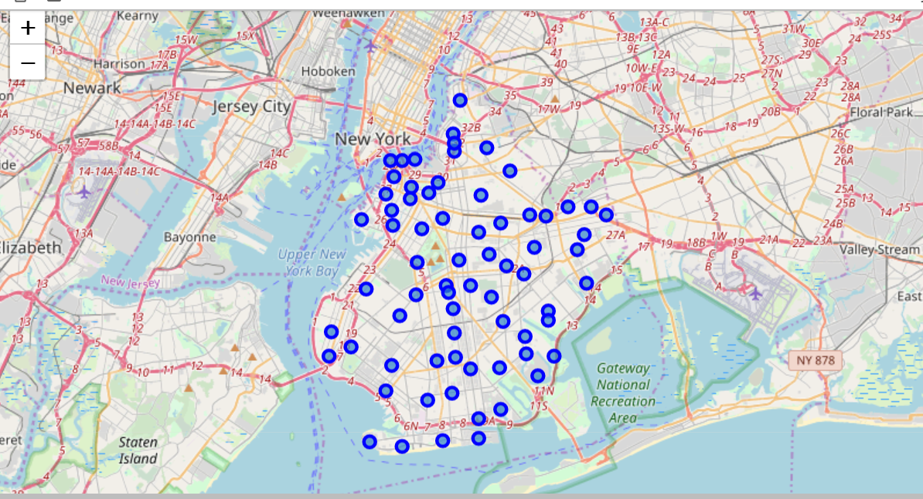

Slide 6
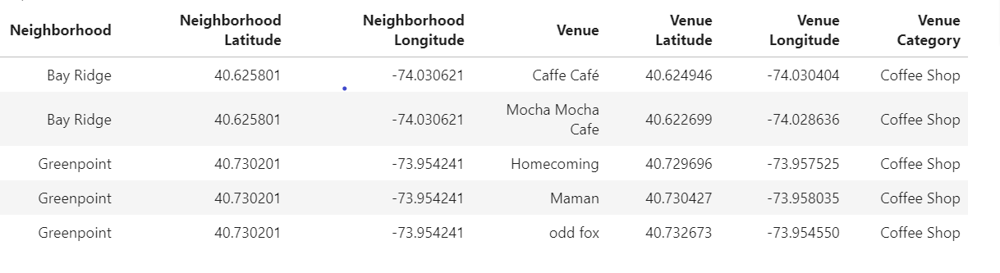
Data for analysis

Slide 7
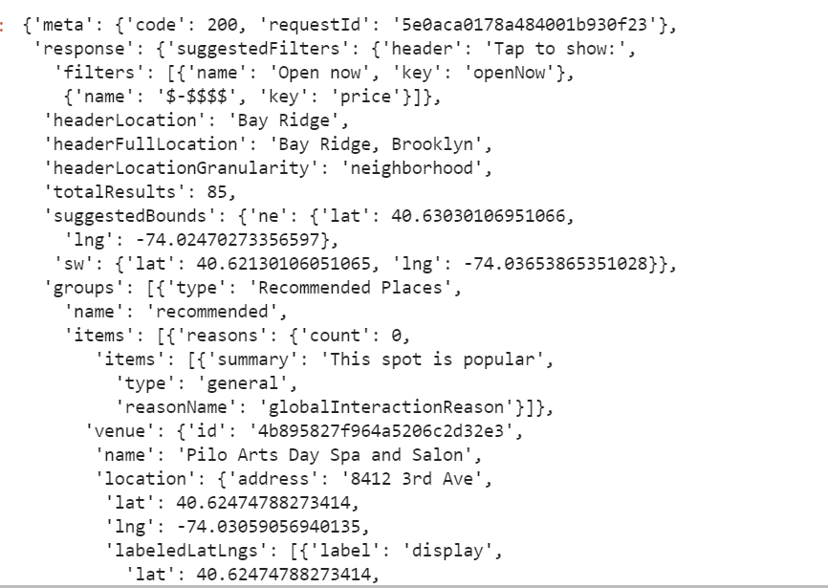
Four Square API for Venue details data

Slide 8
Results and Discussion
Analysis shows that there are few places where there are only 1 Coffee shop. eg- Bath Beach, Bay Ridge..etc These are the places which my friend consider for opening a coffee shop
Further if decides the exact location in neighborhood where he wants to shift then again we can calculate the distance from his house to the location of coffee shop he intended to start and also the distance from existing coffee shope in that location. So that he can fix the place for his new business

Slide 9
Conclusion
Purpose of this project was to identify Brooklyn areas where there are less number of coffee shops. Final decision on optimal coffee shop location will be made by stakeholders based on specific characteristics of neighborhoods and locations in every recommended zone, taking into consideration additional factors like distance from the stake holders house, distance of existing coffee shop if any in the same location and all neighborhoods of Brooklyn

