Slide 1

Password Management System
Password Management System
Veena Katiyar

Slide 2
Software used
Sqlite as Database.
Python for application development.

Slide 3
Requirement Analysis
User should be able to generate password for the given length. Password length should be >=8 and <=20 characters.
User should be able to copy password to clipboard.
User should be able to create database.
User should be able to add record in the db.
User should be able to retrieve details from the db.

Slide 4
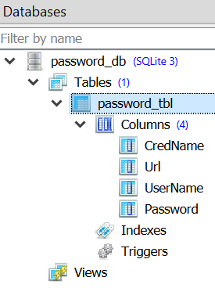
Create Data Base
Launch the application
Click on “Create Database” button.
New Database “password_db.db” will be created.

Slide 5
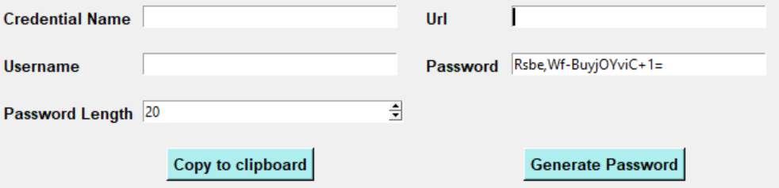
Generate Password
Select the password length.
Minimum length of the password should be 8 characters.
Maximum length of the password should be 20 characters.
Click on “Generate Password” button.
New password has been generated and displayed in the “Password” textbox.

Slide 6
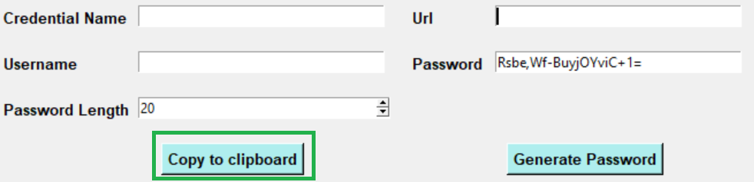
Copy Password to clipboard
Generate password.
Click on “Copy to clipboard” button.
User can paste this password, where ever he/she desires.

Slide 7
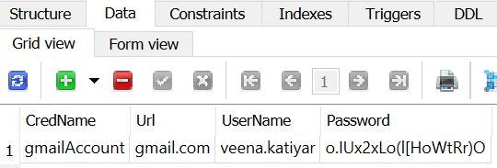
Save record in database
Enter information in all the fields.
Click on “Save to DataBase” button.
The record will be saved in the database.

Slide 8
Retrieve record from database
Enter available information in the fields.
Click on “Get Info. from DataBase” button.
The details will be displayed.

Slide 9

Veena.katiyar@gmail.com

