Slide 1
MAP / REDUCE CONCEPTS
Advanced Database System Design
MODULE 4 – LESSON 1

Slide 2
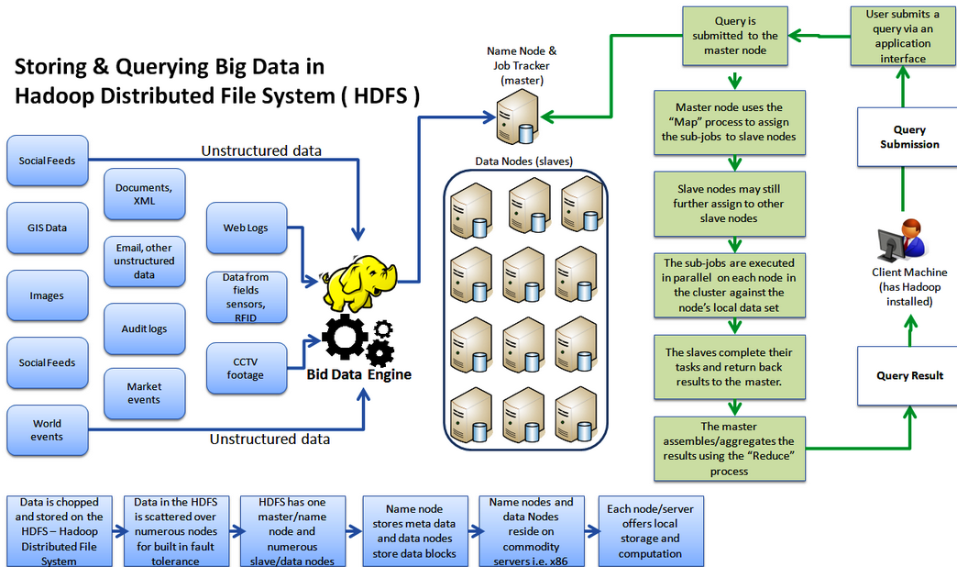
Hadoop Overview

Slide 3
OBJECTiVES
Understand basic concepts of map/reduce
Identify the parts of a map/reduce implementation
Implement a mapper function
Implement a reducer function
Create a map/reduce solution in Python
Try some other map/reduce problems in Python

Slide 4
MapReduce
Distributed query system
Splits the whole search space into parts and distributes the parts
Maps those parts onto partial solutions with keys
Shuffles the elements of the solutions by key values
Reduces all of the partial solutions with the same key into a key result
Combines all of the key results into a final result

Slide 5
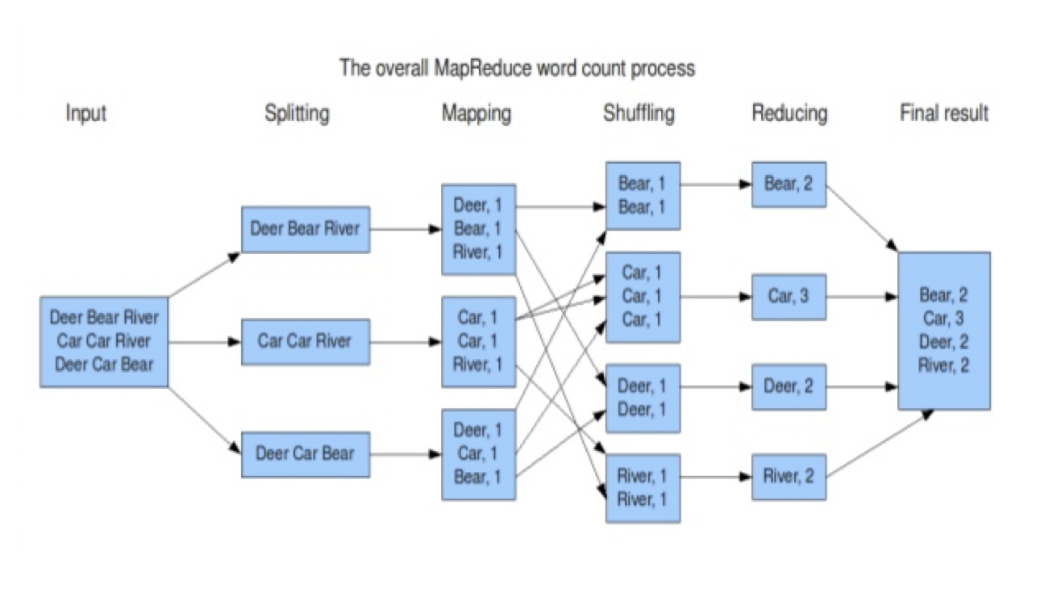
A MapReduce Example

Slide 6
Elements of Map/Reduce
Mapper
Gets elements of a solution (lines, regions, groups, whatever)
Emits Key/Value pairs
Reducer
Gets Key,[Value,Value,Value] sets
Emits Key/KeyResult pairs

Slide 7
Example Mapper
def mapper(self, _, line):
for word in line.split():
yield (word,1)

Slide 8
Example Reducer
def reducer(self, key, values):
yield key, sum(values)

Slide 9
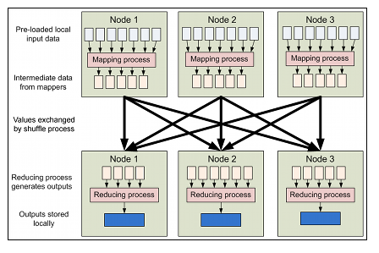
Map Reduce

Slide 10
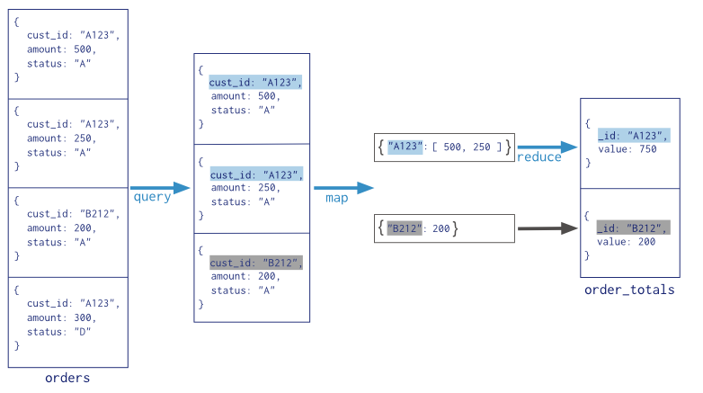
MapReduce in Mongo

Slide 11
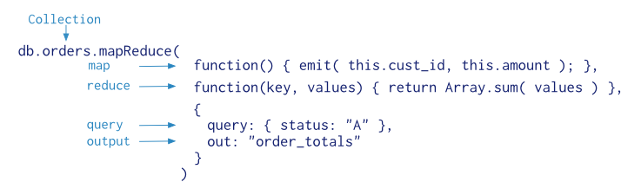
Mongo MapReduce Command

Slide 12
Mongo MapReduce in Python
>>> from bson.code import Code >>> mapper = Code(""" ... function () { ... this.tags.forEach(function(z) { ... emit(z, 1); ... }); ... } ... """)

Slide 13
Reducer Function in Python
>>> reducer = Code(""" ... function (key, values) { ... var total = 0; ... for (var i = 0; i < values.length; i++) { ... total += values[i]; ... } ... return total; ... } ... """)

Slide 14
Running MapReduce
>>> result = db.things.map_reduce(mapper, reducer, "myresults") >>> for doc in result.find(): ... print doc

