Slide 1
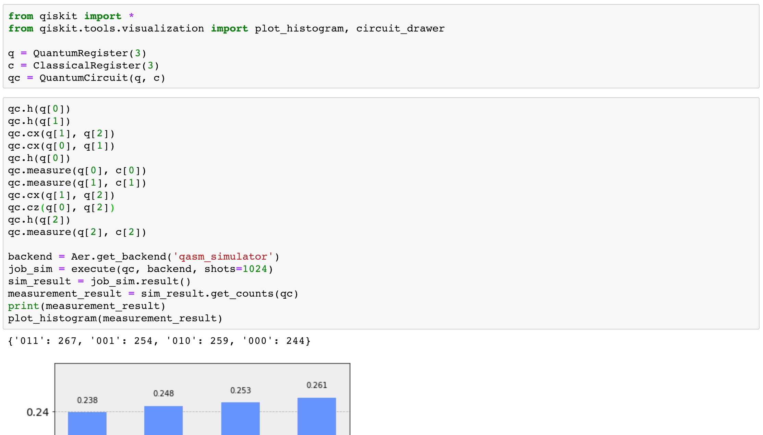

Slide 2
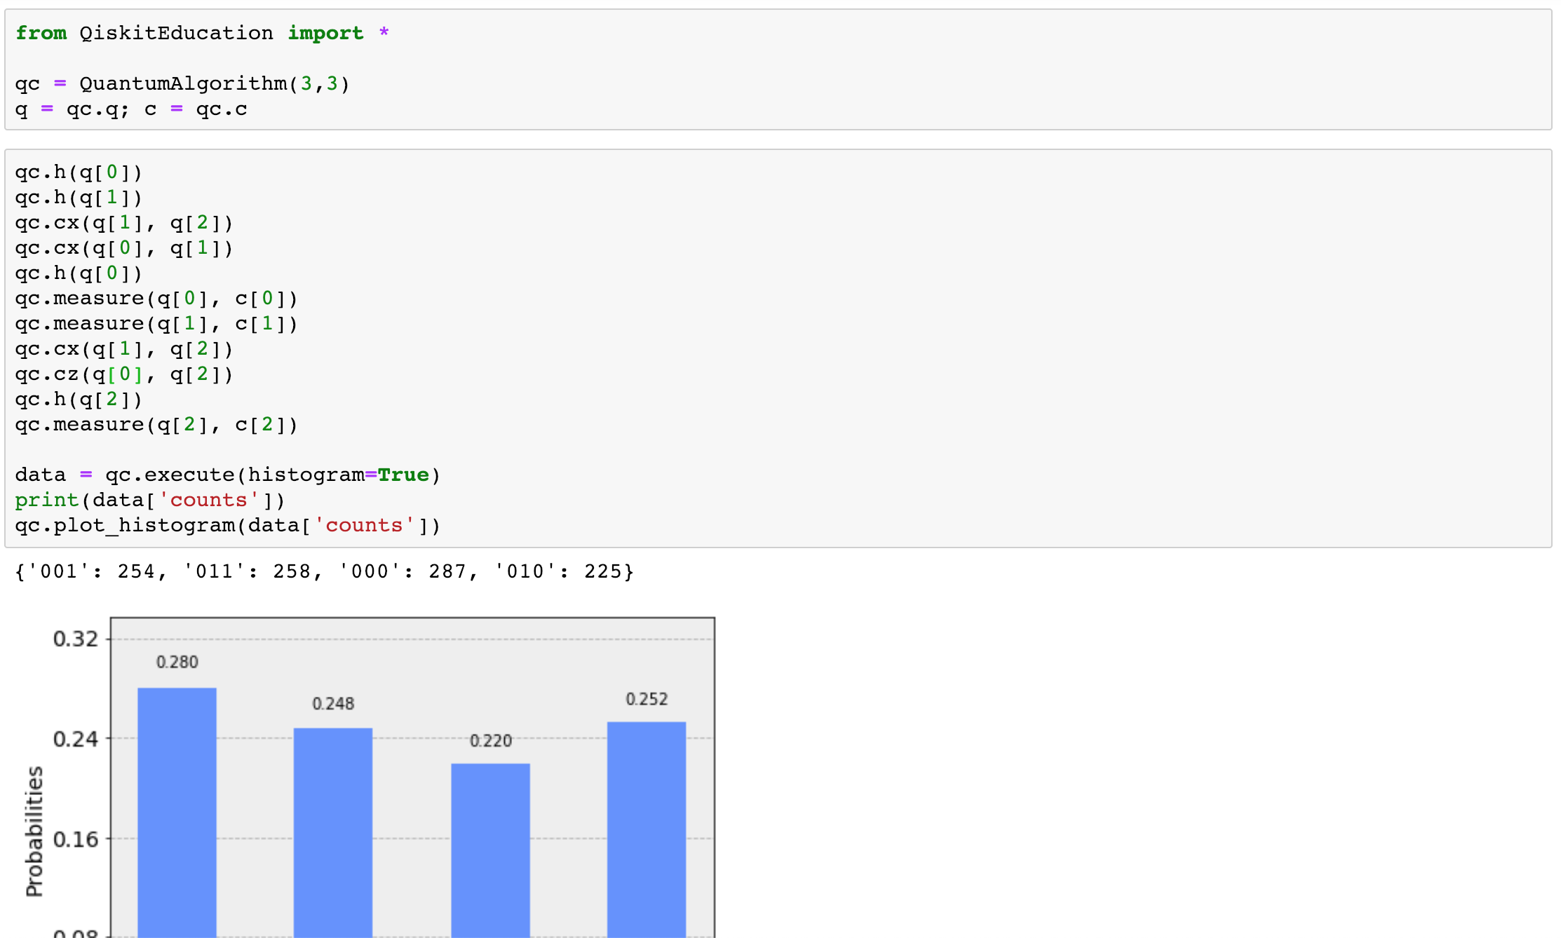

Slide 3
Minimal qiskit syntax, emphasis on quantum computation + education
User sees no changes in QiskitEducation even if there are changes in qiskit-terra

