Slide 1
AWT – Abstract windowing toolkit

Slide 2


AWT (Abstract Windowing Toolkit)
The AWT is roughly broken into three categories
  Components
  Layout Managers
  Graphics
Many AWT components have been replaced by Swing components
It is generally not considered a good idea to mix Swing components and AWT components. Choose to use one or the other.

Slide 3
AWT  Class Hierarchy
Component
Container
Window
Frame
Button
Panel
List
Checkbox
Choice
Note: There are more classes, however,
these are what are covered in this chapter
Label
TextComponent
TextField
TextArea

Slide 4
Component
Component is the superclass of most of the displayable classes defined within the AWT. Note: it is abstract.
MenuComponent is another class which is similar to Component except it is the superclass for all GUI items which can be displayed within a drop-down menu.
The Component class defines data and methods which are relevant to all Components
  setBounds
  setSize
  setLocation
  setFont
  setEnabled
  setVisible
  setForeground -- colour
  setBackground -- colour

Slide 5
Container
Container is a subclass of Component. (ie. All containers are themselves, Components)
Containers contain components
For a component to be placed on the screen, it must be placed within a Container
The Container class defined all the data and methods necessary for managing groups of Components
  add
  getComponent
  getMaximumSize
  getMinimumSize
  getPreferredSize
  remove
  removeAll

Slide 6
Windows and Frames
The Window class defines a top-level Window with no Borders or Menu bar.
  Usually used for application splash screens
Frame defines a top-level Window with Borders and a Menu Bar
  Frames are more commonly used than Windows
Once defined, a Frame is a Container which can contain Components
Frame aFrame = new Frame(Hello World);
aFrame.setSize(100,100);
aFrame.setLocation(10,10);
aFrame.setVisible(true);

Slide 7
Components
Labels : This is the simplest component of Java Abstract Window Toolkit.
This component is generally used to show the text or string
label never perform any type of action.
Label label_name = new Label ("This is the label text.");
Above code simply represents the text for the label.
Label label_name = new Label ("This is the label text.", Label.CENTER);
Justification of label can be left, right or centered

Slide 8
Buttons : This is the component of Java Abstract Window Toolkit and is used to trigger actions and other events required for your application.
Button button_name = new Button ("This is the label of the button.");
You can change the Button's label or get the label's text by using the Button.setLabel(String) and Button.getLabel() method.
Buttons are added to the it's container using the add (button_name) method.

Slide 9
Check Boxes : This component of Java AWT allows you to create check boxes in your applications.
CheckBox checkbox_name = new Checkbox ("Optional check box 1", false);
You can change and get the checkbox's label using the setLabel (String) and getLabel() method.
You can also set and get the state of the checkbox using the setState(boolean) and getState() method provided by the Checkbox class.

Slide 10
Radio Button : TThis is used as a group of checkboxes which group name is same. Only one Checkbox from a Checkbox Group can be selected at a time.
CheckboxGroup chkgp = new CheckboxGroup();
add (new Checkbox ("One", chkgp, false);
add (new Checkbox ("Two", chkgp, false);
add (new Checkbox ("Three",chkgp, false);
If you mention more than one true valued for checkboxes then your program takes the last true and show the last check box as checked.

Slide 11
Text Area: This is the text container component of Java AWT package. The Text Area contains plain text.
TextArea txtArea_name = new TextArea();
You can make the Text Area editable or not using the setEditable (boolean) method.
The text area is by default in editable mode.
Text are set in the text area using the setText(string) method of the TextArea class.

Slide 12
Text Field: This component contains single line and limited text information.
TextField txtfield = new TextField(20);

Slide 13
Panels
When writing a GUI application, the GUI portion can become quite complex.
To manage the complexity, GUIs are broken down into groups of components. Each group generally provides a unit of functionality.
A Panel is a rectangular Container whose sole purpose is to hold and manage components within a GUI.
Panel aPanel = new Panel();
aPanel.add(new Button("Ok"));
aPanel.add(new Button("Cancel"));
Frame aFrame = new Frame("Button Test");
aFrame.setSize(100,100);
aFrame.setLocation(10,10);
aFrame.add(aPanel);

Slide 14
Buttons
This class represents a push-button which displays some specified text.
When a button is pressed, it notifies its Listeners. (More about Listeners in the next chapter).
To be a Listener for a button, an object must implement the ActionListener Interface.
Panel aPanel = new Panel();
Button okButton = new Button("Ok");
Button cancelButton = new Button("Cancel");
aPanel.add(okButton));
aPanel.add(cancelButton));
okButton.addActionListener(controller2);
cancelButton.addActionListener(controller1);

Slide 15
Labels
This class is a Component which displays a single line of text.
Labels are read-only. That is, the user cannot click on a label to edit the text it displays.
Text can be aligned within the label
Label aLabel = new Label("Enter password:");
aLabel.setAlignment(Label.RIGHT);
aPanel.add(aLabel);

Slide 16
List
This class is a Component which displays a list of Strings.
The list is scrollable, if necessary.
Sometimes called Listbox in other languages.
Lists can be set up to allow single or multiple selections.
The list will return an array indicating which Strings are selected
List aList = new List();
aList.add("Calgary");
aList.add("Edmonton");
aList.add("Regina");
aList.add("Vancouver");
aList.setMultipleMode(true);

Slide 17
Checkbox
This class represents a GUI checkbox with a textual label.
The Checkbox maintains a boolean state indicating whether it is checked or not.
If a Checkbox is added to a CheckBoxGroup, it will behave like a radio button.
Checkbox creamCheckbox = new CheckBox("Cream");
Checkbox sugarCheckbox = new CheckBox("Sugar");
[]
if (creamCheckbox.getState())
{
coffee.addCream();
}

Slide 18
Choice
This class represents a dropdown list of Strings.
Similar to a list in terms of functionality, but displayed differently.
Only one item from the list can be selected at one time and the currently selected element is displayed.
Choice aChoice = new Choice();
aChoice.add("Calgary");
aChoice.add("Edmonton");
aChoice.add("Alert Bay");
[]
String selectedDestination= aChoice.getSelectedItem();

Slide 19
TextField
This class displays a single line of optionally editable text.
This class inherits several methods from TextComponent.
This is one of the most commonly used Components in the AWT
TextField emailTextField = new TextField();
TextField passwordTextField = new TextField();
passwordTextField.setEchoChar("*");
[…]
String userEmail = emailTextField.getText();
String userpassword = passwordTextField.getText();

Slide 20
TextArea
This class displays multiple lines of optionally editable text.
This class inherits several methods from TextComponent.
TextArea also provides the methods: appendText(), insertText() and replaceText()
// 5 rows, 80 columns
TextArea fullAddressTextArea = new TextArea(5, 80);
[]
String userFullAddress= fullAddressTextArea.getText();

Slide 21
Layout Managers
Since the Component class defines the setSize() and setLocation() methods, all Components can be sized and positioned with those methods.
Problem: the parameters provided to those methods are defined in terms of pixels. Pixel sizes may be different (depending on the platform) so the use of those methods tends to produce GUIs which will not display properly on all platforms.
Solution: Layout Managers. Layout managers are assigned to Containers. When a Component is added to a Container, its Layout Manager is consulted in order to determine the size and placement of the Component.
NOTE: If you use a Layout Manager, you can no longer change the size and location of a Component through the setSize and setLocation methods.

Slide 22
Layout Managers (cont)
There are several different LayoutManagers, each of which sizes and positions its Components based on an algorithm:
  FlowLayout
  BorderLayout
  GridLayout
For Windows and Frames, the default LayoutManager is BorderLayout. For Panels, the default LayoutManager is FlowLayout.

Slide 23
FlowLayout
Default
Upper-left,left-right,top-bottom
FlowLayout()
FlowLayout(int how)
FlowLayout(int how,int hor,int vert)
How = FlowLayout.LEFT,RIGHT,CENTER

Slide 24
Init(){
setLayout(newFlowLayout(FlowLayout.LEFT))
}

Slide 25
Flow Layout
The algorithm used by the FlowLayout is to lay out Components like words on a page: Left to right, top to bottom.
It fits as many Components into a given row before moving to the next row.
Panel aPanel = new Panel();
aPanel.add(new Button("Ok"));
aPanel.add(new Button("Add"));
aPanel.add(new Button("Delete"));
aPanel.add(new Button("Cancel"));

Slide 26
BorderLayout
It uses five areas to hold components: north, south, east, west, and center.
Has 4 narrow,fixed-width components at the edges and one large area at the center.
4 sides are refered as north,south,east,west and center
BorderLayout() – creates the default BL
BorderLayout(int hor,int vert)

Slide 27
Constants : BL.CENTER,LEFT,RIGHT,NORTH,SOUTH
To add –
Add(Componet c,object region)
Add(new Button(“save”),BorderLayout.SOUTH);

Slide 28
Insets
Space between container and the window
Override getInsets() ,return obj Insets
Public Insets getInsets(){
Return new Insets(10,20,30,40)
}

Slide 29
Border Layout
The BorderLayout Manager breaks the Container up into 5 regions (North, South, East, West, and Center).
When Components are added, their region is also specified:
Frame aFrame = new Frame();
BorderLayout b = new BorderLayout();
aFrame.setLayout(b);
aFrame.add("North", new Button("Ok"));
aFrame.add("South", new Button("Add"));
aFrame.add("East", new Button("Delete"));
aFrame.add("West", new Button("Cancel"));
aFrame.add("Center", new Button("Recalculate"));

Slide 30
Border Layout (cont)
The regions of the BorderLayout are defined as follows:
North
West
Center
East
South

Slide 31
GridLayout
gridLayout()
(int r,int col)
(int r,int c,int hor, int vert)

Slide 32
Grid Layout
The GridLayout class divides the region into a grid of equally sized rows and columns.
Components are added left-to-right, top-to-bottom.
The number of rows and columns is specified in the constructor for the LayoutManager.
Panel aPanel = new Panel();
GridLayout theLayout = new GridLayout(2,2);
aPanel.setLayout(theLayout);
aPanel.add(new Button("Ok"));
aPanel.add(new Button("Add"));
aPanel.add(new Button("Delete"));
aPanel.add(new Button("Cancel"));

Slide 33
What if I dont want a LayoutManager?
LayoutManagers have proved to be difficult and frustrating to deal with.
The LayoutManager can be removed from a Container by invoking its setLayout method with a null parameter.
Panel aPanel = new Panel();
aPanel.setLayout(null);
Ch. VIII - <number>

Slide 34
Graphics
It is possible to draw lines and various shapes within a Panel under the AWT.
Each Component contains a Graphics object which defines a Graphics Context which can be obtained by a call to getGraphics().
Common methods used in Graphics include:
  drawLine
  drawOval
  drawPolygon
  drawPolyLine
  drawRect
  drawRoundRect
  drawString
  draw3DRect
  fill3DRect
  fillArc
fillOval
fillPolygon
fillRect
fillRoundRect
setColor
setFont
setPaintMode
drawImage

Slide 35
Components and containers
A graphical user interface is built of graphical elements called components.
Typical components include such items as buttons, scrollbars, and text fields.
Components allow the user to interact with the program and provide the user with visual feedback about the state of the program.
In the AWT, all user interface components are instances of class Component or one of its subtypes.
Components do not stand alone, but rather are found within containers.
Containers contain and control the layout of components.
Containers are themselves components, and can thus be placed inside other containers.
In the AWT, all containers are instances of class Container or one of its subtypes.

Slide 36



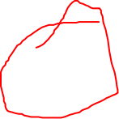
Mouse click
OS
JAVA LIBRARY CLASSES
Your Methods

Slide 37








Delegation Event Model
Register
Source
Event
Listener
Event Notification
Action

Slide 38







A button is SOURCE of EVENT
EVENT is say generated by CLICK
EVENT always has a source
When clicked creates a new object that represents and identifies this EVENT
In this case it is ActionEvent – contains info about the source and the event.
This object is passed to the function to handle the event

Slide 39
Event object corresponding to the button will be passed to LISTENER object,that is registered.
A LISTENER object can listen to more than one EVENt.
Implement a listener interface
Eg: agroup of meu items.

Slide 40


The code that is to receive the event and respond to the event is implemented in a method declared in Listener Interface.
In our eg: actionPerformed() method in the ActionListener interface is called when the event occurs.
You have to connect the listener to the source or sources.
You REGISTER a lister object with a source by calling a particular method in th source object.
Here it is addActionListener() method for Button obecjt ,and pass the Listener object as an argument to the method.
DELEGATION EVENT MODEL – different events that originate with a component , is not handled by the componenet itself,but is delegated to separate listener obejcts

Slide 41

Events
An event is an object that describes the change of state of a source.
Super class of all events : java.util.eventObject
Superclass of all AWT events: java.util.AWTEvent and is a subclass of EventObject.

Slide 42


Class hierarchy
Java.lang.Object
Java.util.EventObject
Java.awt.AWTEvent

Slide 43









EVENTS
EVENT CLASS | Description
ActionEvent | When a button is pressed,list item is double cliked,menu is selected
AdjustmentEvent | Scroll bar moves
ComponentEvent | When a component is moved,resized,hiddden
ContainerEvent | Componenet is added or remocved
Focus | When a component gets focus or loses
InputEvent | Abstract super class for all i/p event classes
ItemEvent | Checkbox is clicked,list item is selected
KeyEvent | i/p from keyboard
Mouse | Dragged,moved,clicked,pressed,released,mouse enters/leaves a compunent
MouseWheel | Wheel is moved
Text | Value of testarea or field is changed
Window | Window is activated,closed,deactivated,opened

Slide 44


Getting location
getLocation() - This method is used to get position of the component, as a Point.
Point p = someComponent.getLocation();
int x = p.x;
int y = p.y;
OR
int x = someComponent.getX();
int y = someComponent.getY();

Slide 45
getLocationOnScreen() - This method is used to get the position of the upper-left corner of the screen of the component, as a Point.
Point p = someComponent.getLocationOnScreen();
int x = p.x;
int y = p.y;

Slide 46

getSize() - This method is used to get the current size of component, as a Dimension.
Dimension d = someComponent.getSize();
int height = d.height;
int width = d.width;
setVisible(boolean) - This method is used for the visibility state of the component.
setEnabled(boolean) - This method is used to toggle the state of the component.
The component will appear if set to true and it will also react to the user. ON the contrary, if set to false then the component will not appear hence no user interaction will be there.

Slide 47

Listeners
Every listener interface has at least one event type.
contains a method for each type of event the event class incorporates.
Eg: KeyListener has three methods: keyTyped(), keyPressed(), and keyReleased().

Slide 48
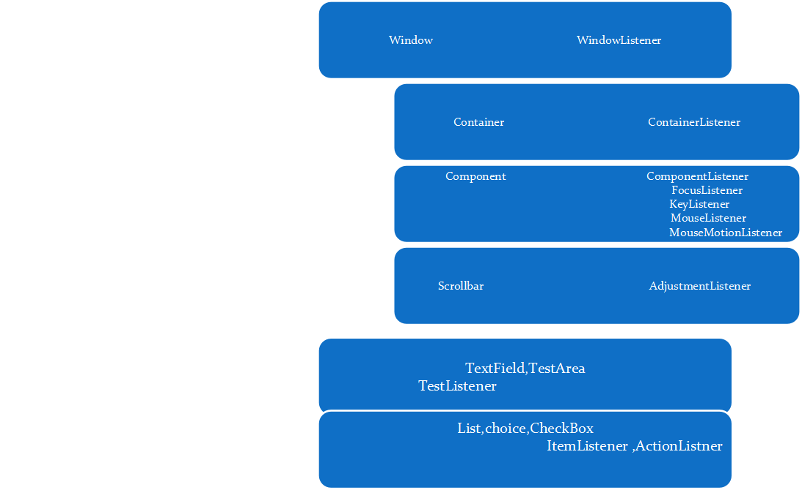

Slide 49









public class M yClass implements M ouseListener {
...
someObject.addMouseListener(this);
...
/* Empty method definition. */
public void mouseEntered(MouseEvent e) {
}
/* Empty method definition. */
public void mouseExited(MouseEvent e) {
}
/* Empty method definition. */
public void mousePressed(MouseEvent e) {
}
public void mouseClicked(MouseEvent e){
// your code goes here;
}
}

Slide 50



Adapter class
avoiding the implementation of the empty method bodies.
For example, the MouseAdapter class implements the MouseListener interface.
An adapter class implements empty versions of all its interface's methods.
To use an adapter : you create a subclass of it, instead of directly implementing a listener interface.

Slide 51

MyClass extends MouseAdapter { ..someObject.addMouseListener(this);
public void mouseClicked(MouseEvent e){
// your code goes here;
}
}

Slide 52






Multiple inheritance issue — define inner class
MyClass extends Applet { ... someObject.addMouseListener(new MyAdapter());
class MyAdapter extends MouseAdapter { public void mouseClicked(MouseEvent e) { ...//Event handler implementation goes here... } } }

