Slide 1
Applets Programming

Slide 2
Introduction
Applets are small Java programs that are embedded in Web pages.
They can be transported over the Internet from one computer (web server) to another (client computers).
They transform web into rich media and support the delivery of applications via the Internet.

Slide 3
How Applets Differ from Applications
Although both the Applets and stand-alone applications are Java programs, there are certain restrictions are imposed on Applets due to security concerns:
  Applets don’t use the main() method, but when they are load, automatically call certain methods (init, start, paint, stop, destroy).
  They are embedded inside a web page and executed in browsers.
  They cannot read from or write to the files on local computer.
  They cannot communicate with other servers on the network.
  They cannot run any programs from the local computer.
  They are restricted from using libraries from other languages.
The above restrictions ensures that an Applet cannot do any damage to the local system.

Slide 4
The genealogy of Applet
java.lang.Object
|
+----java.awt.Component
|
+----java.awt.Container
|
+----java.awt.Panel
|
+----java.applet.Applet

Slide 5


What is an applet
An applet is a subclass of Panel
  It is a container which can hold GUI components
  It has a graphics context which can be used to draw images
An applet embedded within an HTML page
  Applets are defined using the <applet> tag
  Its size and location are defined within the tag
The browser contains a Java Virtual Machine which executes the applet
  The applet .class file is downloaded, through the net, into the Virtual machine.
Unfortunately, most browsers have a very old version of the JVM
  The standard is either Java 1.1.4 or 1.1.5
  Sun has released a Java 1.2 plugin which can be used instead

Slide 6
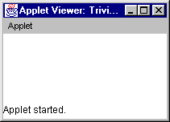
The simplest possible applet
TrivialApplet.java
import java.applet.Applet;
public class TrivialApplet extends Applet { }
TrivialApplet.html
<applet
code="TrivialApplet.class”
width=150 height=100>
</applet>

Slide 7
Building Applet Code: An Example
//HelloWorldApplet.java
import java.applet.Applet;
import java.awt.*;
public class HelloWorldApplet extends Applet {
public void paint(Graphics g) {
g.drawString ("Hello World of Java!",25, 25);
}
}

Slide 8
Embedding Applet in Web Page
<HTML>
<HEAD>
<TITLE>
Hello World Applet
</TITLE>
</HEAD>
<body>
<h1>Hi, This is My First Java Applet on the Web!</h1>
<APPLET CODE="HelloWorldApplet.class" width=500 height=400>
</APPLET>
</body>
</HTML>

Slide 9
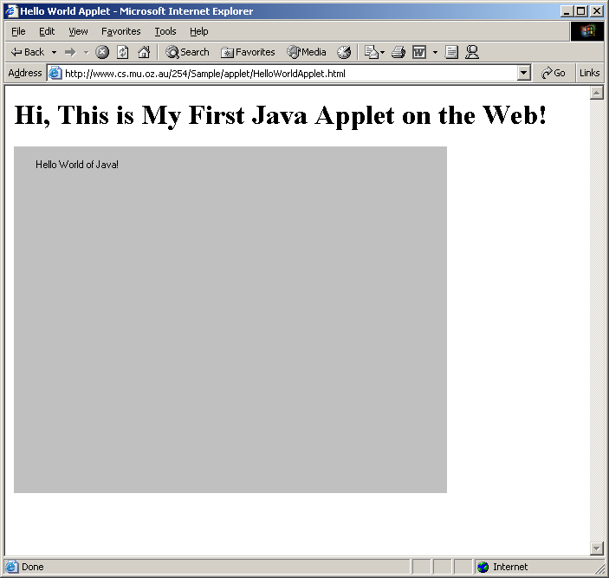
Accessing Web page (runs Applet)

Slide 10
Applet Life Cycle
Every applet inherits a set of default behaviours from the Applet class. As a result, when an applet is loaded, it undergoes a series of changes in its state. The applet states include:
  Initialisation – invokes init()
  Running – invokes start()
  Display – invokes paint()
  Idle – invokes stop()
  Dead/Destroyed State – invokes destroy()

Slide 11
Applet States
Initialisation – invokes init() – only once
  Invoked when applet is first loaded.
Running – invokes start() – more than once
  For the first time, it is called automatically by the system after init() method execution.
  It is also invoked when applet moves from idle/stop() state to active state. For example, when we return back to the Web page after temporary visiting other pages.
Display – invokes paint() - more than once
  It happens immediately after the applet enters into the running state. It is responsible for displaying output.
Idle – invokes stop() - more than once
  It is invoked when the applet is stopped from running. For example, it occurs when we leave a web page.
Dead/Destroyed State – invokes destroy() - only once
  This occurs automatically by invoking destroy() method when we quite the browser.

Slide 12
Applet Life Cycle Diagram
init()
Born
Begin
stop()
start()
Running
Idle
destroy()
paint()
start()
Dead
End

Slide 13
Passing Parameters to Applet
<HTML>
<HEAD>
<TITLE>
Hello World Applet
</TITLE>
</HEAD>
<body>
<h1>Hi, This is My First Communicating Applet on the Web!</h1>
<APPLET
CODE="HelloAppletMsg.class" width=500 height=400>
<PARAM NAME="Greetings" VALUE="Hello Friend, How are you?">
</APPLET>
</body>
</HTML>

Slide 14
Applet Program Accepting Parameters
//HelloAppletMsg.java
import java.applet.Applet;
import java.awt.*;
public class HelloAppletMsg extends Applet {
String msg;
public void init()
{
msg = getParameter("Greetings");
if( msg == null)
msg = "Hello";
}
public void paint(Graphics g) {
g.drawString (msg,10, 100);
}
}
This is name of parameter specified in PARAM tag;
This method returns the value of paramter.

Slide 15
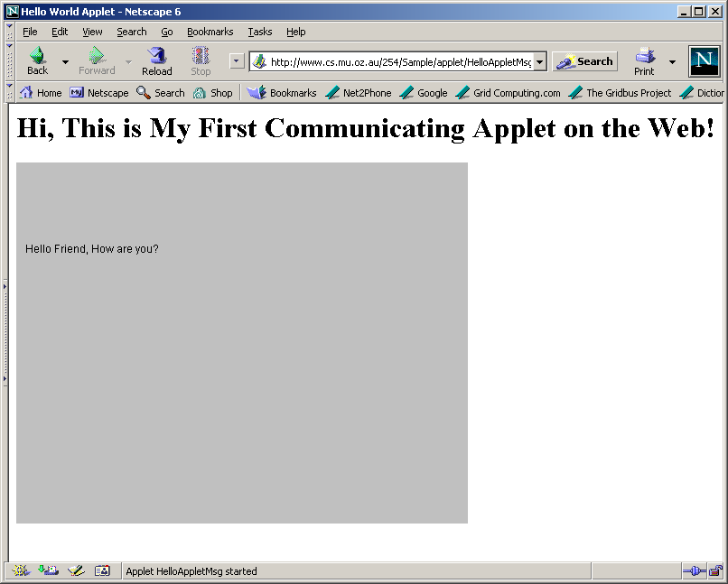
HelloAppletMsg.html

Slide 16
What happen if we don’t pass parameter? See HelloAppletMsg1.html
<HTML>
<HEAD>
<TITLE>
Hello World Applet
</TITLE>
</HEAD>
<body>
<h1>Hi, This is My First Communicating Applet on the Web!</h1>
<APPLET
CODE="HelloAppletMsg.class" width=500 height=400>
</APPLET>
</body>
</HTML>

Slide 17
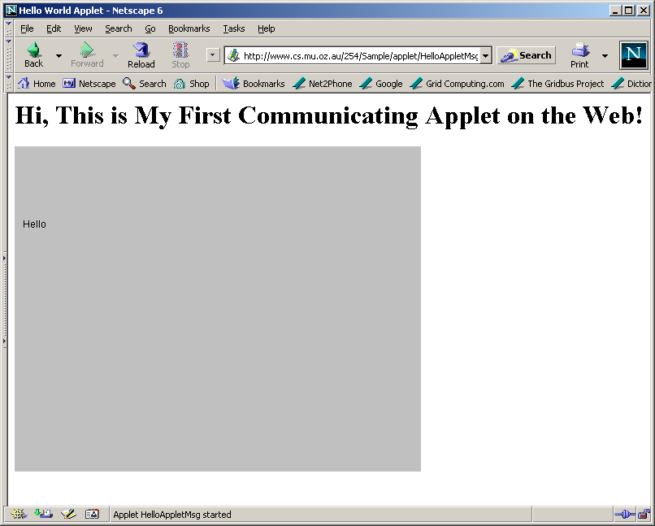
getParameter() returns null. Some default value may be used.

Slide 18
Displaying Numeric Values
//SumNums.java
import java.applet.Applet;
import java.awt.*;
public class SumNums extends Applet {
public void paint(Graphics g) {
int num1 = 10;
int num2 = 20;
int sum = num1 + num2;
String str = "Sum: "+String.valueOf(sum);
g.drawString (str,100, 125);
}
}

Slide 19
SunNums.html
<HTML>
<HEAD>
<TITLE>
Hello World Applet
</TITLE>
</HEAD>
<body>
<h1>Sum of Numbers</h1>
<APPLET CODE="SumNums.class" width=500 height=400>
</APPLET>
</body>
</HTML>

Slide 20
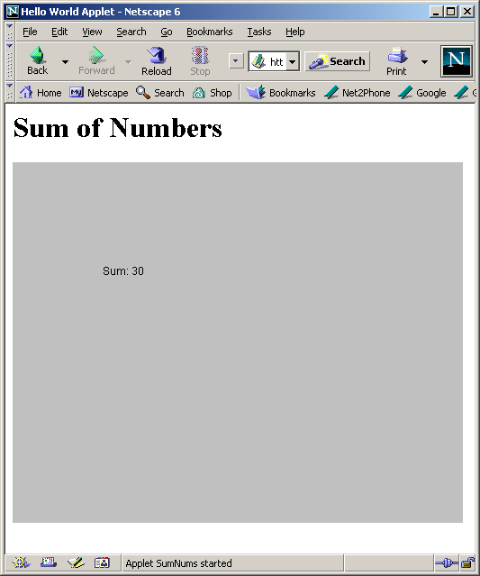
Applet – Sum Numbers

Slide 21
Interactive Applets
Applets work in a graphical environment. Therefore, applets treats inputs as text strings.
We need to create an area on the screen in which use can type and edit input items.
We can do this using TextField class of the applet package.
When data is entered, an event is generated. This can be used to refresh the applet output based on input values.

Slide 22
Interactive Applet Program..(cont)
//SumNumsInteractive..java
import java.applet.Applet;
import java.awt.*;
public class SumNumsInteractive extends Applet {
TextField text1, text2;
public void init()
{
text1 = new TextField(10);
text2 = new TextField(10);
text1.setText("0");
text2.setText("0");
add(text1);
add(text2);
}
public void paint(Graphics g) {
int num1 = 0;
int num2 = 0;
int sum;
String s1, s2, s3;
g.drawString("Input a number in each box ", 10, 50);
try {
s1 = text1.getText();
num1 = Integer.parseInt(s1);
s2 = text2.getText();
num2 = Integer.parseInt(s2);
}
catch(Exception e1)
{}

Slide 23
Interactive Applet Program.
sum = num1 + num2;
String str = "THE SUM IS: "+String.valueOf(sum);
g.drawString (str,100, 125);
}
public boolean action(Event ev, Object obj)
{
repaint();
return true;
}
}

Slide 24
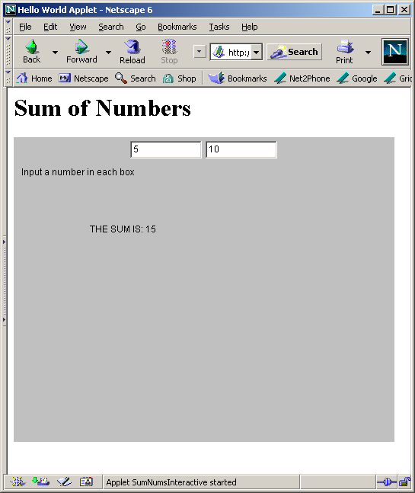
Interactive Applet Execution

Slide 25
Summary
Applets are designed to operate in Internet and Web environment. They enable the delivery of applications via the Web.
This is demonstrate by things that we learned in this lecture such as:
  How do applets differ from applications?
  Life cycles of applets
  How to design applets?
  How to execute applets?
  How to provide interactive inputs?

