Slide 1
Component-Based Software Engineering
Introduction to Java Beans
Paul Krause
and
Sotiris Moschoyiannis

Slide 2
Java Beans
Contents
Definition
Bean Basics

Slide 3
What is a Java Bean?
“A Java Bean is a reusable software component that can be manipulated visually in a builder tool”
JavaSoft

Slide 4
Sources of Builder Tools
NetBeans:
http://www.netbeans.org
JBuilder:
http://www.borland.com/jbuilder/
Note, you also need to have the Java SDK installed.

Slide 5
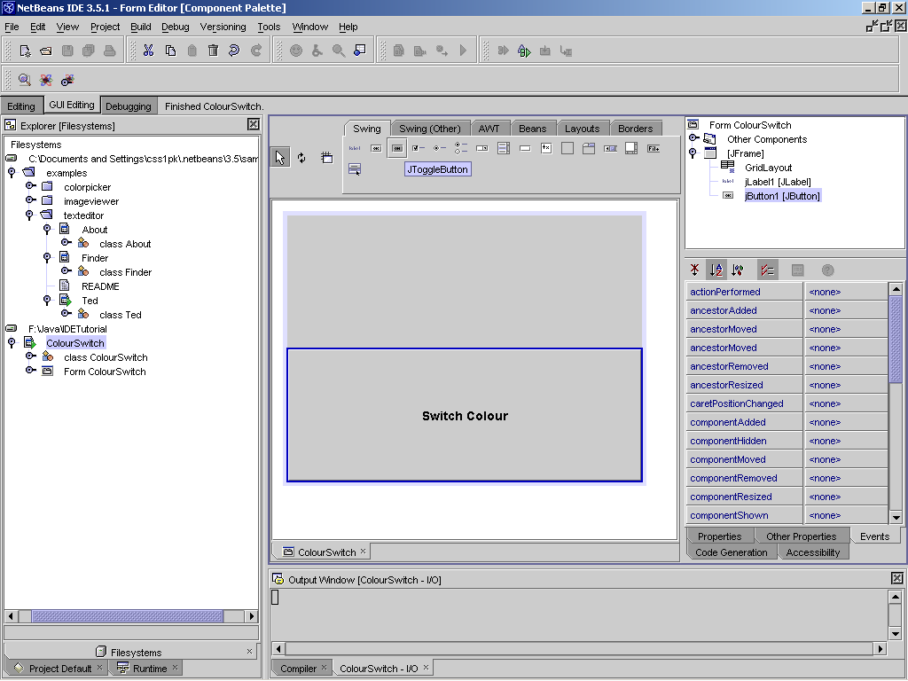

Slide 6
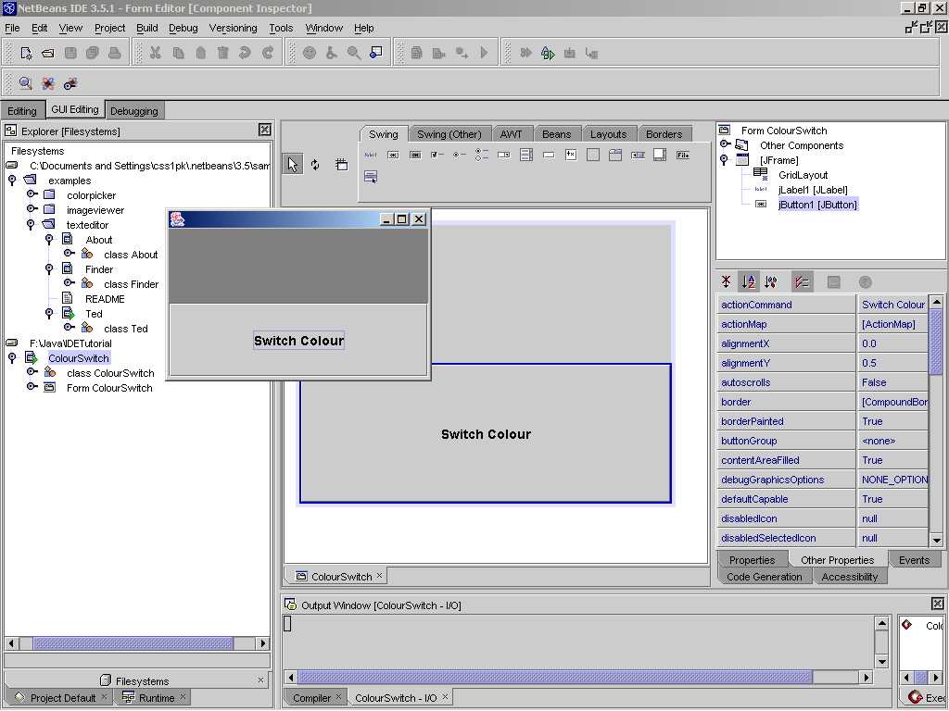

Slide 7
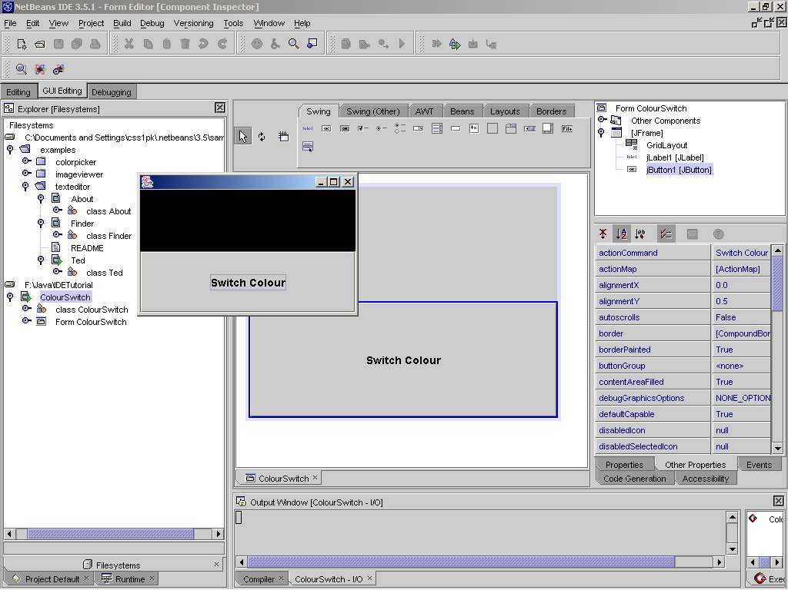

Slide 8
Bean Books
Developing Java Beans | Robert Englander | O’Reilly | Recommended
JavaBeans Programming | J. O’Neil and H. Schildt | McGraw Hill | Good. Contains many examples.
JavaBeans by Example | Henri Jubin | Prentice Hall | Simpler than the above, but with useful examples
NetBeans – the Definitive Guide | Boudreau, Glick, Greene, Spurlin, Woehr | O’Reilly | Not so good on Beans. More about the IDE.

Slide 9
Java Beans
Contents
Definition
Bean Basics

Slide 10
The Component Model
JavaBeans is Java’s component model
The model is made up of an architecture and an API
The API makes it possible to write component software in Java
The architecture provides the framework (services and rules) that allows components to participate properly

Slide 11
The Component Model
Discovery and Registration
Raising and Handling of Events
Persistence
Visual Presentation
Support for Visual Programming

Slide 12
The Component Model
Discovery and Registration
Locate a component at run-time and determine its supported interfaces
Registration process for a component to make itself and its interfaces known
This mechanism allows components and applications to be developed independently

Slide 13
The Component Model
Raising and Handling of Events
Beans (or JavaBeans components) use events to communicate with other Beans
A Bean that wants to receive events (a listener Bean) registers its interest with the Bean that triggers the event (a source Bean)

Slide 14
The Component Model
Persistence
Persistence enables Beans to save and restore their state
JavaBeans uses Java Object Serialization to support persistence

Slide 15
The Component Model
Visual Presentation
The Bean is free to choose its own visual presentation (fonts, colours, shape, etc)
Many of these characteristics will be properties of the Bean (some might be persistent too)

Slide 16
The Component Model
Support of Visual Programming
User can select a component from the toolbox and place it into a container
Properties of the component can then be edited to create the desired behaviour

Slide 17
Bean’s Properties
Properties are a Bean’s appearance and behaviour characteristics that can be changed at design time
By following specific naming conventions, the properties of a Bean that are “revealed” to the world can be identified

Slide 18
Conventions for Access Methods
Simple Properties:
For a property of type Type and name Name:
public Type getName( );
public void setName(Type value);
Boolean Properties:
public boolean isName( );
public void setName(boolean value);

Slide 19
Bean Methods
A Bean may be implemented by a Java Class
That Class contains a number of methods that may be used to access and control the Bean
These are generally all the public methods of the Class that implements the Bean

Slide 20
Events
JavaBeans components interact by generating “Events”
Several components may register an interest in an Event that is generated by a specific component
Occurrence of the Event triggers methods to be called in all the components that are “listening” for it

Slide 21
Introspection
The process by which builder tools discover a Bean’s features
Beans support introspection in two ways:
By adhering to specific rules (design patterns)
when naming properties, methods and events
By explicitly providing property, method and
event info within a Bean Information class

Slide 22
Introspection
Low-level reflection:
Follow Bean coding style (we have seen)
Analysis of the Bean’s class can then reveal properties and methods
Revealing complex properties:
Implement a “BeanInfo” class

Slide 23
Customisation
Beans expose properties so they can be customised at design time
Customisation is supported in two ways:
By using property editors
By creating more sophisticated Bean customisers

Slide 24
Customisation
Simple properties
Development tool will build property sheets dynamically
User may then edit the properties to customise the Bean
For the Advanced User
Create a specific customiser for a Bean
This is kept separate to the Bean Class, as with a BeanInfo Class

Slide 25
Further Features
Visibility
It is not necessary for a Bean to be visible at run-time (e.g. Bean controlling access to a device or data feed)
It is necessary however for a Bean to support the visual builder tool. Even an ‘invisible’ run-time Bean shall be shown on the builder tool

Slide 26
Further Features
Multithreading
Always assume your code will be used in a multithreaded environment
Make sure that your Beans are thread-safe
Multithreading in JavaBeans is no different than multithreading in Java

Slide 27
Further Features
Security
By default assume that your Beans are running in a non-trusted applet
Apply security restrictions such as
Allow no access to the local file system
Limit socket connections to the host system

Slide 28
Summary
Beans build on Java features that already exist
We add a Builder Tool
We use design patterns
We record information about the Classes that implement Beans

