Slide 1

Parallel Programming with ForkJoinPool Tasks in Java
Mokter Hossain, Ph.D.
Founder: https://www.youtube.com/channel/CSITEdExperts

Slide 2
Parallel Programming with Java ForkJoinPool
An Overview of the Presentation
What is Parallel Programming?
How to Implement Parallel Processing?
An Overview of Java ForkJoinPool
The ForkJoinPool Structure & Functionality
Steps in Implementing a Java Program with the ForkJoinPool
A Sample Java Program with the ForkJoinPool Utilization
Thank You

Slide 3
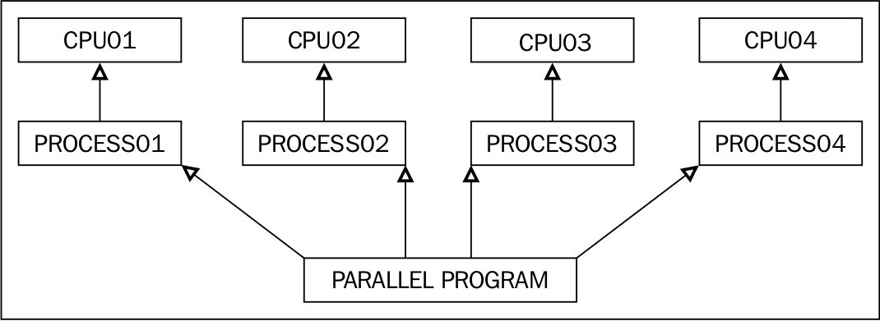
Parallel Programming with Java ForkJoinPool
Parallel programming is a process of running multiple tasks on multiple processors.
YouTube Channel: https://www.youtube.com/channel/CSITEdExperts

Slide 4
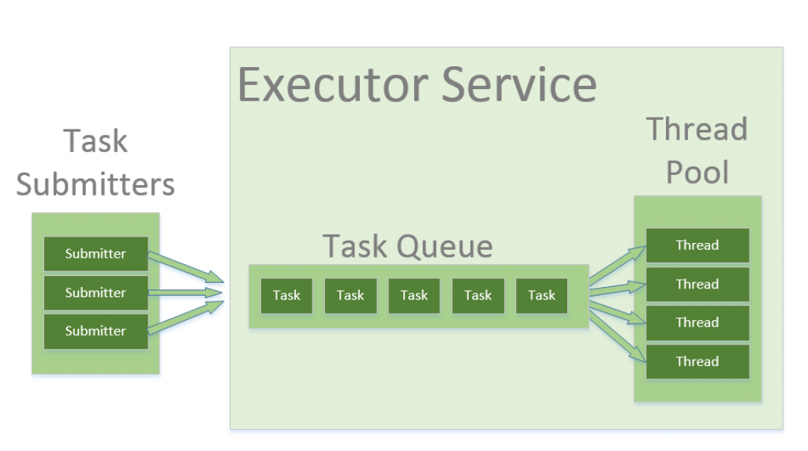
How to Implement Parallel Processing?
Parallel Programming with Java ForkJoinPool
1) Thread Pool in Java
A thread pool is a collection of worker threads that efficiently execute asynchronous callbacks on behalf of the application.
Used to reduce the number of application threads;
Provides management of the worker threads.
2) ExecutorService in Java
Is an asynchronous execution mechanism that is capable of executing tasks in the background. It is a thread pool implementation.
YouTube Channel: https://www.youtube.com/channel/CSITEdExperts

Slide 5
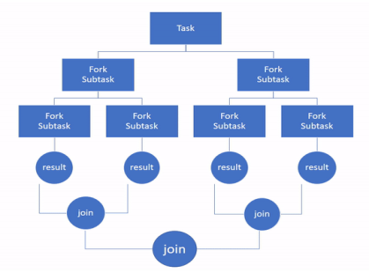
An Overview of Java ForkJoinPool
Parallel Programming with Java ForkJoinPool
3) ForkJoinPool in Java
The ForkJoinPool is similar to the Java ExecutorService but with one difference that it easily split the working task into smaller tasks which are then submitted to the ForkJoinPool; and finally joins the results (if any).
YouTube Channel: https://www.youtube.com/channel/CSITEdExperts

Slide 6
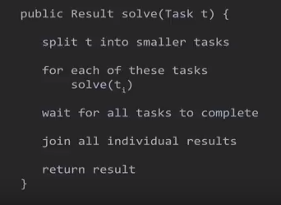
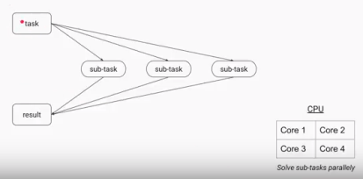
An Overview of Java ForkJoinPool
Parallel Programming with Java ForkJoinPool
Uses Divide & Conquer Fashion:
YouTube Channel: https://www.youtube.com/channel/CSITEdExperts

Slide 7
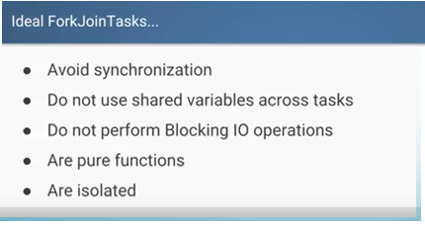
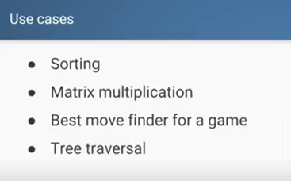
An Overview of Java ForkJoinPool
Parallel Programming with Java ForkJoinPool
YouTube Channel: https://www.youtube.com/channel/CSITEdExperts

Slide 8
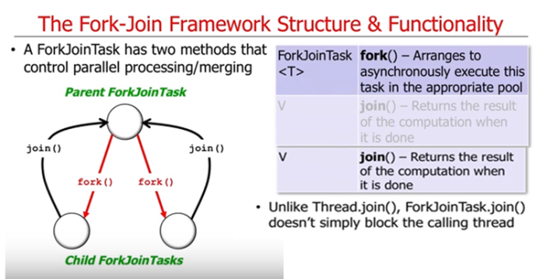
The ForkJoinPool Structure & Functionality
Parallel Programming with Java ForkJoinPool
YouTube Channel: https://www.youtube.com/channel/CSITEdExperts

Slide 9
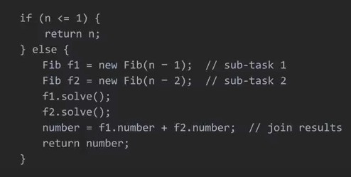
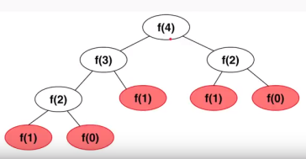
A Java program using ForkJoinPool
Parallel Programming with Java ForkJoinPool
Fibonacci(n) Calculation:
YouTube Channel: https://www.youtube.com/channel/CSITEdExperts

Slide 10
Steps in Implementing a Java Program with the ForkJoinPool
Parallel Programming with Java ForkJoinPool
1) Creating a ForkJoinPool Object
ForkJoinPool fjpool = new ForkJoinPool();
2) Submitting Tasks to the ForkJoinPool Object
fjpool.invoke(task)
RecursiveAction: A task which does not return any value. It just does some work, e.g. writing data to disk, and then exits.
RecursiveTask: A task that returns a result. It may split its work up into smaller tasks, and merge the result of these smaller tasks into a collective result.
YouTube Channel: https://www.youtube.com/channel/CSITEdExperts

Slide 11
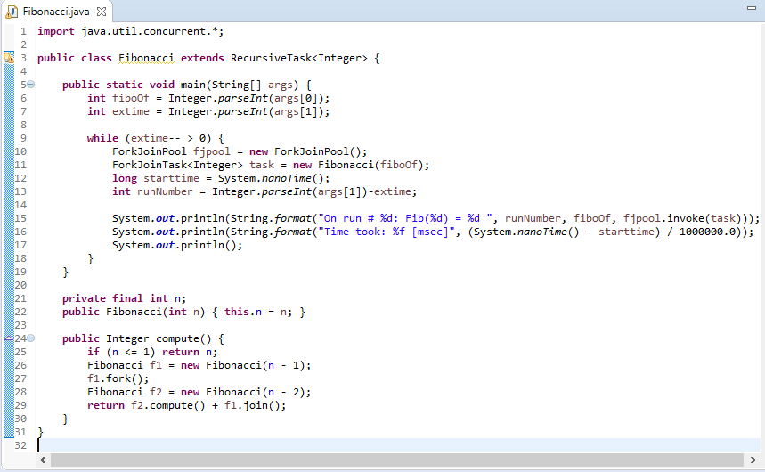
A Sample Java Program with the ForkJoinPool Utilization
Parallel Programming with Java ForkJoinPool
YouTube Channel: https://www.youtube.com/channel/CSITEdExperts

Slide 12
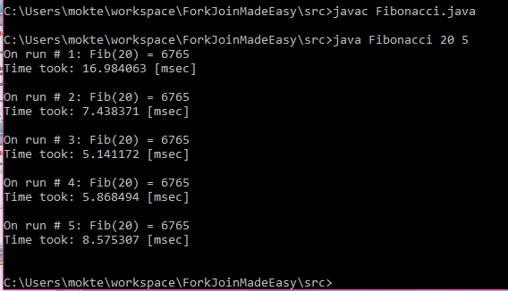
Sample Output:
Parallel Programming with Java ForkJoinPool
A Sample Java Program with the ForkJoinPool Utilization
YouTube Channel: https://www.youtube.com/channel/CSITEdExperts

Slide 13
https://docs.oracle.com/javase/8/docs/api/java/util/concurrent/ForkJoinPool.html https://homes.cs.washington.edu/~djg/teachingMaterials/spac/grossmanSPAC_forkJoinFramework.html http://tutorials.jenkov.com/java-util-concurrent/java-fork-and-join-forkjoinpool.html https://www.youtube.com/watch?v=5wgZYyvIVJk https://github.com/headius/forkjoin.rb/blob/master/examples/recursive/Fibonacci.java
Parallel Programming with Java ForkJoinPool
References:
YouTube Channel: https://www.youtube.com/channel/CSITEdExperts

Slide 14

Thank you!
Please Subscribe:
https://www.youtube.com/channel/CSITEdExperts

