Slide 1

REACTJS

Slide 2

HELLO!
I am Veena Kumaran
(Business Analyst and Freelancer)
You can find me at @VeenaKumaran27@gmail.com

Slide 3
You Will Learn...........
What is ReactJs
Why ReactJs?
Prerequisites to learn ReactJs
Buzzwords around ReactJs
Who should take this Course?
Why you should take this Course?

Slide 4
What is ReactJs?
1

Slide 5

What is ReactJs?
ReactJs is a JavaScript library used for building fast and interactive user interfaces
It was developed by Facebook in the year 2011
Current version in use is 16.7.0
ReactJs follows a component based architecture

Slide 6
What is ReactJs?
Definition :
React is a component based, standard JavaScript library used for creating single page, fast and interactive UI

Slide 7

Websites built on ReactJs

Slide 8
Component Based Architecture
Component is a piece of the UI which is independent, isolated and reusable
These components display data as it changes over time
Root Component
Child Components

Slide 9
Component Based Architecture
APP
Nav Bar
Profile
Feed
Posts
Tweets

Slide 10
State and Render methods
State() → describe the state of the element that is displayed (data)
Render() → describes what the UI should look like (component structure)

Slide 11
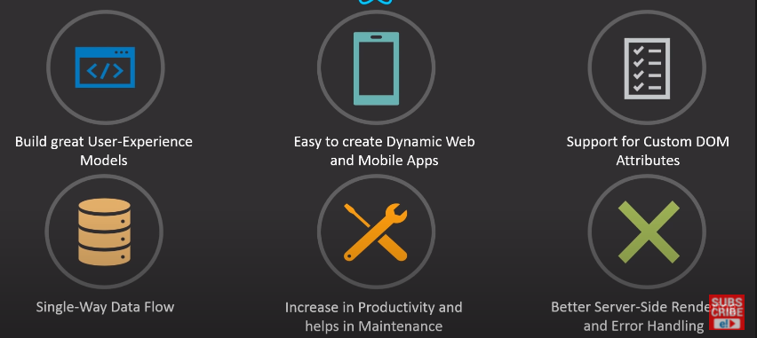
ReactJs Features

Slide 12
Why ReactJs?
2

Slide 13
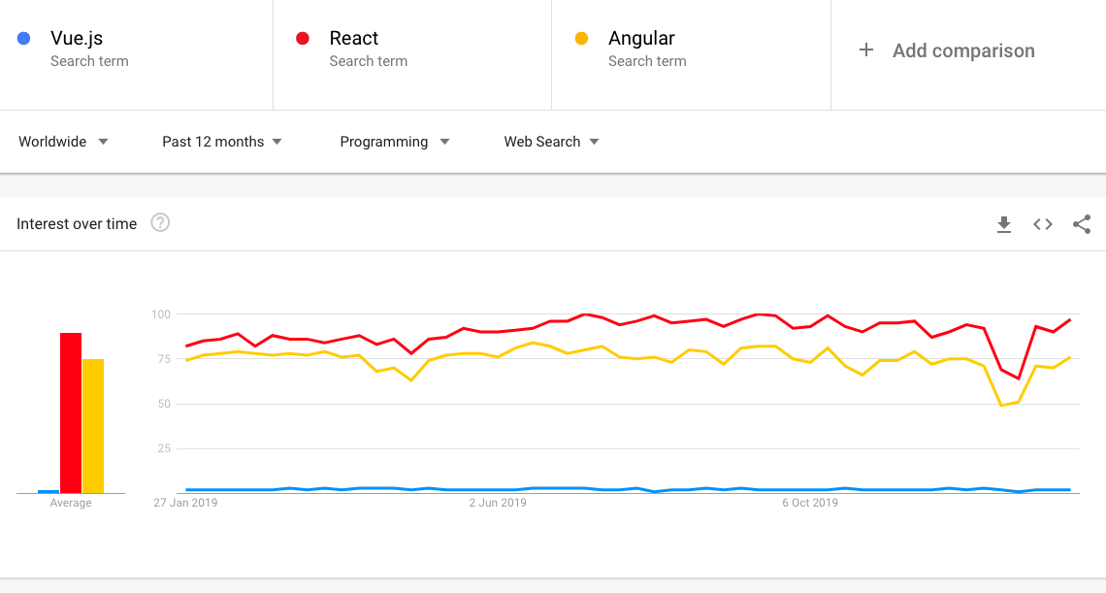
Trends – numbers speak for themselves

Slide 14
Prerequisites
3

Slide 15
Prerequisites
HTML
CSS
JavaScript
JSX
JSON
API

Slide 16
BuzzWords
4

Slide 17
MVC – Model View Controller
View
Model
Controller

Slide 18


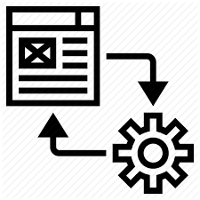
Full Stack
FULL STACK DEVELOPER
CLIENT SIDE
Web Application
HTTP REQUEST
SERVER SIDE
Business Logic
DataBase
API
HTTP RESPONSE
Front End Developer
Back end Developer
Query Languages

Slide 19
MEAN Stack vs MERN Stack
MEAN Stack
Mongo DB
Express Js
Angular Js
Node Js
MERN Stack
Mongo DB
Express Js
React Js
Node Js

Slide 20
Redux
Open Source Js library for managing the state of the objects/application

Slide 21
Who should take this Course?
5

Slide 22
Who should take this Course?
Students looking for internships
Students looking for placements in product based companies
IT professionals looking to change their company
Non IT professionals looking to start their career in the IT sector
Entrepreneurs looking to start their own start-up

Slide 23
Corporate Ladder
Project Manager
Technical lead/Engineering Lead
Software Developer
Software Engineer
Software/ Network Architect
Network Engineer

Slide 24
Why should you take this Course?
6

Slide 25
Why should you take this Course?
Corporate specific training
Live hands-on projects
Everyday class recordings – Online cum Offline class
Mock-interviews
Placement Assistance
Material for future reference

Slide 26
COURSE CONTENTS

Slide 27
What will I learn?

Slide 28
What will I learn
HTML
CSS
JavaScript
React JS
Bootstrap
API (AJAX)
REDUX

Slide 29
ENVIRONMENT SETUP

Slide 30
You Will Learn...........
Inspect React Pages
Install node.js
Create basic React app in primitive way
Create basic React app in modern way
Deploy applications using GIT and GitHub

Slide 31
Inspect React Pages
We can inspect React pages using the React Console present as an extension for all the browsers
Download React developer tools :
Search chrome extensions in browser >> chrome web store >> Search ‘React Developer tools’
Add this extension to chrome

Slide 32
Environment Setup
Node.js → Node is a server side cross platform (runtime environment) build on google chrome V8 engine for building fast and scalable n/w applications
Node is basically a collection of packages.
NPM → Node Package Manager
NPM is an interface to Node Js
Online Repo for Node Js packages/modules
Command line utility for Node.js packages
Node.js
package1
package3
package2
NPM
Local System

Slide 33
Environment Setup – Primitive Way
STEP 1 : Install Node
STEP 2 : Create a root folder manually in the required directory
STEP 3 : Generate the package.json file
STEP 4 : Install the Packages
> npm init
> npm install react --save
> npm install react-dom --save

Slide 34
Webpack and Babel
Webpack → module bundle used for setting the development server
Used for setting or changing the port for local host
Babel → Plugins required for Webpack
For eg : transpiler , compiler

Slide 35
Environment Setup – Primitive Way
STEP 5 : Install Webpack and Babel
STEP 6: create the required files : Index.html, Index.js, App.js and main.js
Once webpack-config file is generated, paste the default code in it to make it compatible
> npm install webpack --save
> npm install webpack-dev-server --save
> npm install webpack-cli --save
> npm install babel --save
> type nul > webpack-config.js

Slide 36
Environment Setup – Advanced Way
STEP 1 : Install Node
STEP 2 : Navigate to the required location(mainly as administrator) and launch the cmd prompt
The First command is used to install the create-react-app package from Node
Second command is used to create a react application without any build configuration and will create a project with all the required folders
> npm install –g create-react-app
> create-react-app nameofthefolder

Slide 37


Deploy Applications – GIT & GitHub
GitHub → Web based code-hosting platform used for code collaboration and version control.
GitHub is a remote repository for your codebase, where multiple people can work on the same code simultaneously.
GIT → Distributed version control system designed to track the changes in project files .
GIT is the heart of GitHub and is responsible for everything GitHub-related that happens locally on your computer.
Most Commonly used GIT commands :
GIT clone → clones or duplicates the repository into local
GIT commit → The git commit command will save all staged changes, along with a brief description from the user, in a “commit” to the local repository.
GIT checkout → The git checkout command is a way of switching between branches or version of your application
GIT Push and GIT Pull → will send changes in local to the repo and will accept incoming changes from repo to local

Slide 38
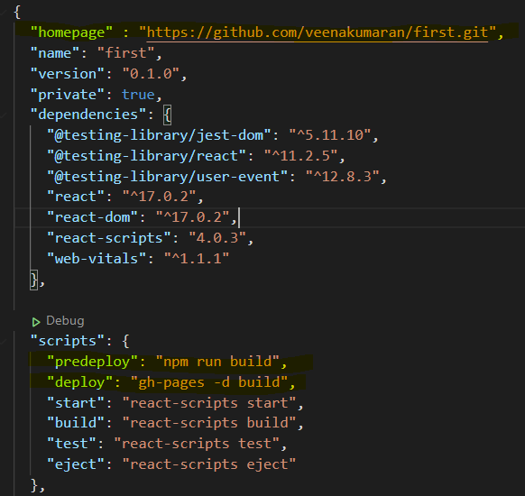
Deploy Applications – GIT & GitHub
STEP 1 : Create A GitHub Account
STEP 2 : Install Git in your machine and Set up Git.
STEP 3 : Install GitHub pages package as dev-dependency
STEP 4 : Add properties to package.json file
“homepage” : “repo link to your project”
"predeploy": "npm run build", "deploy": "gh-pages -d build"
> npm install gh-pages --save-dev

Slide 39
Deploy Applications – GIT & GitHub
STEP 5 : Create a new repo in GitHub and Initialize Git
STEP 6 : Deploy to GitHub pages
> git init
> git remote add origin “GitHub repo link”
> npm run deploy

Slide 40
FILE STRUCTURE IN REACT APP

Slide 41
File Structure
Package.json → stores the list of all node dependencies and the reference to packages installed from the node through npm
Index.html → starting point for the start of the application i.e. first page that is loaded when the application starts ( only html file – single page app )
It define the template of the browser screen
Index.js → renders or maps the content to the elements/div in index.html
App.js → it is the main component which contains all other components ( container )
Webpack-config.js → for setting up the development server or local host

Slide 42
UNDERSTANDING UI ORIENTATION

Slide 43
UI Screen Template
The entire UI is divided into multiple <div>
Index.html file defines the orientation of the page i.e. the number of <div> the page is dived into broadly
div1
div3
div2

Slide 44
UI Screen Content
For each of the <div> we need to specify the html content that needs to be displayed
Index.js file maps the html content/elements to the <div> tags
div1
HTML Element
HTML Element
div3
div2
HTML Element

Slide 45
SAMPLE REACT APP

Slide 46
Sample React App
To get started, first create a new application.
For any application we essentially have 2 important parts in the program
#1: Creating an Element
#2: Rendering an Element
NOTE : Elements are basically html tags and enclosed content that we want to display on the output

Slide 47
Creating an Element
Create an element :
Create Element
(
‘Tag name’,
Attributes,
Html Content
)
SYNTAX
Const tilte = React.createElement (
‘h1’,
{ id: ‘title’ },
“Hello World”
)
arguments

Slide 48
Rendering an Element
Render an element :
Render Element
(
What you want to render,
Where you want to render
)
SYNTAX
ReactDOM.render (
‘title’,
Document.getElemetById (‘root’)
)
arguments

Slide 49
JSX

Slide 50
JSX Syntax
JSX is basically using html tags directly inside JavaScript code
In JSX,
All expressions are written in { }
These expression include variables, properties or any other Js expression.
NOTE:
In HTML if you want to give Js expression, we use → { }
In HTML, if you want to define any property: value pair i.e. attributes then we use → {{ }}

Slide 51
JSX
In traditional JavaScript, we have output methods to display content on output but now using JSX, we can directly write/embed html content/tags in JavaScript without the output methods
Embedding html content directly to render function
Embedding html content indirectly to render function

Slide 52
JSX
Embedding html content directly to render function
Embedding html content indirectly to render function
ReactDOM.render(
<h1>My Webpage</h1>,
document.getElementById('root')
);
var element = <div><h1>My Webpage</h1><p>hi there........</p></div>
ReactDOM.render(
element,
document.getElementById('root')
);

Slide 53
Different types of data in JSX

Slide 54
Different types of Data in JSX
The different types of data which we can use in JSX are
Variable
Object
Arrays/ lists
Array Object

Slide 55
STYLING

Slide 56
JSX Styling
There are different ways to style content in JSX:
Inline or internal
Using External .css file
Using Modules
Styled components

Slide 57
Inline Styling
In inline styling we can give the styles as follows :
#1 : directly in the tags as attributes
<h1 style ={{backgroundColor : 'black', color : 'orange', textAlign :'center’}
#2 : As style objects
<h1 style ={myStyle}> My Webpage </h1>

Slide 58
External Styling
In external Styling, we can give the styles as follows :
#1 : external css for tags
body {
margin: 0;
font-family: -apple-system, BlinkMacSystemFont, 'Segoe UI', 'Roboto', 'Oxygen',
'Ubuntu', 'Cantarell', 'Fira Sans', 'Droid Sans', 'Helvetica Neue',
sans-serif;
}
#2 : external css classes
.txt{
font-size: 200px; }

Slide 59
JSX Styling
There are different ways to style content in JSX:
Inline or internal
Using External .css file
Using Modules
Styled components

Slide 60
COMPONENTS

Slide 61
Components
Components are building blocks of any React Application, which aims at increasing the modularity of the elements that need to be rendered on the UI i.e. how a section of the UI should appear
There are 2 main types of components in React Js
Class component
Functional component

Slide 62
Components
Component
INPUT : (optional)
Props
OUTPUT :
React Element (HTML)

Slide 63
Class Components
SYNTAX FOR DEFINING A CLASS COMPONENT
class Message extends React.Component
{
render()
{
return(
<h1 style = {style_h1}> My Webpage </h1>
)
}
}
SYNTAX FOR REFERENCING A CLASS COMPONENT
ReactDOM.render(
<Message/>,
document.getElementById('root')
)

Slide 64
Class Components
Any variables, objects, arrays, function declared here are global
Here everything needs to be defined with the datatype and accessed by the name directly in the class
class Class_Name extends React.Component
{
Any variables, objects, arrays, function declared here are local
Here everything needs to be defined without the datatype and accessed by the ‘this’ keyword in the class
render()
{
Any variables, objects, arrays, function declared here are global
Here everything needs to be defined with the datatype and accessed by the name directly in the class
return(
<h1 style = {style_h1}> My Webpage </h1>
)
}
}

Slide 65
Functional Components
SYNTAX FOR DEFINING A FUNCTIONAL COMPONENT
function Message()
{
document.write("hey do you want to login?")
return(<p> Welcome….</p>)
}
SYNTAX FOR REFERENCING A FUNCTIONAL COMPONENT
ReactDOM.render(
<Message/>,
document.getElementById('root')
)

Slide 66
Functional Components
Any variables, objects, arrays, function declared anywhere in a functional component are global
Here everything needs to be defined with the datatype and accessed by the name directly in the function
function Message()
{
document.write("hey do you want to login?")
return(<p> Welcome….</p>)
}

Slide 67
Components
We can declare the components in separate .js files and then import them into our index.js file
We can also define all our components in a different file (eg : App.js) and we can export them from App.js and then import them in index.js
export {App, Apple, Mango}; --App.js file
import { Apple, Mango, App } from './App’; -- index.js file

Slide 68
Functional Components
Functional Components | Class Components
Absence of this keyword | this keyword is used for local var, obj and functions
No concept of state | Stateful
Presentational components | Provide lifecycle hooks

Slide 69
Different types of Functional Components
Normal function
function Hello()
{
return(<p>hi there….</p>)
};
Arrow function
const Hello = () => {
return(<p>hi there…..</p>)
} };

Slide 70
FUNCTIONS vs EVENTS

Slide 71
Functions
There are 2 types of functions:
Normal function
Arrow functions
These functions can also be used without the datatype specified inside the class, can be called using ‘this’ keyword
The values that you pass to a function are known as arguments

Slide 72
Normal Functions without Arguments
SYNTAX FOR FUNCTION DEFINITION
function Hello()
{
document.write("hey do you want to login?")
return(<p>Hello….</p>)
}
SYNTAX FOR FUNCTION CALL
<p>{Hello()}</p>

Slide 73
Normal Functions with Arguments
SYNTAX FOR FUNCTION DEFINITION
function Hello(x)
{
return(<p>Hello….{x}</p>)
}
SYNTAX FOR FUNCTION CALL
<p>{Hello(‘veena’)}</p>

Slide 74
Arrow Functions without Arguments
SYNTAX FOR FUNCTION DEFINITION
const=Hello()=>
{
document.write("hey do you want to login?")
return(<p>Hello….</p>)
}
SYNTAX FOR FUNCTION CALL
<p>{Hello()}</p>

Slide 75
Arrow Functions with Arguments
SYNTAX FOR FUNCTION DEFINITION
const=Hello(x)=>
{
document.write("hey do you want to login?")
return(<p>Hello….{x}</p>)
}
SYNTAX FOR FUNCTION CALL
<p>{Hello(‘veena’)}</p>

Slide 76
Events vs Functions
Event is any function that is triggered as a result of user input.
Basic differences between Event and Function :
The way of calling an event or function
There is slight difference in the syntax while calling a function and calling an event
What is returns as output
Function can return anything → html content or JS output methods
Events can return only JS output methods

Slide 77
Events
SYNTAX FOR EVENT DEFINITION : SAME AS DEFINING FUNCTIONS (NORMAL, ARROW OR LOCAL )
SYNTAX FOR EVENT CALL (WITHOUT ARGS)
<button onClick= {Hello} Logout</button>
SYNTAX FOR EVENT CALL (WITH ARGS)
<button onClick={()=>Hello('veena')}>Logout</button>

Slide 78
Events in Components
as functions inside class, (unlike normal functions) it does not have access to ‘this’ keyword .
Thus it will not be able to access the local variables defined in the class in the class
For this we have 3 solutions
Binding the event handler
Convert the existing event handler function to an arrow function
Declare the event handler as a global function
When ever events are declared

Slide 79
PROPS

Slide 80
Props
Any value that we want to pass to a component (class/functional) to make the component dynamic, is known as props.
Till now, we have discussed about both local and global variables in the components while defining the components.
In this section, we will be discussing about how we can pass variables to the component during the component declaration.
The variables that are passed to the component, during the declaration of the component are known as props.

Slide 81
Props
Any value that we want to pass to a component (class/functional) to make the component dynamic, is known as props.
Till now, we have discussed about both local and global variables in the components while defining the components.
In this section, we will be discussing about how we can pass variables to the component during the component declaration.
The variables that are passed to the component, during the declaration of the component are known as props.

Slide 82
Passing different types of Props to Component
Rules :
All strings type props are passed enclosed in “ “
All other type of props like numeric and object are passed enclosed in { }
We can pass multiple props to a component, need not be separated by a , (comma)
Passing props directly to the component :
<Book title=“The King” pages ={100} />
2. Passing variables as props :
<Book title= {x} />

Slide 83
Passing different types of Props to Component
Passing objects as props :
(we can either pass the entire obj or just the properties in the object)
<Book completeobject = {obj} name={obj.name}/>
Passing Arrays as props :
<p>Markslist : {this.props.marks.map((item) => <li> {item.score} </li>)} </p>
We need to define an array named marklist and send it as props to the Component Marks as so :
<Marks marks = {marklist}/>,

Slide 84
Props in Class Component vs Props in Functional Component
Functional Component | Class Component
Passing props : in functional component and class component is similar | Passing props : in functional component and class component is similar
Receiving Props : Const Books = (props)=> { } | Receiving Props : Class Books extends Component { }
Accessing props : {props.name} | Accessing props : {this.props.name}

Slide 85
Passing Props from Component to functions
The functions where we need to pass the props can either be defined inside the component or outside the component
In case of Class Components,
if the function is declared outside the Class Component , it will be accessed by the name of the function
function_name (this.props.value)
if the function is declared inside the Class Component , it will be accessed by this keyword followed the name of function
this.function_name (this.props.value)
In case of Functional Components,
No matter where you define the function it will always be access by the name of the function in the component
Function_name(props.value)

Slide 86
defaultProps
Default Props are useful when we want to pass default values to an array or an object array.
When ever there is no data that comes as response instead of the code breaking for these values, default values are printed.
If the component call is not passing any props, but the component still is accessing the props, then defaultProps come in handy
static defaultProps = { //object
books : [ //key
{'title' : 'default title' , 'author' : 'default author'} //values
]
}
NOTE : we will always declare ‘defaultProps‘ in the component which is accessing it (through the map function)
i.e. the one that is passing the props

Slide 87
propTypes
PropTypes are used to specify the type of the props for easy understanding and code readability.
Does not have any technical impact.
NOTE: in order to use propTypes we need to import it using this command :
import propTypes from 'prop-types’
Library.propTypes ={
title : propTypes.string,
pages : propTypes.number
}

Slide 88
STATE

Slide 89
State
State is an object in react used to store the properties/variables for which the state needs to be updated.
setState( ) is the method which takes as argument the variable or property, that needs to be updated.
Defined as :
State :
{
Key : ‘value’,
}
Updated as :
this.setState( { key : this.state.key +1 } )

Slide 90
State
Drawbacks with using normal variables are as follows :
Inconsistency in the values - (b/w html and console.log)
Takes time to update the values
We have to redeclare the entire html content (using document.getelementbyId) that we want to show as part of the updated value, as automatic re-rendering is not possible
Solution :
State variables in class component
UseState hook in functional component

Slide 91
Difference b/w props and state
Props | State
Props include data that we pass to the component | State includes data that is local/private to the component
Props is read only | State values can be changed

Slide 92
PARENT- CHILD COMPONENTS

Slide 93
Parent → Child
Just like we can call a component from render method we can also call a component from inside of another component.
From the render function we will call <Parent/> → from Parent we will call </Child>
From parent to child, we can pass normal props
<B status='a is active'>
From parent to child we can pass html content as props
Child component
<p>{this.props.status}</p>
Parent component
Child component
<B><p>hi there i am A</p></B>
<p>{this.props.children}</p>
Parent component

Slide 94
State
We can change the state or pass some values to the child using props
But if we want to change the state or pass some values back to the parent from child, we need to use function call-backs
Props
PARENT
CHILD
Call-Back Functions

Slide 95
COMPONENT LIFE CYCLE

Slide 96
Component Life Cycle
Each component in React has a lifecycle which you can monitor and manipulate during its three main phases.
The three phases are: Mounting, Updating, and Unmounting.
#1 : Mounting : Mounting is executed when the page is loaded/ reloaded and it puts elements to the DOM
#2 : Updating : Update is executed whenever there is a change in the component’s state
#3 : Unmounting : Unmounting is executed when a component is removed from the DOM.
Mounting
removed
Unmounting
Updating
updated

Slide 97
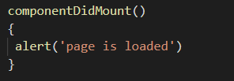
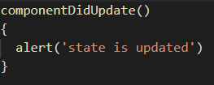
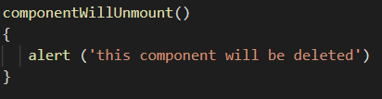
Component Life Cycle
Three important methods available in the lifecycle of components are :
componentDidMount()
componentDidUpdate()
componentWillUnmount()

Slide 98
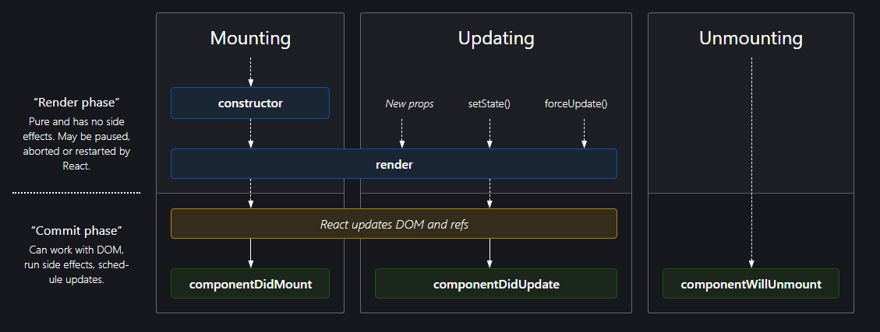
Component Life Cycle

Slide 99
HOOKS

Slide 100
Hooks
Hooks are a new addition in React 16.8. They let you use state and other React features without writing a class.
Hooks are functions that let you “hook into” React state and lifecycle features from function components.
NOTE : Hooks don't work inside classes
Rules of Hooks
Hooks are similar to JavaScript functions, but you need to follow these two rules when using them. Hooks rule ensures that all the stateful logic in a component is visible in its source code. These rules are:
1. Only call Hooks at the top level
Do not call Hooks inside loops, conditions, or nested functions. Hooks should always be used at the top level of the React functions. This rule ensures that Hooks are called in the same order each time a components renders.
2. Only call Hooks from React functions
You cannot call Hooks from regular JavaScript functions. Instead, you can call Hooks from React function components. Hooks can also be called from custom Hooks.

Slide 101
Y Hooks?
React Hooks are functions that serve as a modular replacement for State management, DOM manipulation and lifecycle methods written in functional components.
Due to certain drawbacks while using lifecycle components in class components, we use Hooks with functional components :
Use of this keyword can be confusing at times
Reloading is very unreliable
May forget to bind events in class components

Slide 102
Hooks
The popular Hooks available in React are :
useState()
useEffect()
useContext()
useReducer()
useRef()

Slide 103
useState Hook
useState hook that allows us to use state variables and maintain their state in functional components
(add state to functional components)
useState hook returns an array with 2 elements :
Element 1 : value of the state variable
Element 2 : the function that is used to modify the state variable

Slide 104
useState Hook
In class components, we use the state object to access the state and setState method to modify the state,
However in functional component using hooks, the state variable need not be an object
And we use the setter method to modify the value of the state variable.

Slide 105
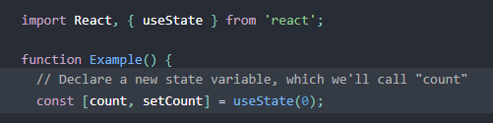

Understanding useState Hook
Declaring a useState hook
state variable
function to update state var
initial value of state variable
updated value of state variable
Updating the state

Slide 106
useEffect Hook
useEffect hook is used to perform the following :
Side effects
Modifying the DOM
Handle Lifecycle methods (similar to class component)
Fetching data using API
In class components we can render or re-render a component using life cycle methods, similarly we will use useEffect hook in functional components.
useEffect can handle ComponentdidMount() , ComponentDidUpdate() and ComponentWillUnmount() in functional components

Slide 107
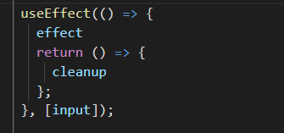
Understanding useEffect Hook
specifies what the state variable should do on ComponentdidMount
specifies what the state variable should do on ComponentWillUnmount i.e. on cleanup
Dependency array : specifies the state variable the useEffect hook must watch for changes
If we don’t specify any dependency array, all useEffect in the component will re-render on any state change
We can specify empty array if we want useEffect to render only on the initial load
We can specify single or multiple state values to the array depending on which state variable change should re-render the component

Slide 108
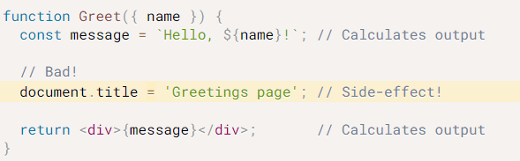
useEffect Hook
#1 : useEffect hook is used to perform the side-effects :
A functional React component uses props and/or state to calculate the output. If the functional component makes calculations that don’t target the output value, then these calculations are named side-effect
Examples of side-effects are fetch requests, manipulating DOM directly, using timer functions like setTimeout(), and more.
The component rendering and side-effect logic are independent. So it would be a mistake to perform side-effects directly in the body of the component.

Slide 109
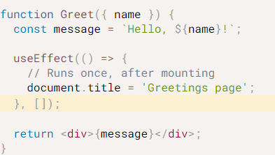
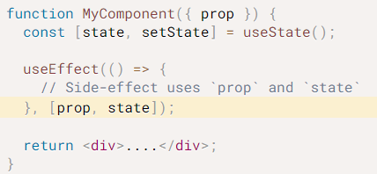
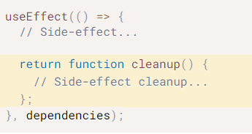
useEffect Hook
#2 : useEffect hook is used to implement Lifecycle methods:
The side-effect on ComponentdidMount()
The side-effect on ComponentdidMount()
The side-effect on ComponentWillUnmount

Slide 110
useEffect Hook
#3 : useEffect hook is used to fetch data from API
API stands for Application Programming Interface
APIs are needed to bring applications together in order to perform a designed function built around sharing data and executing pre-defined processes.
API’s work based on the request – response model
request
FRONT END
BACK END
response

Slide 111
API
REST VS SOAP
REST : REpresentational State Transfer
It is a software architecture style that relies on a stateless communications protocol, most commonly, HTTP
SOAP : Simple Object Access Protocol
It is a protocol that defines how data should be transferred or exchanged between programs that are built using different platforms and programming languages

Slide 112
API
Sr. No. | Key | REST API | SOAP API
1 | Implementation | Rest API is implemented as it has no official standard at all because it is an architectural style. | On other hand SOAP API has an official standard because it is a protocol.
2 | Internal communication | REST APIs uses multiple standards like HTTP, JSON, URL, and XML for data communication and transfer. | SOAP APIs is largely based and uses only HTTP and XML.
3 | Description | REST API uses Web Application Description Language for describing the functionalities being offered by web services. | On other hand SOAP API used Web Services Description language for the same.
4 | Security | REST has SSL and HTTPS for security. | On other hand SOAP has SSL( Secure Socket Layer) and WS-security due to which in the cases like Bank Account Password, Card Number, etc. SOAP is preferred over REST.
5 | Interchange | REST can make use of SOAP as the underlying protocol for web services, because in the end it is just an architectural pattern. | On other hand SOAP cannot make use of REST since SOAP is a protocol and REST is an architectural pattern.

Slide 113
useEffect Hook
API’s work based on the request – response model
Different types of HTTP Request :
GET Request
POST Request
PUT Request
Delete Request
Different types of Response
XML
JSON
request
FRONT END
BACK END
response

Slide 114
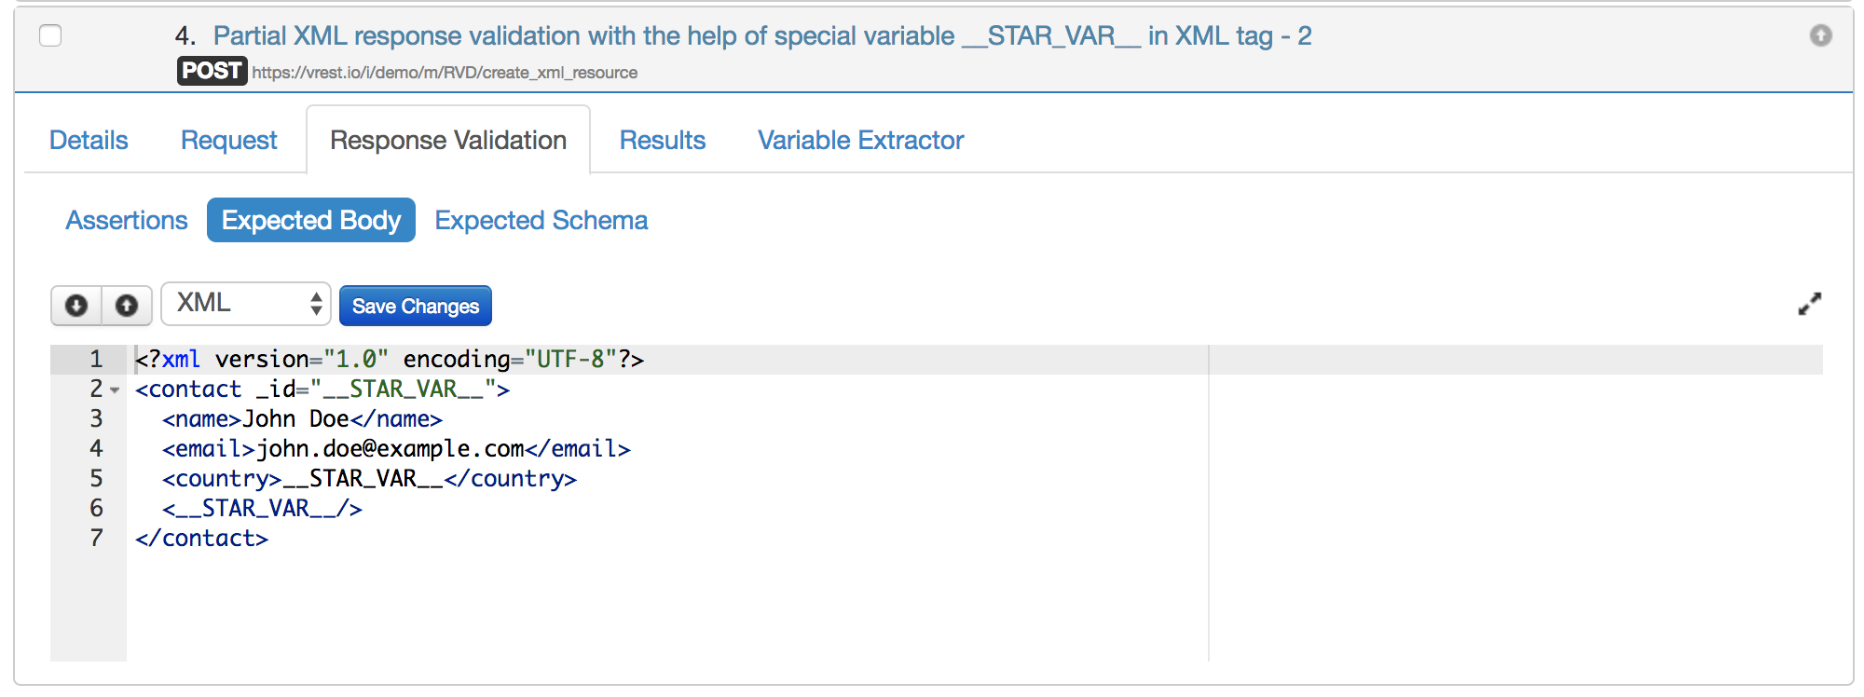
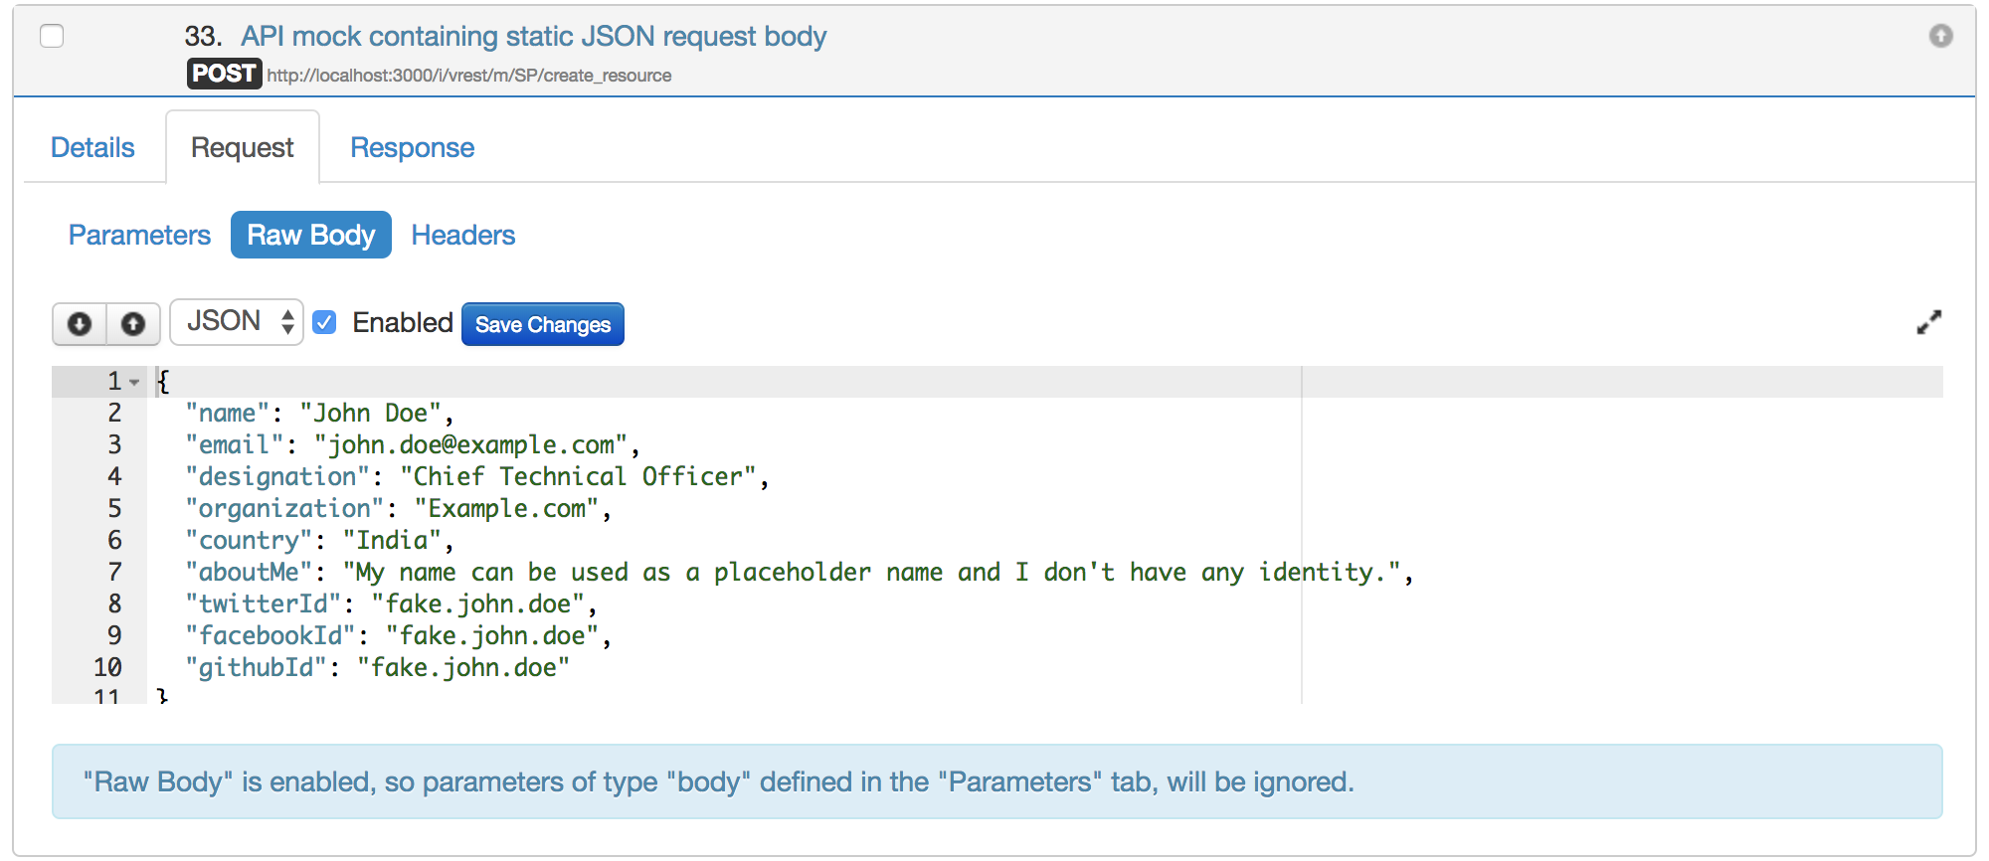
useEffect Hook
XML data format
JSON data format

Slide 115
useEffect Hook
Different ways to access data from API:
XMLHTTPRequest
AJAX – jQuery
Fetch
Axios

Slide 116
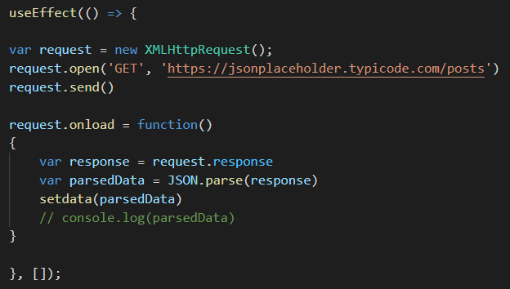
useEffect Hook
XMLHTTPRequest

Slide 117
useEffect Hook
Fetch (inbuilt)
AJAX
$ajax ( {
url : ‘.........’
success : function (response) {
console.log(response)
}
}
Axios (external package)

Slide 118
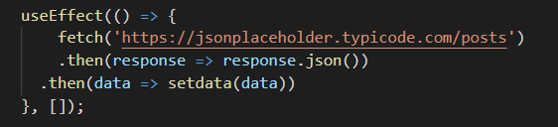
useEffect Hook
Fetch

Slide 119
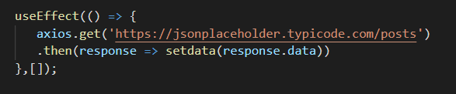
useEffect Hook
Axios

Slide 120
useEffect Hook
Axios

Slide 121
useReducer Hook
The useReducer is a hook is used to sometimes manage the state of the application. It is very similar to the useState hook, just more complex. It acts as an alternate hook to the useState hook to manage complex state in your application or when the new state is dependent on the previous one.
The useReducer hook is used to define a list of actions and dispatch them in a component.

Slide 122
useReducer Hook
The useReducer is a hook is used to sometimes manage the state of the application. It is very similar to the useState hook, just more complex. It acts as an alternate hook to the useState hook to manage complex state in your application or when the new state is dependent on the previous one.
The useReducer hook is used to define a list of actions and dispatch them in a component.

Slide 123
useReducer Hook
useState hook | useReducer
Different setState for each state variable | Can use same reducer to setState for multiple state variable
Is useful when dealing with number, string or boolean | Useful when dealing with obj or array
Useful when the number of state variables are less | Useful when number of state variables are more
Useful when there is no related state transition | Useful when there is related state transition
Local state management | Global state management

Slide 124


Understanding useReducer Hook : for ‘setter methods’
State variable
Initial value of the state variable
Setter method for the state variable
Function that defines what the setter method should do
NOTE : similar to the useState hook but here the functionality of the setter method is in the reducer

Slide 125
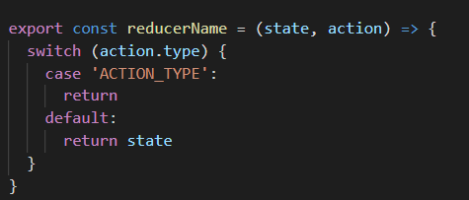
Understanding useReducer Hook : for ‘dispatch methods’
State variable
Initial value of the state variable
Similar to setter method that specified the type of action in
render
Reducer is a function that takes current state and action as parameters

Slide 126
useContext Hook
When we are working with nested components, there my be a requirement to pass some props from one the root component to the nested components.
If we want to pass the props down the component tree, then we must pass the
Props to the respective parents as well (even if not required)
Thus in this case we can make use of Content Hook, which allows us to
Pass data to through the component tree without having to pass the
Props manually at each level.
APP
A
C
D
B
E

Slide 127
useContext Hook
Suppose we want to pass the props from App to D
Then we can pass in the following ways
We can pass props in the primitive way
Render → A → D
We can make use of Provider and Consumer
We can make use of useContext hook
APP
A
C
D
B
E

Slide 128
useRef Hook
useRef is used to reach out to any component and determine the value of its elements.
useRef hook is used to refer to a DOM node or store any mutable value
Using useRef hook is an alternative for using e.target.value each time we want to capture some content from DOM.
useRef hook returns a mutable ref object whose .current property is initialized with the passed argument (initialValue)
The returned object will persist for the lifetime of the component.

Slide 129
useRef Hook
useRef is used to reach out to any component and determine the value of its elements.
useRef hook is used to refer to a DOM node or store any mutable value
Using useRef hook is an alternative for using e.target.value each time we want to capture some content from DOM.
useRef hook returns a mutable ref object whose .current property is initialized with the passed argument (initialValue)
The returned object will persist for the lifetime of the component.

Slide 130
REDUX

Slide 131
REDUX
Redux is an open-source JavaScript library. It is most commonly used with libraries such as React or Angular for building user interfaces.
Redux is a predictable state container for JavaScript apps to develop applications that behave consistently, run in different environments (client, server, and native), and are easy to test.
On top of that, it provides a great developer experience, such as live code editing combined with a time traveling debugger.
Redux is nothing but a tool for application state management, that maintains the state of the entire application in a single immutable object.

Slide 132
REDUX
Application
Search
Display Results
Login
Let us suppose Search component wants to pass on some keyword
And then it needs to share the results with Display Result component
In order to pass data across siblings we need to raise the
state up to the parent component and then pass the keyword
as props to all the child components
Drawback : all the component which do not need to use the props will also need to pass the props to the child
Solution : use redux to maintain the state outside the component
Application
Search
Display Results
Login
Pass props only to req component
Redux state container
update

Slide 133
REDUX
The 3 main concepts in redux are :
REDUX
STORE
ACTION
REDUCER

Slide 134
REDUX
The 3 main concepts in Redux are :
STORE : holds the state of the application
Example : Shop
ACTION : changes/modifies the state variable in the application based on the condition
Example : Purchase of item
REDUCER : ties the state and the action together i.e. the transition to the state depends on the action
Example : shopkeeper

Slide 135
REDUX
3 Principles of Redux :
The state of the whole application is stored in a single object tree within a single Store
The only way to change the state is to emit an Action, an object describing what happened
To specify how the state tree is transformed by actions, we write pure Reducers
object
object
function

Slide 136
REDUX
Application
subscribe
emit/ dispatch
Do not update directly
REDUX STORE
ACTION
REDUCER

Slide 137
REDUX
Action Implementation :
Action creator
Function
Action
Object that returns type (of action)

Slide 138
REDUX
Reducer Implementation :
Reducers specify how the application state should change in response to actions sent to store
Reducer is a function that takes in state and action and returns the next state
state
REDUCER
next state
action

Slide 139
REDUX
Store Implementation :
Single store for entire application, holds application state
getState() : allows the application to access the state it holds in store
Dispatch(action) : allows any updates to the application state
subscribe(listener) : executed when state in redux store changes
can also unsubscribe by calling the function returned by unsubscribed method

Slide 140
REDUX with React
Redux is an external JavaScript library, thus we need to import Redux into react
npm install redux react-redux
Folder Structure :
UI : Components Folder → container.js file
Functionality : <nameofthecomponent> Folder -> constants.js, actions.js, reducer.js
Redux : Redux folder → store.js

Slide 141
REDUX REDUX with React
Application
1
6
5
Component
Container.js
ComponentName
REDUX
Store.js
Actions.js
2
Constants.js
ComponentName
4
3
Reducer.js
initialstate

Slide 142
REDUX with React
Step 1 : define the UI in container.js file in component folder
Export the container and import it in the app.js file
Step 2 : define the constants.js and actions.js in <componentname> folder
Export the constants.js and import it in actions.js
Step 3 : Define a reducer that takes as input the state and action
Import the constants.js file in reducer .js
Step 4 : define a store.js file in redux folder → createStore() is a method that takes the reducer as arg and returns store
Import the reducer.js file in store.js
Import createStore from redux in store.js
Step 5 : import the store to app.js file and provide the store to the required component using provider
Import Provider from react-redux in app.js

Slide 143
REDUX with React
Step 6 : In the respective component in container.js file the store has been provided as the input
We need to capture the store and the dispatch for actions as props
Import actions to container.js file
Using mapStateToProps(state) & mapDispatchToProps(dispatch) functions
Using useSelector() & useDispatch() hooks

Slide 144
REDUX with React
Multiple Components in Redux :
Create 2 actions creators
Create 2 different reducers and then combine them using combineReducers

Slide 145
BIG CONCEPT

Slide 146
THANKS!
Any questions?

