Slide 1
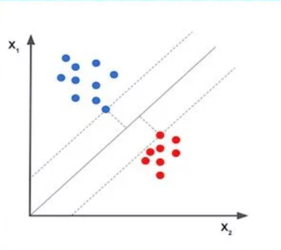
SUPPORT VECTOR MACHINE

Slide 2
“Support Vector Machine” (SVM) is a supervised machine learning algorithm which can be used for classification.
In this algorithm, we plot each data item as a point in n-dimensional space (where n is number of features you have) with the value of each feature being the value of a particular coordinate. Then, we perform classification by finding the hyper-plane that differentiate the two classes very well.

Slide 3
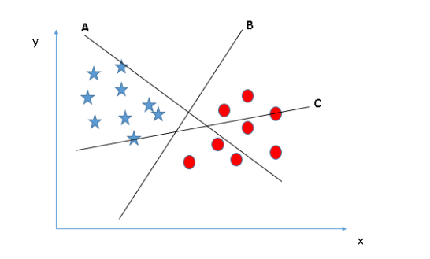
How does it work? How can we identify the right hyper-plane?
Identify the right hyper-plane (Scenario-1):
Here, we have three hyper-planes (A, B and C). Now, identify the right hyper-plane to classify star and circle.
You need to remember a thumb rule to identify the right hyper-plane: “Select the hyper-plane which segregates the two classes better”. In this scenario, hyper-plane “B” has excellently performed this job.

Slide 4
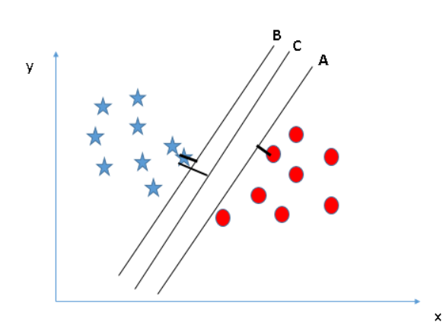
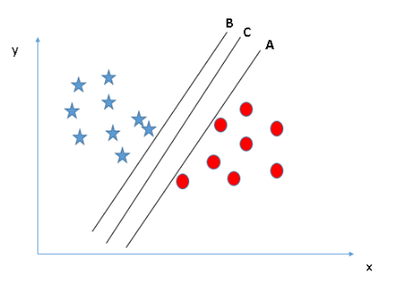
Identify the right hyper-plane (Scenario-2):
Here, we have three hyper-planes (A, B and C) and all are segregating the classes well. Now, How can we identify the right hyperplane?
Here, maximizing the distances between nearest data point (either class) and hyper-plane will help us to decide the right hyper-plane. This distance is called as Margin. Hence, we name the right hyper-plane as C.
If we select a hyper-plane having low margin then there is high chance of miss-classification.

Slide 5
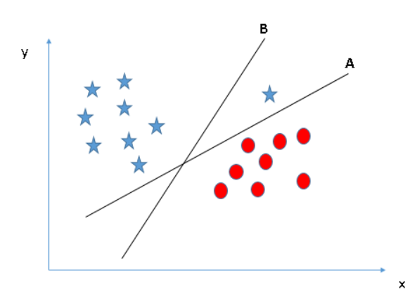
Identify the right hyper-plane (Scenario-3):
Using the rules as discussed in previous section to identify the right hyper-plane.
Some of you may have selected the hyper-plane B as it has higher margin compared to A.
But, here is the catch, SVM selects the hyper-plane which classifies the classes accurately prior to maximizing margin. Here, hyper-plane B has a classification error and A has classified all correctly. Therefore, the right hyper-plane is A.
Also SVM has a feature to ignore outliers.

Slide 6
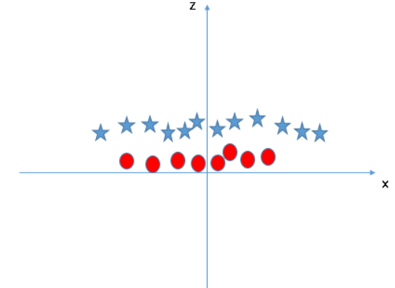
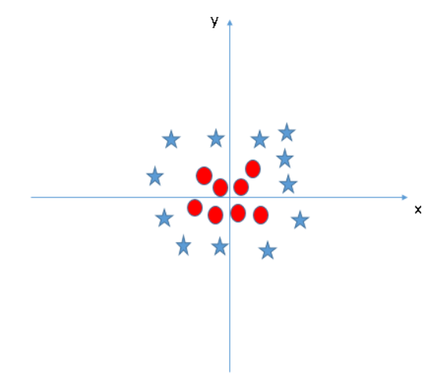
SVM can solve this problem. Easily! z=x^2+y^2
Find the hyper-plane to segregate to classes (Scenario-5):
we don’t need to add this feature manually to have a hyper-plane. SVM has a technique called the kernel trick.

Slide 7
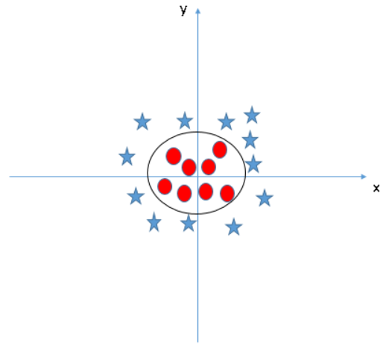
Thankfully, you don’t have to guess/ derive the transformation every time for your data set. The sklearn library's SVM implementation provides it inbuilt.
Functions which takes low dimensional input space and transform it to a higher dimensional space i.e. it converts not separable problem to separable problem, these functions are called kernels. It is mostly useful in non-linear separation problem.
Simply put, it does some extremely complex data transformations, then find out the process to separate the data based on the labels or outputs you’ve defined.
When we look at the hyper-plane in original input space it looks like a circle.

Slide 8
Kernel Options
Linear
Radial Basis Function
Polynomial
Sigmoid

Slide 9
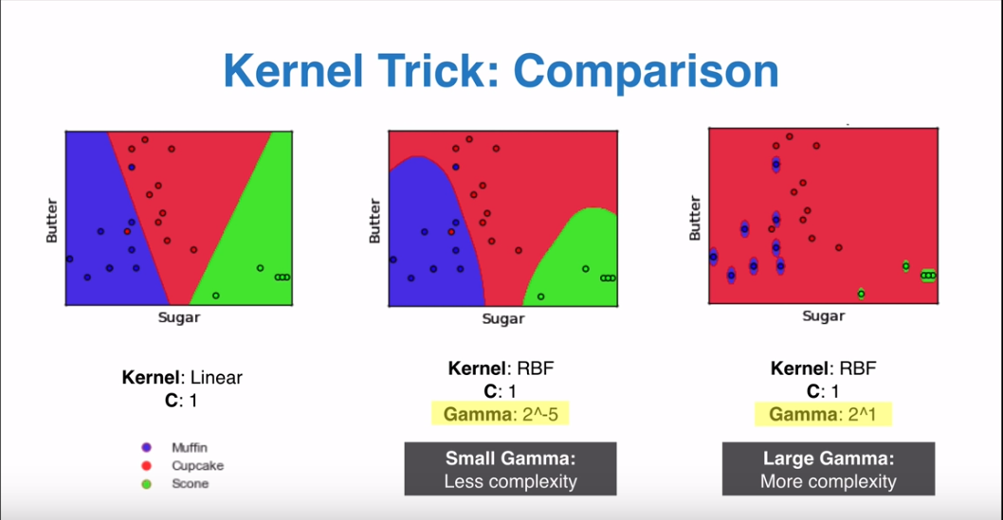

Slide 10
Properties of SVM
Flexibility in choosing a similarity function
Sparseness of solution when dealing with large data sets
- only support vectors are used to specify the separating hyper plane
Ability to handle large feature spaces
- complexity does not depend on the dimensionality of the feature space
Over fitting can be controlled by soft margin approach
Nice math property: a simple convex optimization problem which is guaranteed to converge to a single global solution
Feature Selection

Slide 11
Pros
It works really well with clear margin of separation.
It is effective in high dimensional spaces.
It is effective in cases where number of dimensions is greater than the number of samples.
It uses a subset of training points in the decision function (called support vectors), so it is also memory efficient.

Slide 12
Cons
It doesn’t perform well, when we have large data set because the required training time is higher
It also doesn’t perform very well, when the data set has more noise i.e. target classes are overlapping.
It only considers two classes.

Slide 13
SVM Applications
SVM has been used successfully in many real-world problems
- text (and hypertext) categorization
- image classification
- bioinformatics (Protein classification,
Cancer classification)
- hand-written character recognition

Slide 14
References:
https://www.analyticsvidhya.com/blog/2017/09/understaing-support-vector-machine-example-code/
https://medium.com/machine-learning-101/chapter-2-svm-support-vector-machine-theory-f0812effc72
http://www.cristiandima.com/basics-of-support-vector-machines/

