Slide 1
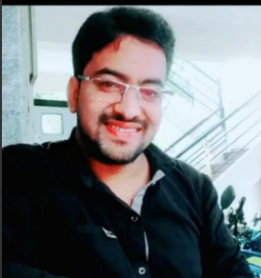
Kubernetes Team Lead
Kiraann Kumar reddy Pothamsetti
Worked in TCS as weblogic Administrator for 3 years.
An weblogic administrator with over 5 years of relevant work experience in the areas of Implementation and Support projects. (Over all experience of 7 years in weblogic Domain).
Working on Kubernetes support and development projects for 2 years.
Hands on experience on Jules pipeline deployment in UAT, and Dev environments.
Worked on Tools like Nolio,Blue prism,Automation Anywhere to automate the project daily activities.
Gathering requirements from clients and functional, prioritize and distribute work among team members.
Working on Kubernetes migration projects from NAS dev setup to GKP.
[Project 1: JPM Chase Pre Application]
Role: Senior Consultant
Responsible for developing the code and do the deployment via Jules pipeline
Responsible for configuring the Splunk alerts and test it.
Responsible for testing the control M job jobs in GKP environment and create the test evidences.
Monitor and support the control M jobs in Prod and raise tickets to L2 incase of issues.
Responsible for developing the scripts to redirect the logs to splunk as per client requirement.
[Project 2:Credit suissie]
Role: Associate Consultant
Responsible for supporting the UAT and DEV environments for testing.
Performing the deployments via automated tools like Nolio,Teamcity etc.
Responsible for performing the automations via Blue prism, Shell scripts and Automation Anywhere.
[Project 3:British Telecomm]
Role: IT Analyst
Responsible for handling P1/P2 issues, handling and troubleshooting incidents.
Responsible for enhancements and developments of weblogic ear files
Responsible for deploying the code into UAT and Test environment and create the Documentation with test evidences.
Application Development Assoc Manager
k.reddy.Pothamsetti@accenture.com
6361433492
Kubernetes,shell script,weblogic
Weblogic certified
M.Tech(CS), B.tech(IT)
Tools:
Kubernetes
Jules
Nolio
JIRA,
Weblogic

