Slide 1

Name of the School: School of Computer Science and Engineering
Course Code: E1UA307C Course Name:JAVA PROGRAMMING
HOSPITAL MANAGEMENT SYSTEM
Team Leader: KUMAR ARUN
Team Details:
KUMAR ARUN 23SCSE1010434 arunr5209@gmail.com
VEER TEOTIA 23SCSE1011113 veerteotia.2709@gmailcom
DIVYANSH BHARDWAJ 23SCSE1010653 bdivyansh28@gmail.com
SAGAR CHAUDHARY 23SCSE1011398 chaudharysagar1751@gmail.com
Section:27

Slide 2
Name of the School: School of Computer Science and Engineering
Course Code: E1UA307C Course Name:JAVA PROGRAMMING
Problem Statement
The system should have a menu-driven interface that allows users to perform the following operations:
Create a new patient record
Schedule an appointment
Update patient information
Check patient medical history
Display all patient records (for administrative purposes)
Exit the system

Slide 3
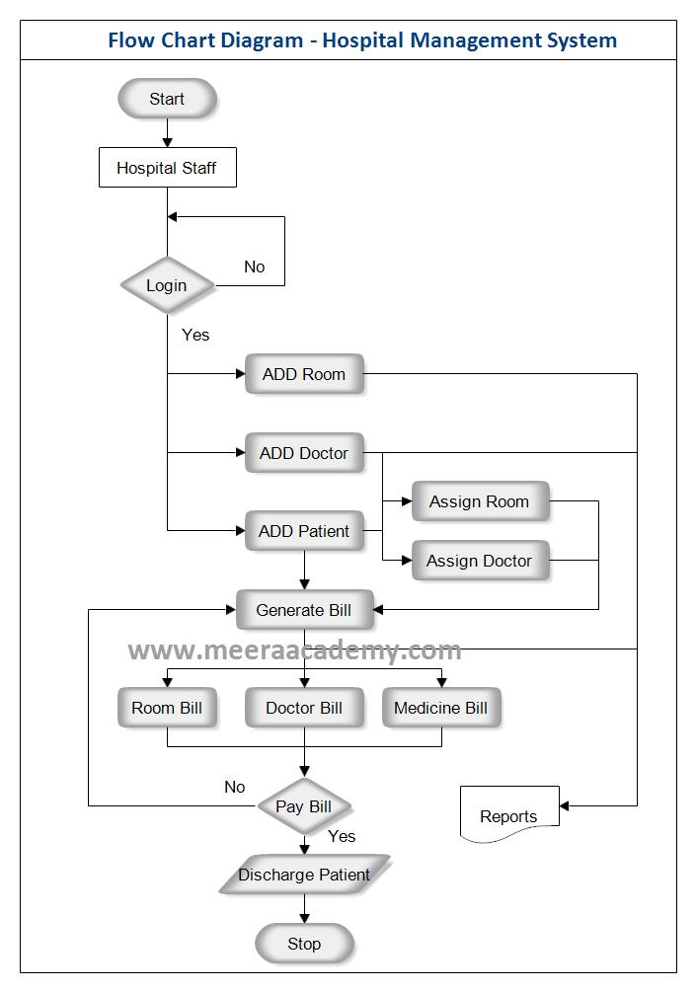
Name of the School: School of Computer Science and Engineering
Course Code: E1UA307C Course Name:JAVA PROGRAMMING
Flowchart

Slide 4
Name of the School: School of Computer Science and Engineering
Course Code: E1UA307C Course Name:JAVA PROGRAMMING
Technology Used
1.JAVA
2.JAVA SWING
3.VS Code
4.My SQL Workbench

Slide 5
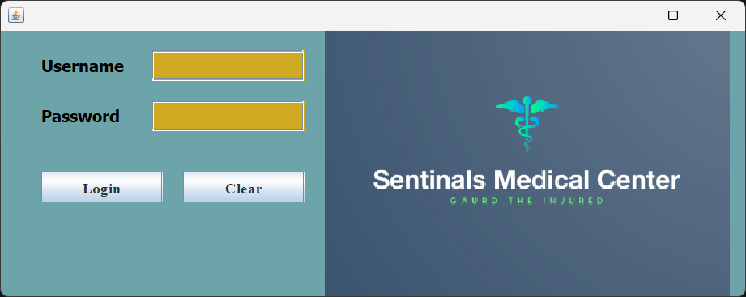
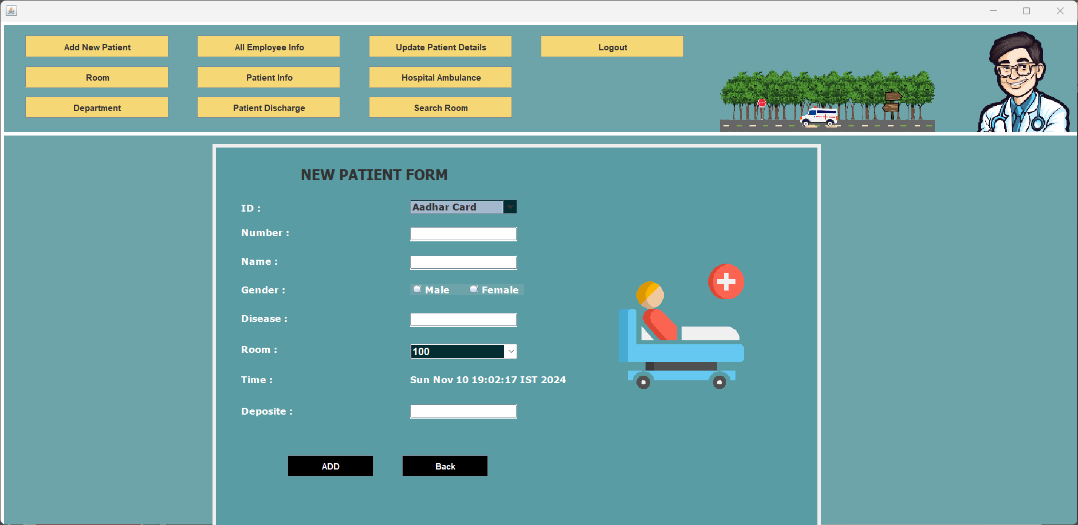
Name of the School: School of Computer Science and Engineering
Course Code: E1UA307C Course Name:JAVA PROGRAMMING
Some Screenshots

Slide 6
Name of the School: School of Computer Science and Engineering
Course Code: E1UA307C Course Name:JAVA PROGRAMMING
Conclusion
Here's a short conclusion for the Hospital Management System using JAVA:
The Hospital Management System (HMS) developed using Java and MySQL offers an efficient and scalable solution for managing healthcare operations. By leveraging Java's robust programming capabilities and MySQL's reliable database management, the system can effectively handle patient records, appointment scheduling, billing, and inventory management. This integration ensures data consistency, security, and accessibility, ultimately enhancing patient care and operational efficiency. The modular design allows for easy updates and feature enhancements, making it a sustainable choice for hospitals seeking to improve their management processes.

